Slide 1
Python Technical Task:
Find the Intent of the tweet which are missing using one of the ML models

Slide 2
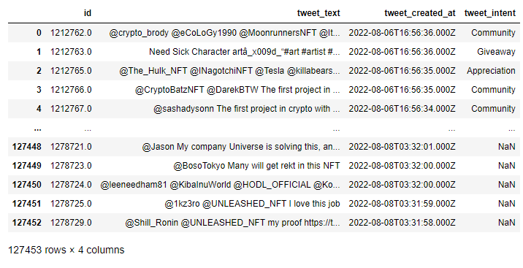
Dataset contains 100k over observations
There are tweets with identified intent: Appreciation, Community, Done, Giveaway, Interested, Launching Soon, PinkSale, PreSale, Whitelist

Slide 3
Overall EDA
 | ID | Tweet Text | Created at | Intent
Total | 127k | 127k | 127k | 96k
Data Type | float | object | object | object
Missing vales | 0 | 0 | 0 | 30k
Unique | 127k | 114k | 50k | 9

Slide 4
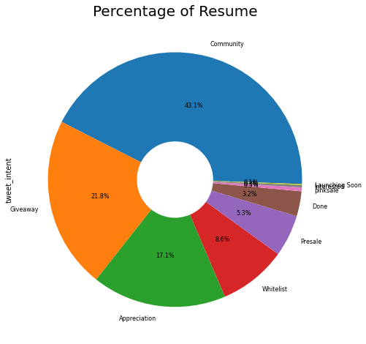
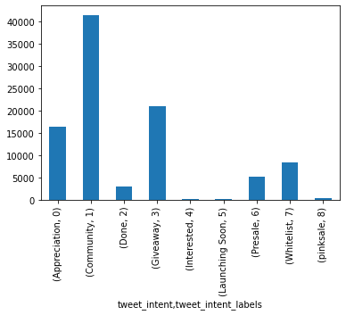
Visualizations
Number of label of data pie chart
Number of labels of data

Slide 5
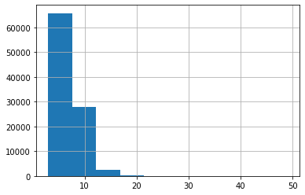
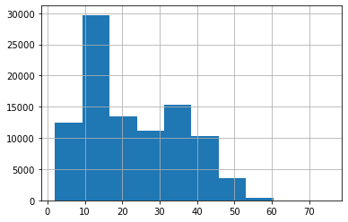
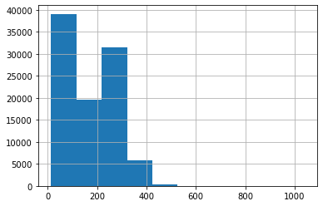
Average word length
Number of words in each tweet
Number of characters present in each sentence

Slide 6
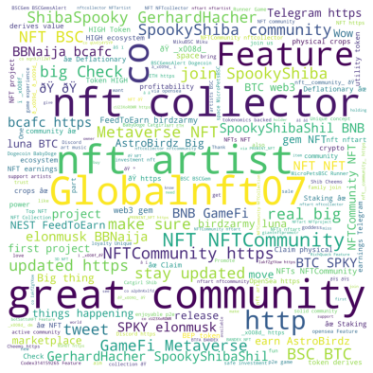
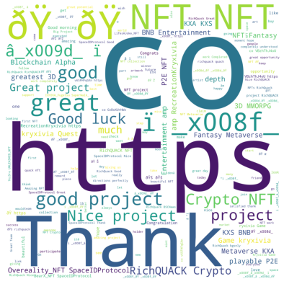
Appreciation Related words
Community Related words

Slide 7
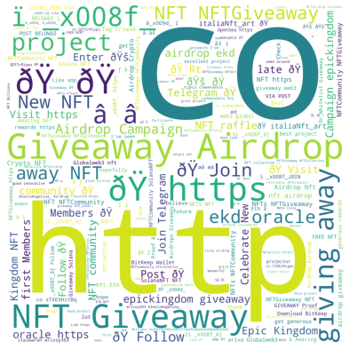
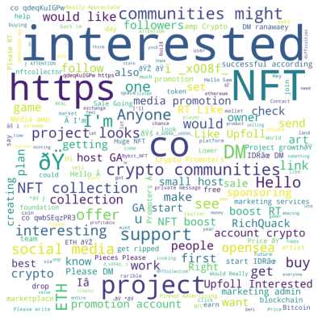
Gateway Related words
Interested Related words

Slide 8
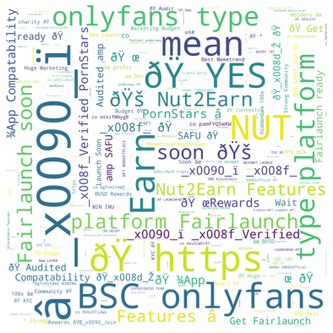
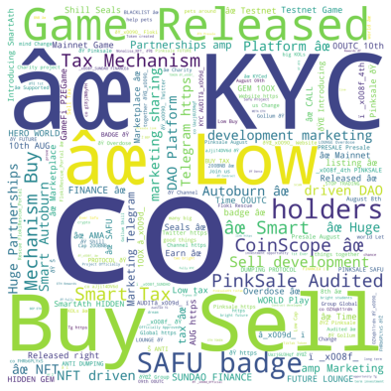
Launching soon Related words
Pinksale Related words

Slide 9
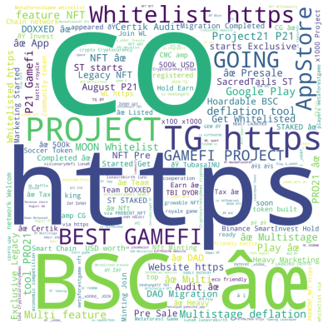
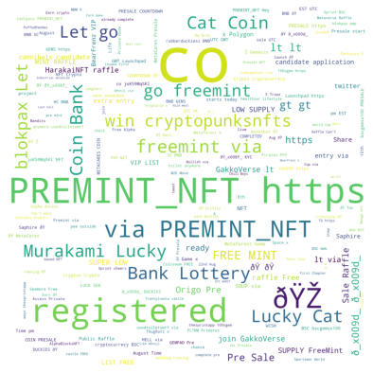
Presale Related words
Whitelist Related words

