Slide 1
PROJECT TITLE
CAPSTONE PROJECT
Presented By: Nasirin Banu.N
College Name & Department : Sri Manakula Vinayagar Engineering College & computer and communication engineering

Slide 2
OUTLINE
Problem Statement
Technology used
Wow factor
End users
Result
Conclusion
Git-hub Link
Future scope

Slide 3
Problem Statement
"Secure Data Hiding in Images Using Steganography" is a project that focuses on embedding confidential data within digital images to ensure privacy. It utilizes techniques like Least Significant Bit (LSB) substitution to conceal information while preserving image quality. By integrating encryption with steganography, the system enhances data security and prevents unauthorized access. This approach provides a reliable method for secure communication and data protection.

Slide 4
Technology used
Technologies, Platform, and Libraries Used
Technologies & Platform
Programming Language: Python
Platform: Cross-platform (Windows, Linux, macOS)
Libraries Used
1. OpenCV (cv2) – Used for image processing (reading, modifying, and saving images).
2. OS (os) – Used to open the saved encrypted image automatically.
3. String (string) – Used for character encoding, though not explicitly needed in this code.
This script performs image-based steganography by embedding text into an image and retrieving it using a password.

Slide 5
Wow factors
Unique Features of the Project 1. Simple and Lightweight Implementation 2. Custom Character Encoding 3. Password-Protected Decryption 4. Cross-Platform Compatibility 5. Fast Execution

Slide 6
End users
Cybersecurity Professionals – For secure communication and data protection.
2. Journalists & Activists – To hide sensitive information in images.
3. Forensic Experts – For covert data transmission and evidence protection.
4. Software Developers & Researchers – For studying and enhancing steganography techniques.
5. General Users – For private messaging and personal data security.

Slide 7
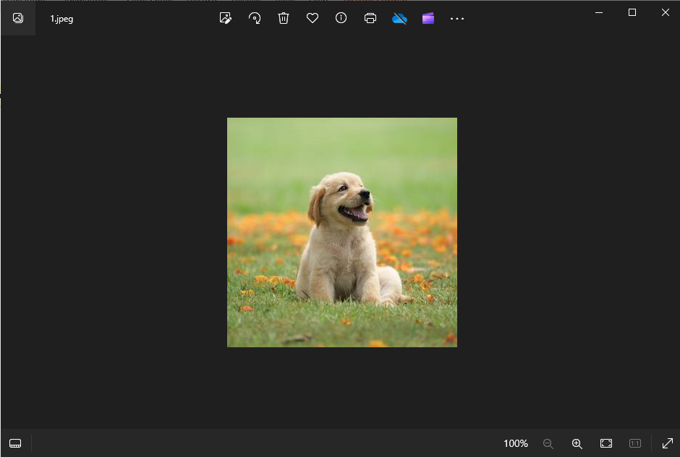
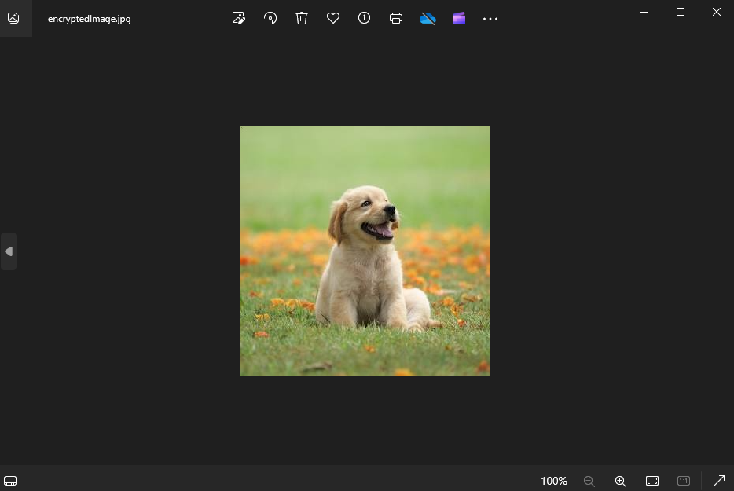
Results

Slide 8
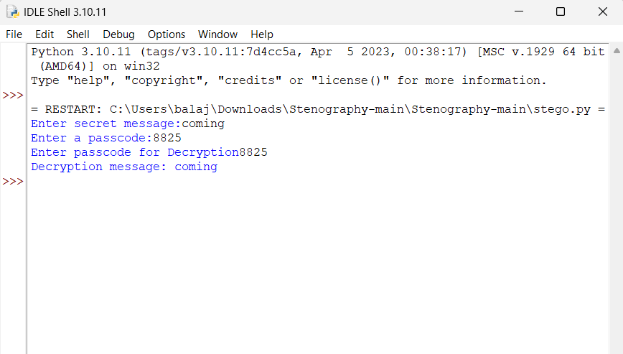
Results

Slide 9
Conclusion
This project addresses the need for secure and hidden communication by embedding messages within images using pixel manipulation and password protection. By leveraging a simple yet effective approach, it ensures confidentiality and accessibility while preventing unauthorized access. This solution is useful for secure messaging, digital forensics, and data protection, making it a practical steganographic tool.

Slide 10
GitHub Link
https://github.com/Nasirin-banu

Slide 11
THANK YOU

