Slide 1
Achieving Encryption & Decryption with PHP, MySql Presented by
Group # 05
Asim Shaik (811170897, ashaik5@kent.edu )
Mohammed Duvvur (811191992, mduvvur@kent.edu )

Slide 2
Agenda
Introduction
System Architecture
Technical Details
Results
Conclusion
Limitations and Future Work

Slide 3

Introduction-Goal
Our Main goal in this project is to store the data encrypted(cipher text) at the DB(locally), but when you try to read it will give you a non-cipher text( plain text).
Here we used AES (advanced encryption standard) algorithm for encryption and an AES key length of 256 bits.

Slide 4
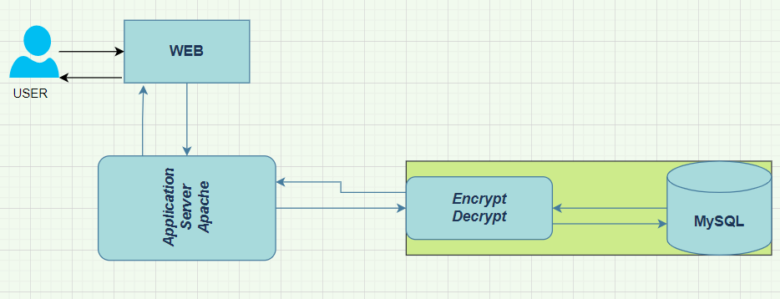
System Design

Slide 5
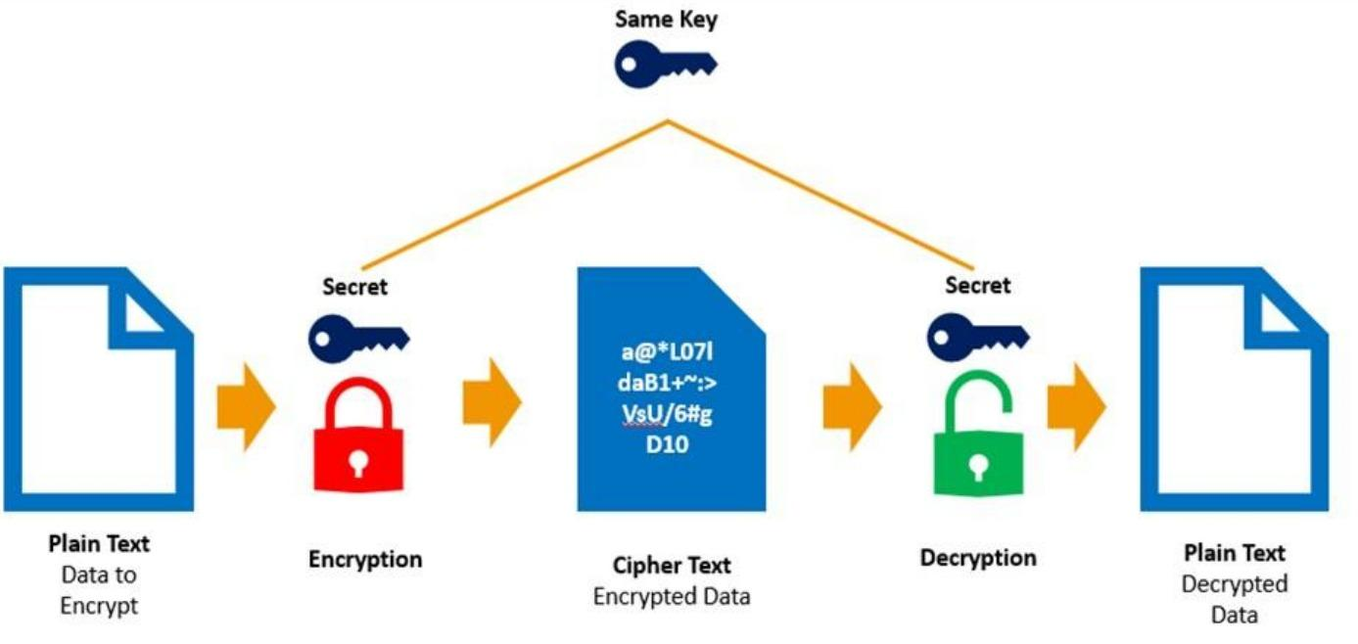
System Design- Encrypt, Decrypt

Slide 6
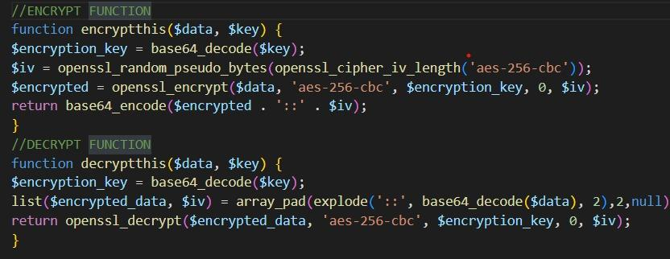
System Design - Encrypt, Decrypt
Encrypt and Decrypt function:

Slide 7
Technical Details
Backend: PHP, MySQL
Encryption: AES 256 CBC
Coding Environment: VS code
OS: Windows 10
Server: Apache(XAMPP v 3.3)

Slide 8
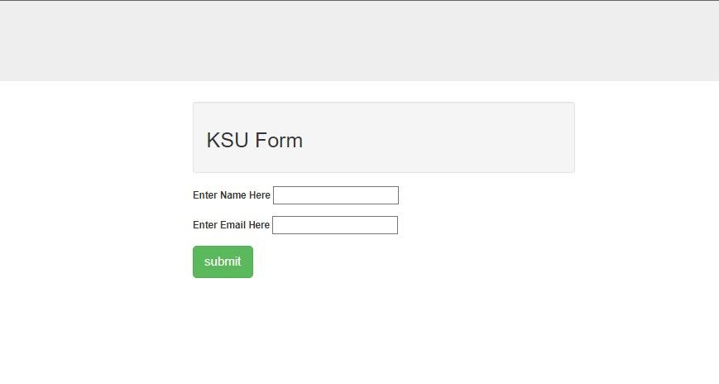
Results

Slide 9
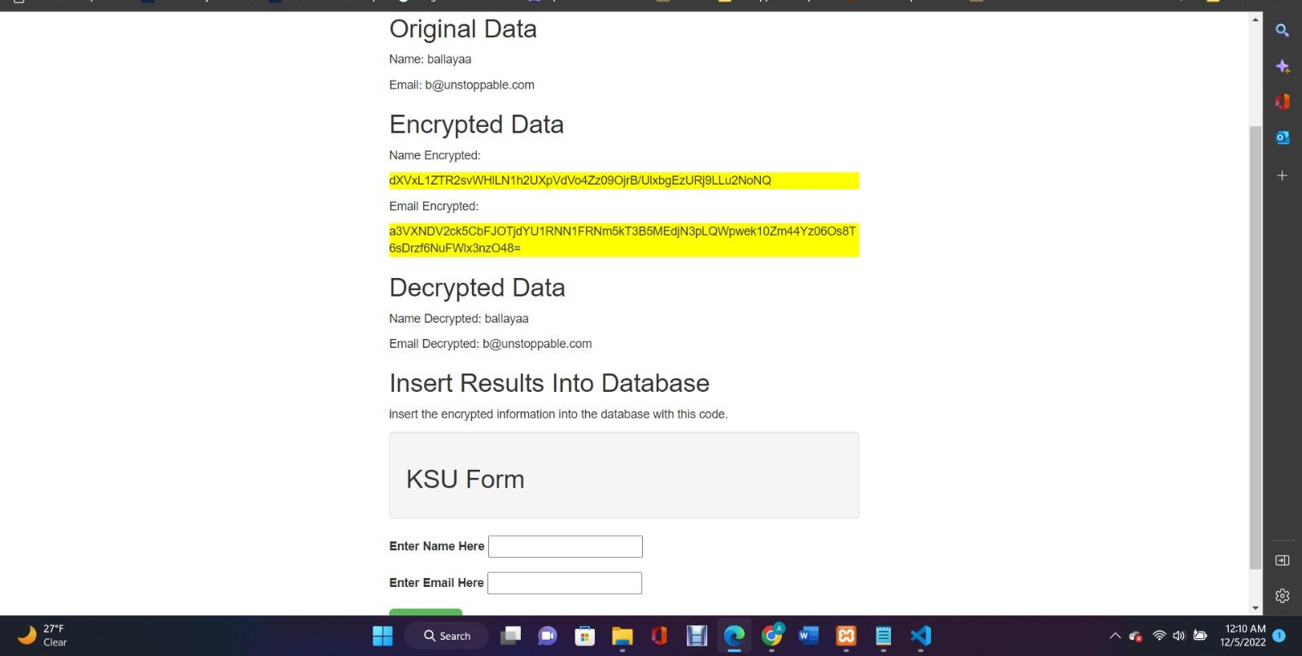
Results- Entering Record1

Slide 10
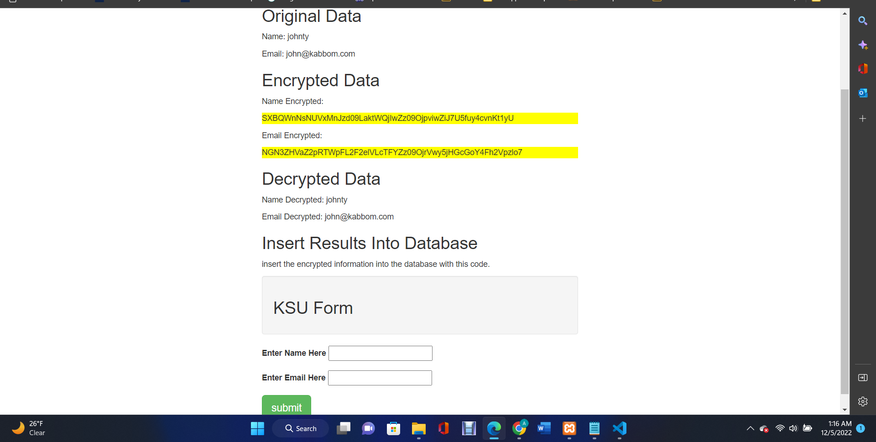
Results- Entering Record2

Slide 11
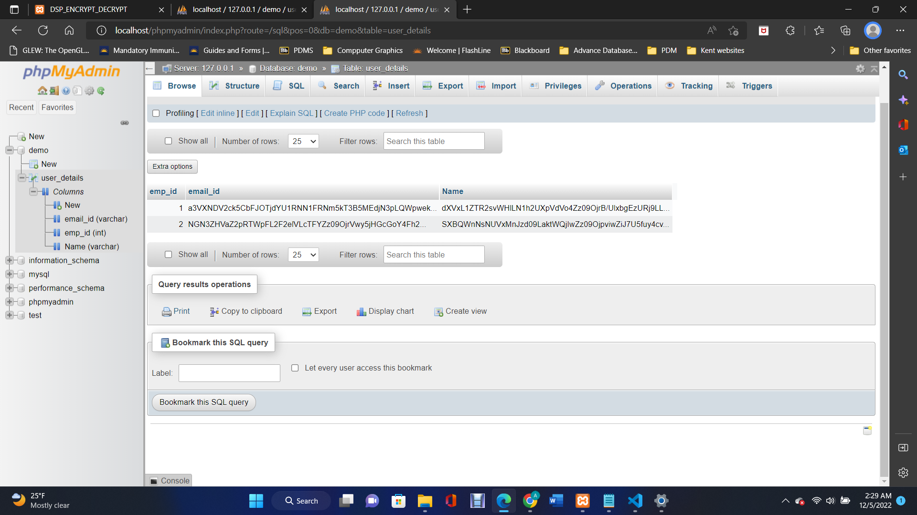
Result-DB

Slide 12
Limitations
Storing Locally can be vulnerable in production.
Not ideal for large-scale applications.
AES in the counter mode is complex for implementing in software.

Slide 13
Conclusion and Future Work
We developed a small-scale web-application, for securing data stored in DB by encryption and when you retrieve it will get decrypted. We used secret key for encryption and decryption which is stored at a secure location locally.
In future we would like to give a try with Cloud and Non-Relational DB (Mostly MongoDB with AWS(KMS)).

Slide 14

Questions?

