Slide 1
Credit Card fraud detection using Random Forest - An ML approach
By Team 6

Slide 2

INTRODUCTION
Credit card payments are the most common type of transaction, both in-store and online. Fraudsters target credit card details due to the increasing accessibility of e-commerce websites/platforms.
More than 70% of financial frauds are banking/financial frauds, with unauthorized credit card payments being the highest category of fraud.
In this project we focus on solving this problem with a fraud detection model.
The frequency of fraud has increased due to the large amount of information generated by digitalization. If this data is not secured, fraudsters can easily access it.

Slide 3
MACHINE LEARNING APPROACH
Machine learning plays a critical role in credit card fraud detection by analyzing transaction data and identifying patterns that are indicative of fraudulent behavior.
Here are some ways machine learning can be used in credit card fraud detection:- a. Classification – Random Forest b. Anomaly detection c. Continuous Learning d. Risk Assessment e. Fraud Network Detection

Slide 4
Related work:
Previous Work | Highest Accuracy | Imbalanced Data | F1 score, recall, precision, speed
[1]KNN | No | No | Yes (less speed)
[2]SVM | No | Yes | Yes
[3]Decision Tree | No | Yes | No
Our model(RF) | Yes | Yes | Yes

Slide 5
Background - Credit Card fraud detection
Credit card fraud detection is a common application of machine learning where our goal is to detect fraudulent transactions in credit card transactions.
It is a critical problem for banks and financial institutions to prevent fraudulent activities and minimize financial losses.
The model is trained on a labeled dataset that contains both legitimate and fraudulent transactions, and it learns to distinguish between the two. We’re using Confusion Matrix to predict fraudulent transactions.
The performance of our credit card fraud detection model will be evaluated using metrics such as accuracy, precision, recall, F1 score, and Matthews correlation coefficient.

Slide 6
WHAT IS RANDOM FOREST ALGORITHM?
Random Forest is an ensemble machine learning algorithm that combines multiple decision trees to create a more accurate and robust model for classification and regression tasks.
It constructs a collection of decision trees independently using bootstrap samples of the original data and selects a random subset of features to split at each node.
The output of each decision tree is then aggregated to produce a final prediction using simple majority voting (in classification problems) or averaging (in regression problems).
It is widely used in various real-world applications, such as finance, healthcare, and image recognition.

Slide 7
WHAT IS CLASSIFICATION AND RANDOM CLASSIFIER?
Classification is a type of supervised learning task in machine learning where the goal is to predict the category or class to which an input data point belongs.
In classification, a machine learning model is trained using a labeled dataset, where each data point is associated with a class label.
The model learns to identify patterns and relationships between the input features and the corresponding output labels. The trained model can then be used to predict the class of new, unseen data points.
Random Forest Classifier is an implementation in machine learning which is used for classification tasks.

Slide 8
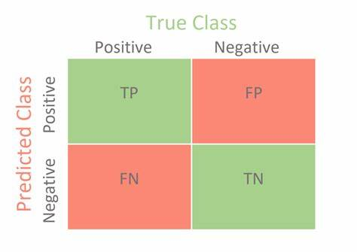
WHAT IS A CONFUSION MATRIX?
A confusion matrix is a table that summarizes the performance of a machine learning model on a test dataset. Using confusion matrix values, the classification metrics can be calculated.
True Positive (TP): The number of transactions that are truly fraudulent and are correctly classified as fraudulent by the model.
False Positive (FP): The number of transactions that are not fraudulent but are incorrectly classified as fraudulent by the model.
True Negative (TN): The number of transactions that are not fraudulent and are correctly classified as not fraudulent by the model.
False Negative (FN): The number of transactions that are truly fraudulent but are incorrectly classified as not fraudulent by the model.

Slide 9
Steps:
Milestone 1:
Data Loading.
Data Exploration
Mile stone2:
Data Analysis, Data Preprocessing
Data Visualization, Correlation Matrix
MileStone3:
Splitting the data into train/test.
Building random forest classifier
Milestone4, 5:
Evaluation Metrics.
Visualizing the random tree
Deployment.

Slide 10
DATA-SET
We’ve collected the dataset from Kaggle. https://www.kaggle.com/datasets/mlg-ulb/creditcardfraud?resource=download
The data set consists of Time, User identities and sensitive features from V1 to V28, Amount, and Class as columns.
Data set contains 284,808 records.(148MB)

Slide 11
Infrastructure
Scikit-Learn: Machine Learning library, which provides ml algorithms, data pre-processing, model selection evaluation etc.
Python packages: NumPy for math functions, pandas for data framing etc and matplotlib and seaborn for visualizing.
OS : Windows 8 and above (will be using windows 11)
GPU : Random forest does not support GPU acceleration ( need to use third party implementations services if required.)
Version Control: Git, Github
Jupyter Notebook for Analysis, model building and visualization.

Slide 12
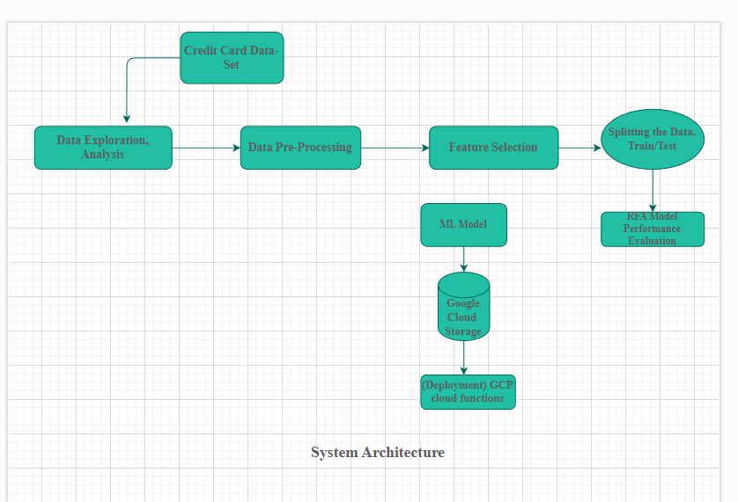
System Architecture

Slide 13
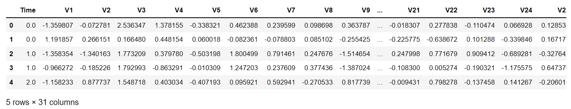
Milestone 1
Data Loading: Here we load the dataset by importing csv file using python.
Data Understanding: We get a peak at the data wherein we observed that we’ve total of 31 columns which includes Time, features from V1 to V28 as columns, Amount, Class.

Slide 14
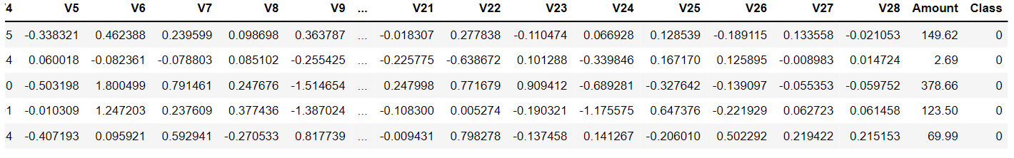
Milestone 1
Time - Time here is the number of seconds elapsed between two transactions.
Amount - Transaction amount.
Class - In class attribute, 0 represents the Non-Fraudulent transaction and 1 represents the Fraudulent Transaction.

Slide 15
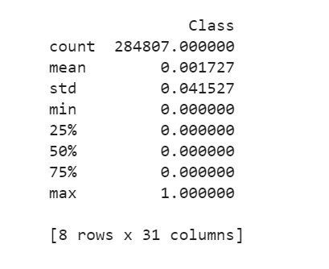
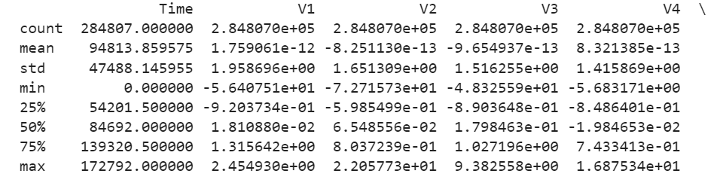
Milestone 1-
Data Describing: In data describing we calculate values such as Count, Mean, Standard Deviation, Min, 25%, 50%, 75% Max for the attributes. From this we can do further analysis on how our data actually is, how we can use it and what can we learn from it.
Data Exploration: In this step we have used python libraries like pandas to load and frame the data and explored the different features we are having in the data set.
We have also performed basic analysis of the data features we have in the data like mean, total count etc.

Slide 16
Milestone 2- Data Analysis, Visualization and Co relation
In this stage of the project we focused on Data Analysis, feature selection and some visualization, more insights from the data set by identifying distribution of each feature we have in the data.
Some examples like time, amount features below;

Slide 17
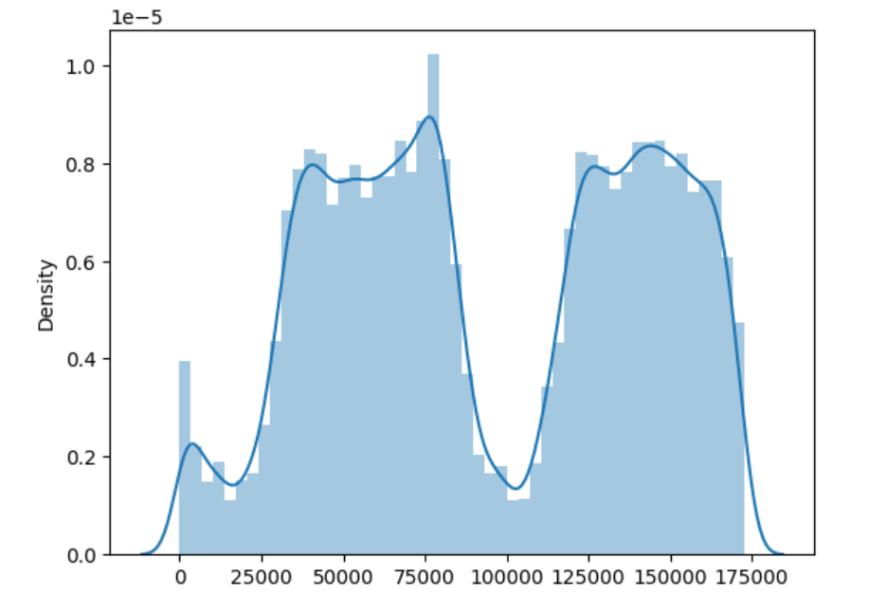
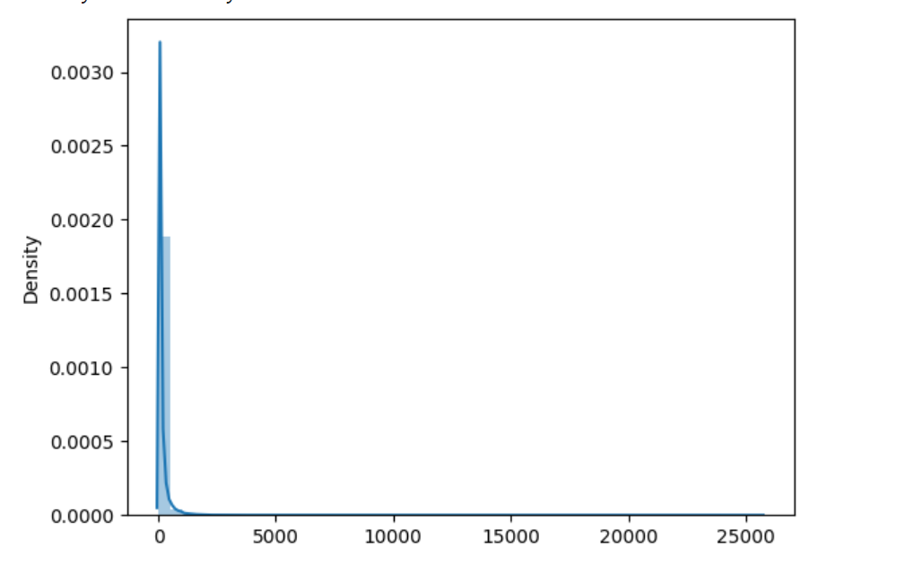
Milestone 2

Slide 18
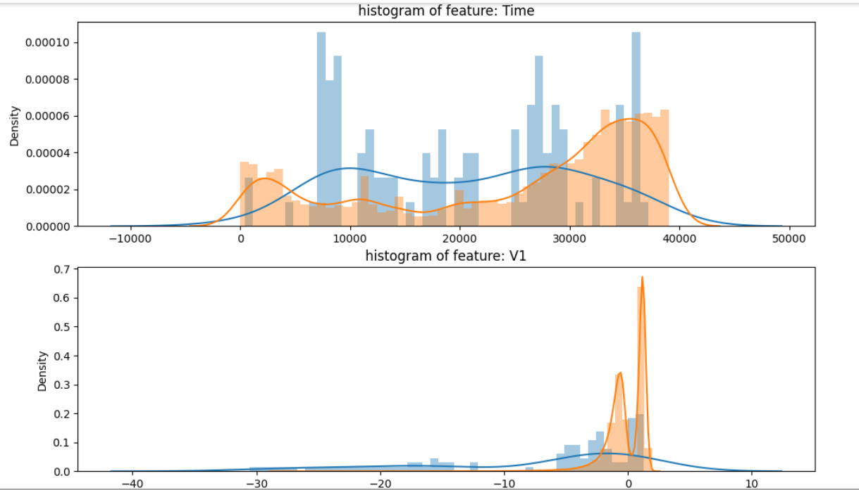
Milestone 2
Histograms:

Slide 19
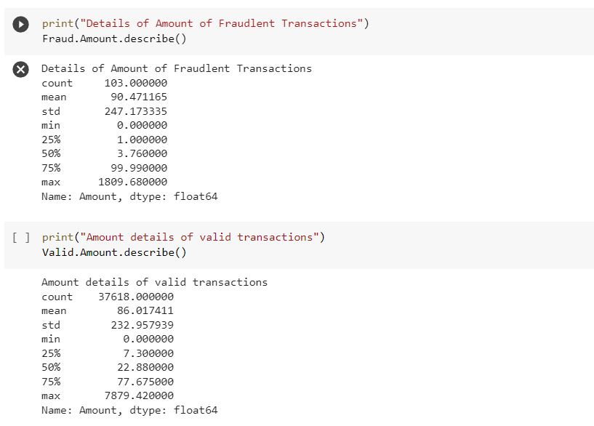
Milestone 2
Finally we have identified number of valid and in valid transactions present in the dataset and we identified the details like Count, Mean, standard deviation, Min, Max etc..

Slide 20
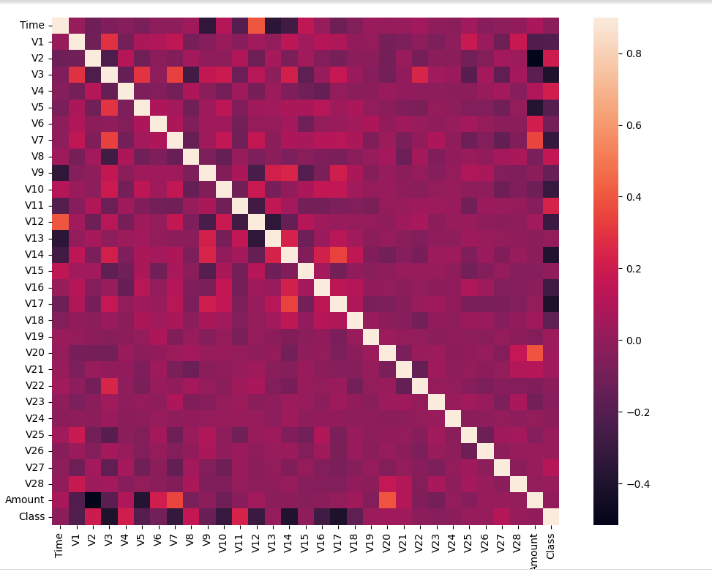
Milestone 2- Corelation Matrix
we have also developed a co-relation matrix using a heat map, which show the co-relation coefficients between the two variables of each individual cell in the table. The value is usually between -1, +1.

Slide 21
Milestone 3
Separating the Data Set and splitting into two sets training and testing using scikit learn : In this step we separated the data into x, y values.
Building the random classifier: We built a classifier using random forest and split the data into training and testing.
Performance Evaluation of our classifier using test data:
we have multiple metrics like accuracy, precision, recall, f1 score, Mathew correlation coefficient

Slide 22
MileStone 3
Accuracy: Accuracy is the ratio of correctly predicted observations to the total number of observations. In other words, it is the percentage of correct predictions made by a model.
Precision is the ratio of true positives (correctly predicted positive instances) to the total number of instances predicted as positive.
Recall is the ratio of true positives to the total number of actual positive instances. It is a measure of the model's ability to correctly identify all positive instances.
F1 Score: It provides a balance between precision and recall and is often used as a single metric to evaluate a model's performance.
MCC: MCC ranges from -1 to +1, where a value of +1 represents a perfect prediction, 0 represents a random prediction, and -1 represents a completely wrong. In general it is a quality of measure of binary classification

Slide 23
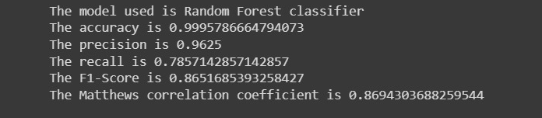
Milestone 3 - Results
Screenshots shows the ac accuracy, precision, recall, f1 score, Mathew correlation coefficient.
Figure: Shows the performance metrices of our model.

Slide 24
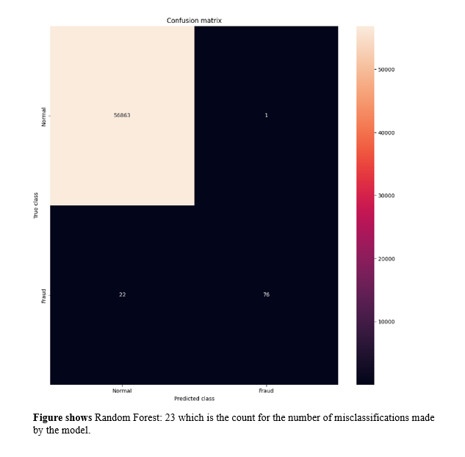
Milestone 4
Generated a confusion matrix, to check the true positivity, true negativity and false positivity and false negativity of the model.

Slide 25
Milestone 4
X-axis has the Predicted class and Y-axis has the True Class. Also, the label DNormal represents a Positive Class and the label Fraud represents a Negative Class.
TrueNegative(TN) = 56863 are the non-fraudulent transactions that are correctly classified as non-fraudulent, FalsePositive(FP) = 1 are the non-fraudulent transactions that were incorrectly classified as fraudulent, FalseNegative(FN) = 22 are fraudulent transactions that are incorrectly classified as non-fraudulent, TruePositive(TP) = 76 are the fraudulent transactions that are correctly classified as fraudulent.

Slide 26
Conclusion
We’ve built a credit card fraud detection model using Python and Scikit-learn. We began by understanding the importance of detecting fraudulent transactions to protect customers and financial institutions.
We’ve used Random Forest Classifier. For beginning learning the model, we have set the hyperparameters and to evaluate the performance of this model, we used confusion matrix, accuracy, precision, recall, F1-score, and Matthew’s correlation coefficient. Ultimately, we found that our Random Forest Classifier provided the best results in terms of detecting fraud transactions.

Slide 27
References
[1] Sai Kiran, Jyoti Guru, Rishabh Kumar, Naveen Kumar, Deepak Katariya, and Maheshwar Sharma. Credit card fraud detection using na¨ıve bayes model based and knn classifier. International Journal of Advance Research, Ideas and Innovations in Technoloy, 4(3):44, 2018.
[2] Vaishnavi Nath Dornadula and Sa Geetha. Credit card fraud detection using machine learning algorithms. Procedia computer science, 165:631–641, 2019.
[3] Admel Husejinovic. Credit card fraud detection using naive bayesian and c4. 5 decision tree classifiers. Husejinovic, A.(2020). Credit card fraud detection using naive Bayesian and C, 4:1–5, 2020.
https://scikitlearn.org/stable/modules/generated/sklearn.ensemble.RandomForestClassifier.html

