Slide 1
C# ASYNC – Await In Detail

Slide 2
What Are We Going To COVER
Why Bother With Async?
From Sync to Async
Asynchronous vs Multithreaded
Task & Task<T>
The async & await Keywords
Is Async Faster Than Sync?
Gotchas & Antipatterns
Cancelling Tasks
Tasks Behind The Scenes
async & await Behind The Scenes
The New ValueTask

Slide 3
WHY ASYNC

Slide 4
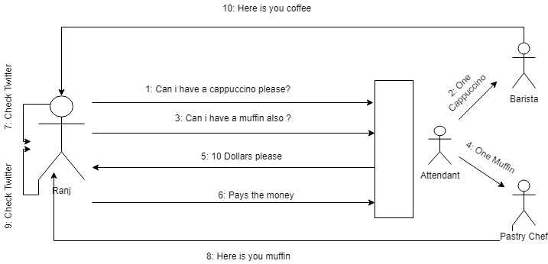
Why Bother with async programming?
Real-world example – coffee ordering

Slide 5
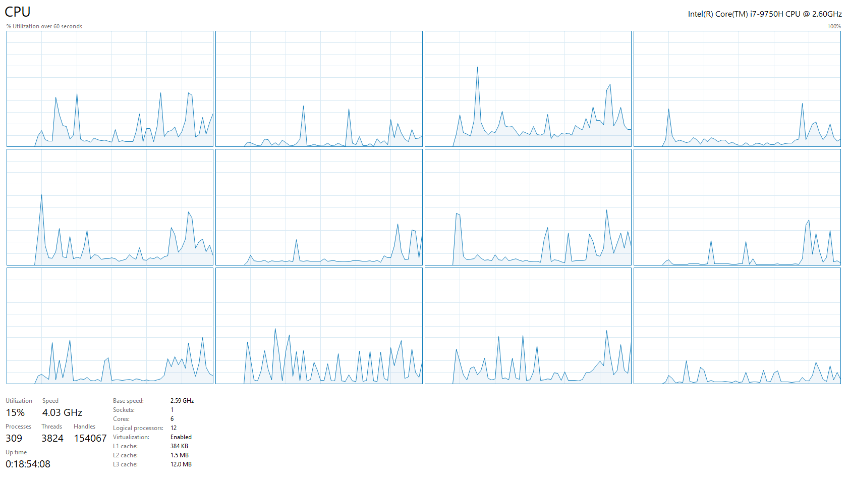
Why Bother with async programming?
Async has many pros:
Avoid unreliable applications
Improve user experience
Leverage all resources on a machine
Improve performance of CPU & IO operations
But also lots of cons:
More difficult code
More difficult to debug
Harder to understand as a concept
Too much is going on

Slide 6
FROM SYNC TO ASYNC

Slide 7
From SYNC TO ASYNC
Async code:
No longer runs line by line
Multiple operations run simultaneously
Asynchronous, in computer programming, refers to the
occurrence of events independent of the main program
flow and ways to deal with such events. These may be
“outside” events such as the arrival of signals, or
actions instigated by a program that take place
concurrently with program execution, without the
program blocking to wait for results.

Slide 8
From SYNC TO ASYNC
For example, take a look at this code:
What is the result?
Don’t be scared! Everything will be explained!
var task = Task.Run(() => Console.WriteLine("First!"));
Console.WriteLine("Second");
task.Wait();

Slide 9
DEMO

Slide 10
From SYNC TO ASYNC
Let’s cook burgers!
Pans need to be heated – 2 minutes
Meat needs to be unfrozen – 3 minutes
Potatoes need to be peeled – 2 minutes
Burgers need to be cooked – 5 minutes
Fries need to be fried – 3 minutes
Drinks need to be poured – 1 minute
All of these should be eaten! – 5 minutes
Synchronous cooker – 21 minutes in total (Slow)
All at once asynchronous cooker – 5 minutes in total (Fastest, but impossible)
Synchronized asynchronous cooker – 13 minutes in total (Fast)

Slide 11
DEMO

Slide 12
Asynchronous vs Multithreaded

Slide 13
Asynchronous vs Multithreaded
Asynchronous programming is not multithreaded programming!
These two are different programming models!
When you write asynchronous code, you don’t necessary use threads!
Back to the burgers:
Synchronous: you cook the meals one step at a time
Asynchronous: you cook the meals by doing multiple things at a time
Multithreaded:
you open a burgers restaurant
you hire a cook to make the burgers
you hire a cook to make the fries
you hire a waiter to serve the meals
you coordinate the employees so that they do not conflict with shared kitchen resources

Slide 14
Multithreading
Threading is about workers
Each thread is a separate worker
You can consider each CPU to be a separate worker
The perfect scenario is to have a thread for each CPU
In reality your OS allows you many threads and coordinates them

Slide 15
DEMO

Slide 16
Asynchronous
Asynchrony is about tasks
You assign tasks to workers
One worker may execute multiple tasks at once
Tasks are not CPU-bound by concept
A task may be put on another thread (if CPU is required), but it is not necessary
Do I need to hire a second cook, if I make burgers for myself?

Slide 17
Task & Task<T>

Slide 18
TASK
Tasks simplify working with asynchronous code
The Task class represents a void work without result
The Task<T> class returns T as a result
We create tasks with Task.Run
var voidTask = Task.Run(() => { \* Lots of work! *\ });
var resultTask = Task.Run(() =>
{
return 42; // After lots of work!
});

Slide 19
Task methods
What to do with created tasks?
Wait them to finish – blocks until the task is done
Continue with another task – chain tasks one after another
Cancel them – if the task is taking too much time
Check their state – success or faulty
Run it synchronously – don’t do that! ☺
Useful static task methods
Run – create a new task
Factory.StartNew – create a new task with advanced options
Delay – wait some time
WhenAll and WhenAny – wait for multiple tasks
FromResult and CompletedTask – finished tasks

Slide 20
DEMO

Slide 21
ASYNC & AWAIT

Slide 22
ASYNC & AWAIT
These two keywords always work together
Async methods return void, Task or Task<T>
They allow you to make Task-based code more readable
Async code looks & feels more “synchronous”
Task.Run(() => { \* Lots of work! *\ })
.ContinueWith(prev => Console.WriteLine(“Done”));
await Task.Run(() => { \* Lots of work! *\ });
Console.WriteLine(“Done”);

Slide 23
DEMO

Slide 24
.WAIT() vs await
It may look like .Wait() and await are similar, but they are not
.Wait()
Blocks the caller thread synchronously
The current thread is waiting and not doing anything
await
Does not block the caller thread
The current method is paused, and its state is captured
The caller thread is released, allowing it to do some other work
After the awaited task is completed, the caller methods continues
Always prefer the await keyword
If you need to block – use .GetAwaiter().GetResult() instead of .Wait() or .Result;

Slide 25
DEMO

Slide 26
LET’s See a performance example

Slide 27
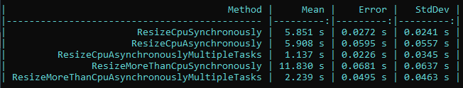
Performance example
We are going to resize images and will measure the performance
The number of CPUs images synchronously
The number of CPUs images with tasks but no .WhenAll()
The number of CPUs images with tasks by using .WhenAll()
More than CPUs images synchronously
More than CPUs images with tasks by using .WhenAll()
Don’t use tasks in non-scalable solutions! They bring overhead!

Slide 28
DEMO

Slide 29
Gotchas & Antipatterns

Slide 30
Gotchas & Antipatterns
Forgetting await
If you forget to await a task, it will simply not run as you expect causing bugs
Don’t use async void
It is fire and forget and exceptions cannot be caught
Be careful with async void lambda expressions
async Action delegates are hidden void methods
Try not to mix sync and async context
It is like trying to cook a burger with three hand while obviously have only 2… ☺
Never call .Result or .GetAwaiter().GetResult()
Always do async/await all the way down
Otherwise deadlocks may occur
If you get a deadlock, use .ConfigureAwait(false) on your tasks

Slide 31
DEMO

Slide 32
Deadlock DEMO

Slide 33
Cancelling Tasks

Slide 34
Cancelling Tasks
Some async methods can be cancelled
The method must accept a cancellation token as a parameter
You can implement cancellation in your async methods too
var cancellation = new CancellationTokenSource();
cancellation.IsCancellationRequested;
cancellation.Cancel();

Slide 35
DEMO

Slide 36
Tasks Behind The Scenes

Slide 37
Task completion source
It enables the creation of a task that can be handed out to consumers
It has helpful methods and properties:
SetResult
SetException
Task
It is useful to add async functionality to event-based APIs

Slide 38
DEMO

Slide 39
Awaiter pattern
The .GetAwaiter() method must return anything that matches this interface:
You can use the build in TaskAwaiter or TaskAwaiter<T> to for custom await implementations
bool IsCompleted { get; }
void OnCompleted(Action continuation);
TResult GetResult(); // TResult can also be void

Slide 40
Awaiter pattern
await actually works on every type having a GetAwaiter() method
You can even implement custom awaiter but most of the time it is not needed
public static TaskAwaiter<string> GetAwaiter(this Uri uri)
=> new HttpClient().GetStringAsync(uri).GetAwaiter();
var content = await new Uri("https://mytestedasp.net");

Slide 41
DEMO

Slide 42
Task SCHEDULER
The TaskScheduler class is the one who queues the tasks in your application
The default implementation uses the ThreadPool to queue and execute work
It is a pool of worker threads that are managed by the system
Maximum number of threads depend on the virtual memory
When all threads are busy, tasks are queued
The work is put on this shared queue and eventually de-queued onto the next thread that becomes available
Its algorithm is performance-oriented and does not lock by default
Top-level tasks use this global queue
Nested tasks have a local per thread queue for optimization
You can create your own TaskScheduler, if you really need it

Slide 43
Child Tasks
Tasks created in the scope of other tasks are considered child tasks
They can be attached and detached to their parent
By default they are detached by you can specify it explicitly
Attached child tasks:
Are waited by their parent to finish
Exceptions are propagated
Control the status of the parent task
Detached tasks are easier to control and thus they are recommended
By using async/await and Task.Run you don’t need to consider attaching
TaskCreationOptions.AttachedToParent

Slide 44
DEMO

Slide 45
async & await Behind The Scenes

Slide 46
The state machine
For every async method, the compiler generates a state machine
That’s an extra class (struct for release) in the final output (100 bytes)
The state machine has a MoveNext() method to change the state of the execution
Let’s decompile this async method on https://sharplab.io/
public static async Task SomeAsyncMethod(int id)
{
Console.WriteLine("Async without await" + id);
}

Slide 47
The state machine
The state machine has:
State – the state of the execution
AsyncTaskMethodBuilder to create tasks (also used by the compiler)
Initial state is -1, completed state is -2
Without an await, the state machine is pretty straightforward
Our method is also transformed:
Instantiate the method’s state machine
Create new AsyncTaskMethodBuilder and set it as state machine’s builder
Set the state machine to a starting state
Start the builder with the method’s state machine by calling the Start method.
Return the Task

Slide 48
The state machine
Now let’s add an await:
Try it with code before and after the await!
public static async Task SomeAsyncMethod(int id)
{
await Task.Run(() => {
Console.WriteLine("Async without await" + id);
});
}

Slide 49
The state machine
Now the state machine has changed
The first state is -1 so a task is created
If the task has completed synchronously, the method continues
Otherwise, the state changes and the task is registered to be executed
When the task executes, it calls again the MoveNext() method through a callback
This time the state is different, so the state machine continues after the task completion
The completed state is -2, which happens also with exceptions

Slide 50
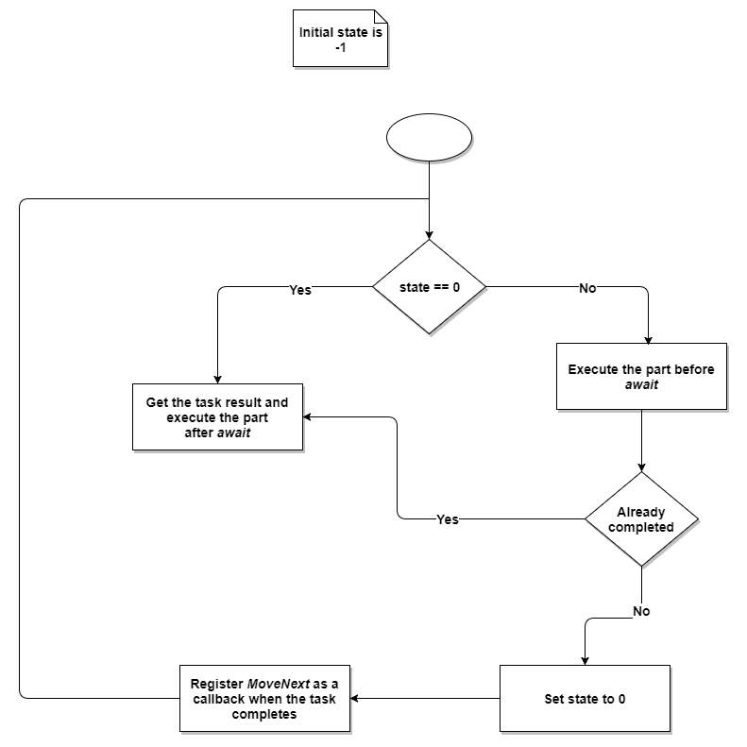
The state machine

Slide 51
The state machine
You can try it with more than 1 await to see the switch statement generated
int input = 5
await Task.Run(()=>{Console.WriteLine("First" + input);});
await Task.Run(()=>{Console.WriteLine("Second" + input);});
await Task.Run(()=>{Console.WriteLine("Third" + input);});

Slide 52
DEMO

Slide 53
The state machine
Performance improvements in the state machine
Builder reuses known tasks
Task.CompletedTask
boolean – true/false
Integers and more
But you can avoid it but removing async/await
Not by using .Wait()
But on methods which return tasks directly
There are catches though – usings, exceptions, and AsyncLocal will not work correctly
Remove async/await only on methods which are “pass through” or overloads
More information: https://blog.stephencleary.com/2016/12/eliding-async-await.html

Slide 54
Value Task

Slide 55
Value Task
The ValueTask<T> was added to .NET Standard 2.1
It is a struct so it allows less memory allocations compared to the normal Task
Can be converted to Task by calling .AsTask()
However, it should be used only after performance analysis
Tasks are the preferred approach (especially on the “hot path”)
ValueTask must:
NOT be awaited multiple times
NOT call AsTask multiple times
NOT use .Result or .GetAwaiter().GetResult() multiple times or if not completed
Because the results may be undefined (and the object already recycled)

Slide 56
FINAL WORDS

