Slide 1
SmartReceipt
By team FBL

Slide 2
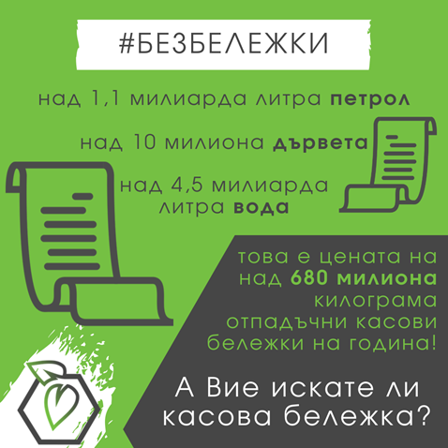
The problem
Notes:
55000 unprinted recepits = 1 saved tree
1.2 millions receipts per month in Bulgaria
22 trees per month

Slide 3
solution
Digital receipts
Expose API to save receipts
Receive digitally formatted receipts
Scan QR code to identify user of our system
Store customer’s receipts
Provide recommendations based on user’s purchases and settings preference
Provide statistics

Slide 4

Benefits
Reduce paper usage
Access to receipts no matter where or when
Analyze one’s spending
Get insight on product category purchases
Get insight on product nutrition and clustering
Notes:
Когато има промоция (кока кола еленче) не е нужно да пазиш бележката за да си вземеш наградата
Bio, eco, recyclable, plastic, etc.

Slide 5

Business approaches
As extension to the store software
Fully managed system – small businesses
Make people aware of what and how they use most
Raise concern about the importance of the global problem
Notes:
Integrate with the current software as a plug-in
Move da si registrirame prilovenieto v nap
Супто.com

Slide 6
Customers
Mobile / Web app
Unique QR Code to be scanned on the cash-desk
Check Receipt history
Shopping recommendations based on customer needs (Health, Budget)
Statistics

Slide 7
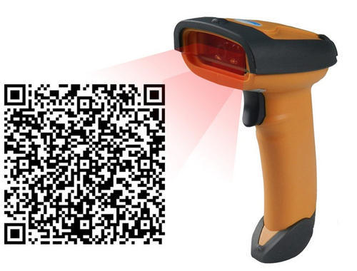
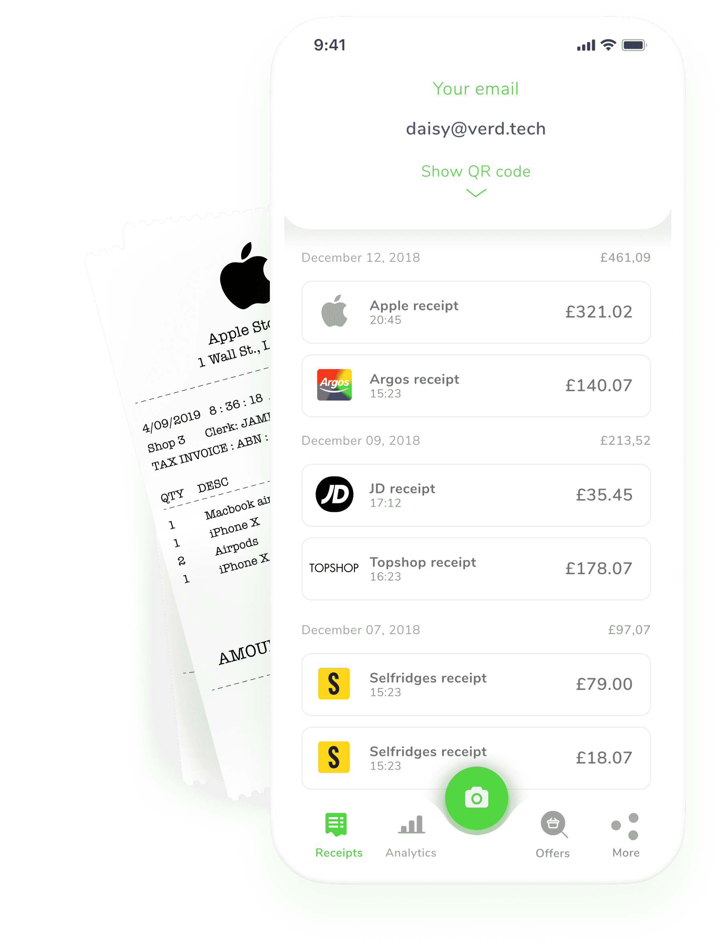

Cash-Desk
Store integration
Scans the QR code
Interacts with a mapper
Interacts with our API
Mapper
Developed per company
Unique authentication token
Bridge between their system and ours

Slide 8
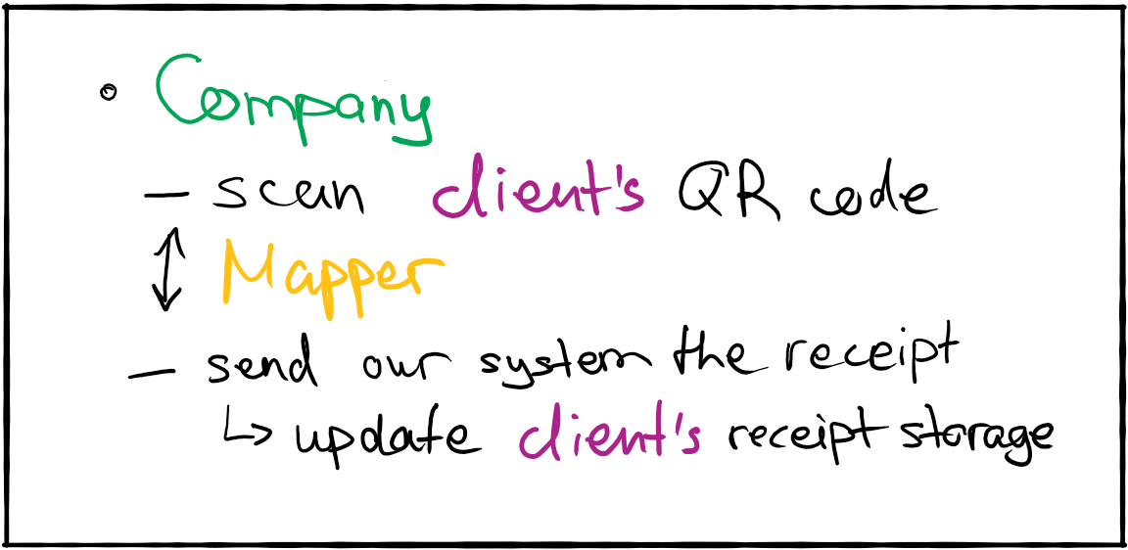
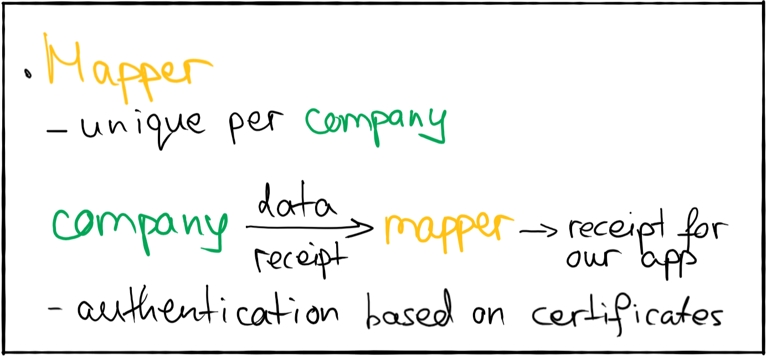
integration

Slide 9
Other benefits – Recommendations (Healthy)
Adding a food to our database
Dataset Foods -> nutrients
Calculate Goal Scores
Predefined formulas based on different goals - Low carb, Mediterranean, paleo, vegan, gluten-free, low fat
Recommend a more healthy alternative
Match the current food with our foods
Translate
Word2Vec Clustering
Pick best based on score out of cluster

Slide 10
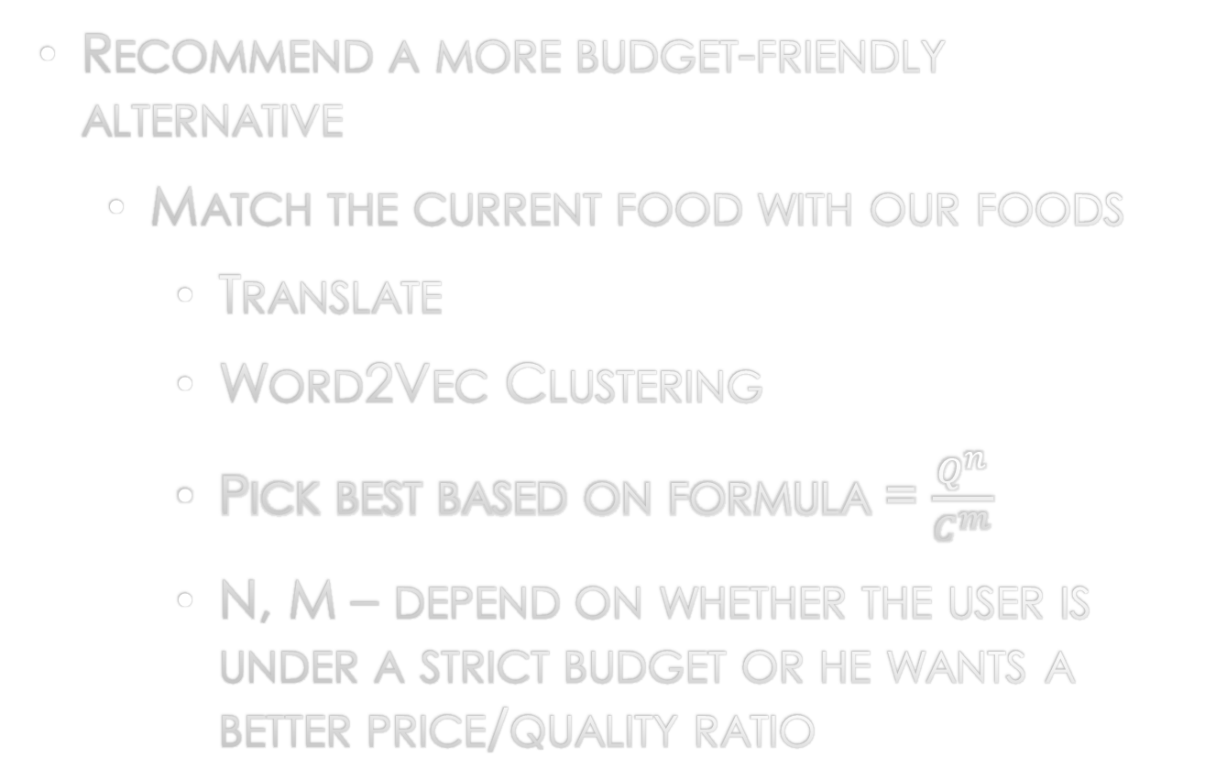
Other benefits – Recommendations (Budget)
Quality (Item) = Buys (Item)/AvgBuys(Cluster)
Cost (Item) = Cost(Item) / AvgCost (Cluster)
Recommend a more budget-friendly alternative
Match the current food with our foods
Translate
Word2Vec Clustering
Pick best based on formula = $\frac{Q^{n}}{C^{m}}$
N, M – depend on whether the user is under a strict budget or he wants a better price/quality ratio

Slide 11
Demo

