Slide 1
Heart Disease Prediction Using Machine Learning
Presented by:
Nasla K

Slide 2
Contents
Objective
Introduction
Proposed System
About dataset
Imported Libraries(Data Analysis & Prediction)
Analysis
Classifiers Performance
Conclusion
References

Slide 3
Objective
1
2​
To find and Analyze various classifier accuracy.
3
To implement a GUI window for heart disease prediction.
To implement heart disease prediction using ML.

Slide 4
Introduction
Globally many people suffered due to heart disease.
Traditional Diagnosis done by a physician.
-Analysis of medical history , physical examination report and analysis of symptoms.
-Disadvantages:
Results obtained from this diagnosis method are not accurate.
Expensive and computationally difficult to analyse.
Machine learning (ML) to resolve these issues.
Proposed a machine learning based diagnosis method for the identification of HD.
LR, K-NN, SVM, DT, and RF are used for the identification of HD.
Cleveland heart disease data set was used for the identification problem of HD :Downloaded from Kaggle.

Slide 5
Proposed System
Fig1:Work-flow

Slide 6
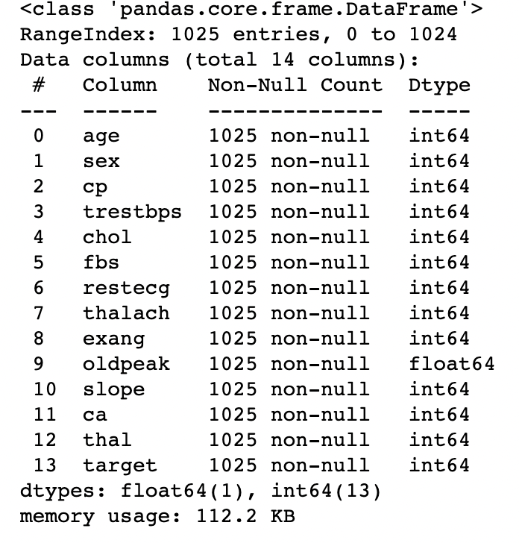
About dataset
Dataset Information
Cleveland heart disease data.
Categorical
Sex, cp, fbs, restecg, exang, slope, ca, thal, and target
Continuous
Age, trestbps, chol, thalach and oldpeak
Rows: 1025 and Columns: 14

Slide 7
Imported Libraries (Data Analysis & Prediction)
Pandas-For data manipulation and analysis
Sklearn-For feature scaling, train test split, ML
Seaborn-For graphical representation
Matplotlib-For graphical representation
Joblib-For saving model
Tkinter-For GUI

Slide 8
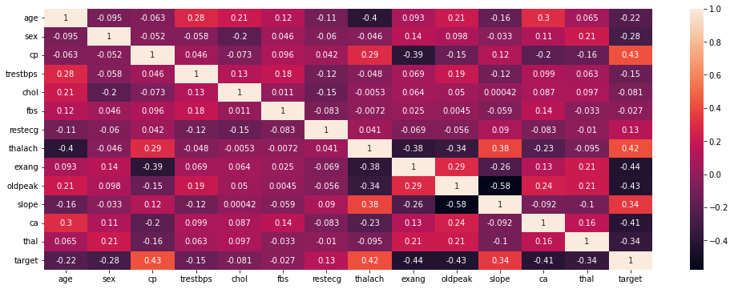
Analysis
Fig2: Heat Map

Slide 9
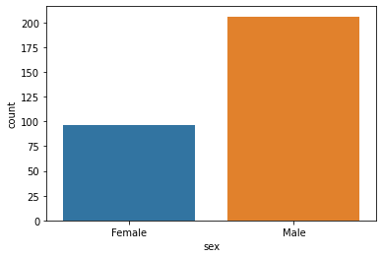
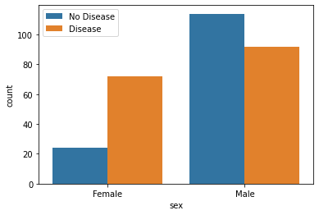
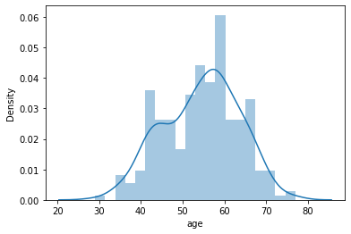
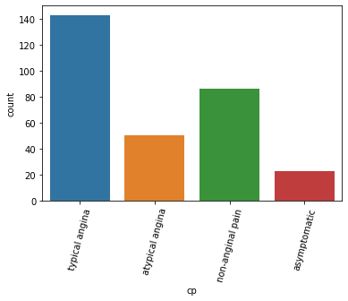
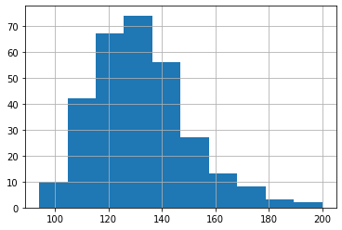
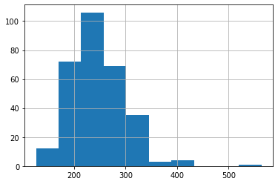
Analysis
1. Count of Male & Female
2. Gender distribution
3. Age distribution in the dataset
4. Which Chest pain type (4 values)is more common in the dataset?
5. Blood pressure distribution
6. Distribution of serum cholesterol

Slide 10
Model training
Preprocessing
Splitting
X_train,X_test,y_train,y_test=train_test_split(X,y,test_size=0.2,random_state=42)
-No missing values
-Contains duplicates
-Dataset shape after dropping duplicate:(302, 14)
-StandardScaler applied in continues variable

Slide 11
Linear classification models
Logistic regression
SVM
from sklearn import svm
from sklearn.linear_model import LogisticRegression
svm=svm.SVC()
svm.fit(X_train,y_train)
y_pred2=svm.predict(X_test)
accuracy_score(y_test,y_pred2)
log=LogisticRegression() log.fit(X_train,y_train)
y_pred1=log.predict(X_test)
accuracy_score(y_test,y_pred2)

Slide 12
Linear classification models
K Neighbors Classifier
knn=KNeighborsClassifier(n_neighbors=7)
knn.fit(X_train,y_train) y_pred3=knn.predict(X_test) accuracy_score(y_test,y_pred3)
from sklearn.neighbors import KNeighborsClassifier

Slide 13
Non- Linear classification models
Decision Tree Classifier
Random Forest Classifier
from sklearn.ensemble import RandomForestClassifier
from sklearn.tree import DecisionTreeClassifier dt=DecisionTreeClassifier()
rf=RandomForestClassifier() rf.fit(X_train,y_train) y_pred5=rf.predict(X_test)
dt.fit(X_train,y_train)
y_pred4=dt.predict(X_test)
accuracy_score(y_test,y_pred4)
accuracy_score(y_test,y_pred5)

Slide 14
Non -Linear classification models
Gradient Boosting Classifier
grb=GradientBoostingClassifier() grb.fit(X_train,y_train) y_pred6=grb.predict(X_test) accuracy_score(y_test,y_pred6)
from sklearn.ensemble import GradientBoostingClassifier

Slide 15
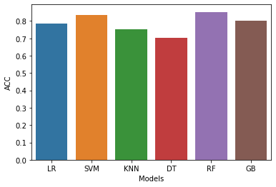
Classifiers Performance
Models | Accuracy
LR | 0.786885
SVM | 0.836066
KNN | 0.754098
DT | 0.704918
RF | 0.852459
GB | 0.803279

Slide 16
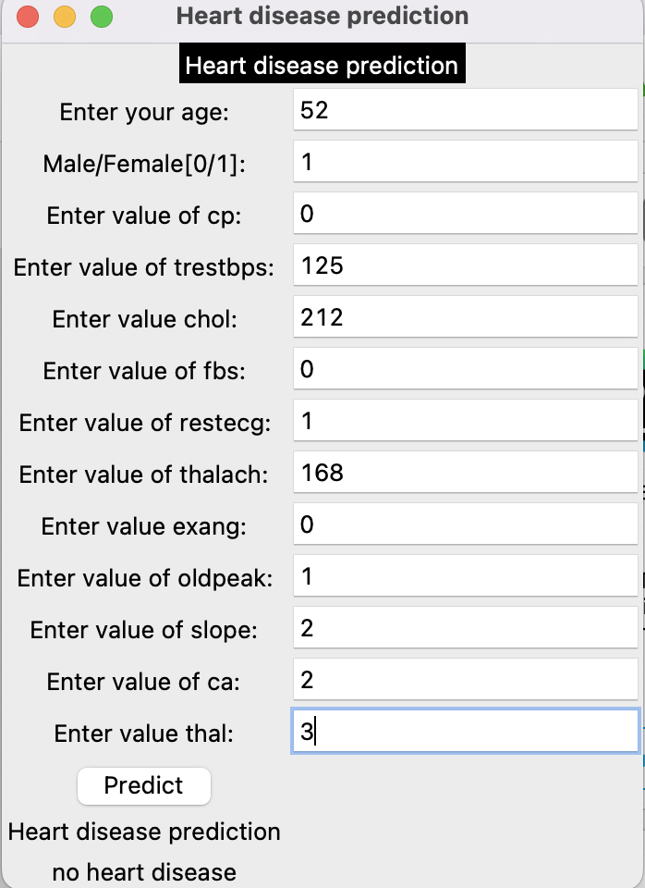
GUI Window

Slide 17
Conclusion
Efficient machine learning based diagnosis system has been developed for the diagnosis of heart disease
Machine learning classifiers include LR, K-NN,SVM, GB, RF and DT are used in the designing of the system.
According to prediction result, RF is the best predictive system for detection of HD
In the future, will use other features selection algorithms to increase the performance of a predictive system for HD diagnosis.

Slide 18
References
[1] Lapp, D. (2019, June 06). Heart disease dataset. Retrieved March 20, 2023, from https://www.kaggle.com/datasets/johnsmith88/heart-disease-dataset
[2] Li, J. P., Haq, A. U., Din, S. U., Khan, J., Khan, A., & Saboor, A. (2020). Heart disease identification method using machine learning classification in E-Healthcare. IEEE Access, 8, 107562-107582. doi:10.1109/access.2020.3001149
[3] Mohan, N., Jain, V., & Agrawal, G. (2021). Heart disease prediction using supervised machine learning algorithms. 2021 5th International Conference on Information Systems and Computer Networks (ISCON). doi:10.1109/iscon52037.2021.9702314

