Slide 1
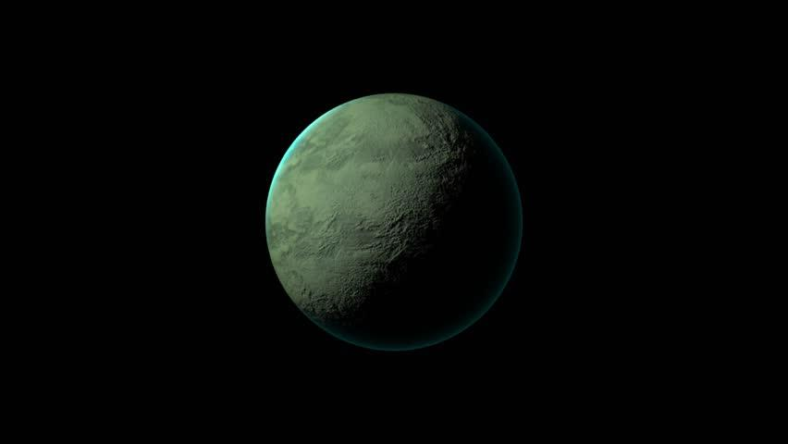

habitable EXOLPANETS
Σκαλτσάς Νάσος
Αβραμόπουλος Γιώργος
ΙΕΕΕ-τμήμα ΑΙ

Slide 2
exoplanet habitability criteria
How do you determine if an exoplanet is habitable?
Mass. In order to be potentially habitable, an exoplanet would have to have a mass between 0.1 and 10 Earth masses.
Radius. The radius of a habitable exoplanet would range between 0.5 and 2.5 Earth radii.
Temperature. The temperature must be between 273.2 Kelvin and 373.2 Kelvin.

Slide 3
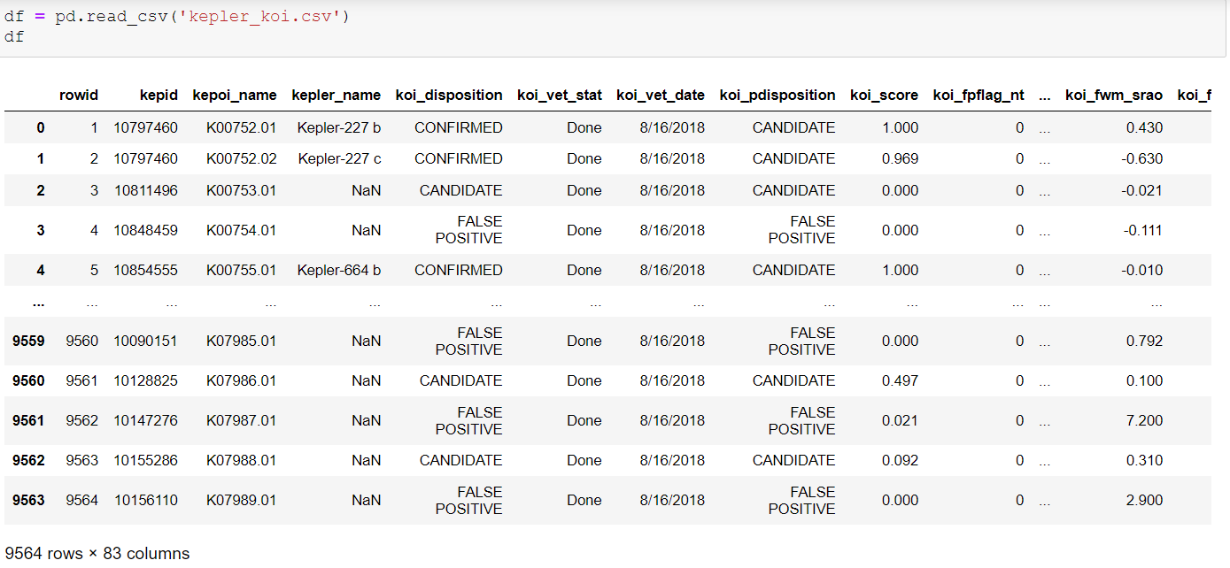
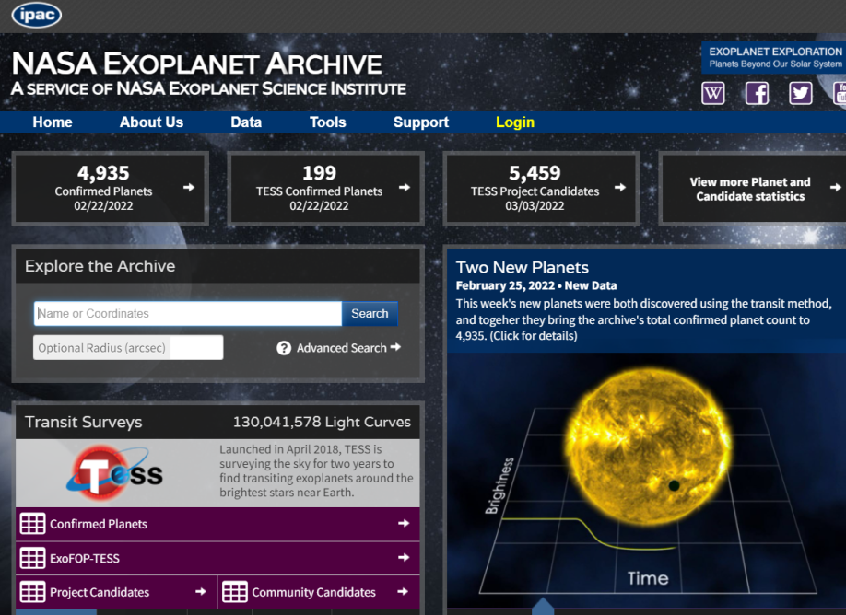
Reading CSV file

Slide 4
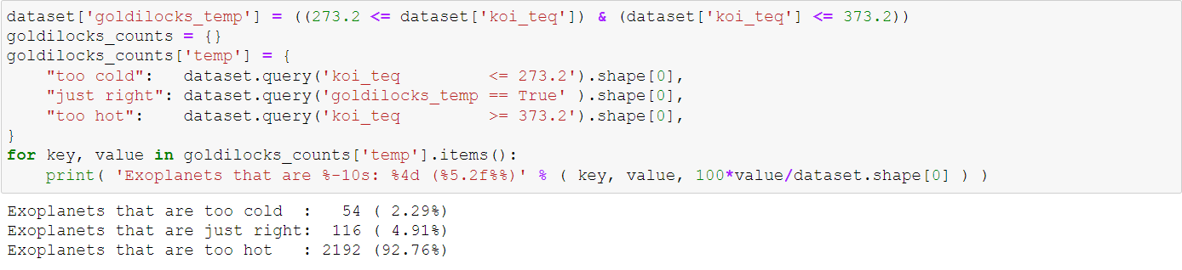
Planets with the right temperature

Slide 5
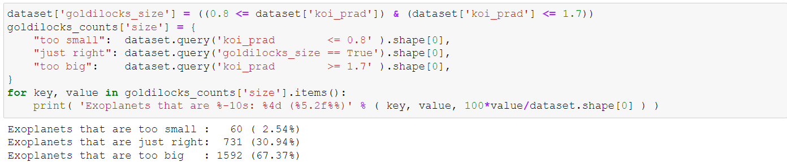
Planets with the right size

Slide 6
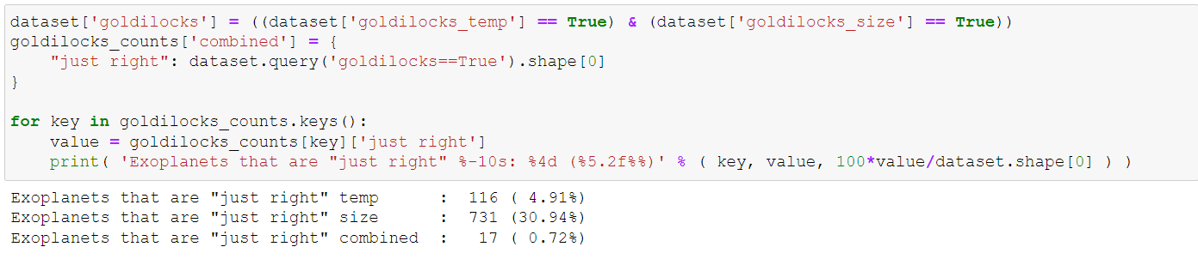
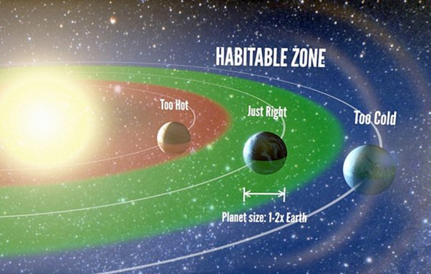
Planets with the right temperature and size

Slide 7
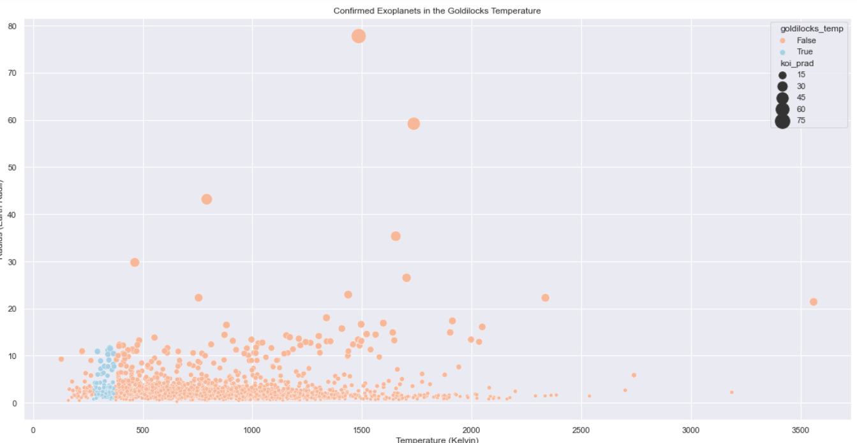

Slide 8
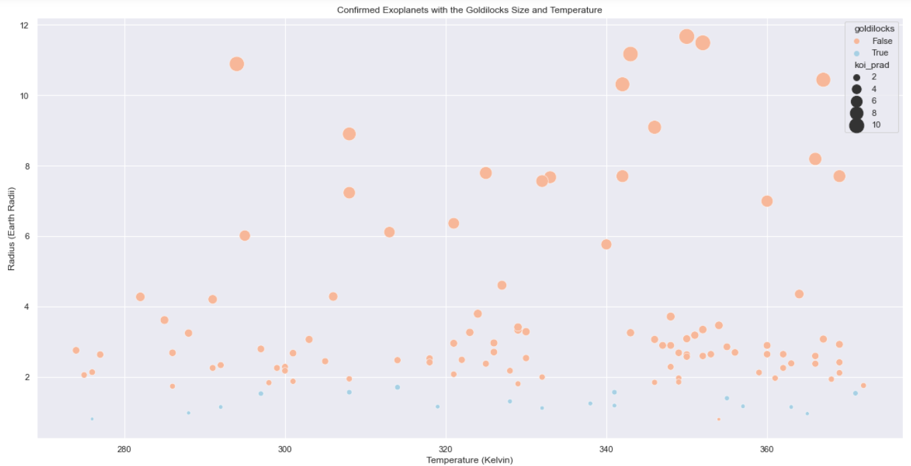

Slide 9
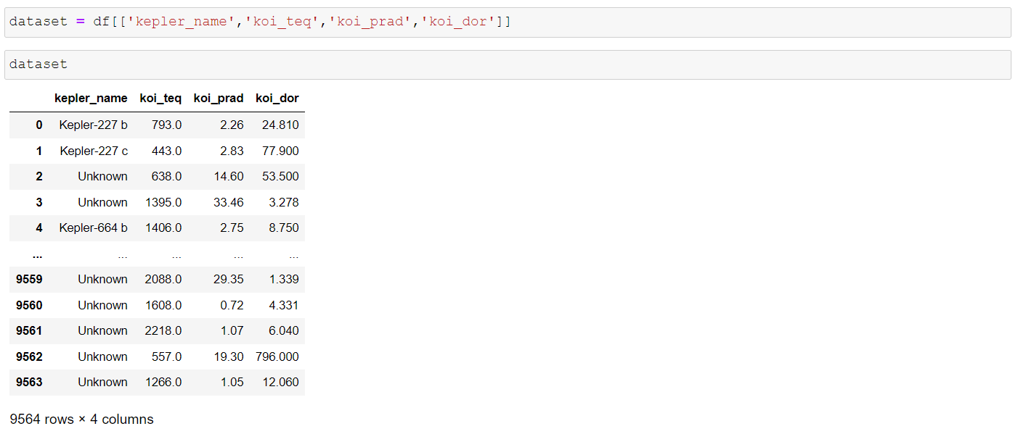
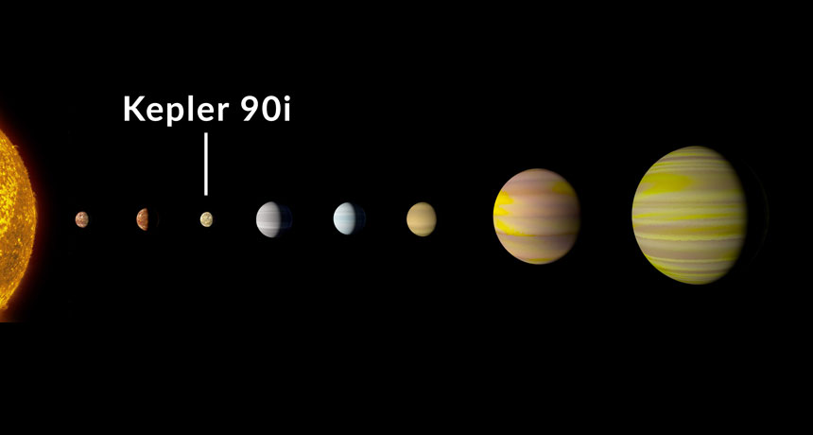

Slide 10
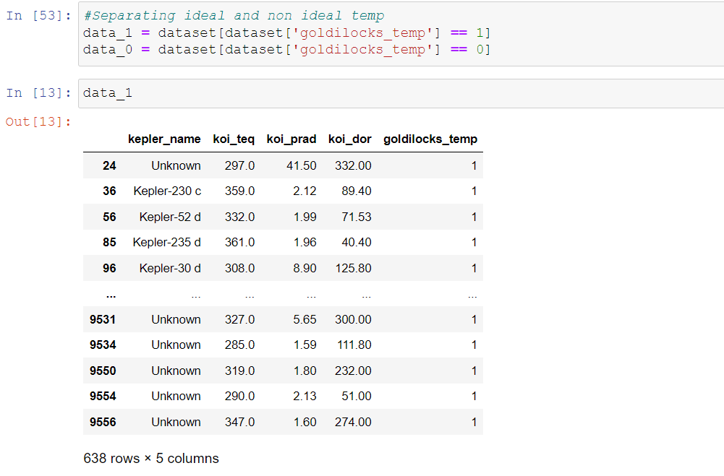

Slide 11
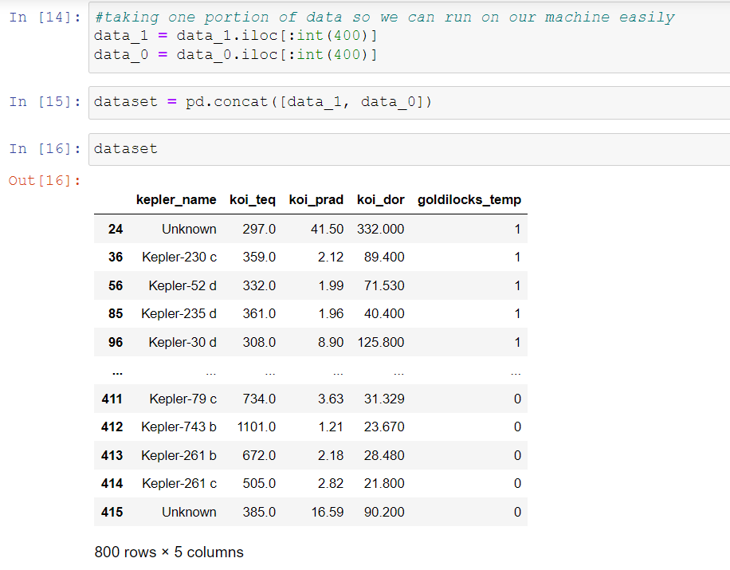

Slide 12
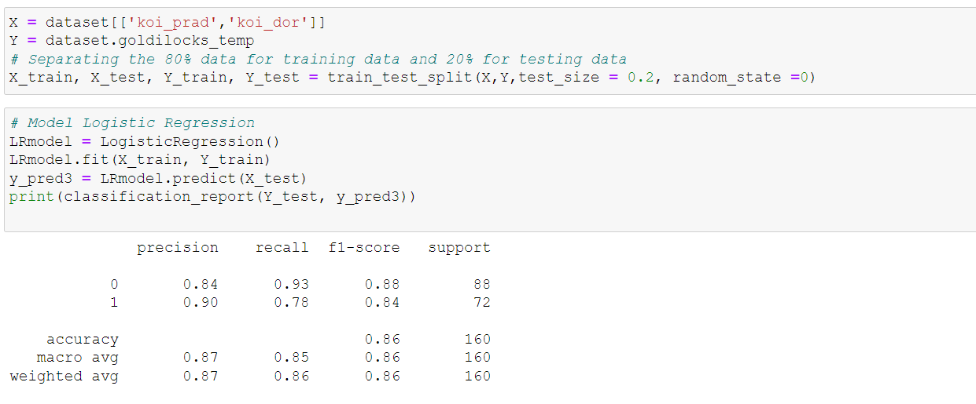
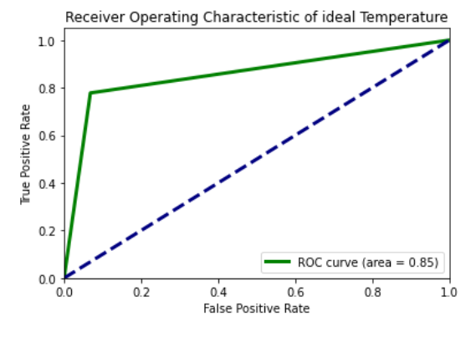

Slide 13
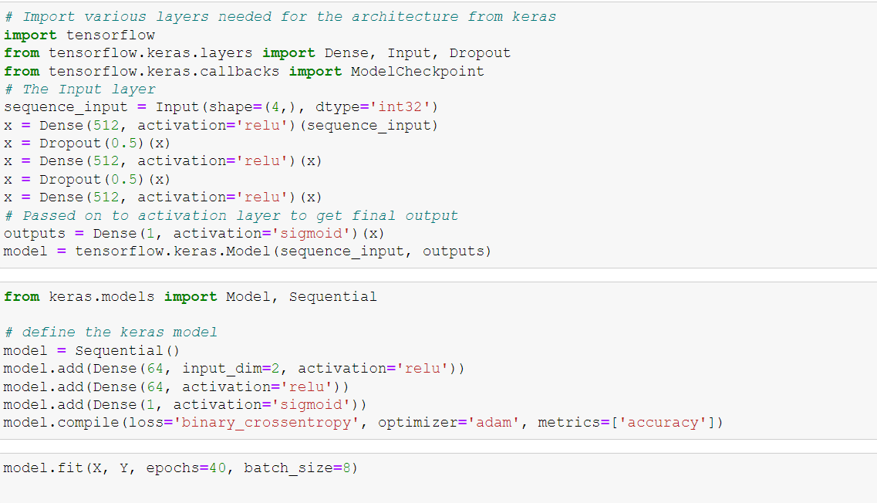

Slide 14
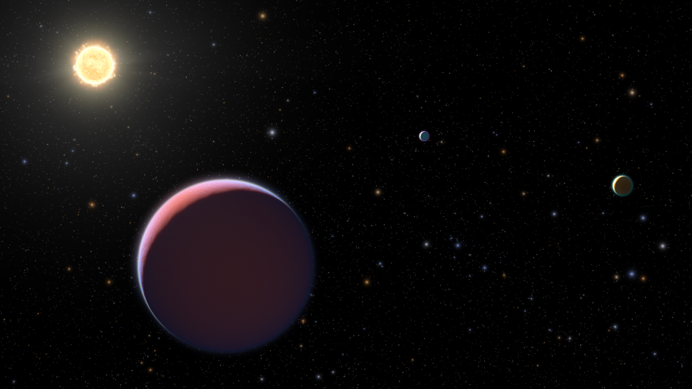
Thank you for your time
Important reference: We haven’t taken into consideration every possible factor that affects one planet’s habitability!

