Slide 1









OpenDRR Platform
RiskProfiler
OQ Canada
Workflow
Provide tools to facilitate decision making prior to and during a crisis
Share
Key Components
OpenQuake Engine
GitHub Data Repository
Stakeholder Portal (OQ Canada)
Public Portal (RiskProfiler.ca)
Publish
GitHub
Peer Review
Generate Scenario Outputs
Risk Analyst
Refine
OpenQuake Engine
Emergency Planner, Risk Manager
Model Scenarios
Public

Slide 2
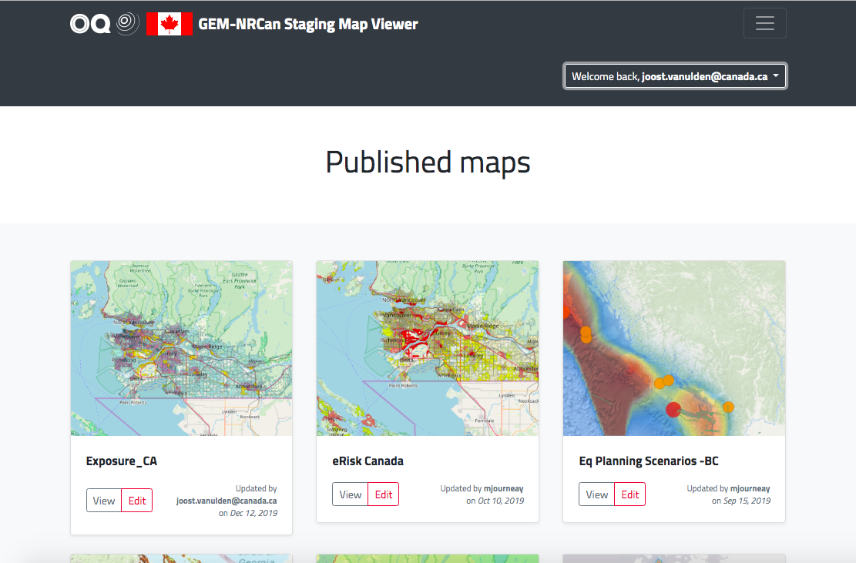
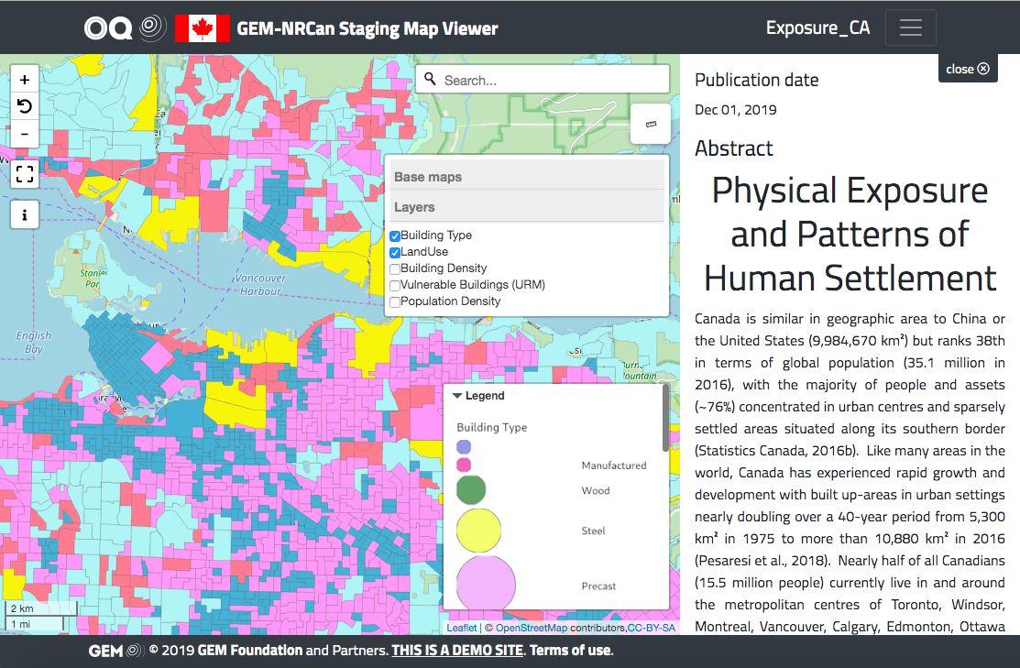
OpenQuake Canada
https://nrcan.openquake.org
Facilitates peer review
Primary interface for Domain Experts
Levels of access:
Private – Data producer only
Shared – Project level access
Public – FGP, Open Canada, P/T SDI’s
Standard API’s (e.g. OGC)

Slide 3
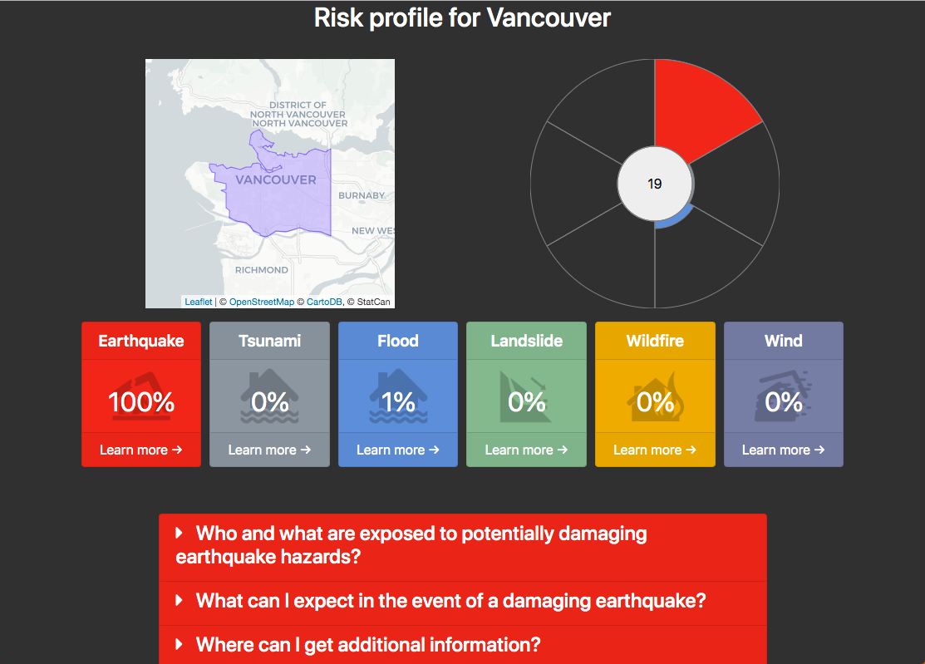
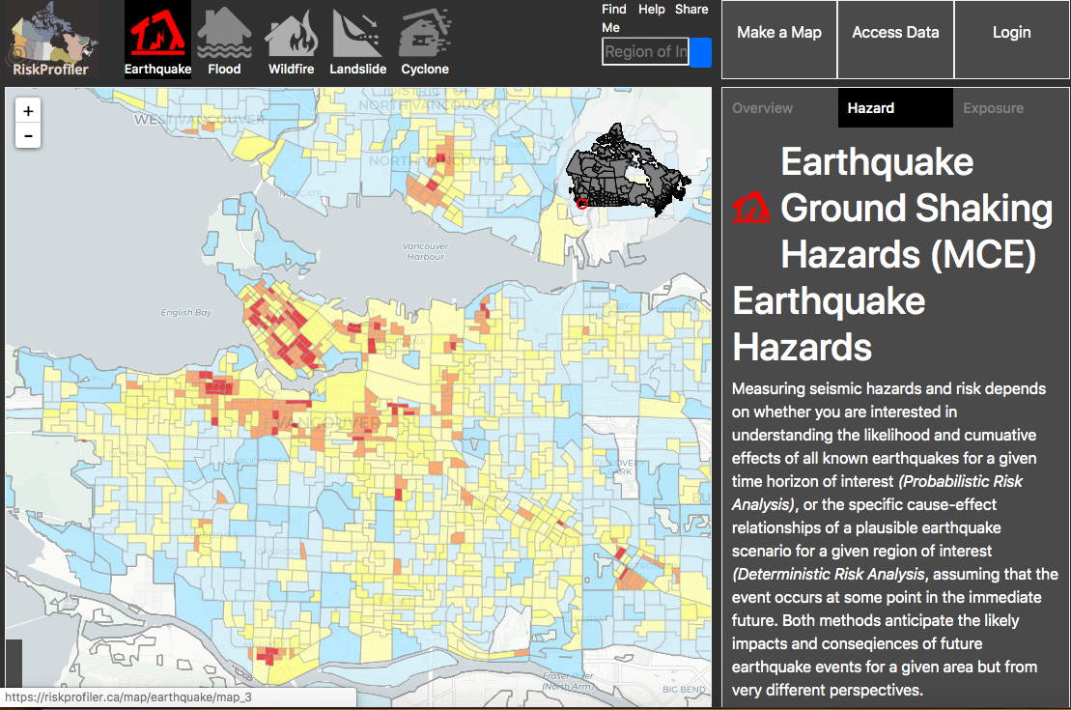
RiskProfiler.ca
Purpose-built web application for non-experts
High-level overview of hazard risk
Interactive maps and graphic visualizations with supporting text
Contact points for more information about hazard risk

