Slide 1
NRCan OpenDRR Platform
Technology Brief

Slide 2
Stated objective
“The OpenDRR platform aims to provide tools to investigate, assess, and mitigate natural disasters for policy makers, risk analysts, private and public institutions, and citizens to facilitate decision-making prior to and during crisis.”

Slide 3



Primary Users & Their Requirements
Risk Analyst
Generate scenario outputs
Allow for peer-review of outputs
Disseminate outputs
Emergency Manager, Land-Use Planner, Risk Manager
Access to up-to-date hazard scenarios
Access to scenario outputs and datasets
Ability to integrate scenario data into a GIS
Public
Intuitive and context aware access to hazard scenarios
High level overview of risk
Natural language descriptions and simple but effective visualizations

Slide 4

Workflow
Refine
Model Scenarios
Generate Scenario Outputs
Peer Review
Publish
Share

Slide 5






Key Components
RiskProfiler
OQ Canada
OpenQuake Engine
GitHub Data Repository
Stakeholder Portal (OQ Canada)
Public Portal (RiskProfiler.ca)
GitHub
OpenQuake Engine

Slide 6

Open Quake Engine
OpenQuake Engine
GEM’s state-of-the-art, open-source software collaboratively developed for earthquake hazard and risk modelling
Generates raw scenario outputs for further processing
Risk Analysts push outputs to the Github data repository
Scenario Outputs
GitHub

Slide 7
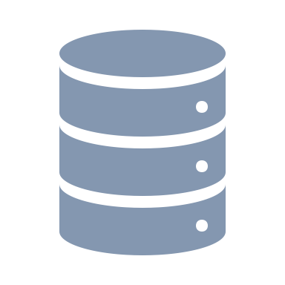

GitHub Data Repository
OpenQuake Engine
Versioned datasets
Pre-release: intended for peer-review and editing
Final release: intended for broader dissemination
Scenario Outputs
Custom ETL Process
Spatial Database
GitHub

Slide 8


Stakeholder Portal
RiskProfiler
OpenQuake Canada
A fork of the GEM OQ GeoViewer
Facilitates peer review
Primary interface for Domain Experts
3 Levels of Publishing
Private – only the data producer can access
Shared – only those with accounts can access (e.g. peer reviewers)
Public - Open to the world through industry standard API’s
Public
3rd Party SDI’s
SENDAI
Spatial Database
GeoPackage

Slide 9
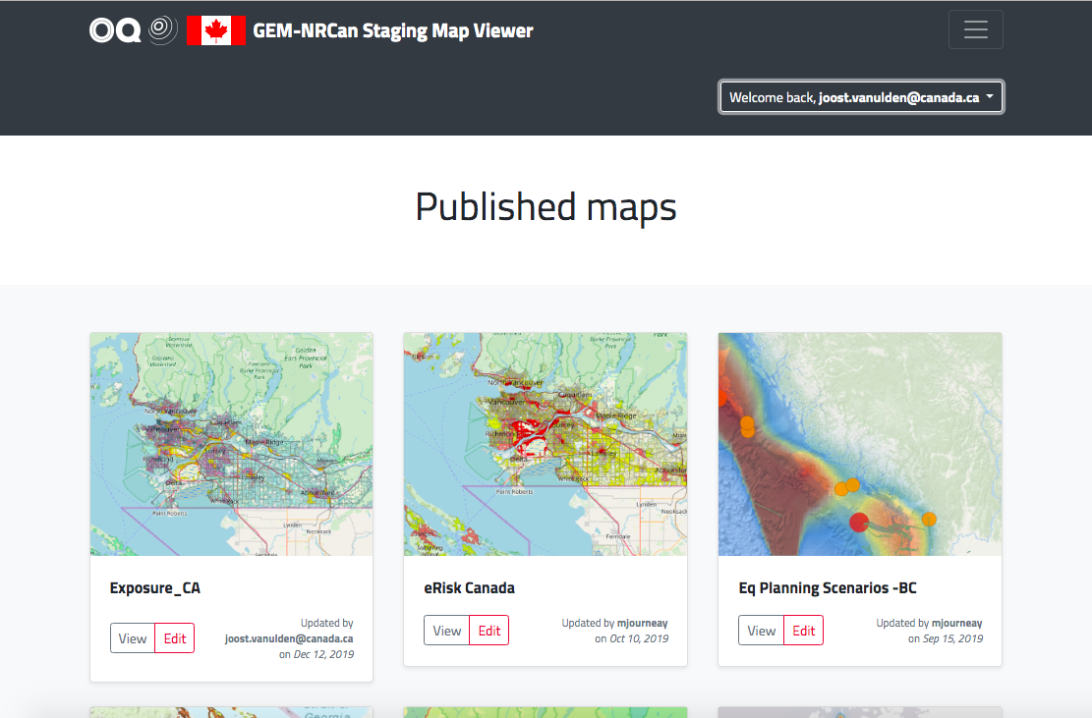
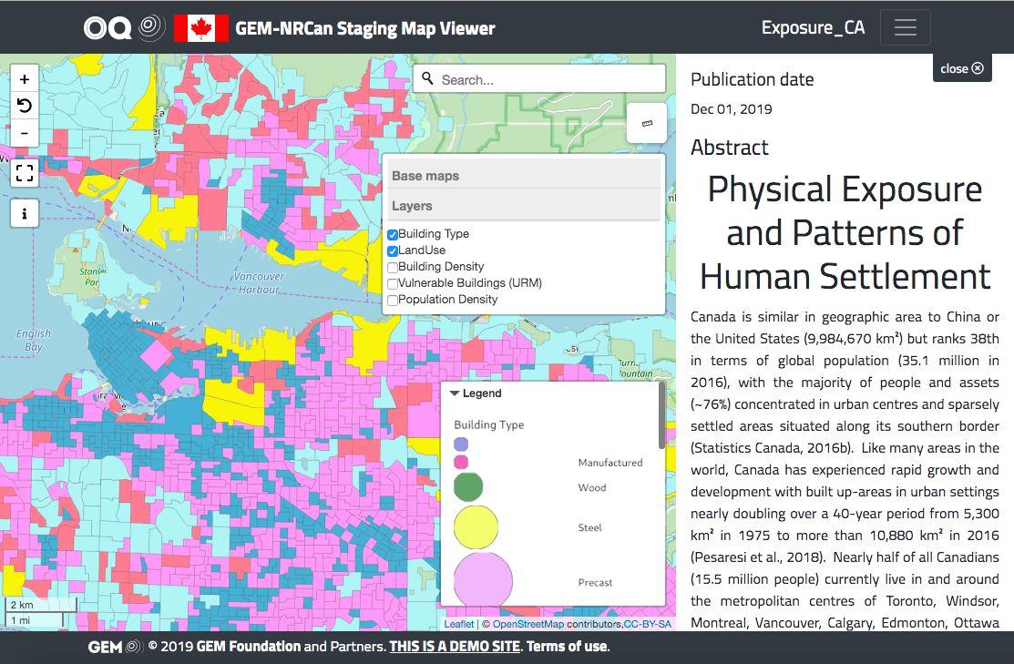
OpenQuake Canada
https://nrcan.openquake.org
Demo site available
Hosted at GEM
Extensible
Standards based

Slide 10
Public Portal
RiskProfiler
https://www.riskprofiler.ca
Purpose-built web application catering to non-experts
Intuitive and context aware
High-level overview of hazard risk
Interactive maps and graphic visualizations with supporting text
Contact points for more information about hazard risk
OpenQuake Canada
Public
3rd Party SDI’s
SENDAI
Spatial Database
GeoPackage

Slide 11
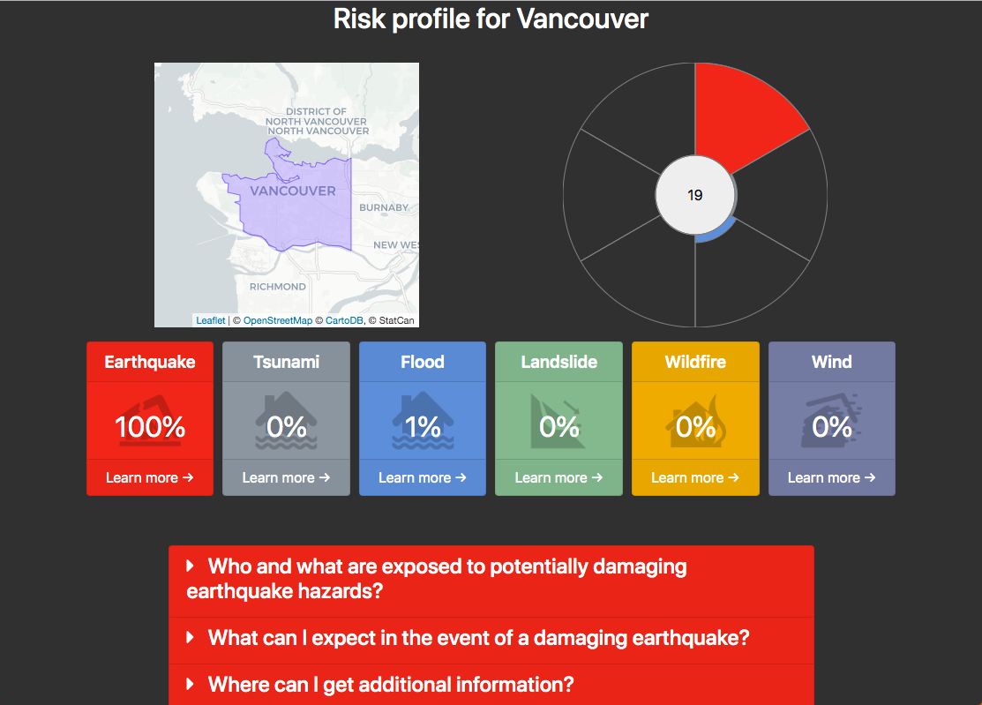
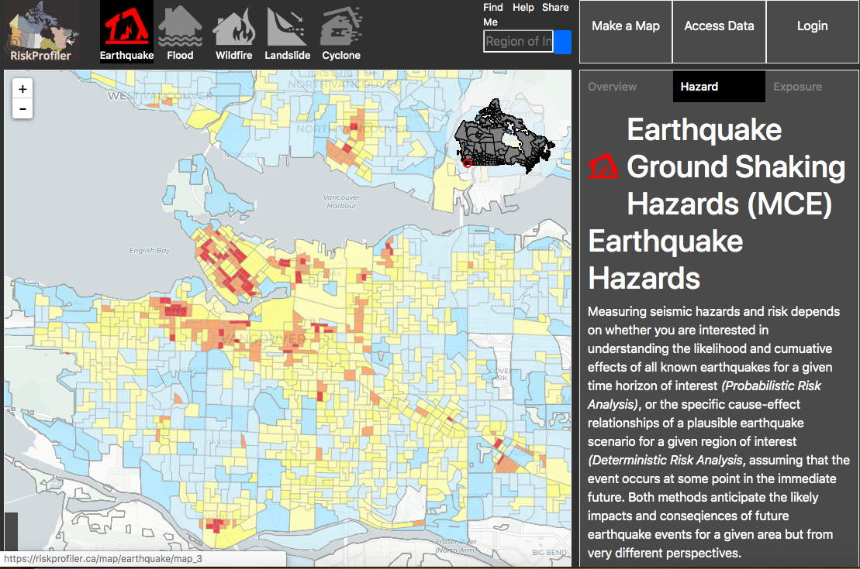
RiskProfiler.ca
Prototype
Open Source
Standards based

Slide 12
Summary
RiskProfiler
OpenQuake Engine
OpenQuake Canada
Public
3rd Party SDI’s
SENDAI
Scenario Outputs
Custom ETL Process
Spatial Database
GeoPackage
GitHub

Slide 13
Things to look out for
April 2020 is the scheduled launch date
GitHub Repository – coming soon
Demo’s of progress every two weeks

Slide 14
Questions?
Reach me at: joost.vanulden@canada.ca

