Slide 1
Case Study: How Does a Bike-Share Navigate Speedy Success?
By Nasra Salim
Case Study for the course 'Google Data
Analyst Professional Certificate'

Slide 2
Business Task: Analysing the customers usage pattern to understand how to convert casual users to annual memebers, using data from the last twelve months.
Tools
Data cleaning through R
Data visualizations through R and Tableau

Slide 3
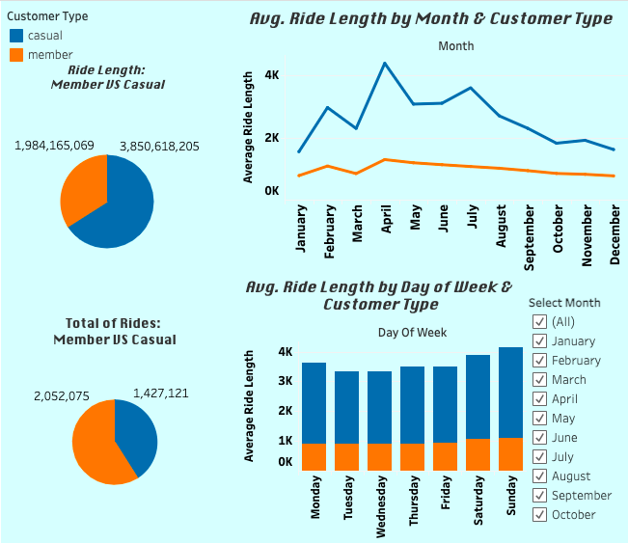
Made with Tableau

Slide 4
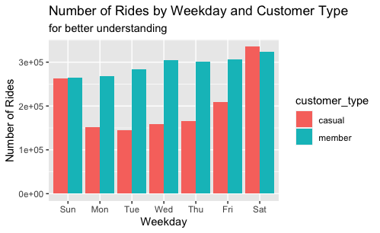
Made with R

Slide 5
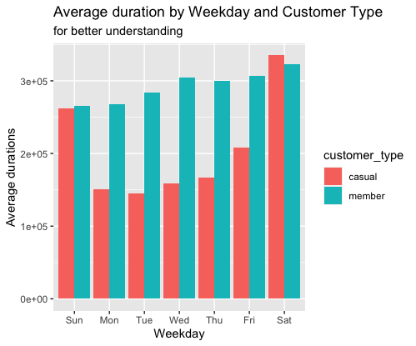
Made with R

Slide 6
Key Findings
Customers use Cyclistic’s services mostly on the summer.
Customers use Cyclistic’s services least on the winter.
Casual users average duration on rides is approximately two (1.9) times higher than annual members, which strengthens the chance to convert them to annual members.
The most popular month of the year is April for the customers.
The least popular month of the year is December for casual users, and January for annual members.

Slide 7
My top 3 recommendations for Cyclistic
The purpose is to target casual users, and convert them to annual members
- Advertisements and marketing campaigns should be carried out in the Summer, because it is the most popular season.
- A new annual membership which has a lower price, a limitation on the ride length from Monday to Friday and free limit on Saturday and Sunday should be introduced. The target is the casual users who use the services much more on the weekend compared to the rest of the week, according to the data.
- Discounts for the casual users who wants to become annual members on the first year should be introduced.

