Slide 1
Case Study: How Does a Bike-Share Navigate Speedy Success?
By Nasra Salim
Case Study for the course 'Google Data
Analyst Professional Certificate'

Slide 2
Business Task: Analysing the customers usage pattern to understand how to convert casual users to annual memebers, using data from the last twelve months.
Tools
Data cleaning through R
Data visualizations through R and Tableau

Slide 3
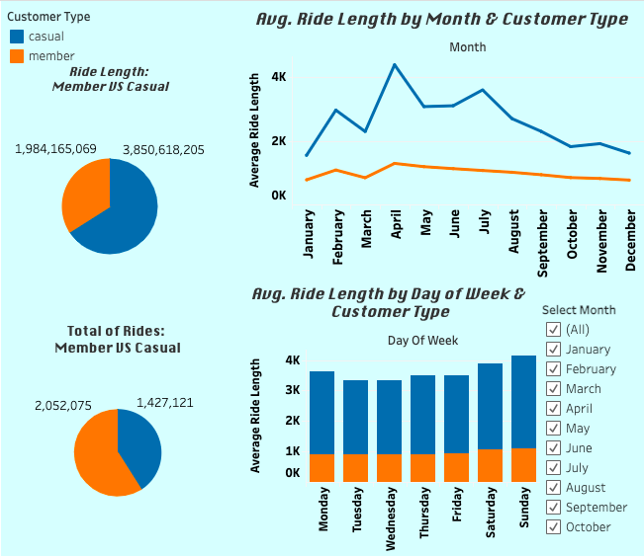
Made with Tableau

Slide 4
Average duration by Weekday and Customer Type
Made with R

Slide 5
Number of Rides by Weekday and Customer Type
Made with R

Slide 6
Key Findings

