Slide 1
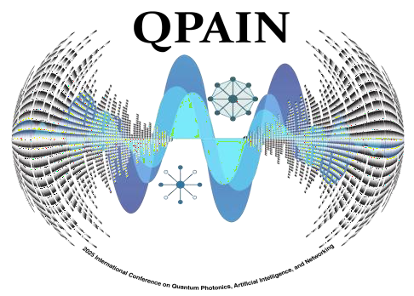

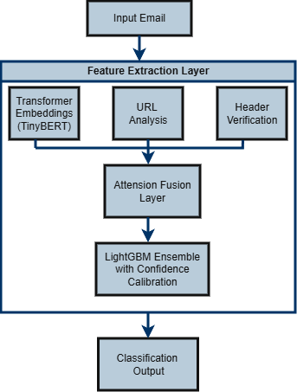
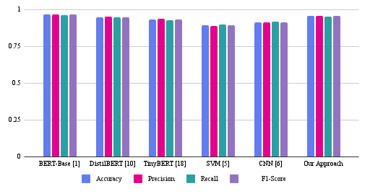
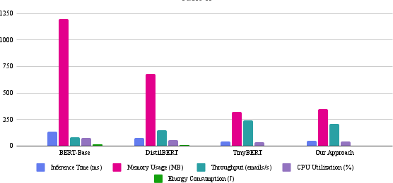
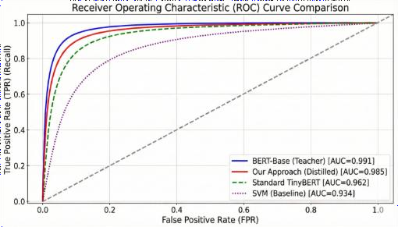
Paper ID:2527
Deploying Distilled AI Models for Email Phishing Detection
Nasrat Jahan, Md. Rasheduzzaman Imran, Md. Murad Jahan, Muntasir Hasan Porag, T. M. Shahriar Sazzad
Abstract & Introduction
Email Phishing remains one of the most significant
cybersecurity threats, costing organizations billions
annually. While large pre-trained language models like BERT demonstrate superior accuracy in detecting sophisticated phishing content, their substantial computational requirements make them impractical for real-time email filtering in production environments.
This paper presents a comprehensive framework for deploying knowledge-distilled AI models in enterprise email phishing detection systems. We propose an optimized knowledge distillation approach that transfers detection capabilities from large BERT models to compact TinyBERT architectures, enabling high-accuracy real-time phishing detection while maintaining computational efficiency.
Methodology
Our system employs a stacked classifier architecture that fuses distilled transformer embeddings with traditional cybersecurity features through attention-based mechanisms. The TinyBERT
Result (If extra space needed)
Our distilled TinyBERT framework achieves enterprise-ready phishing detection with 95.7% accuracy while reducing:
student model (distilled from BERT-base via progressive
Model size by 85% (440MB → 65MB)
Inference latency by 61% (135ms → 52ms)
Energy consumption by 84% (12.5J → 4.8J)
distillation) extracts semantic features, while parallel processing extracts URL, header, and keyword features. These are combined via attention fusion and passed to a LightGBM ensemble with confidence calibration for final classification.
Data Processing: Email parsing, URL analysis (VirusTotal), header verification (SPF/DKIM/DMARC), feature extraction
Knowledge Distillation: Progressive compression BERT-base → TinyBERT with attention transfer (T=2.5)
Hybrid Classification: Attention-based fusion of transformer
outputs + security features
Throughput increases by 147% (85 → 210 emails/sec) with
balanced errors (FPR: 4.1%, FNR: 4.6%).
Conclusion & Future Work
Our approach achieves 95.7% detection accuracy while reducing model size by 85% and inference latency by 61%, establishing a practical benchmark for resource-constrained security applications.
Future Work:
Objectives
To propose a phishing detection–specific knowledge distillation framework that enables lightweight transformer models to achieve accuracy comparable to large-scale BERT architectures while significantly reducing computational overhead
To introduce a hybrid detection paradigm that integrates transformer-based natural language representations with handcrafted cybersecurity features for improved robustness against diverse and evolving phishing attacks.
Longitudinal studies in production environments across multiple organizations
Enhanced detection of adversarial phishing techniques
using generative AI
Integration of user behavior analytics and email interaction patterns.
Result
References
[1] X. Jiao, Y. Yin, L. Shang, X. Jiang, X. Chen, and Q. Liu,
"TinyBERT: Distilling BERT for natural language
Method
Our stacked classifier fuses TinyBERT embeddings with URL, header, and keyword features via attention-based fusion, followed by a LightGBM ensemble with confidence calibration. The distillation process uses attention transfer, response-based distillation (T=2.5), progressive compression through intermediate models, and task-specific adaptation for URL and sender scoring. The framework is deployed as a containerized microservice using FastAPI, Docker, and ONNX Runtime with Kubernetes auto-scaling.
understanding," in Findings of the Association for
Computational Linguistics: EMNLP, 2020, pp. 4163-4174.
J. Gou, B. Yu, S. J. Maybank, and D. Tao, "Knowledge distillation: A survey," International Journal of Computer Vision, vol. 129, pp. 1789-1819, 2021.
Y. Zeng et al., "Phishing URL detection using BERT and adversarial training," IEEE Access, vol. 10, pp. 32145-32156, 2022.
S. I. Mirzadeh, M. Farajtabar, A. Li, and H. Ghasemzadeh, "Improved knowledge distillation via teacher assistant," in Proceedings of the AAAI Conference on Artificial Intelligence, vol. 34, no. 04, pp. 5191-5198, 2020.
2026 IEEE International Conference on Quantum Photonics, Artificial Intelligence, and Networking
RESEARCH POSTER PRESENTATION DESIGN © 2019
www.PosterPresentations.com

