Slide 1

Prediction for Diagnosing Liver Disease in Patients using MACHINE LEARNING MODELS
Project Guide:
Mr. N. V. Naik
Sr. Assistant Professor
Presented By:
D. Nasreen
S. Chowdeswar Reddy
P. Lasya Sri

Slide 2
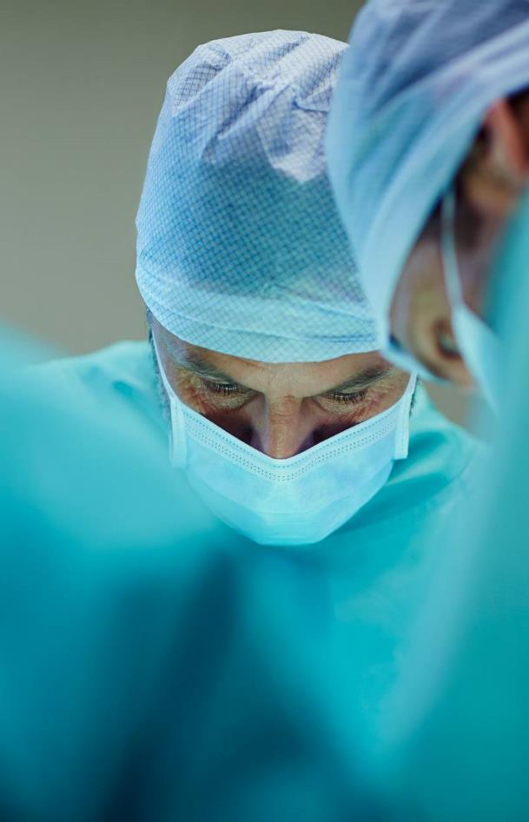
ABSTRACT
In recent years, Liver disorders have increased rapidly and it is considered to be a very fatal disease in many countries like – Egypt, Mongolia, Cambodia etc. There is a lot of data on patients who undergo medication or medical examinations at the hospital and this is information that must be extracted so that it can provide information for future improvement conditions, meaning that past data can be used as a prediction basis for liver disease in patients. This is very beneficial for medical personnel and also for patients if they experience symptoms that match the symptoms felt by a patient. So, for early detection of fatty liver disease, an automated program is needed to build with more accuracy and reliability. Specific machine learning models like Support Vector Machines (SVM), Decision Tree (DT) and Random Forest (RF) are developed for this purpose to predict the disease. In this paper, hybrid of ANN and XGBOOST algorithms is proposed to predict liver disease with better precision, accuracy and reliability.

Slide 3
Introduction
Fatty liver disease (steatosis) is a common condition caused by having too much fat build up in your liver. A healthy liver contains a small amount of fat. It becomes a problem when fat reaches 5% to 10% of your liver’s weight.
It progresses through three stages:
Your liver becomes inflamed (swollen), which damages its tissue. This stage is called steatohepatitis.
Scar tissue forms where your liver is damaged. This process is called fibrosis.
Extensive scar tissue replaces healthy tissue. At this point, you have cirrhosis of the liver.

Slide 4
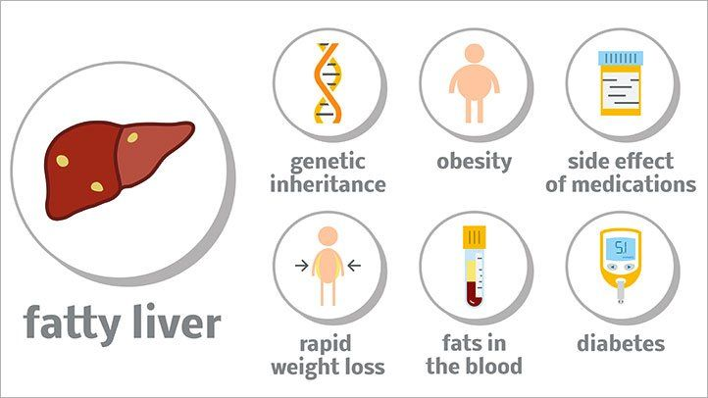
Disease Causes

Slide 5
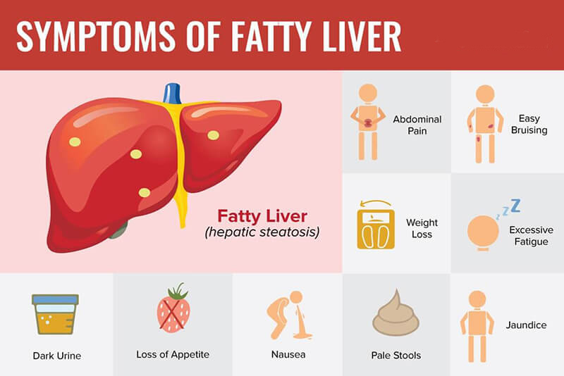

Slide 6
Objective
Fatty liver disease (FLD) is a common clinical complication; it is associated with high morbidity and mortality. However, an early prediction of FLD patients provides an opportunity to make an appropriate strategy for prevention, early diagnosis and treatment. We aimed to develop a machine learning model to predict FLD that could assist physicians in classifying high-risk patients and make a novel diagnosis, prevent and manage FLD. So main objective of this project is to detect the FLD in early stages of disease with low cost.

Slide 7
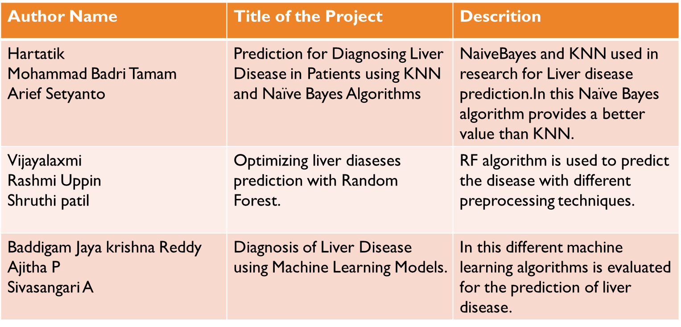
Literature Survey

Slide 8
Existing System
Classification models such as Random Forest (RF), Naïve Bayes (NB), Artificial Neural Networks (ANN), Logistic Regression(LR) were developed to predict FLD. The area under the Receiver Operating Characteristic curve (ROC) was used to evaluate performances among the four models.
Disadvantages:
To detect FLD is difficult task and it’s detecting at last stages.
By using number of filters we are detecting the FLD which increases the cost of the system and also expert person need to be there to detect the FLD

Slide 9
Proposed System
ANN(Artificial Neural Network) and XG-BOOST.
XG-Boost is a decision-tree-based ensemble Machine Learning algorithm that uses a gradient boosting framework. In prediction problems involving unstructured data (images, text, etc.)
XG-Boost is a scalable and accurate implementation of gradient boosting machines and it has proven to push the limits of computing power for boosted trees algorithms as it was built and developed for the sole purpose of model performance and computational speed.
By using the system and software only we can detect the FLD.
No need of expert to declare the result.
There is no use of machines, filters and expert persons this obviously reduce the cost.
Accuracy is also increased
ADVANTAGES:

Slide 10
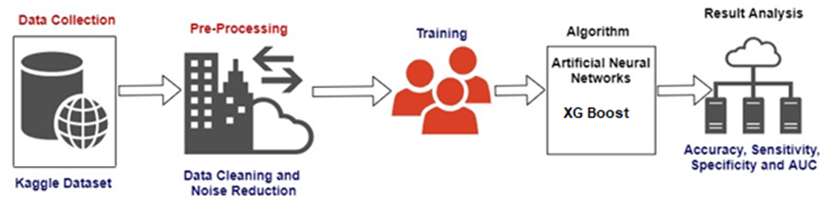
System Architecture

Slide 11

Conclusion:
From the analysis of the result we can conclude that our proposed model by combination of hybrid algorithm we can obtain good model results for detection of fatty liver disease this method will lead effectively in identify of FLD for novel diagnosis.

Slide 12

Thank you

