Slide 1

Prediction for Diagnosing Liver Disease in Patients using MACHINE LEARNING MODELS
Project Guide:
Mr. N. V. Naik
Sr. Assistant Professor
Presented By:
D. Nasreen
S. Chowdeswar Reddy
P. Lasya Sri

Slide 2
Introduction
Nowadays the main leading causes of death are heart disease, respiratory disease, lung disease, etc…Most liver disorders can’t be identified at an early stage. One of them is fatty liver disease which is a common condition caused by having too much fat build up in your liver. It is also known as hepatic steatosis. Heavy drinking obliges more likely to get it. It can get even if they don’t drink a lot of alcohol. A healthy liver contains a small amount of fat. It becomes a problem when fat reaches 5% to 10% of your liver’s weight.
It progresses through three stages:
Your liver becomes inflamed (swollen), which damages its tissue. This stage is called steatohepatitis.
Scar tissue forms where your liver is damaged. This process is called fibrosis.
Extensive scar tissue replaces healthy tissue. At this point, you have cirrhosis of the liver.

Slide 3
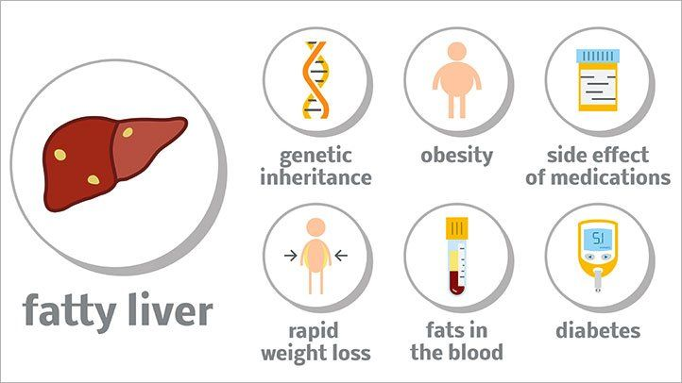
Disease Causes

Slide 4
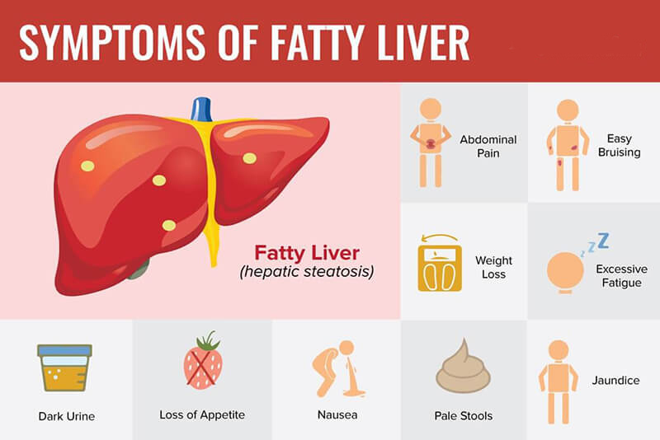

Slide 5
Motivation:
Fatty liver disease can’t be identified at early stage. It can be identified using ultrasound, CT scan and MRI at final stage. In the existing system KNN and Naïve Bayes are used to predict liver disease. Naïve Bayes(72.5 AUC value) given better result then KNN(61.9 AUC value)

Slide 6
Objective
Fatty liver disease (FLD) is a common clinical complication; it is associated with high morbidity and mortality. However, an early prediction of FLD patients provides an opportunity to make an appropriate strategy for prevention, early diagnosis and treatment. We aimed to develop a machine learning model to predict FLD that could assist physicians in classifying high-risk patients and make a novel diagnosis, prevent and manage FLD. So main objective of this project is to detect the FLD in early stages of disease with low cost.

Slide 7
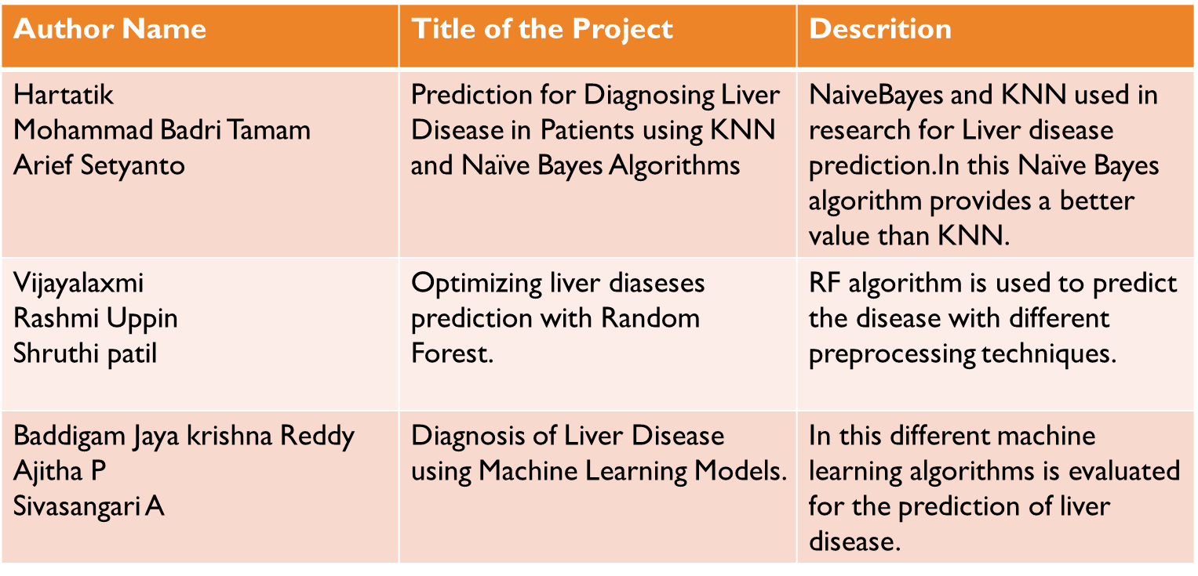
Literature Survey

Slide 8
Existing System
Classification models such as Random Forest (RF), Naïve Bayes (NB), Artificial Neural Networks (ANN), Logistic Regression(LR) were developed to predict FLD. The area under the Receiver Operating Characteristic curve (ROC) was used to evaluate performances among the four models.
Disadvantages:
To detect FLD is difficult task and it’s detecting at last stages.
By using number of filters we are detecting the FLD which increases the cost of the system and also expert person need to be there to detect the FLD

Slide 9
Proposed System
ANN(Artificial Neural Network) and XG-BOOST.
XG-Boost is a decision-tree-based ensemble Machine Learning algorithm that uses a gradient boosting framework. In prediction problems involving unstructured data (images, text, etc.)
XG-Boost is a scalable and accurate implementation of gradient boosting machines and it has proven to push the limits of computing power for boosted trees algorithms as it was built and developed for the sole purpose of model performance and computational speed.
By using the system and software only we can detect the FLD.
No need of expert to declare the result.
There is no use of machines, filters and expert persons this obviously reduce the cost.
Accuracy is also increased
ADVANTAGES:

Slide 10
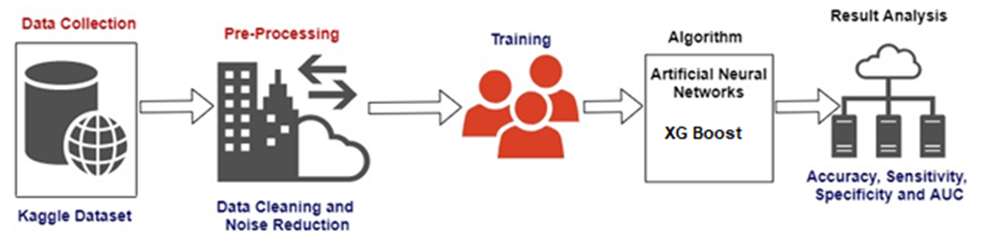
System Architecture

Slide 11
FUTURE WORK:
In this project, we used age, blood test reports, whether the person is alcoholic or not and whether the person smokes or not and we didn’t use any ultrasound images. This project can be extended using ultrasound images which may give better results.

Slide 12

Conclusion:
From the analysis of the result, we can conclude that our proposed model by a combination of hybrid algorithms can obtain good model results for the detection of fatty liver disease. this method will lead effectively in identifying FLD for novel diagnosis.

Slide 13

Thank you

