Slide 1
Paperless Ticketing Using Face Recognition for Metro Rail
Project Guide:
Mr.A.Sree Rama Chandra Murthy
Sr.Assitant Professor
Presented by
D.Nasreen

Slide 2
Contents
Abstract
Introduction
Objective
Face Recognition
System Analysis
System Configuration
System Architecture
Modules
Conclusion

Slide 3
ABSTRACT
Paperless Ticketing Using Face Recognition for Metro Rail is to improve the metro rail ticketing system which is more efficient without paper. Now a days traffic is increasing which leads to increase the fuel cost and pollution. The solution to eradicate this problem is public transport system. This is safe and it can transport many persons at a time. Metro is one of the public transport system which is safe and which runs with high speed. To use the metro trains passengers need some metro cards, paper tickets with barcodes etc. The main aim of this project is to improve the metro rail ticketing system is more efficient without paper. As face is one of the easiest ways to distinguish the individual identity of a person, we are planning to use Face recognition to implement a Paperless ticketing system. So if we use this ticketing method then passengers can easily enter in to the metro, they can overcome problem of forgetting metro cards etc.. which are required to enter into the metro.

Slide 4
Introduction
Time and convenience have great importance in human life. We are trying to make metro rail ticketing system more efficient without paper. As face is one of the easiest ways to distinguish the individual identity of a person, we are planning to use Face recognition to implement a Paperless ticketing system.

Slide 5
Objective
To make Metro rail ticketing system more efficient and convenient without paper.

Slide 6
Face Recognition
A biometric is a biometric software application capable of uniquely identifying or verifying a person by comparing and analyzing pattern based on the persons facial contours.

Slide 7
SYSTEM ANALYSIS

Slide 8
Existing System
Paper tickets with barcodes are used as entry
And exit pass for metro rail transport.
Drawbacks:-
Inconvenience for safe keeping of paper tickets
Wastage of paper
Time consuming

Slide 9
Proposed System
A paperless ticketing system using face recognition by identifying and analyzing the shape of a person’s face. Each face has approximately 80 unique nodal points which distinguishes one from another.
Advantages:-
Convenient
Eco-friendly
Time saving

Slide 10
SYSTEM CONFIGURATION

Slide 11
Software Specification
OS : MS Windows7 or higher versions/ Ubuntu 14.04
Opencv
Python 3.7
Mysql

Slide 12
Hardware Specification
Intel Core 2 Duo/Quad or higher and 64bit processor
Hard Disk capacity of 1- 4TB, 4 GB RAM or more
Input devices: keyboard, digital camera
Output device : computer monitor

Slide 13
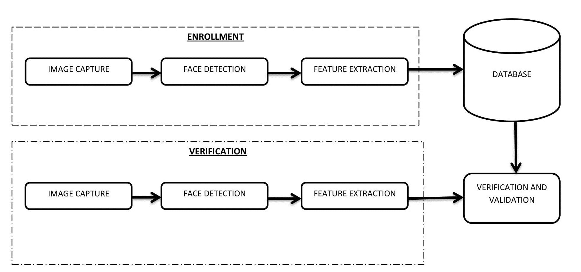
System Architecture

Slide 14
List Of Modules
Administrator
Station master
Entrance verification
Exit validation

Slide 15
Administrator
Station master management
Database management
Rules and regulations
Fare rate calculation

Slide 16
Station master
Ticket reservation
Face capturing
Details collection
Name
Contact details - phone number
From station
Destination
Ticket cancellation
Database update

Slide 17
Entrance Verification
Face recognition
verification
Time stamp allocation
Ticket activation

Slide 18
Exit Validation
Face recognition
Verification
Time stamp checking
Ticket deactivation

Slide 19
STATION MASTER MODULE

Slide 20
Station Master Functions
Station Validation
Station Username
Password
Ticketing
Name
Destination
Fare calculation
Face Detection, Capture & Storing

Slide 21
Station Table
FIELD | TYPE | NULL | KEY | DEFAULT | EXTRA
station_id | Int(5) | No | PRIMARY | None
station_name | varchar(20) | No |  | None
user_name | varchar(20) | No |  | None
password | varchar(20) | No |  | None

Slide 22
Passenger Table
FIELD | TYPE | NULL | KEY | DEFAULT | EXTRA
passenger_id | int(5) | No | PRIMARY | None | AUTO_INCREMENT
name | varchar(20) | No |  | None
Contact_no | Int(10) | No |  | None
from_station | int(5) | No |  | None
to_station | int(5) | No |  | None
date | datetime | No |  | None
status | int(5) | No |  | None

Slide 23
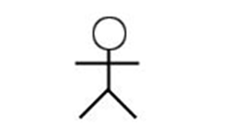

Use-Case Diagram
Face Recognition System
login
Enter details
From station
Face capture
user
Make payment
Face detection
Entry validation
To station
Exit verification

Slide 24
SCREENSHOTS

Slide 25
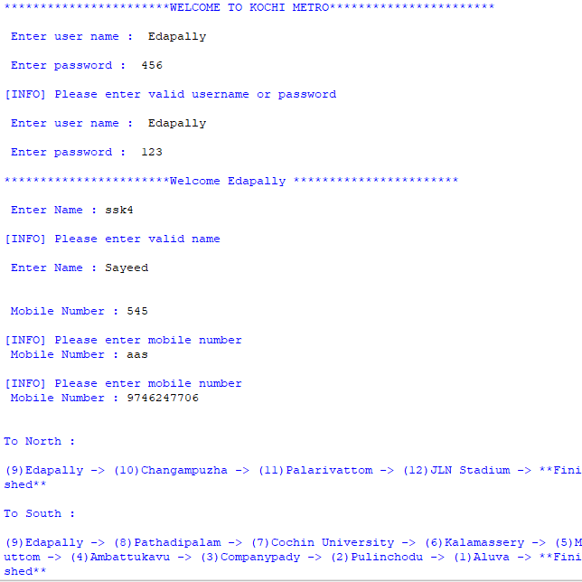

Slide 26
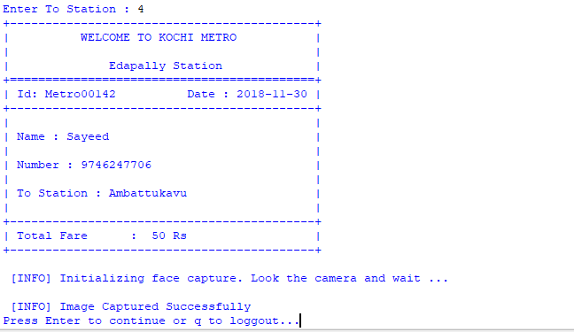

Slide 27
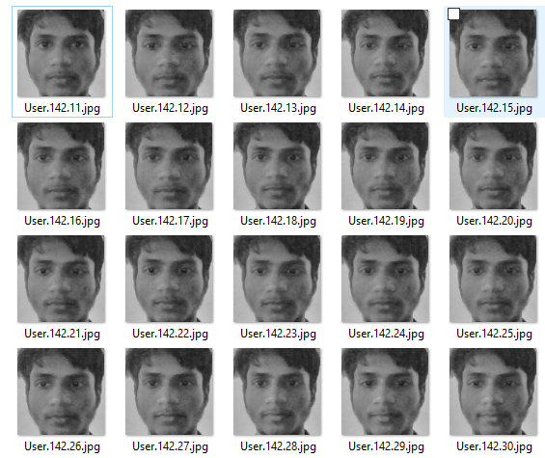

Slide 28
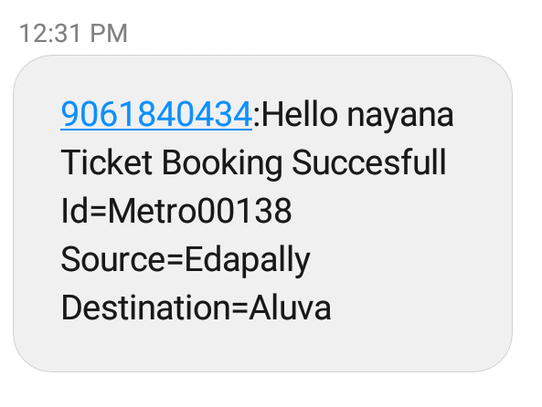

Slide 29
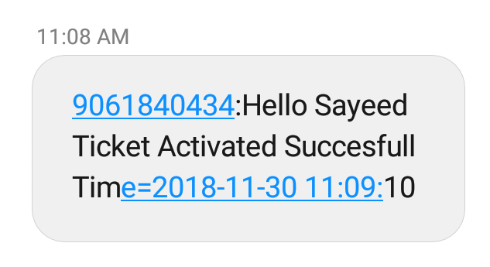

Slide 30
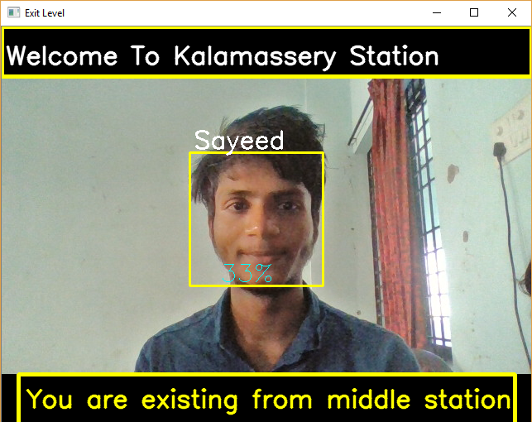

Slide 31
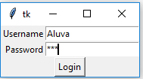


Slide 32
Conclusion
We are trying to create a convenient and time saving ticketing model for metro rail ticketing with the help of face recognition technique.

Slide 33
Reference
https://www.pyimagesearch.com/2018/06/18/face-recognition-with-opencv-python-and-deep-learning/
https://www.youtube.com/watch?v=5yPeKQzCPdI
Facial Recognition Technology A Clear and Concise Reference
https://pypi.org/project/face-recognition/
https://www.youtube.com/watch?v=Ax6P93r32KU
The 2018-2023 World Outlook for Facial Recognition

Slide 34
THANK YOU...!

