Slide 1
COUNSELLOR’S DAIRY

Slide 2
ABSTRACT
In this project, I am developing Android based application which is useful for counsellor’s to keep track for their students details. By using this application counsellors can get information in mobile(small, portable)which is available everytime. Whenever the counsellors need information regarding their students. They can easily get by their mobile. In this app, I am providing information like Name, Roll No., Mobile No., Parent Details, CGPA, Attendance, Backlogs, Category(Management/BC-Scholar),Hostel/Bus, Fees Due. If there is any change in student details, Counsellor can modify this information using edit screen. We are providing one touch call and message options in this application. So, Counsellors can feel comfort and easy to use.

Slide 3
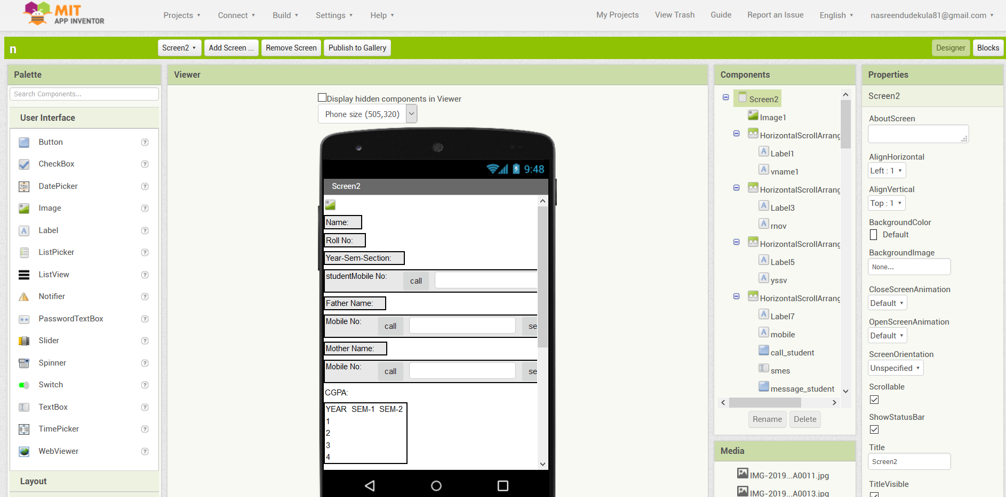
View Screen Designer

Slide 4
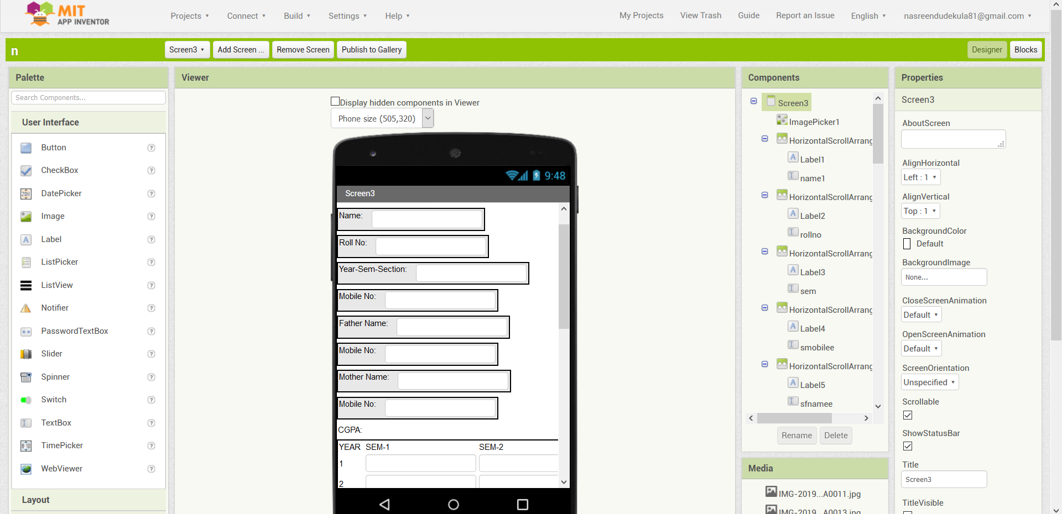
Edit Screen Designer

Slide 5
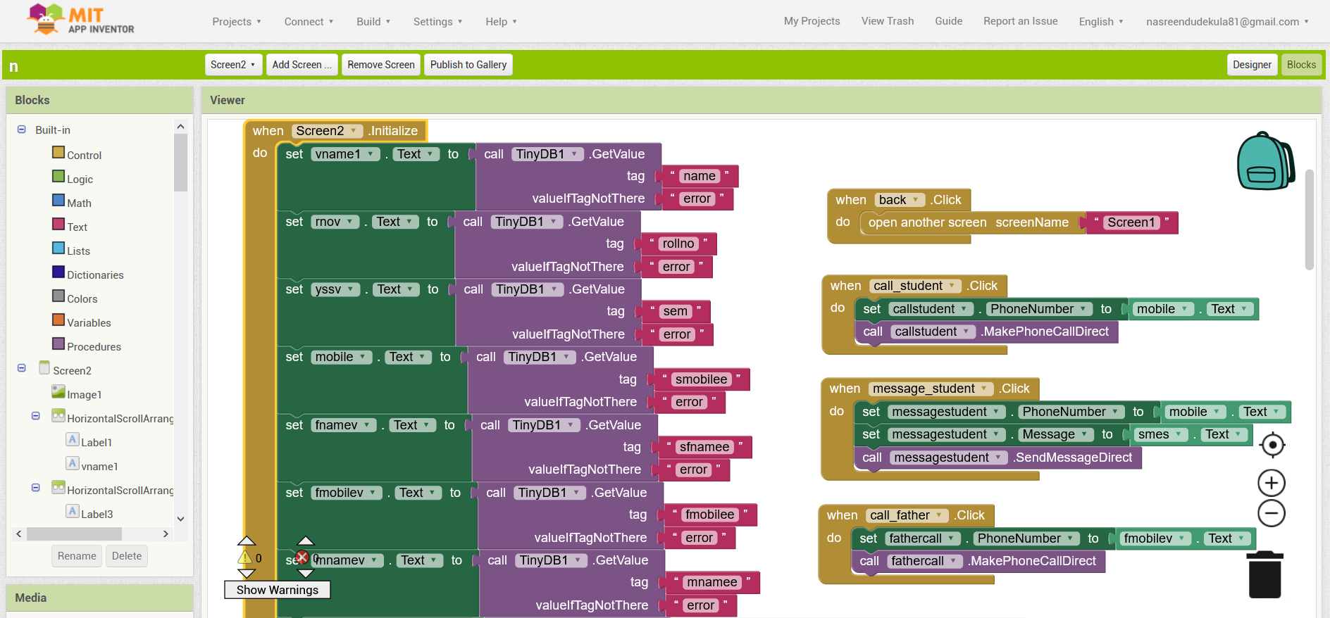
View Screen Block

Slide 6
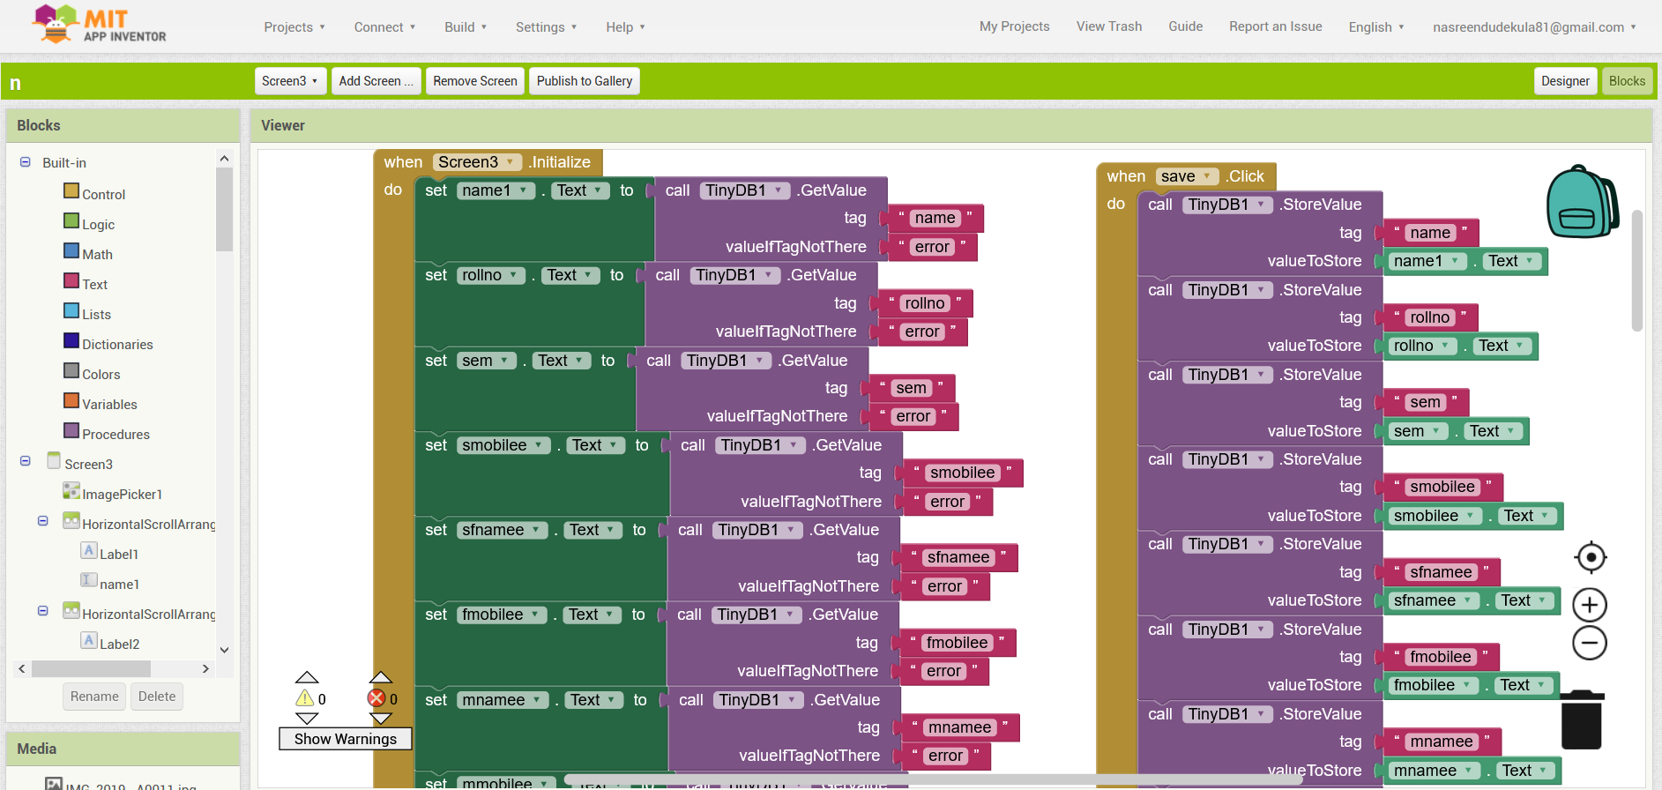
Edit Screen Block

Slide 7
Output in Mobile

Slide 8
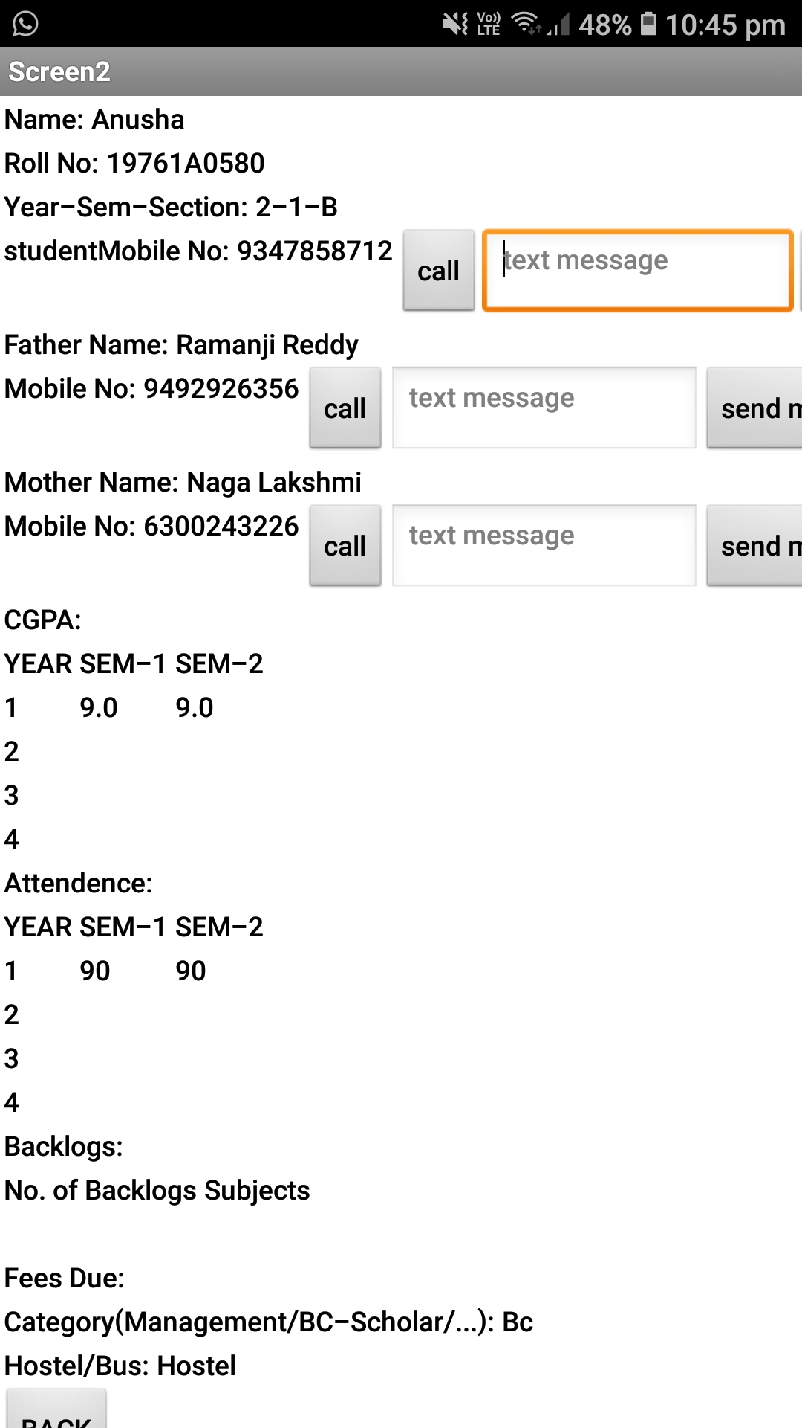
View Screen

Slide 9
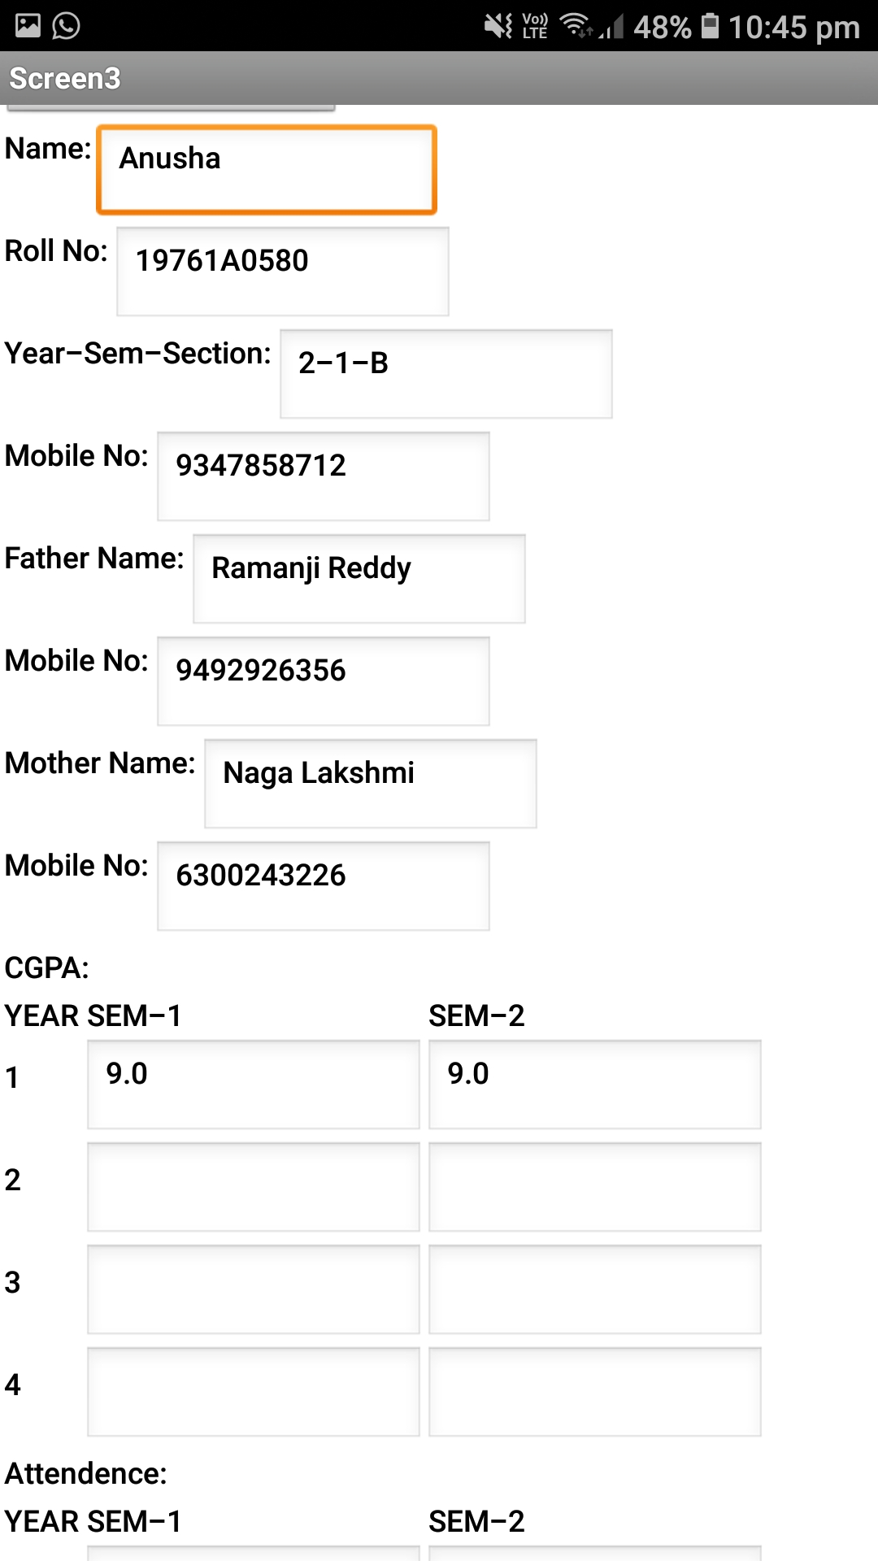
Edit Screen

Slide 10
CONCLUSION: Finally an app is created for counsellor’s to store and get their student information Counsellor’s can easily make calls and messages to students and their parents by using this app

