Slide 1
Chapter 2 Part 4
Singly Linked List Implementation

Slide 2
Key topics
Single Linked List: Implementation
Non-Generic SingleLinkedList
Single linked list of objects of a specific type
Generic SingleLinkedList
Single linked list of objects of any Java class type

Slide 3
Implementing Single Linked List of objects of a Specific Class Type
Do not use generics in implementation
Node storing a reference to an object of a specific class type like Magazine (renamed to MagazineNode)
Package linkedlist_1objtype (FOR SELF-READING)
Magazine.java – Definition of all magazines
MagazineListSingleLinked.java –
Definition of single linked list of Magazine objects
Contains definition of a private MagazineNode class inside
MagazineListSingleLinkedTest.java
A Java application that uses class MagazineListSingleLinked.

Slide 4
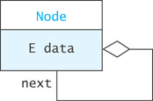
Structure in a MagazineNode object for MagazineSingleLinkedList class
A MagazineNode object in a single linked list of Magazine objects contains:
a data item of Magazine type
one link referencing the MagazineNode immediately after
MagazineNode structure:
MagazineNode
Magazine data

Slide 5
Structure in a MagazineNode object for MagazineSingleLinkedList class
MagazineNode structure:
Sample MagazineNode object
MagazineNode
Node
MagazineNode
Magazine data
data
next
null
Node
Magazine
Node
String
title
editor
value = "Vogue"
vogueNode
Node
String
value =
"Anna Wintour"

Slide 6
MagazineListSingleLinked - Example
myMagList
MagazineNode
MagazineList
SingleLinked
MagazineNode
next =
data =
next =
data =
head =
size = 2
null
Node
Magazine
Node
title
editor
Magazine
title
editor
Node
Node
String
String
Node
Node
value = “Eduard"
value = “Times"
String
String
value = "Anna"
value = “Vogue"

Slide 7
Implementing Generic Single Linked Lists
Use generics in the implementation
Node stores a reference to an object of any Java class type
Use type parameter E,representing Student, String, Magazine, etc
Mark classes as generic: Node<E>, SingleLinkedList<E>
Package linkedlist_generic
SingleLinkedList.java
Definition of single linked list of any Java objects
Contains definition of a private Node<E> class inside
SingleLinkedListTest.java
A Java application that uses class SingleLinkedList<E>

Slide 8
A Generic Single Linked List Node
A node can contain:
a data item
one link
A link is a reference to a list node
In our structure, the node contains
a data field named data of type E
E – generic element type
E can be Integer, String, Student etc
and a reference to the next node, named next

Slide 9
Directly Connecting Nodes: generic Node<E>
Connect nodes DIRECTLY INSIDE class SingleLinkedList<E> because Node<E> class is private.
See main(…) method inside class SingleLinkedList<E>.java
They are similar to the code in file UseNodes.java.
Node<String> tom = new Node<>("Tom");
//Or var tom = new Node<String>("Tom");
Node<String> dick = new Node<>("Dick");
Node<String> harry = new Node<>("Harry");
Node<String> sam = new Node<>("Sam");
//connect the Node<String> objects
tom.next = dick;
dick.next = harry;
harry.next = sam;

Slide 10
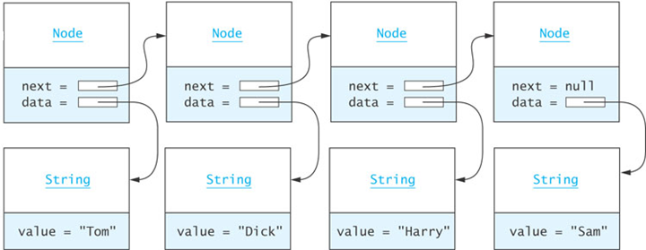
Directly Connecting Nodes: generic Node<E> (cont’d)
tom
dick
harry
sam
Node<String>
Node<String>
Node<String>
Node<String>
The figure shows the resulting list from the previous slide.

Slide 11
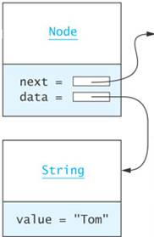
Add First: generic Node<E>
bill
tom
dick
harry
sam
Node<String>
Node<String>
Node<String>
Node<String>
Node<String>
Bill"
Node<String> bill = new Node<>("Bill");
bill.next = tom;
OR
Node<String> bill = new Node<>("Bill", tom);

Slide 12
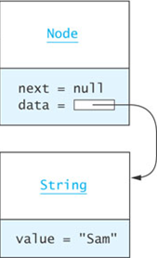
Add in-between: generic Node<E>
bill
tom
dick
harry
Sue
sam
Node<String>
Node<String>
Node<String>
Node<String>
Node<String>
Node<String>
Node<String>
Bill"
Sue"
Node<String> sue = new Node<>("Sue", sam);
harry.next = sue;

Slide 13
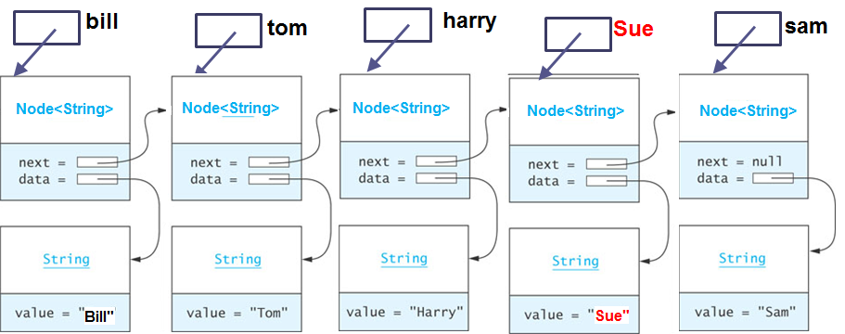
Remove Dick: generic Node<E>
sue
Sue"
tom.next = dick.next;
Or
tom.next = tom.next.next;

Slide 14
Indirectly Connecting Nodes: generic Node<E>
Connect nodes INDIRECTLY OUTSIDE class SingleLinkedList<E>
Program: ConnectNodesGenericIndirect.java
SingleLinkedList<String> names
= new SingleLinkedList<>();
//connect nodes indirectly
names.add("Tom");
names.add("Dick");
names.add("Harry");
names.add("Sam");

Slide 15
A Generic Single-Linked List Class
Generally, we do not have individual references to each node.
A SingleLinkedList object has a data field head, the list head reference, which references the first list node
public class SingleLinkedList<E> {
private Node<E> head = null;
private int size = 0;
...
}

Slide 16
Example of SingleLinkedList <E>: SingleLinkedList<String> names
SingleLinkedLList
<String>
Node<String>
Node<String>
names
head =
size = 2
next =
data =
next =
data =
null
Node
Node
String
String
value = "Tom"
value = “Dick"
names is a reference variable of type SingleLinkedList<String>. Its declaration:
SingleLinkedList<String> names;
The figure above is the result of the following operations:
names.add("Tom");
names.add("Dick");

Slide 17
Implementing public void addFirst(E item)
names
Details of action: names.addFirst("Ann");
starting from list content in previous slide.
SingleLinkedList
<String>
Node<String>
Node<String>
head =
size = 2
next =
data = "Tom"
next =
data = "Dick"
null
size = 3
Node
Node
String
String
Node<String>
value = "Tom"
value = “Dick"
next =
data = "Ann"
The element to be added to the list
Node
String
value = "Ann"

Slide 18
Implementing public void addFirst(E item) (cont.)
public void addFirst (E item) {
Node<E> temp = new Node<E>(item, head);
head = temp;
size++;
}
or, more simply ...
public void addFirst (E item) {
head = new Node<E>(item, head);
size++;
}
This works even if head is null

Slide 19
Implementing helper method private void addAfter(Node<E> node,E item)
Details of action: this.addAfter(node,"Ann");
starting from list content in Slide 16.
this means: calling from INSIDE class SingleLinkedList
names
node
SingleLinkedList
<String>
Node<String>
Node<String>
head =
size = 2
next =
data = "Tom"
next =
data = "Dick"
null
size = 3
Node<String>
next =
data = "Ann"
The element to be added to the list
Note: the data field data is a reference variable.
It references a String object.
The references are not shown here.

Slide 20
Implementing helper method (cont.) private void addAfter(Node<E> node, E item)
private void addAfter (Node<E> node, E item) {
Node<E> temp = new Node<E>(item, node.next);
node.next = temp;
size++;
}
or, more simply ...
private void addAfter (Node<E> node, E item) {
node.next = new Node<E>(item, node.next);
size++;
}
We declare this method private since it should not be called from outside the class. Later we will see how this method is used to implement the public add methods.

Slide 21
Implementing helper method private E removeFirst()
Details of action: this.removeFirst();
starting from list content in Slide 16.
this means: calling from INSIDE class SingleLinkedList
names
SingleLinkedList
<String>
Node<String>
head =
size = 2
next =
data = "Dick"
null
size = 1
Node<String>
temp
next =
data = "Tom"
Note: the data field data is a reference variable.
It references a String object.
The references are not shown here.

Slide 22
Implementing helper method private E removeFirst() (cont.)
private E removeFirst () {
Node<E> temp = head;
if (head != null) {
head = head.next;
}
if (temp != null) {
size--;
return temp.data;
} else {
return null;
}
}

Slide 23
Implementing helper method private E removeAfter(Node<E> node)
names
temp
node
SingleLinkedList
<String>
Node<String>
Node<String>
head =
size = 3
next =
data = "Tom"
next =
data = "Dick"
size = 2
Node<String>
Details of action: this.removeAfter(node);
starting from list content in this slide.
this means: calling from INSIDE class SingleLinkedList
next =
data = "Ann"
Note: the data field data is a reference variable.
It references a String object.
The references are not shown here.

Slide 24
Implementing helper method (cont.) private E removeAfter(Node<E> node)
private E removeAfter (Node<E> node) {
Node<E> temp = node.next;
if (temp != null) {
node.next = temp.next;
size--;
return temp.data;
} else {
return null;
}
}

Slide 25
Implementing helper method private Node<E> getNode(int index)
private Node<E> getNode(int index) {
Node<E> node = head;
for (int i=0; i<index && node != null; i++) {
node = node.next;
}
return node;
}

Slide 26
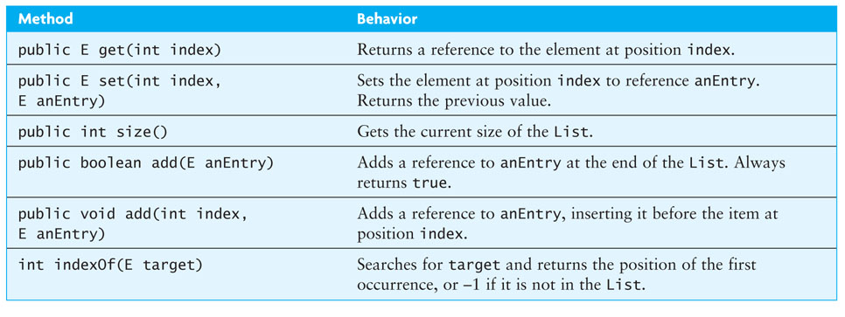
Completing the SingleLinkedList<E> Class
public

Slide 27
Implementing public E get(int index)
public E get (int index) {
if (index < 0 || index >= size) {
throw
new IndexOutOfBoundsException(Integer.toString(index));
}
Node<E> node = getNode(index);
return node.data;
}

Slide 28
Implementing public E set(int index, E newValue)
public E set (int index, E newValue) {
if (index < 0 || index >= size) {
throw new IndexOutOfBoundsException(Integer.toString(index));
}
Node<E> node = getNode(index);
E result = node.data;
node.data = newValue;
return result;
}

Slide 29
Implementing public void add(int index, E item)
public void add (int index, E item) {
if (index < 0 || index > size) { //not index >= size
throw new
IndexOutOfBoundsException(Integer.toString(index));
}
if (index == 0) {
addFirst(item);
} else {
Node<E> node = getNode(index-1);
addAfter(node, item);
}
}

Slide 30
Implementing public boolean add(E item)
To add an item to the end of the list
public boolean add (E item) {
add(size, item);
return true;
}
Note:
The add calls the public method: add(int index, E item), which allows index to be size, meaning appending to the end of the list.

Slide 31
Traversing a Generic Single-Linked List
names
SLList<String>
Node<String>
Node<String>
head =
size = 3
next =
data = "Tom"
next =
data = "Dick"
Do something with nodeRef
Do something with nodeRef
Do something with current node
current
Node<String>
null
next =
data = "Ann"
null
Note: the data field data is a reference variable.
It references a String object.
The references are not shown here.

Slide 32
Traversing a generic Single-Linked List (cont.)
toString()can be implemented with a traversal:
Use StringBuilder to hold intermediate resulting strings.
public String toString() {
StringBuilder listInfo = new StringBuilder("[");
Node<E> current = head;
while (current != null) {
listInfo.append(current.data.toString());
listInfo.append(", ");
current = current.next;
}
listInfo.append("]");
return listInfo.toString();
}

Slide 33
Use class SingleLinkedList<E>
Programs (Not in book)
SingleLinkedListTestString.java
Use SingleLinkedList<E> for creating and processing a single linked list of String objects (used for movie titles)
SingleLinkedListTestMagazine.java
Use SingleLinkedList<E> for creating and processing a single linked list of Magazine objects

