Slide 1
Docker 12 AUG-2021 Nasruddin khan

Slide 2

AGENDA
What is Docker ? What is Docker Image? What is Docker Containerization? What is Docker Engine? What is Docker file ? How to container intercommunication ? What is Docker compose ? How to define container in docker compose ?

Slide 3
Docker Workflow
Central Repository :
This repository like as GitHub where all Docker image are stored. Docker Host:
This is the system or machine where we install the docker engine when we install the Docker desktop then
Docker Engine, Docker CLI client, Docker Compose, Docker Content Trust, Kubernetes are present. Docker Client:
We simply just run command.

Slide 4
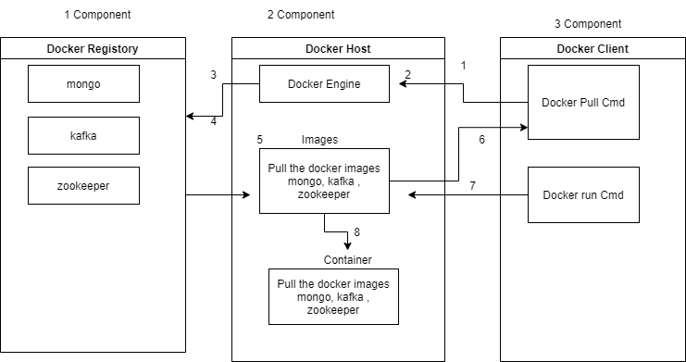
Docker Workflow Image

Slide 5
Docker Cmd.
docker help : Get all option which we run on commands.
docker images: show the all images.
docker container ls: showing the all running container.
docker container ls –a: showing the all running container and also showing which container are alredy running previous.
docker container stop 100229ba687e: stop the container
docker container rm 100229ba687e: remove the container
docker pull mongo[image name]: pull the image from hub.
docker search mongo [image name]: given the image in details.
docker image remove mongo: removing the image
docker container prune: remove unused container which is showing in “docker container ls –a” cmd.
docker network: given docker network details all above ls prune also present there.

Slide 6
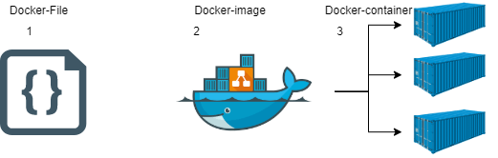
Docker File
Docker file is simple text file where we mention all commands, based on command it's assemble the Docker image
Simple Docker File e.g: FROM openjdk:8-jdk-alpine
VOLUME /tmp
EXPOSE 8088
COPY target/*.jar content-submit-api.jar
CMD ["java", "-jar", "content-submit-api.jar"]

Slide 7
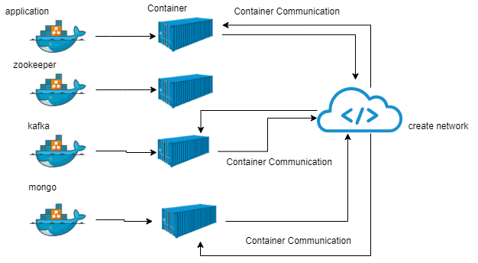
Container
Container is a tool to deploy java application or any other application.
Containers are isolated from one another and bundle their own software, libraries and configuration files and container is also bring together all the components that are required. Application also itself as container & easy to move any environment.

Slide 8
Network / command to create network / create image for my use case
Docker network is used to attached the container, there are 3 type network are there Bridge , Host and none.
docker network create my-app-network launch container
1. docker run -d -p 27017:27017 --network=my-app-network --name mymongodb mongo:latest 2. docker run -d --name zookeeper-server --network my-app-network -e ALLOW_ANONYMOUS_LOGIN=yes zookeeper:latest 3. docker run -d --name kafka-server --network my-app-network -e ALLOW_PLAINTEXT_LISTENER=yes -e KAFKA_CFG_AUTO_CREATE_TOPICS_ENABLE=true -e KAFKA_CFG_ZOOKEEPER_CONNECT=zookeeper-server:2181 bitnami/kafka:latest
4. docker run -d -p 8087:8088 --name content-api --network=my-app-network nasruddinkhan/content-submit-api:0.0.1-SNAPSHOT
docker info

Slide 9
Docker Compose
Docker compose is a Docker tools where we define multiple containers. Which we have done via cmd line, we will do all those thing via docker-compose-yml file.
Docker Compose Commands
docker-compose up : It is search file and launch the containers. docker-compose down : It is search file and down the containers.
docker-compose config: It validates Docker-compose file is correct or not. Docker compose yml file for my use case:

