Slide 1

College of Computing and Informatics
Department of Computer Science
Mobile Application Development
HUEventScheduler_App
Prepared by:
Nasru Jemal | 1334/14
Abdulmalik Battery | 1960/14
Amanuel Behailu | 2128/14
Alemu Ayelu | 2109/14
Submitted to: Mr. Keno

Slide 2
Outline
Introduction
Problem Statement
Objectives
User interface
Functionality
Limitations
Future improvements
Conclusion
Screenchots

Slide 3
Introduction
- Project Overview: HUEventApp is a mobile application designed for university students to discover, track, and engage with campus events.
- Target Audience: Students, faculty, and staff at the university.
- Technology Stack: Android native application with Material Design components and custom UI elements.

Slide 4
Problem Statement
- Students often miss important campus events due to lack of centralized information.
- Traditional event promotion methods (posters, emails) have limited reach and engagement.
- Difficulty in filtering events based on personal interests and availability.
- No streamlined way to register for events or receive updates about changes.

Slide 5
Objectives
General Objectives
- Create a user-friendly mobile platform for event discovery and management.
Specific Objectives
- Implement a modern, visually appealing UI with glassmorphism design elements.
- Provide robust search and filtering capabilities for events by category (Academic, Cultural, Sports, Entertainment).
- Enable user authentication for personalized experiences.
- Incorporate university branding elements (colors, logos) for consistent identity.

Slide 6
User interface
Key Features
- Glassmorphism Design: Translucent UI elements with blur effects for a modern look.
- University Branding: Consistent use of university colors (blue #2196F3 and yellow #FFC107).
- Responsive Layouts: Adaptive designs for various screen sizes.
- Material Components: Leveraging Google's Material Design library for consistent UI elements.
- Custom Animations: Implemented fade, slide, and scale animations for smooth transitions.
- Responsive Layouts: Using ConstraintLayout and CoordinatorLayout for adaptive UI.

Slide 7
Functionality
- Event Browsing: Card-based event listings with essential information.
- Search & Filtering: Advanced search capabilities with category filtering.
- Event Details: Comprehensive view of event information including location, time, and description.
Events have status (Active & Expired) it will become expired after it took place losing its active status and users cannot set reminder notification on an expired events.

Slide 8
cont...
- User Authentication: Secure login and registration system and both users can login and logout.
- Modules: There are two modules. 1. Admin Module (Haramaya University) 2. Users Module (Students, faculty, and staff at the university.).
- Admin module: Only admin can create, update and delete events. admin can update their profile (username, password)
* current credintials: username: admin password:admin123 email:admin@hu.edu Fullname: System Administrater. #you can use it for test
- Users module: users can browse through the available events and they can put a reminder notification on for the events they're interested in when those events will take place.
* Users should be registered to use the app and once users are registered they can update their profiles (username, password)

Slide 9
limitations
- Currently available only on Android platform.
- Requires internet connection for real-time updates.
- Limited offline functionality.
- Manual event creation process (no integration with university calendar systems yet).
- No vast database system is implemented in the current version.

Slide 10
Future Improvements
- iOS version development.
- Integration with university calendar and scheduling systems.
- Social sharing capabilities.
- Event registration and attendance tracking.
- Analytics dashboard for event organizers.
- A website application development version.

Slide 11
Conclusion
- HUEventApp successfully addresses the need for a centralized, user-friendly platform for university event management.
- The application's modern design and intuitive interface enhance the student experience.
- The implementation of university branding creates a sense of familiarity and trust.
- Future enhancements will further improve functionality and user engagement.

Slide 12
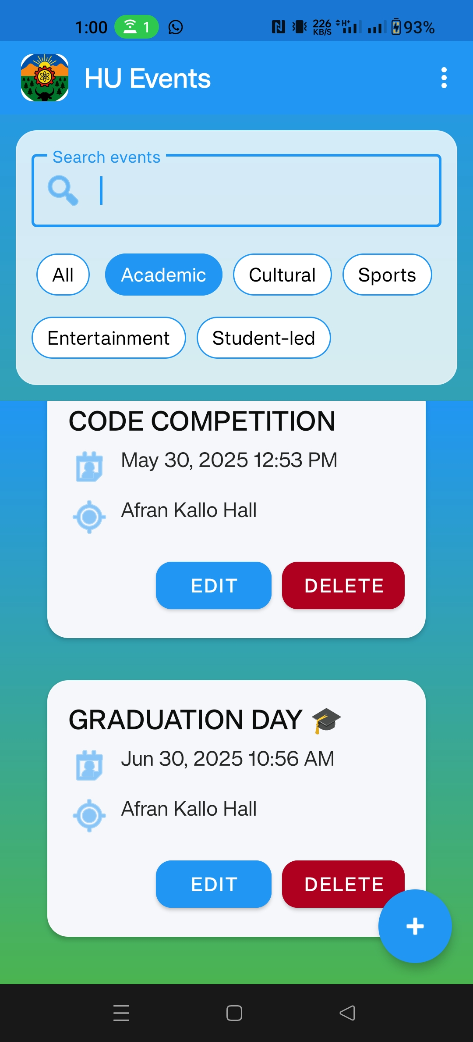
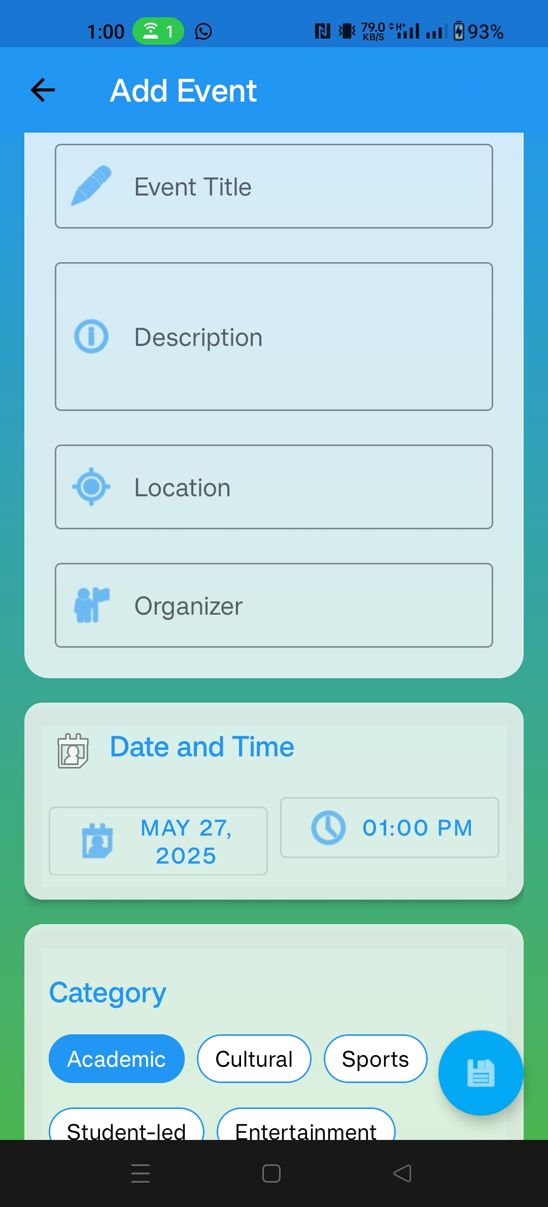
Screenshots
Admin module
-Delete/edit event
-Add event

Slide 13
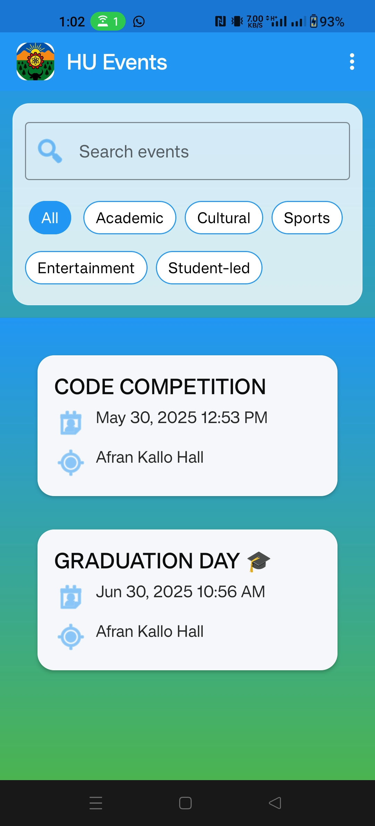
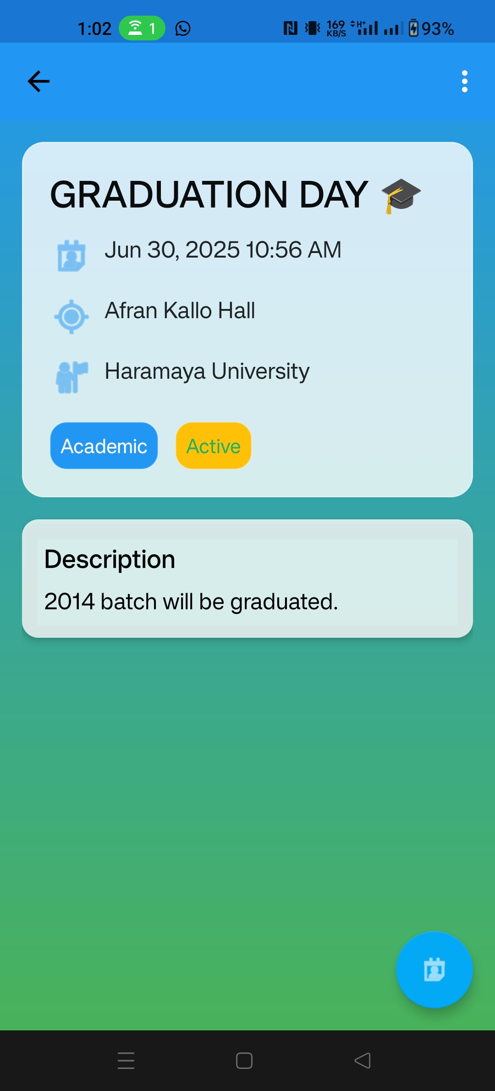
Cont...
Users’ Module
-Users browsing events
-Event details WHEN clicked

Slide 14
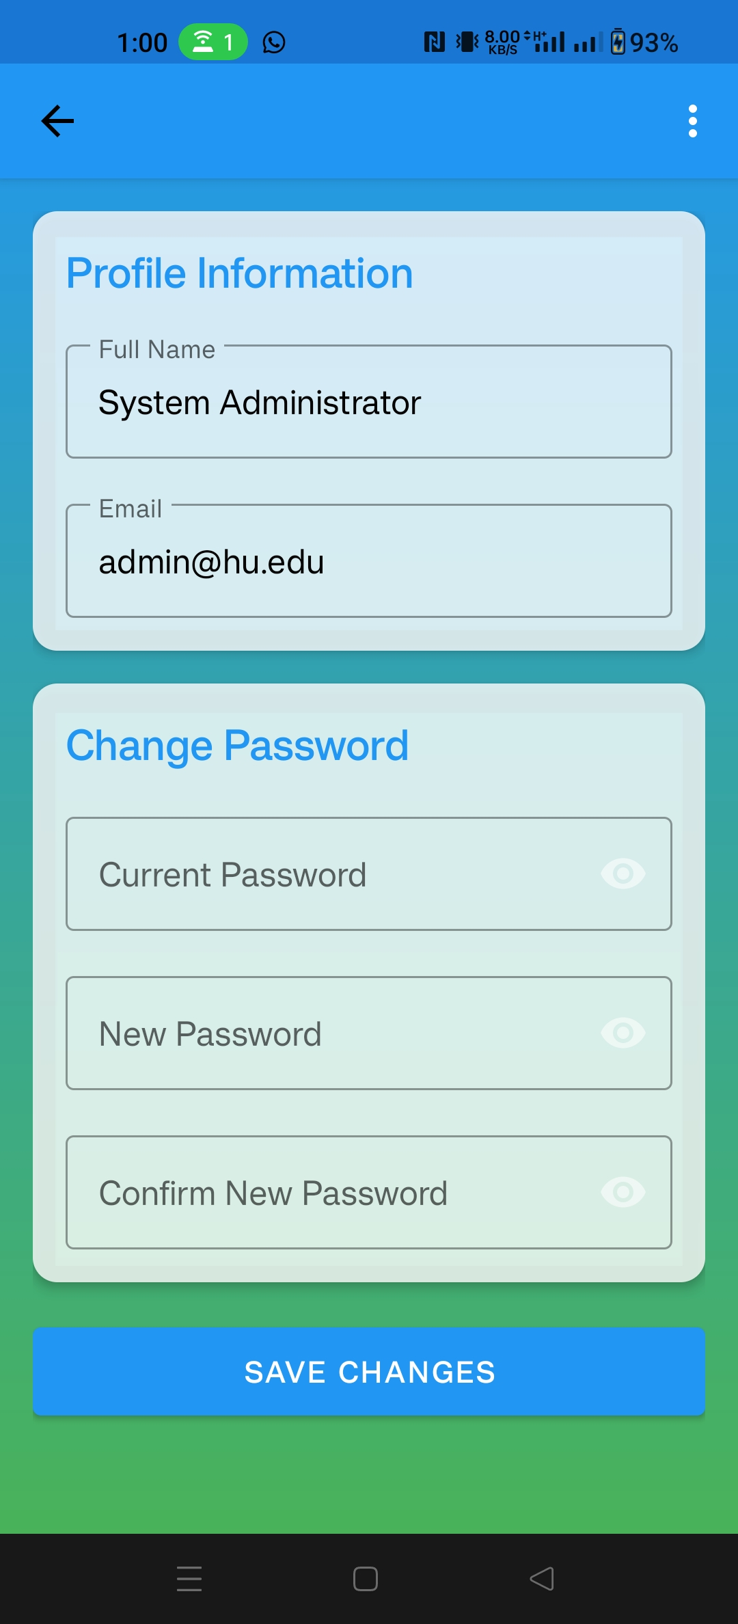
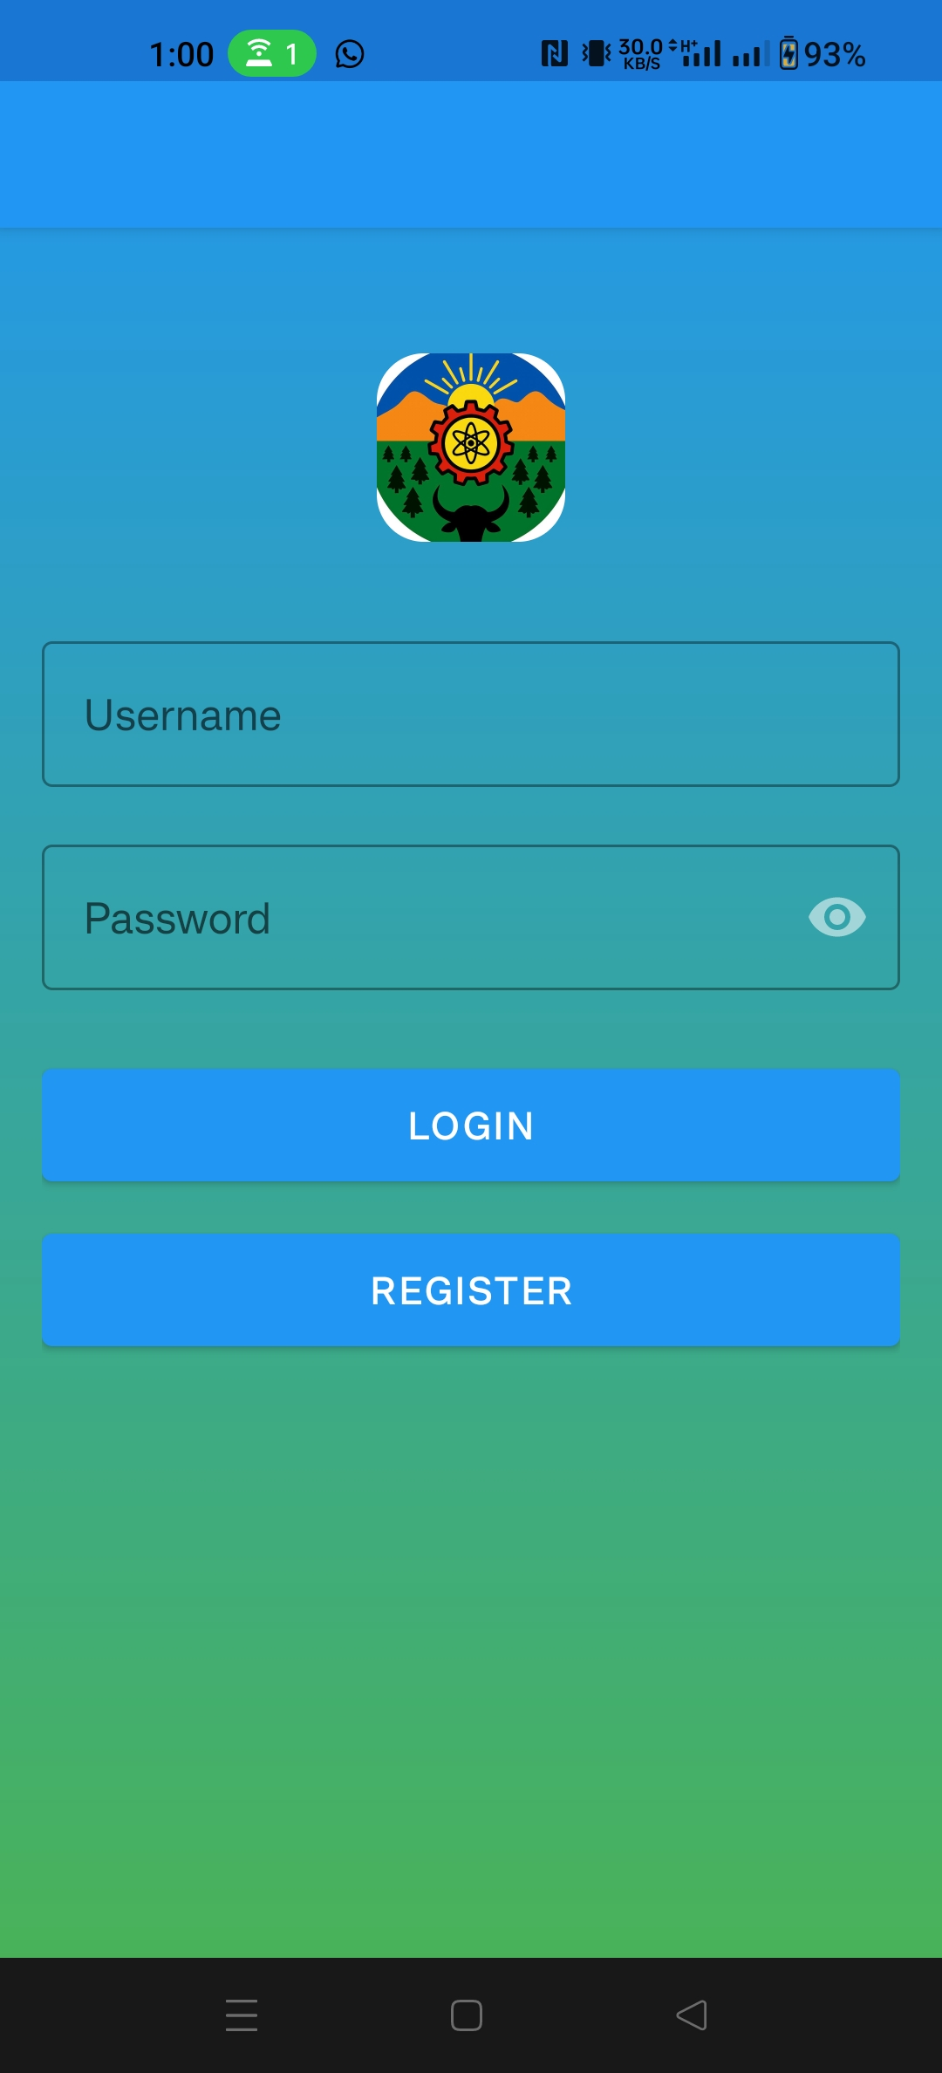
Cont...
-Update profile page
-Login page

Slide 15
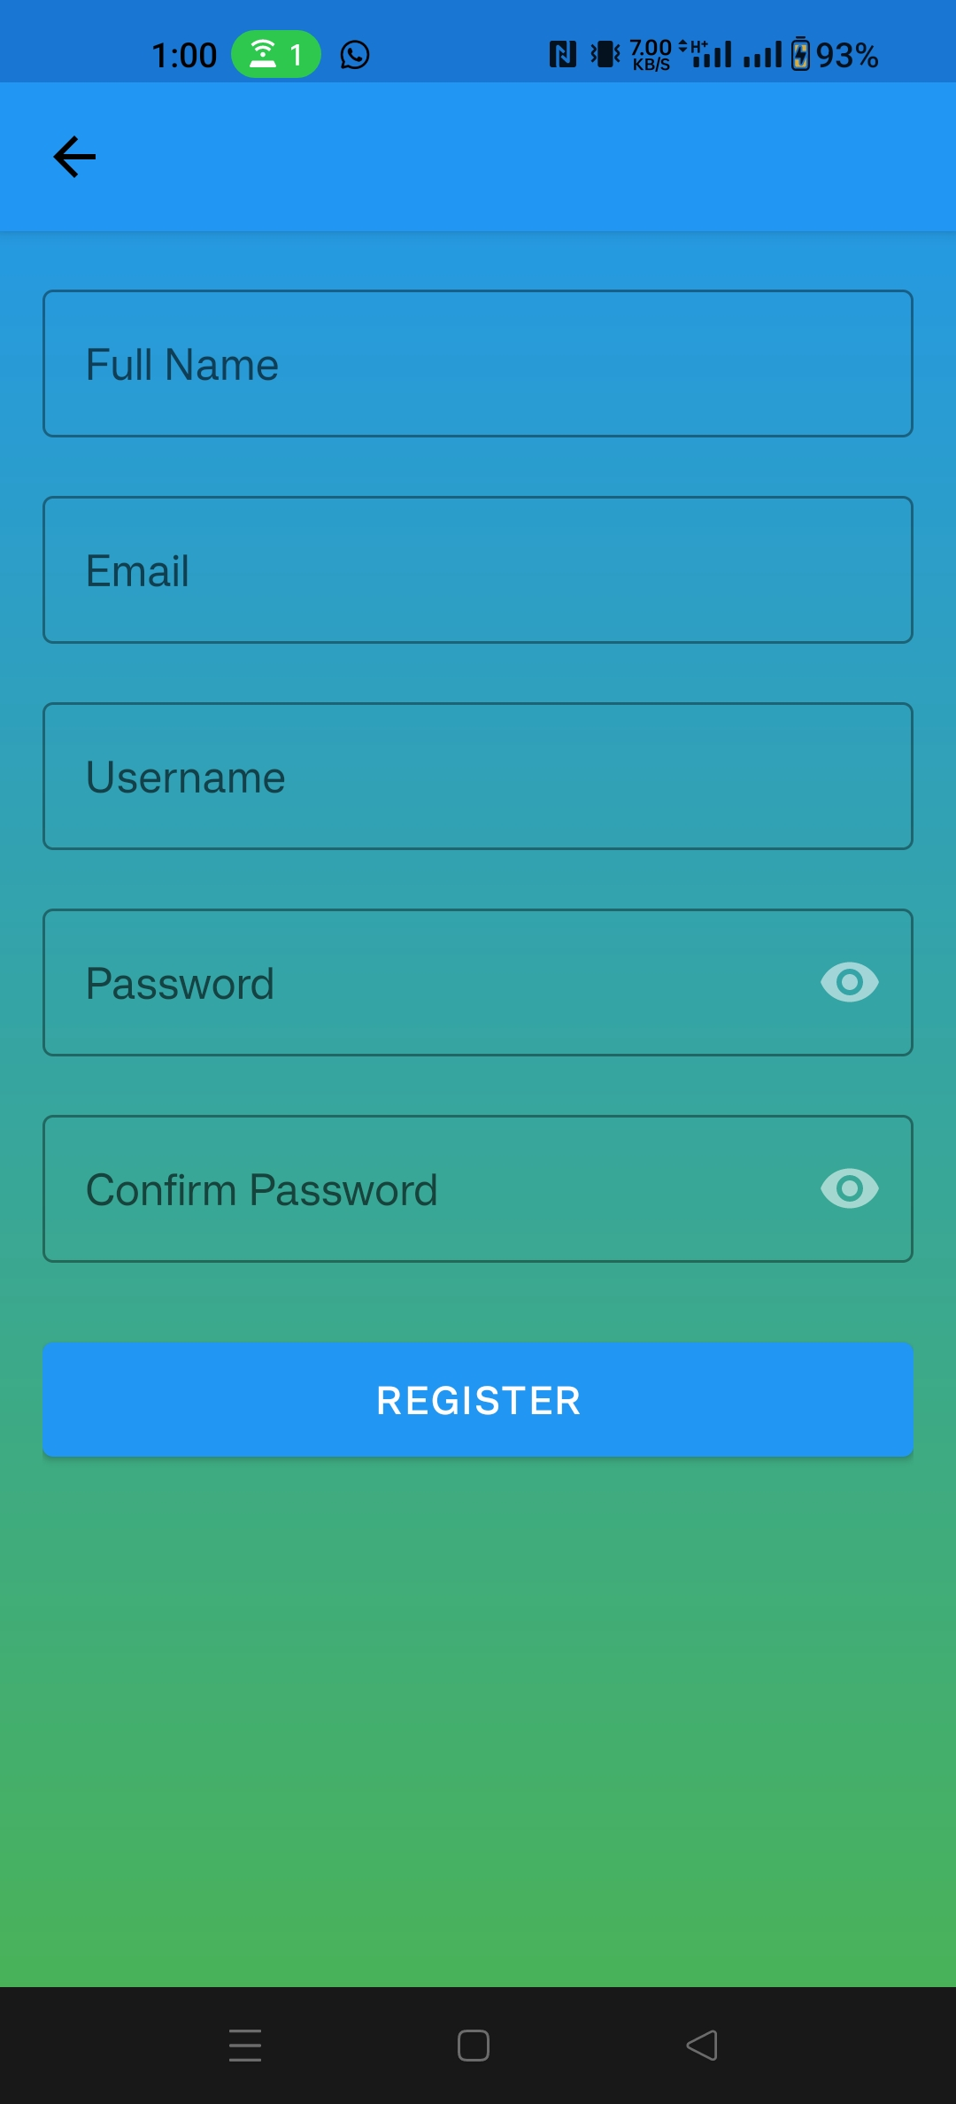
Cont...
User registration page

Slide 16

THANK YOU

