Slide 1

Dynamic Modelling of An Electric Vehicle
Presented by: CMS ID
Nasrun Sithara Ramees 356480
Ahamad Rishard 356482
Hashir Khan 332123

Slide 2

Introduction
Problem Statement:
Conventional vehicles has low fuel economy and exhaust gas emission causing environmental pollution. To overcome this, we use electric vehicle technology.
Develop a mathematical model that represent the behavior of electric vehicle and its components including:
Challenge:
The control system regulates the speed based on inputs: accelerator pedal position, brake pedal position, and vehicle speed.
It must account for the nonlinear behavior of the components, including the effects of delay and noise.
Goals:
Battery
Motor
Power Electronics
Control Systems
Goal 1
Goal 2
Design an efficient model to predict the performance, efficiency, and speed of the electric vehicle under different operating conditions.
Optimize the components and control systems to meet the desired specifications.

Slide 3

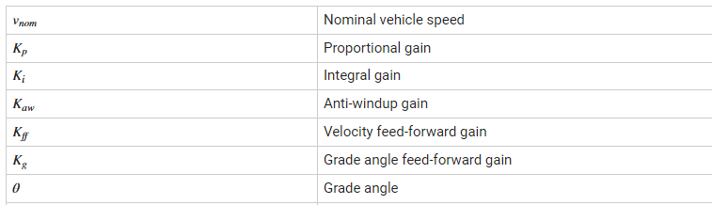
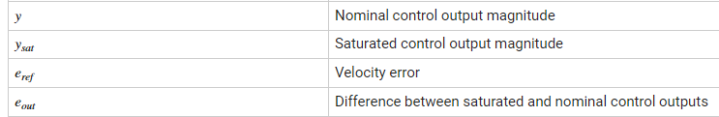
Mathematical Modelling of EV System
Longitudinal Driver Simulink Block

Slide 4
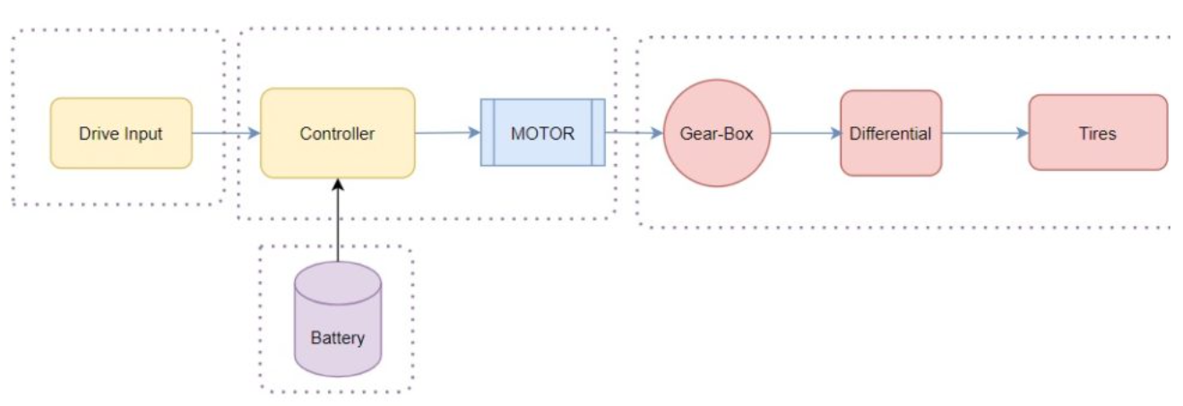
Proposed Methodology
The model comprise of 4 block systems.
Vehicle Body model 3. Driver Input Model
Motor and Controller part 4. Battery Pack

Slide 5
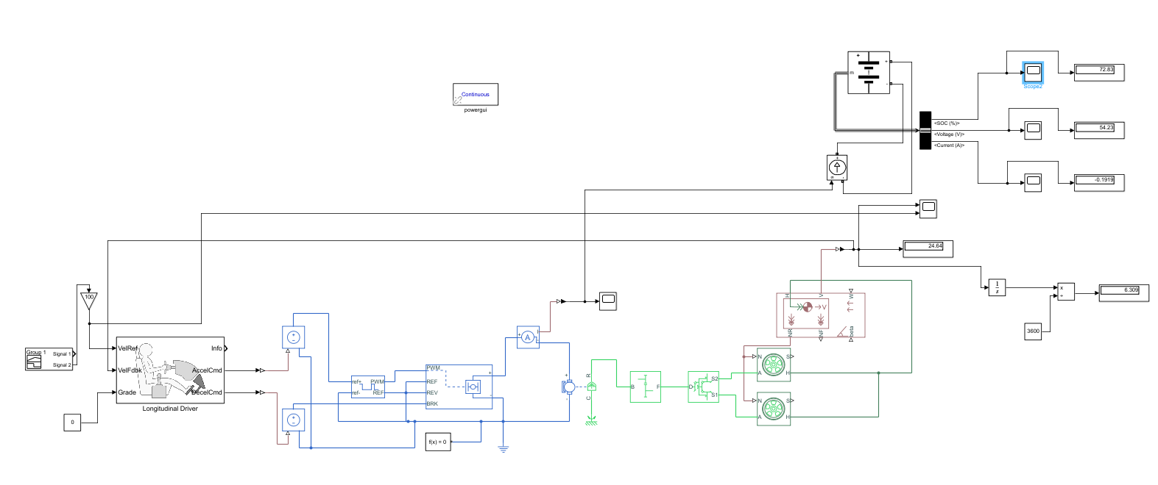
Complete model

Slide 6
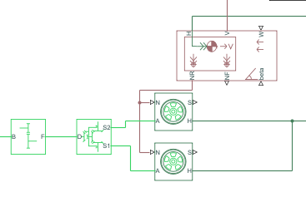
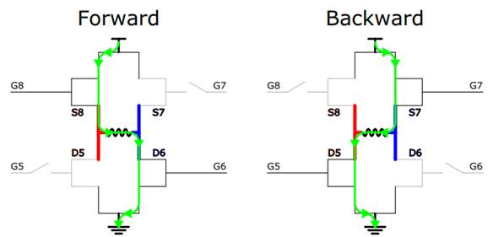
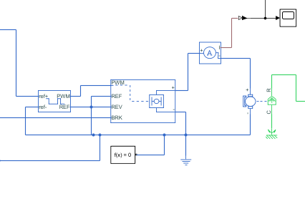
Design of proposed system and working of model
Vehicle Body System
Used to model the vehicle body chassis
Parameters used to vary – Vehicle Mass
- Frontal Area
- Drag Coefficient
Other components- Differential
- Gear Box
Vehicle Body System
2. Motor and Controller Part
Motor can be of any type-BLDC, Brushed DC, IMs
Controller used to vary speed of motor. (H-Bridge used).
-
Controller and Motor part

Slide 7
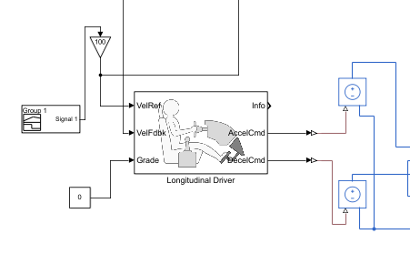
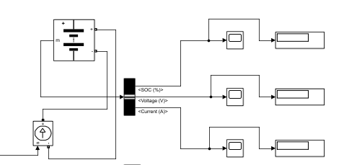
Design of proposed system
3. Driver Input model
Used to model the real driver
Parameters used to vary – Acceleration
- Deceleration
Signal builder block used to generate the signals
Driver Input Module
4. Battery Pack
Powerhouse to the motor. (Earlier just used for starting)
Acceleration uses the charges in the battery- Discharge
Deceleration charges the battery after short circuiting output of motor – Charge
Battery Pack

Slide 8
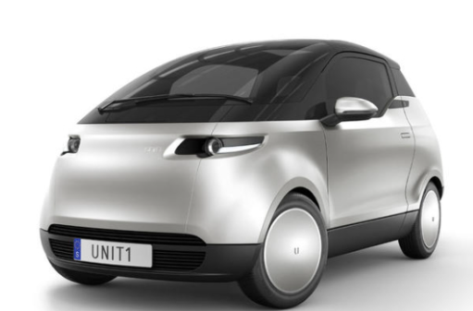
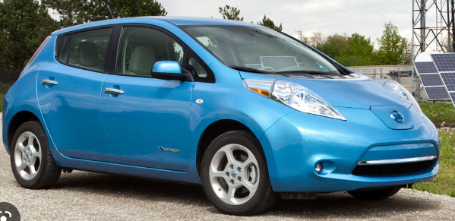
Results
Results of actual speed vs reference speed.
B. Battery SOC Model.
We tested the above model on two of the most common EV vehicle in the market and verified how well performed.
Nissan Leaf
2. Mini-EV

Slide 9
Vehicle parameters
Vehicle Type | Body weight (Kg) | Frontal Area (ft/s^2) | Drag Co. ef | No-load Speed (rpm) | Rated Speed (rpm) | Nominal Battery voltage(V)
Nissan Leaf | 1567 | 24.5 | 0.32 | 10000-15000 | 8000-10000 | 350
Mini-EV | 600 | 15 | 0.33 | 10000-15000 | 7000 | 200

Slide 10
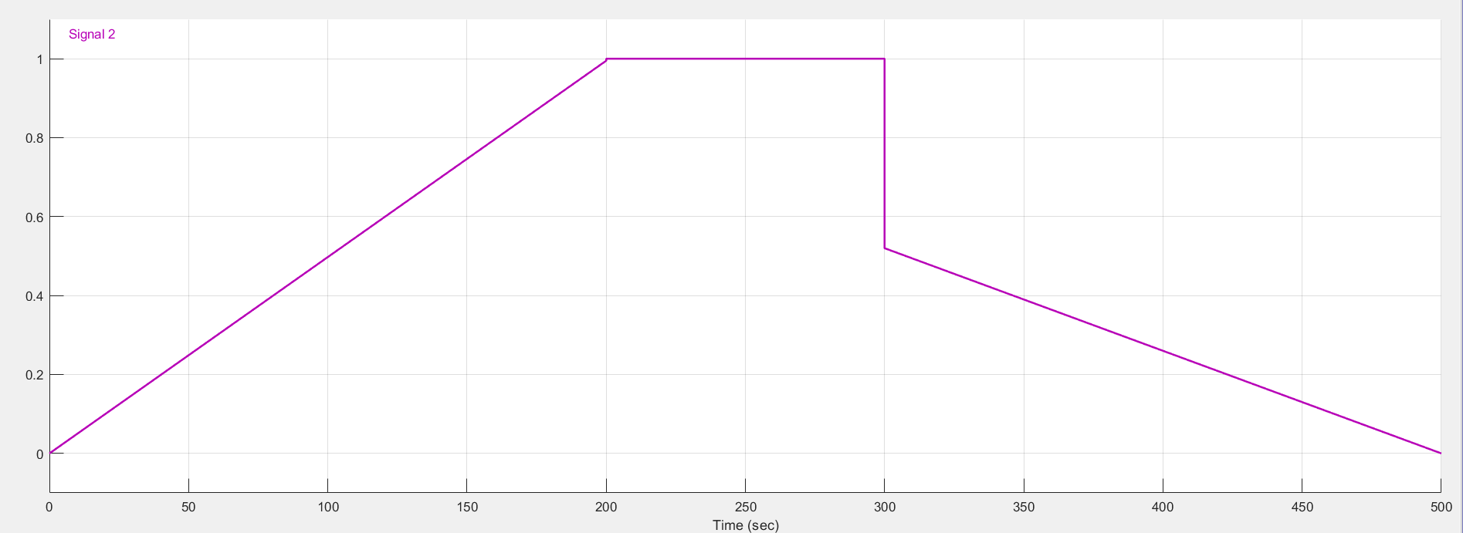
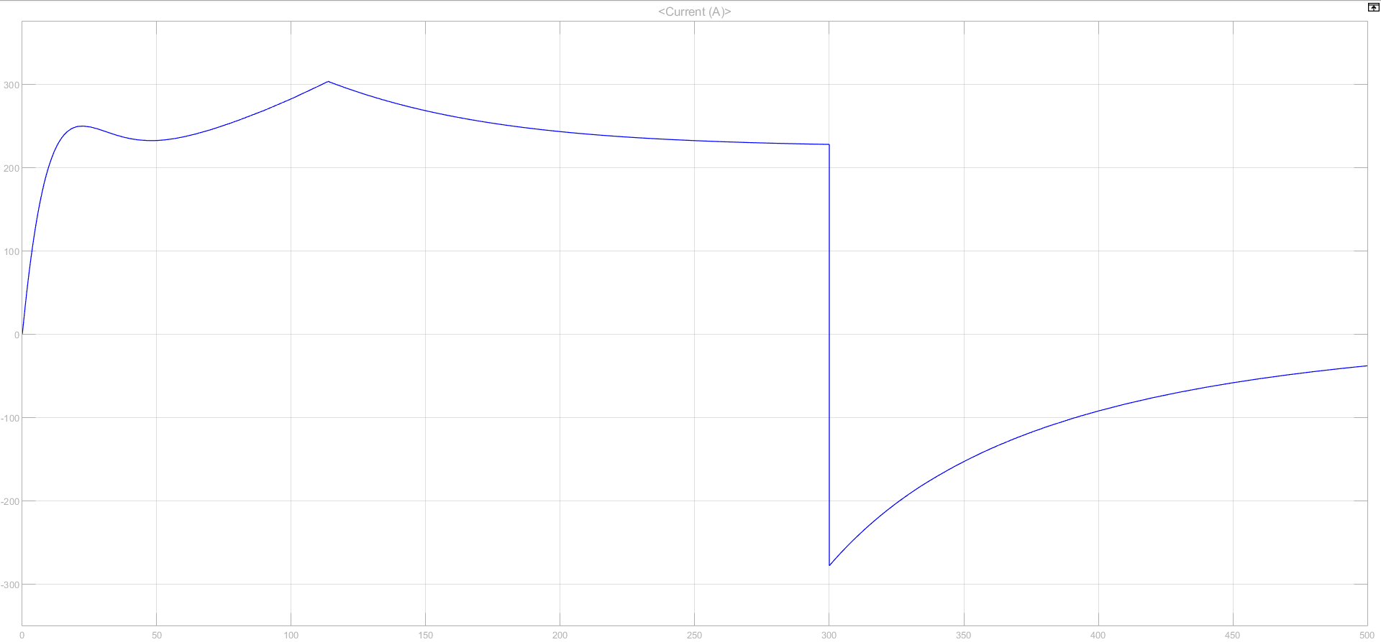
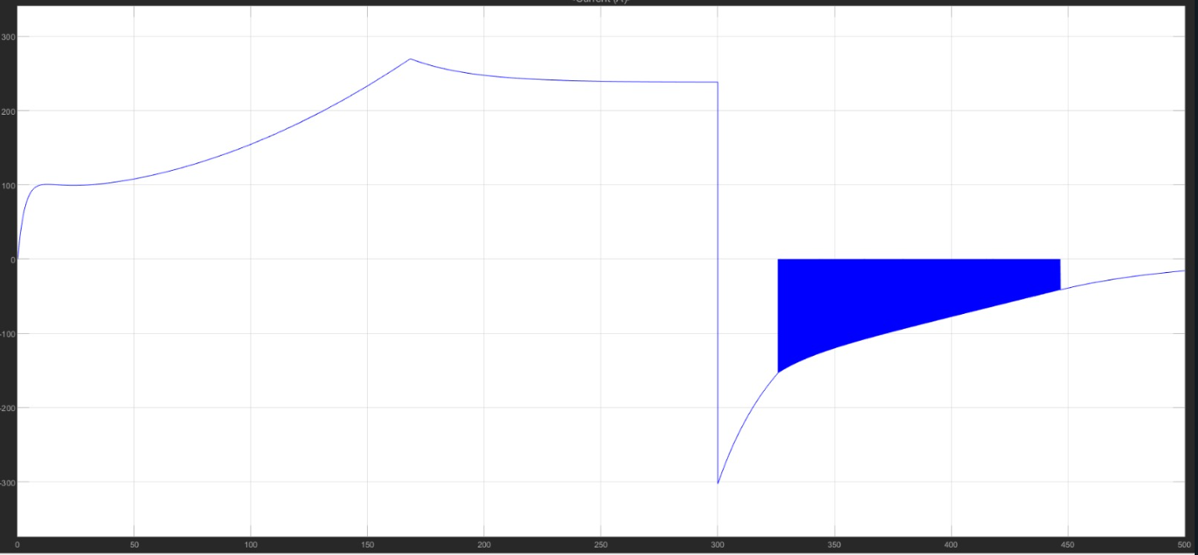
Reference speed input
Nissan Leaf
Mini EV
Current/A
Current/A
time/s
time/s

Slide 11
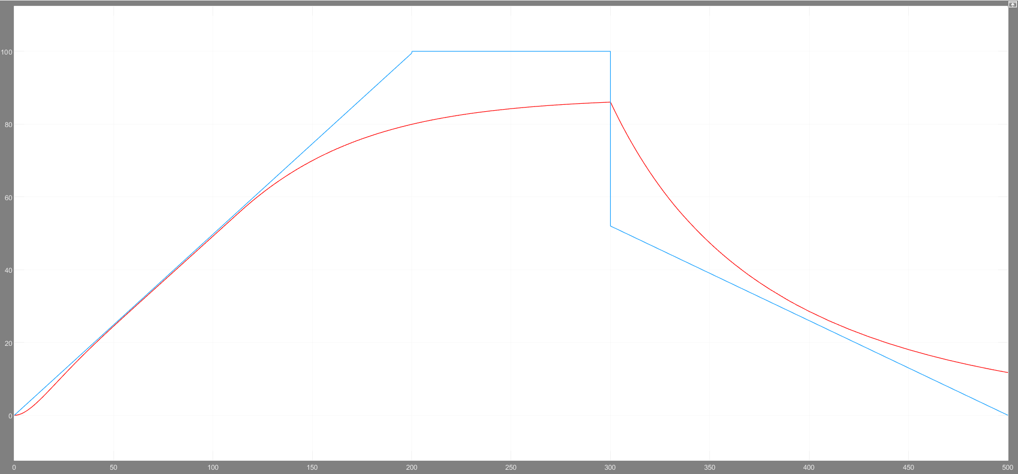
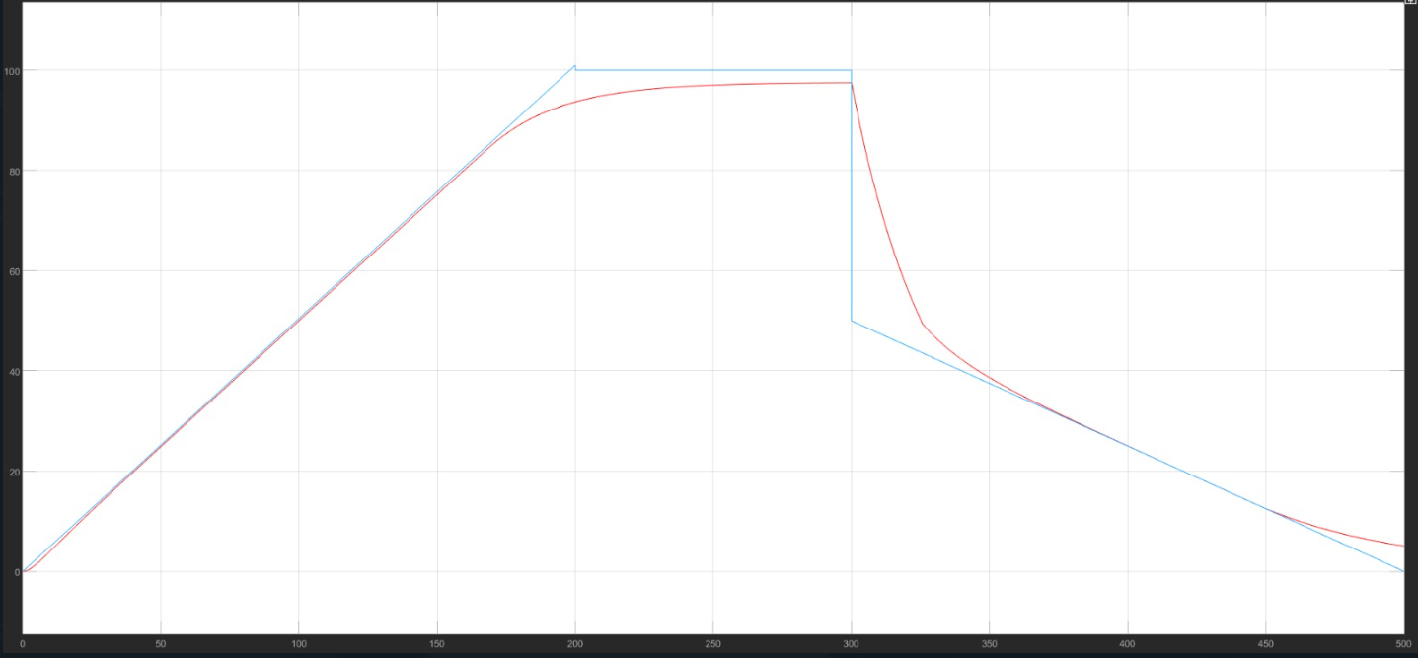
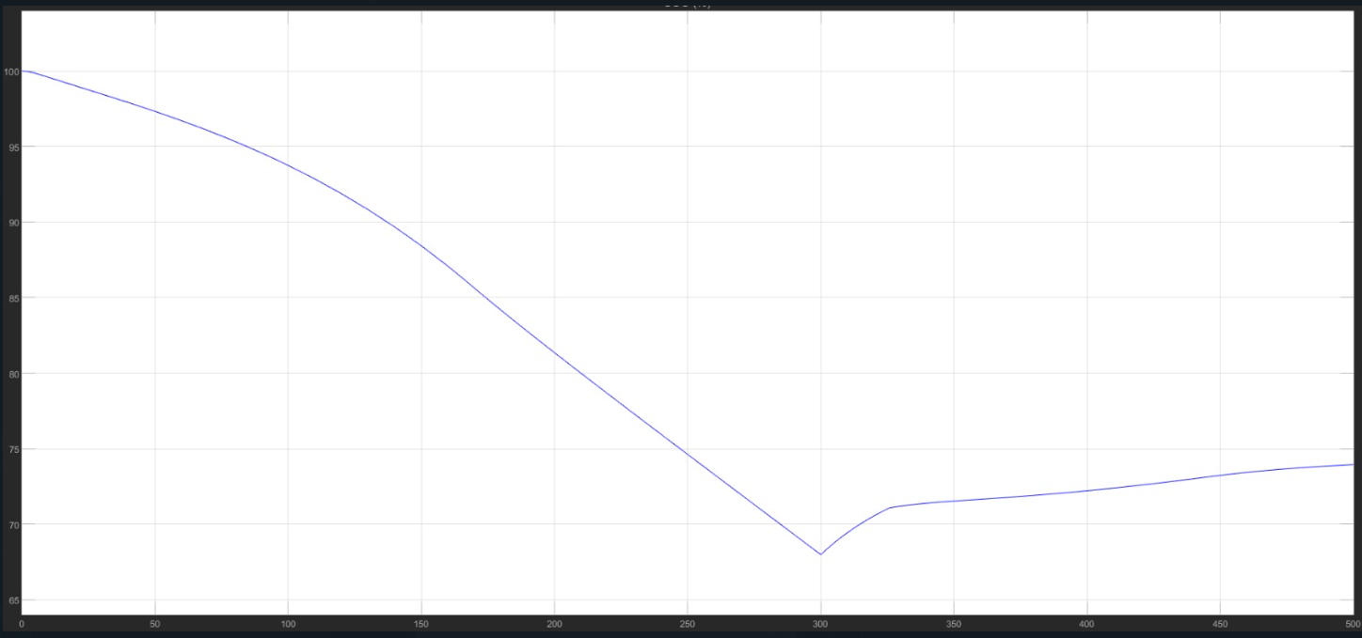
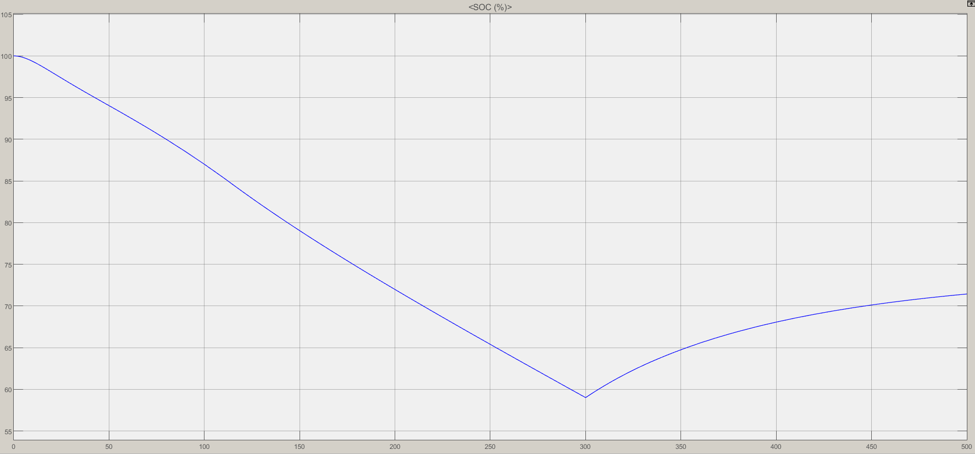
Battery SOC and Speeds Graphs
Set Reference speed=50km/hr
Nissan Leaf
Speed/km/h
Mini EV
Speed/km/h
time/s
time/s
Battery SOC%
Battery SOC%
time/s
time/s
Battery SOC after drive cycle = 58%
Battery SOC after drive cycle = 68%

Slide 12
Discussion and Analysis
Mass/Speed relationship with the actual and reference speed graph.
Mini EV car, the best approximation to the model.
More complexity in building High mass EVs

Slide 13
Conclusion
Best suitable for Low weight EVs
Higher the rated rpm speed of the motor, better is the approximation to our model.
Trade-off between both these to achieve optimal performance.
Highly efficient than internal combustion engine.

Slide 14
Future Work
Hybrid Vehicle System
Solar Power System

Slide 15
References
[1] Mohd, T. a. T., Hassan, M. A., & Aziz, W. N. a. W. A. (2015). MATHEMATICAL MODELING AND SIMULATION OF AN ELECTRIC VEHICLE. Journal of Mechanical Engineering and Sciences, 8, 1312–1321. https://doi.org/10.15282/jmes.8.2015.6.0128
[2] User, & User. (2023b). The Main Components of Electric Vehicles | Parts of EV. YoCharge - Charging Management Software CMS. https://yocharge.com/in/ev/components/
[3] Longitudinal speed-tracking controller - Simulink. (n.d.). https://www.mathworks.com/help/vdynblks/ref/longitudinaldriver.html

Slide 16

The End
Any Questions???
Thank you.

