Slide 1
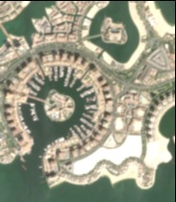
UrbanHeat AI
The Pearl planning pilot
Al Zubarah · Qatar
Urban Expansion, Land Use Change & Heat Risk
Open-data PoC · October 2026
Notes:
Contains modified Copernicus Sentinel data (2026). Exact scene S2C_39RWJ_20260930_0_L2A. Analyst-defined window, not an official district boundary. This deck is a review draft.

Slide 2
The planning problem
Urban planners need a spatial starting point for heat-mitigation site visits.
Our pilot screens a small part of The Pearl using repeatable satellite observations and mapped urban features.
The decision: where should a planner inspect pedestrian use, existing shade and planting feasibility first?
UrbanHeat AI · Al Zubarah · Qatar
2

Slide 3
Data and implemented scope
Source | Date | Used for
Sentinel-2 L2A | 5, 15, 30 Sep 2026 | Green signal and optical quality
Landsat 8/9 L2 | 6, 14, 30 Sep 2026 | Surface temperature and QA
ESA WorldCover v200 | 2021 | Historical ML-derived land cover
OpenStreetMap | Downloaded 4 Oct 2026 | Mapped buildings and references
Open data. No VHR, 813 or hyperspectral imagery. We use a precomputed ML product and contributed geometry.
UrbanHeat AI · Al Zubarah · Qatar
3
Notes:
Sources: https://www.usgs.gov/landsat-missions/landsat-collection-2-surface-temperature ; https://science.nasa.gov/mission/landsat-9/ ; https://doi.org/10.5281/zenodo.7254220 ; https://www.openstreetmap.org/copyright . Exact scene metadata and licences are packaged.

Slide 4
Analysis workflow
Source crops
Quality screening
Matched cells
Planning shortlist
Exact scenes and
reference snapshots
Water, coast, crop
edges and thermal QA
Same inland footprint
on accepted dates
Explainable score
and sensitivity checks
Thermal detail: about 100 m. Reporting cells: 300 m. Retained delivered pixels: 30 m and spatially dependent.
UrbanHeat AI · Al Zubarah · Qatar
4
Notes:
Workflow implemented in src/coastal_multidate.py, src/planning.py and src/export_map.py. WorldCover uses CatBoost upstream; this PoC does not run its own AI segmentation.

Slide 5
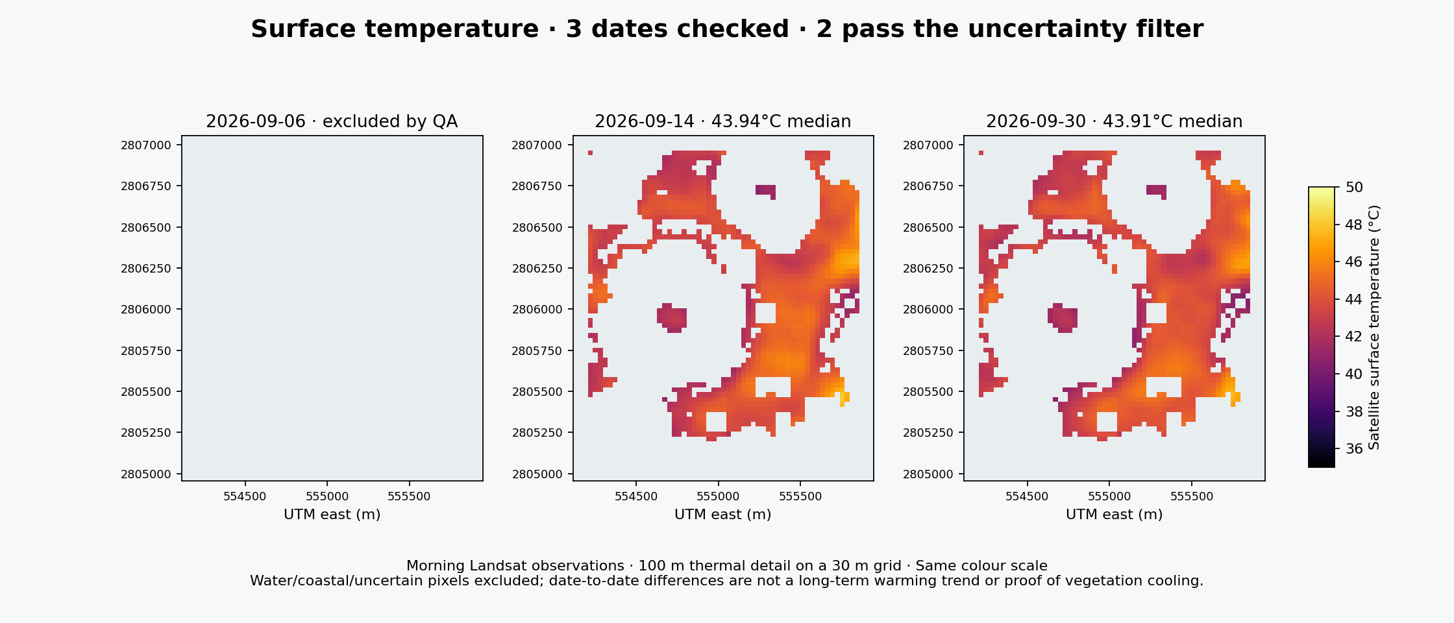
Accepted surface-temperature observations
1.15 km² retained on the same footprints. Surface temperature is distinct from air temperature and human heat exposure.
UrbanHeat AI · Al Zubarah · Qatar
5
Notes:
Actual results generated from packaged Landsat crops. USGS method: DN × 0.00341802 +149 −273.15. Two accepted September morning dates do not establish a trend or causal cooling.

Slide 6
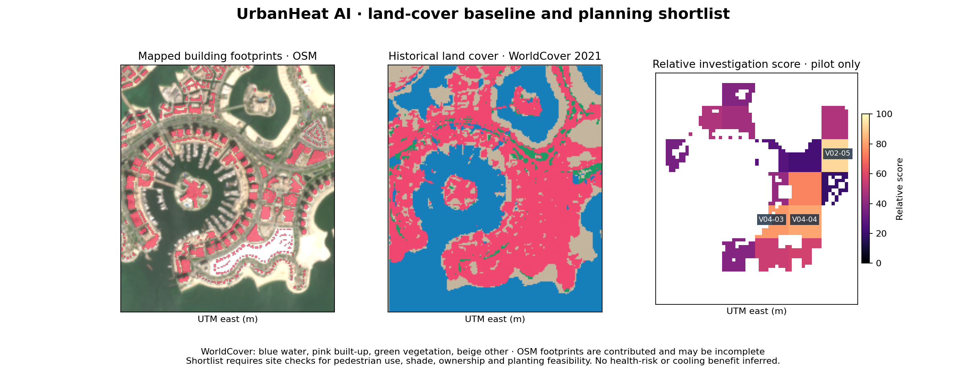
Land cover and investigation priorities
Historical land cover and contributed footprints provide context for site inspection.
UrbanHeat AI · Al Zubarah · Qatar
6
Notes:
Actual results from OSM contributed building geometry and ESA WorldCover 2021. Score is a within-pilot heuristic: 50% heat rank, 30% inverse green-signal rank, 20% mapped-building rank. Not a calibrated risk index.

Slide 7
Shortlist and sensitivity
Cell | Surface °C* | Green %* | Buildings % | Rank range
V02-05 | 45.2 | 5.2 | 34.9 | 1–1
V04-04 | 44.9 | 6.0 | 24.7 | 2–3
V04-03 | 44.2 | 4.2 | 30.3 | 2–6
The first two candidates remain near the top across all 11 tested settings. The third is less stable.
*Averages of the two date-level cell summaries. Coverage is partial and reported per cell. No cooling benefit is estimated.
UrbanHeat AI · Al Zubarah · Qatar
7
Notes:
All values are actual outputs in results/planning-cells.csv. Rank ranges are across eleven selected scenarios and are not probabilistic confidence intervals. Mapped building fractions may omit unmapped features.

Slide 8
Reference checks and remaining limits
30 / 30 coastal-water points agree with the water screen
Small water features: all 3 sampled interiors are missed.
Grass: no interiors survive the reference erosion.
Buildings: 1 of 30 sampled interiors passes the green threshold.
Human reference confirmation and independent thermal calibration remain pending. These checks cannot certify overall accuracy.
UrbanHeat AI · Al Zubarah · Qatar
8
Notes:
Checks in results/reference-samples.csv, using contributed OSM reference geometry. Thirty coastline right-side points are spaced at least 100 m and offset 60 m offshore, with at least 40 m distance to mapped coastline. Limited positive checks are not a representative accuracy assessment.

Slide 9
Impact and decision limits
The output helps organise targeted site visits
A planner can inspect the shortlist, its contributing indicators, coverage and sensitivity before choosing local work.
No measured savings, intervention benefit, heat-health risk, rural-reference UHI intensity or long-term warming trend is claimed.
UrbanHeat AI · Al Zubarah · Qatar
9
Notes:
Intended use, not measured impact. USGS caveats: historical ASTER emissivity, vegetation-adjustment anomaly, small-target blockiness and cloud effects. ST_QA does not capture all systematic bias. No field or heat-health validation has been performed.

Slide 10
Next steps and submission readiness
Next scientific work
Confirm reference samples with a human reviewer. Add suitable VHR segmentation and paving/shade indicators when the data support them. Validate thermal observations independently.
Before submitting
Run the notebook in normal Jupyter on another machine. Confirm member names and roles, GitHub access and the current deadline. Submit the form with this PDF after team review.
UrbanHeat AI · Al Zubarah · Qatar
10
Notes:
Required submission guide snapshot: hackathon-snapshot/07-submission-guide.txt. Dashboard session expired on 4 October, so current eligibility/deadline not verified. All team member identities/roles and accessible GitHub repository must be confirmed. Normal Jupyter kernel cannot start in this sandbox; clean Python cell execution is separate.

Slide 11
Sources and licences
Contains modified Copernicus Sentinel data (2026)
Copernicus Sentinel terms. Exact scene records are in the repository.
Landsat imagery courtesy of the U.S. Geological Survey
Landsat 8–9 Collection 2 L2. doi.org/10.5066/P9OGBGM6
ESA WorldCover 2021 v200, Zanaga et al. (2022)
CC BY 4.0. doi.org/10.5281/zenodo.7254220
© OpenStreetMap contributors
ODbL 1.0. openstreetmap.org/copyright
UrbanHeat AI · Al Zubarah · Qatar
11
Notes:
Primary sources and licences. Exact source metadata, full citations, derived-database licences and processing parameters are included in the README and DATA-LICENSES.md.

