Slide 1
UrbanHeat AI
Al Khor area study, Qatar
Theme: Urban Expansion, Land Use Change & Heat Risk
Satellite and local evidence for heat-protection site assessments
Team Al Zubarah, Qatar
UAE Space Academy hackathon, October 2026
Notes:
Review draft. Theme: Urban Expansion, Land Use Change & Heat Risk. The Al Khor README and supplied handover are the sources for this deck.

Slide 2
The planning problem
Find hot cells, then check who uses them and when.
Satellite screening helps organise visits; local review adds context about shade, access and planned use.
Human exposure has not been measured. Trees, shelters and safer routes are options to assess.
The prototype supports investigation; it does not establish heat-health risk.
Notes:
Proposed problem and user need from README sections 1 and 2. No field interviews, exposure measurements or validated benefit claimed.

Slide 3
Bus-stop site assessment: V04-23
Satellite: 50.4 °C mean of two cell medians; 0% detected green pixels at the current threshold.
Local evidence: roadside trees, no shelter and limited walking access; Nasser confirms site visits.
Next check: waiting-time shade, passenger use, route safety, ownership and feasibility.
300 m values are not stop measurements. Nasser confirms unchanged physical conditions; visit dates unspecified.
Notes:
Source: docs/Local-Review.md, results/local-greenery-audit.json and unchanged planning-cells.csv. Local observer: Abdulrahman Almohannadi; reports recorded 6 October 2026, observation date unspecified. Street View link supplied by Nasser: https://maps.app.goo.gl/gPEzxW3NFqErPWNP8 . Panorama McFzT23rIzQ4UJTSgSHFCQ, capture March 2023. Camera 25.7175476, 51.5145504 is inside V04-23, about 84 m from its centre, not a surveyed sign coordinate. It provides historical context, historical imagery, supplemented by Nasser's firsthand report. Some tree shadow is visible; shade varies. Nasser reports visiting the sites and confirms the described physical situation is the same as in September 2026; exact visit dates were not supplied. No passenger counts, cooling benefits or design recommendations are established. Street View imagery is linked, not redistributed. Google guidance: https://about.google/brand-resource-center/products-and-services/geo-guidelines/ .

Slide 4
Open satellite data and mapped context
Sentinel-2: green-pixel indicators from 5, 15 and 30 September 2026.
Landsat: surface temperature from 14 and 30 September. The 6 September scene fails coverage QA.
WorldCover 2021: historical land-cover context. OpenStreetMap: contributed building footprints downloaded 5 October.
No hyperspectral, 813 or proprietary VHR data are used.
Thermal native detail is about 100 m, delivered on a 30 m grid. We report 300 m cells.
Notes:
Sources: scene.json, landsat-scene.json, metadata, README sections 3 and 4. Contains modified Copernicus Sentinel data (2026). Landsat courtesy USGS, doi:10.5066/P9OGBGM6. ESA WorldCover 2021 v200, Zanaga et al. (2022), CC BY 4.0, doi:10.5281/zenodo.7254220. OpenStreetMap contributors, ODbL 1.0.

Slide 5
From source crops to an inspectable shortlist
Packaged inputs
Satellite crops
+ mapped context
Quality screening
Cloud, coast and
common support
300 m indicators
Temperature, green
and buildings
Local review + map
Use and shade
Site assessment
Relative ranking
Candidate rules
+ 13 scenarios
Deterministic processing; upstream WorldCover uses ML. Our own segmentation model is future work.
Notes:
Editable workflow diagram. Methods are detailed in README section 4. Inputs are 35 hashed files; matching support is required for the two accepted thermal dates. Ranking is an investigation heuristic. Local review is a separate evidence stage. It does not alter the satellite ranking or create a human-use score.

Slide 6
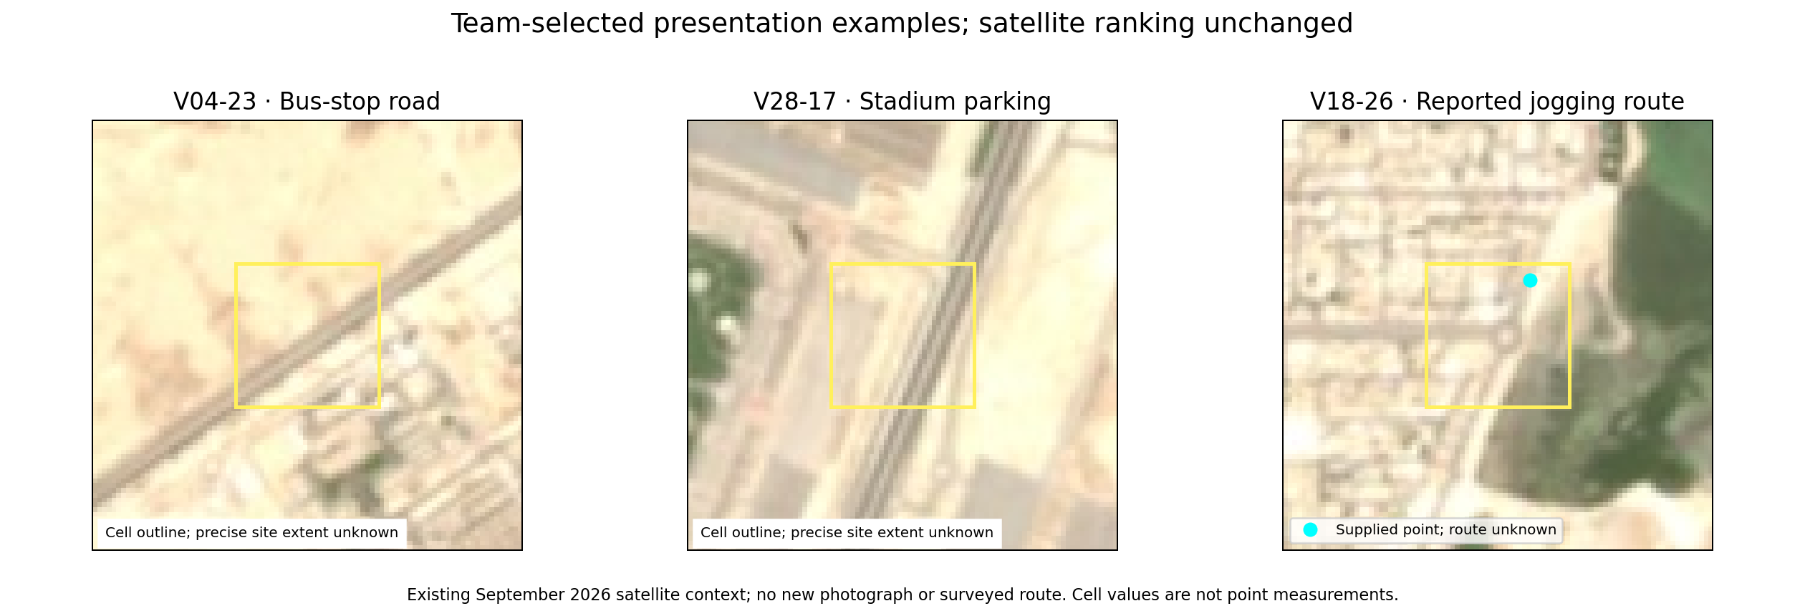
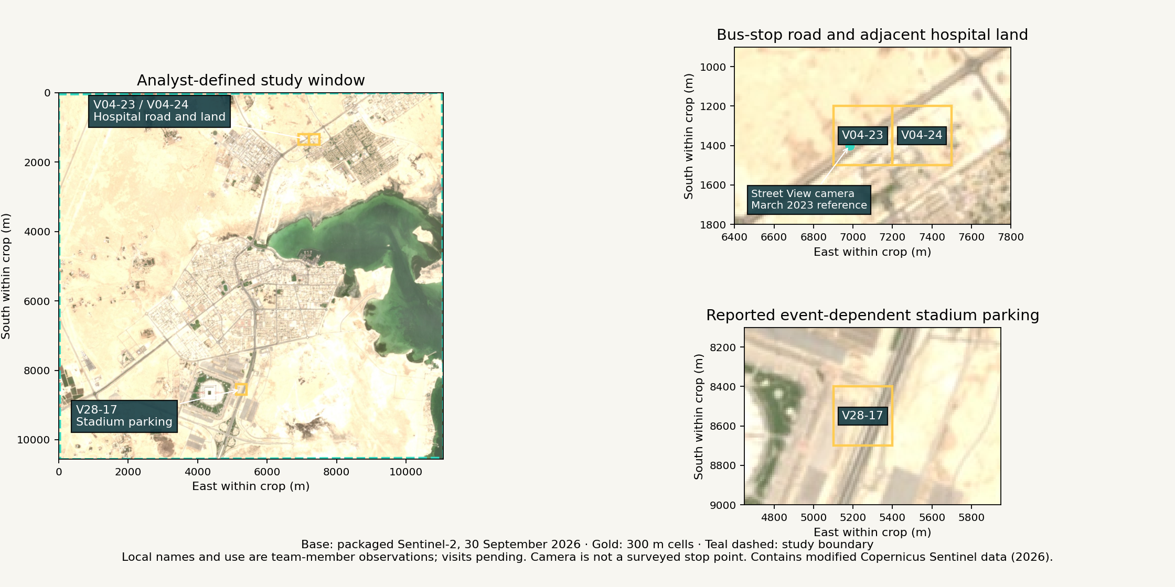
Al Khor presentation examples
Team-selected examples; all 1,111 observed cells and 373 candidates remain. The satellite top three are unchanged.
Notes:
Source: results/local-review-map.png, packaged Sentinel-2 RGB 30 September 2026, app/local-review.json, aoi.geojson and unchanged planning-cells.geojson. Labels identify the full 300 m polygons. Teal dashed line is the analyst-defined study boundary. Local location names and uses are from Abdulrahman; Nasser confirms site visits and unchanged physical conditions relative to September 2026; exact visit dates unspecified, detailed assessment pending. V04-23 and V04-24 are adjacent; a nearby farmers market has not been assigned to a cell. Street View marker is the historical camera, not an exact stop point. Contains modified Copernicus Sentinel data (2026).

Slide 7
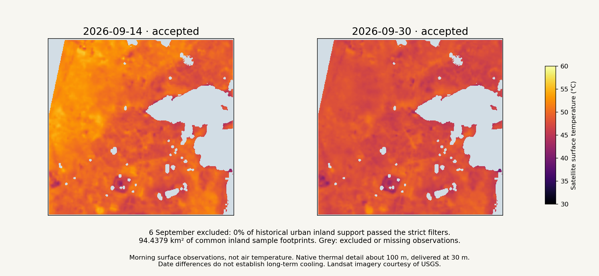
Matched surface-temperature observations
94.4379 km² of common inland sample footprints across the broad study window.
Notes:
Source: results/multidate-temperature.png and coastal-multidate-summary.json. The two accepted dates share screened support. Footprint is observed sample area, not total built-up city area. Surface temperature is not air temperature or heat-health risk. Updated display uses the two unchanged common-temp rasters with a common 30–60 °C scale. The rejected 6 September date is explained in text instead of an empty map; its exclusion record is preserved.

Slide 8
Three examples for site investigation
Case study | Surface °C* | Green %* | Buildings % | Rank range
V04-23 | 50.4 | 0.0 | 2.3 | 1-14
V28-17 | 50.0 | 0.0 | 0.1 | 1-23
V18-26 | 47.47 | 0.0386 | 0.0 | 203–336
Bus stop: waiting-area shade. Stadium: event use. Jogging route: reported lack of path shade; dated evidence pending.
Team-selected examples, not the top three ranks. V18-26 ranks 275/373; hospital land stays in the full results. Visits do not measure use or shade.
*Means of date-level cell summaries. V18-26: 48.02/46.92°C; 72% coverage. Scenario ranges are not confidence intervals.
Notes:
Source: results/planning-summary.json, planning-sensitivity.csv and README section 8. Green-pixel share is thresholded NDVI, not subpixel vegetation fraction. Building coverage is contributed and incomplete. Candidate retained sample footprint totals 31.8195 km². Local observations: docs/Local-Review.md; Nasser confirms site visits; detailed assessment pending. V04-23 maxima are 0.26262 and 0.24985; matched-support shares at diagnostic threshold 0.20 are 2.7222% and 0.3889%. Nasser confirms roadside trees and unchanged physical conditions relative to September 2026 from site visits; exact visit dates were not supplied. This does not validate the optical threshold or vegetation health. Scenario ranks remain unchanged; no unique certified intervention site. The fixed score weights remain 50% heat, 30% inverse green, 20% mapped buildings.

Slide 9
Reproducibility and reference checks
The package includes 35 hashed input files, source metadata and pinned Python 3.12 dependencies.
Clean GitHub execution passed through a normal Jupyter kernel: five cells, zero errors and all 35 input hashes verified.
Optical rule checks: 24/25 grass points pass; 0/30 building points pass. All 30 coastal points are excluded from thermal support.
Contributed reference labels have conflicts. Human confirmation and independent thermal validation remain pending.
Notes:
Source: README sections 6 and 8, reference-samples.csv, notebook-verification.json when available. 20/30 coastal references agree with the spectral/QA screen. All 30 OSM water-polygon references disagree, with some contributed polygons spanning dry land. These positive-only agreement tests do not establish overall accuracy. Reproducibility does not establish scientific accuracy. Normal-kernel verification: https://github.com/NasserAlhuri/spaceHacathon/actions/runs/37269889977. Source commit 9781b95a46d86eb858ae9714ee53198ad22cfb6c. The executed notebook was retrieved from artifact 11328001190. All seven regenerated CSV tables match the supplied baseline byte for byte. These are rule-agreement checks on contributed positive reference points, not overall accuracy. The separate local pixel audit reproduces the baseline V04-23 result; it is not independent thermal or vegetation calibration.

Slide 10
Potential impact and incubation next steps
Completed: reproducible satellite screening, sensitivity checks and local-review examples for site assessment.
Next: detailed shade, use and access checks plus planner feedback; evaluate inspection decisions.
Prepared: September 2021/2026 Dynamic World comparison code. Earth Engine access, local coverage and validation are blocked; 2023 is deferred.
The current PoC does not measure urban expansion, health risk, causal cooling or long-term warming.
Notes:
Proposed next-stage activities, not completed work. See README sections 1, 2 and 8. A planner partnership, field validation and suitable imagery are dependencies; no partner agreement or funded incubation is claimed. No additional thermal date or historical change measurement was added in this local-review revision.

Slide 11
Team responsibilities
Nasser Alhuri: team coordination, site-visit confirmation and submission.
Abdulrahman Almohannadi: review the project; collect dated photographs and local observations.
Mohammed Almarri: practise the presentation and explain the project.
Majed Alkuwari: review slides and explain the limitations.
Ali Alkubaisi: demonstrate the project and prepare judge questions.
Original site visits confirmed; photographs, detailed assessment and member reviews/rehearsals remain pending.
Notes:
Nasser selected responsibilities on 5 October 2026. Abdulrahman supplied the observations in the teammate notes, recorded 6 October 2026. Nasser reports visiting the sites and confirms the described physical situation is the same as in September 2026. Exact visit dates were not supplied; detailed measurements remain pending. Other members retain the assigned responsibilities, without claimed completion. Repository visibility verified public; submission requires final approval.

Slide 12
Data attribution and sources
Actual data: Copernicus Sentinel via Earth Search; Landsat via Planetary Computer (USGS); WorldCover 2021; OSM.
Credits: modified Copernicus Sentinel data (2026); Landsat courtesy USGS; WorldCover CC BY 4.0; OSM ODbL.
Consulted/planned: Dynamic World documentation (data not retrieved), Copernicus Browser, NASA Earthdata and Bellingcat. These are separate from actual analysis sources.
Exact scene provenance and full licences accompany the package. Original code: MIT.
Notes:
Sources: README sections 3 and 10, DATA-LICENSES.md, scene.json, landsat-scene.json and metadata. These are dataset attributions, not claims of field validation. Instructor recommended Copernicus Browser (https://browser.dataspace.copernicus.eu/ ; official documentation checked: https://documentation.dataspace.copernicus.eu/Applications/Browser.html), NASA Earthdata supplied dashboard link (https://earthdata.nasa.gov/dashboard ; exact destination unconfirmed), Bellingcat geolocation toolkit (https://bellingcat.gitbook.io/toolkit/categories/geolocation ; checked). NASA Worldview was an additional suggestion, not the instructor exact link. No data provenance was changed to these portals. Full supplied instructor links and verification status are in docs/Discovery-Resources.md. Earth Search remains optical download provenance and Planetary Computer thermal provenance. WorldCover DOI and OSM licence above are retained. Street View reference is linked, capture March 2023; no Google imagery redistributed.

