Slide 1
UrbanHeat AI
Al Khor area study, Qatar
Theme: Urban Expansion, Land Use Change & Heat Risk
Satellite and local evidence for heat-protection site assessments
Team Al Zubarah, Qatar
UAE Space Academy hackathon, October 2026
Notes:
Review draft. Theme: Urban Expansion, Land Use Change & Heat Risk. The Al Khor README and supplied handover are the sources for this deck.

Slide 2
The planning problem
Proposed user: a municipal planning team choosing where to inspect first.
Shortlist cells, then inspect use, shade, access, ownership and feasibility before choosing an intervention.
Proposed value: organise evidence and inspection decisions. No adoption or measured benefit is established.
The prototype supports investigation; it does not establish heat-health risk.
Notes:
Proposed problem and user need from README sections 1 and 2. No field interviews, exposure measurements or validated benefit claimed.

Slide 3
Bus-stop site assessment: V04-23
Satellite: 50.4 °C mean of two cell medians; 0% detected green pixels at the current threshold.
Local evidence: roadside trees, no shelter and limited walking access; Nasser confirms site visits.
Next check: waiting-time shade, passenger use, route safety, ownership and feasibility.
300 m September values are not stop measurements. October field photos show context, not measured use or shade.
Notes:
Source: docs/Local-Review.md, results/local-greenery-audit.json and unchanged planning-cells.csv. Local observer: Abdulrahman Almohannadi; reports recorded 6 October 2026, observation date unspecified. Street View link supplied by Nasser: https://maps.app.goo.gl/gPEzxW3NFqErPWNP8 . Panorama McFzT23rIzQ4UJTSgSHFCQ, capture March 2023. Camera 25.7175476, 51.5145504 is inside V04-23, about 84 m from its centre, not a surveyed sign coordinate. It provides historical context, historical imagery, supplemented by Nasser's firsthand report. Some tree shadow is visible; shade varies. Nasser reports visiting the sites and confirms the described physical situation is the same as in September 2026; exact visit dates were not supplied. No passenger counts, cooling benefits or design recommendations are established. Street View imagery is linked, not redistributed. Google guidance: https://about.google/brand-resource-center/products-and-services/geo-guidelines/ .

Slide 4
Open satellite data and mapped context
Sentinel-2: green-pixel indicators from 5, 15 and 30 September 2026.
Landsat: surface temperature from 14 and 30 September. The 6 September scene fails coverage QA.
WorldCover 2021: historical land-cover context. OpenStreetMap: contributed building footprints downloaded 5 October.
Field photos: 8 October 2026; thermal data: September. No hyperspectral, 813 or proprietary VHR data.
Thermal native detail is about 100 m, delivered on a 30 m grid. We report 300 m cells.
Notes:
Sources: scene.json, landsat-scene.json, metadata, README sections 3 and 4. Contains modified Copernicus Sentinel data (2026). Landsat courtesy USGS, doi:10.5066/P9OGBGM6. ESA WorldCover 2021 v200, Zanaga et al. (2022), CC BY 4.0, doi:10.5281/zenodo.7254220. OpenStreetMap contributors, ODbL 1.0.

Slide 5
From source crops to an inspectable shortlist
Packaged inputs
Satellite crops
+ mapped context
Quality screening
Cloud, coast and
common support
300 m indicators
Temperature, green
and buildings
Local review + map
Use and shade
Site assessment
Relative ranking
Candidate rules
+ 13 scenarios
External AI land cover: WorldCover for heat screening; Dynamic World in a separate experiment. QA/ranking are rule based. No new model trained.
Notes:
Editable workflow diagram. Methods are detailed in README section 4. Inputs are 35 hashed files; matching support is required for the two accepted thermal dates. Ranking is an investigation heuristic. Local review is a separate evidence stage. It does not alter the satellite ranking or create a human-use score.

Slide 6
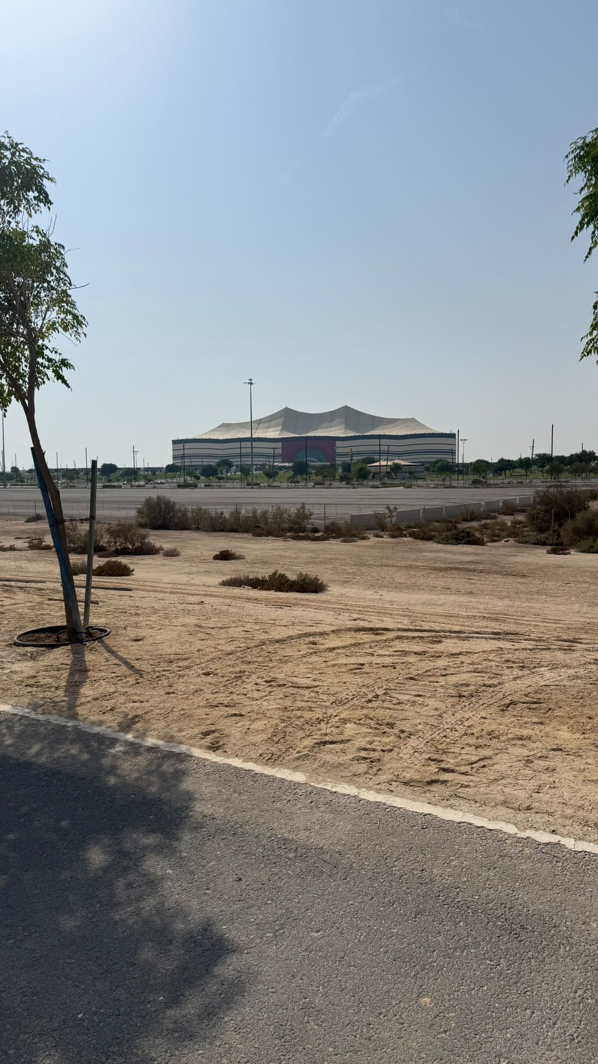
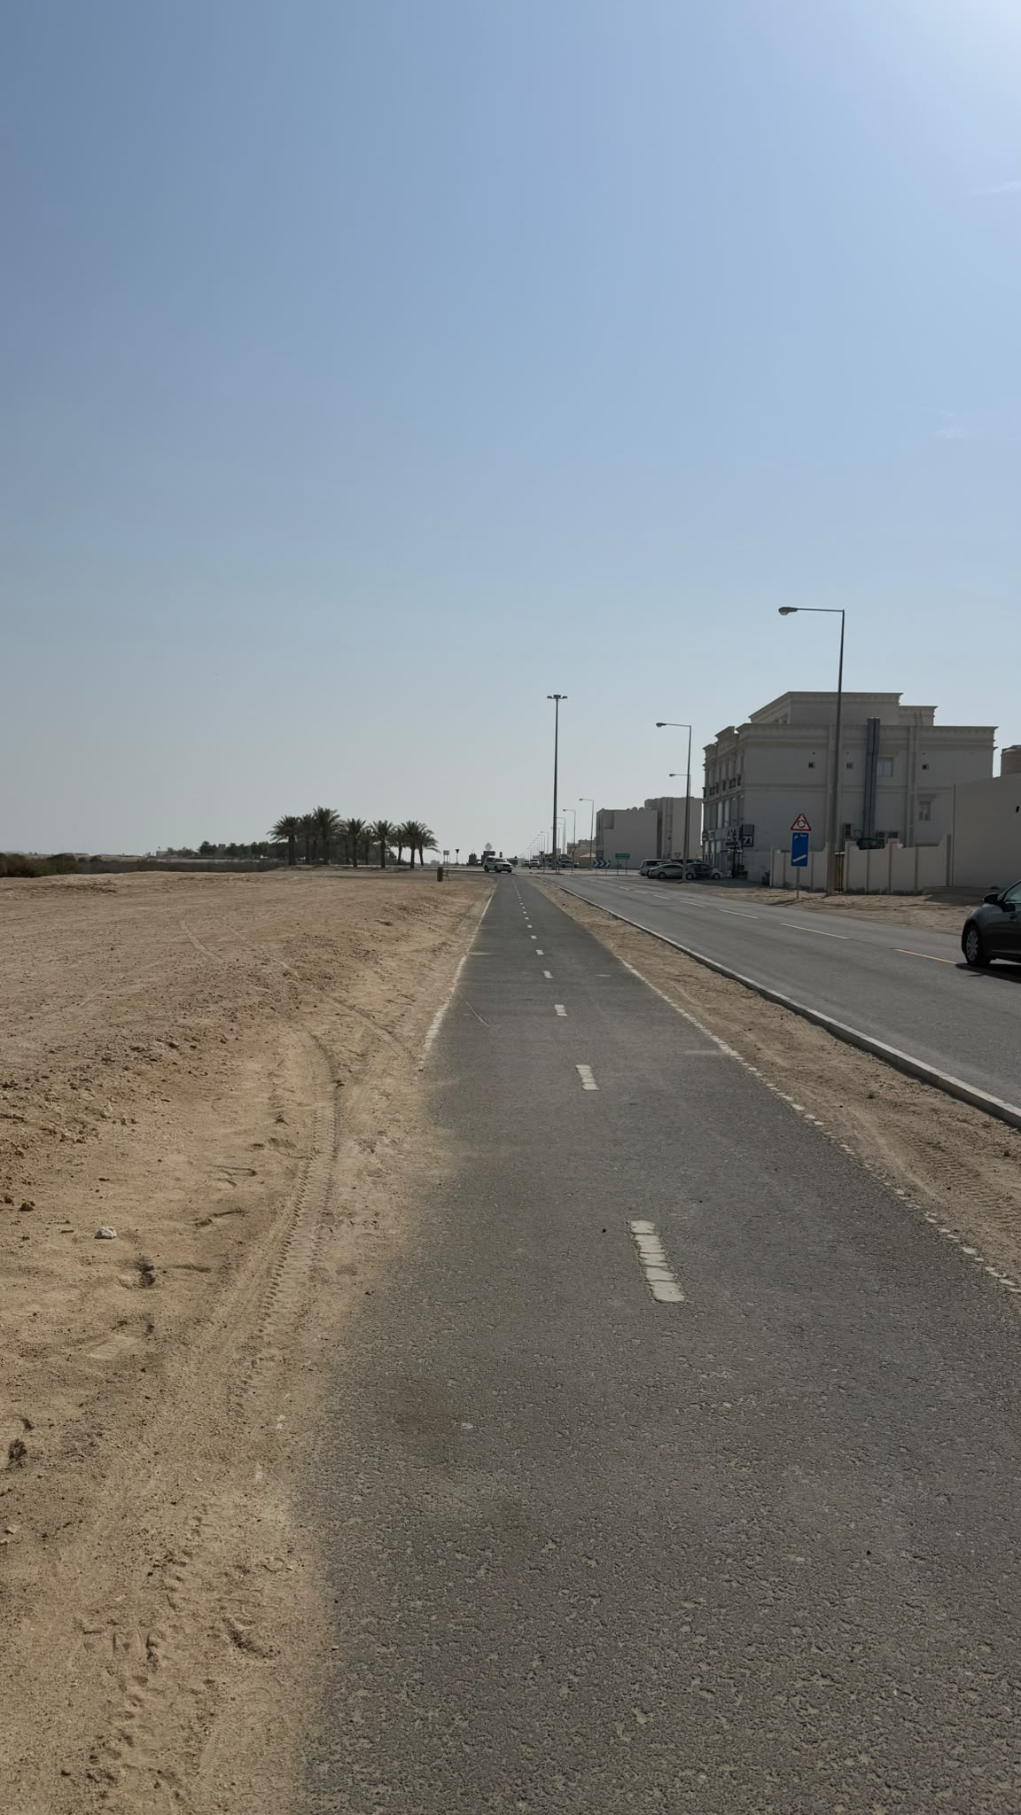
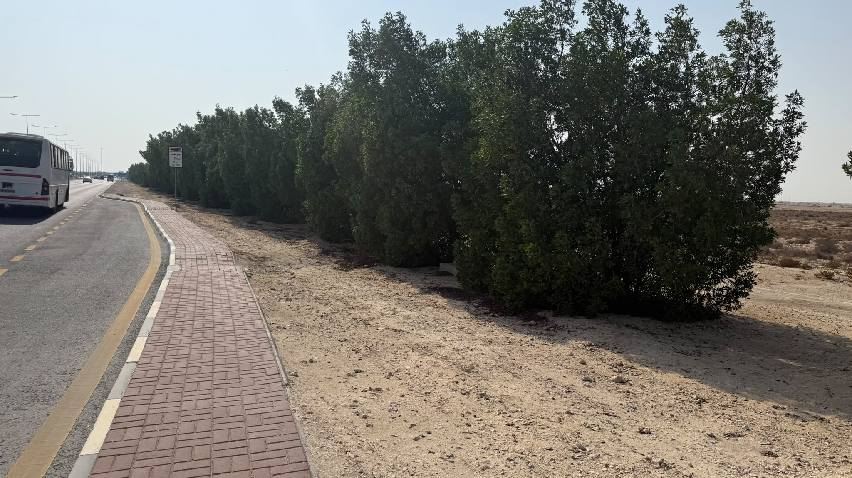
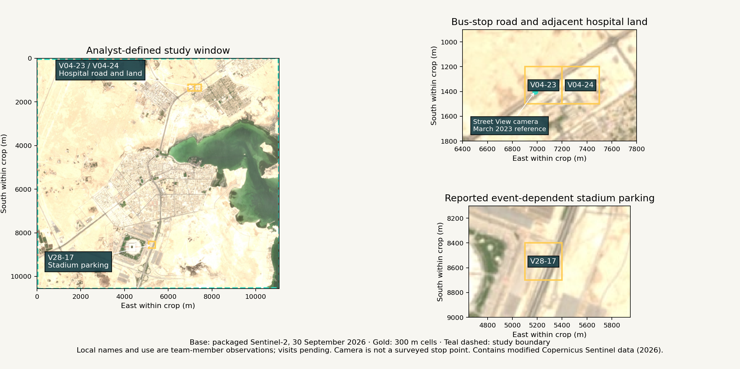
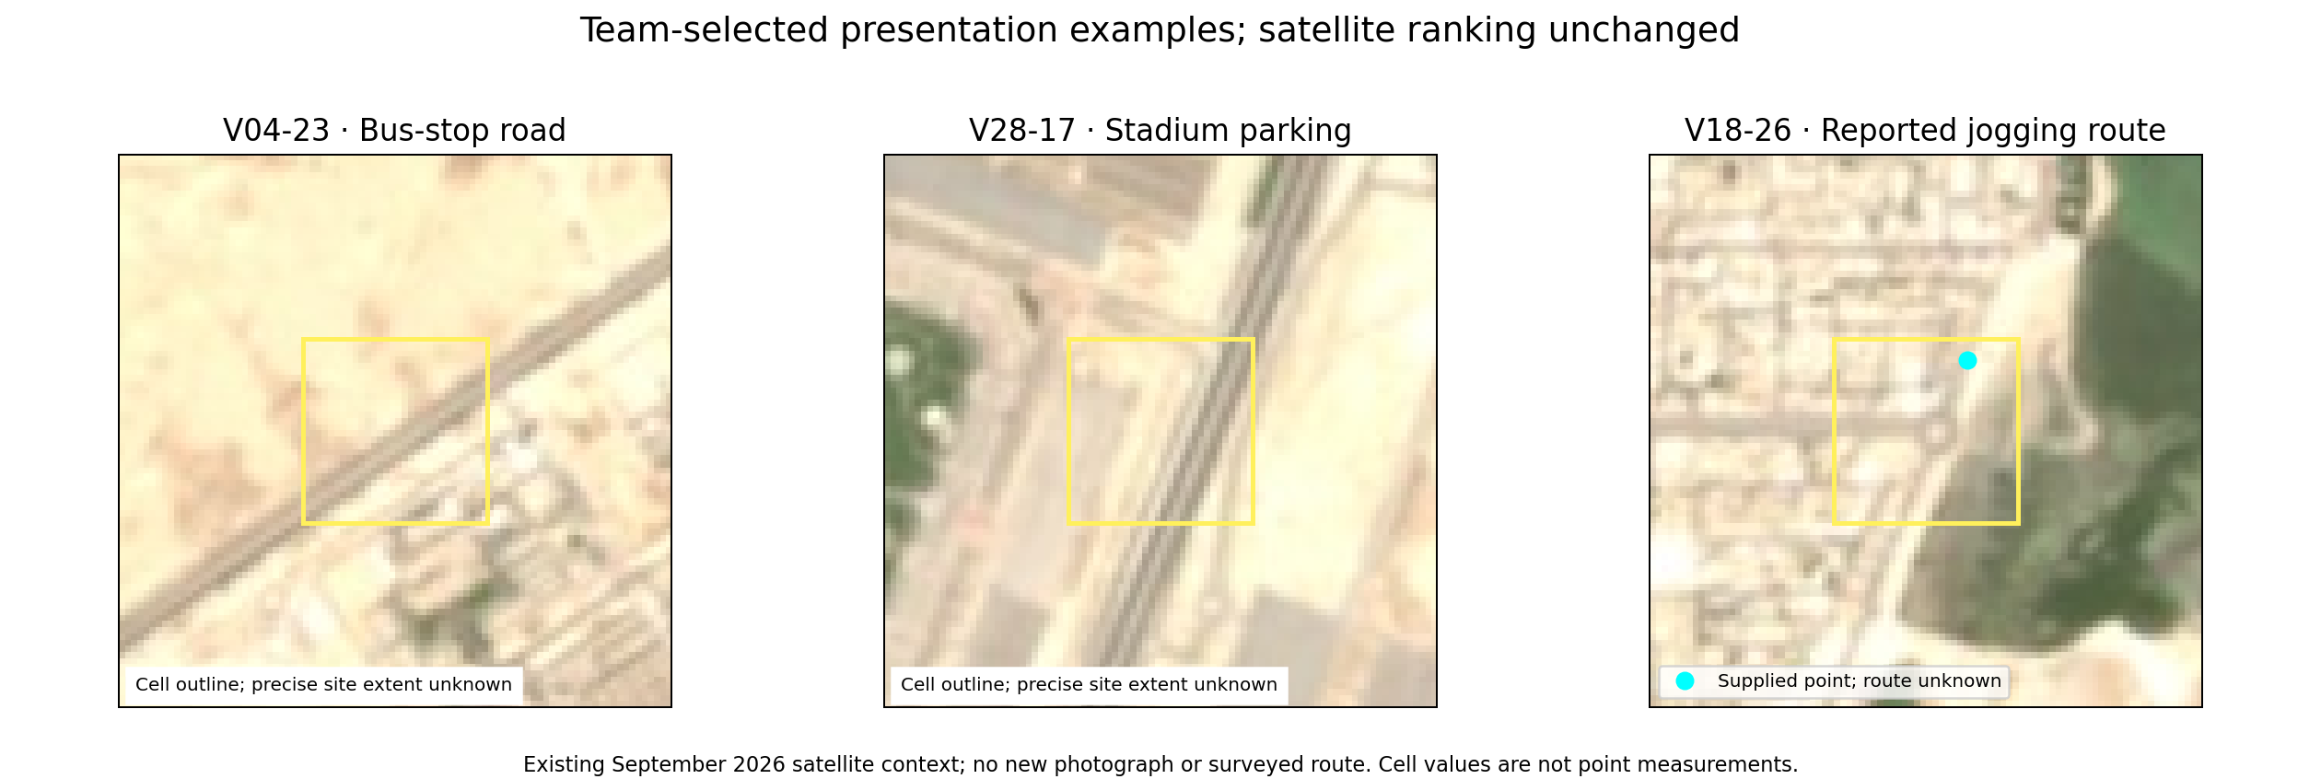
Al Khor presentation examples
V04-23 | Bus-stop road
V28-17 | Stadium parking
V18-26 | Jogging route
Trees and stop sign; no shelter visible.
Stadium and parking; use unmeasured.
Marked path beside road and sandy ground.
8 October 2026 | 13:00–14:00 Qatar (UTC+3) | Shared capture window
Photographer: Abdulrahman Almohannadi | Confirmed by Nasser, not EXIF | Exact per-file time: Unknown
Team-selected examples; all 1,111 observed cells and 373 candidates remain. The satellite top three are unchanged.
Notes:
Source: results/local-review-map.png, packaged Sentinel-2 RGB 30 September 2026, app/local-review.json, aoi.geojson and unchanged planning-cells.geojson. Labels identify the full 300 m polygons. Teal dashed line is the analyst-defined study boundary. Local location names and uses are from Abdulrahman; Nasser confirms site visits and unchanged physical conditions relative to September 2026; exact visit dates unspecified, detailed assessment pending. V04-23 and V04-24 are adjacent; a nearby farmers market has not been assigned to a cell. Street View marker is the historical camera, not an exact stop point. Contains modified Copernicus Sentinel data (2026).

Slide 7
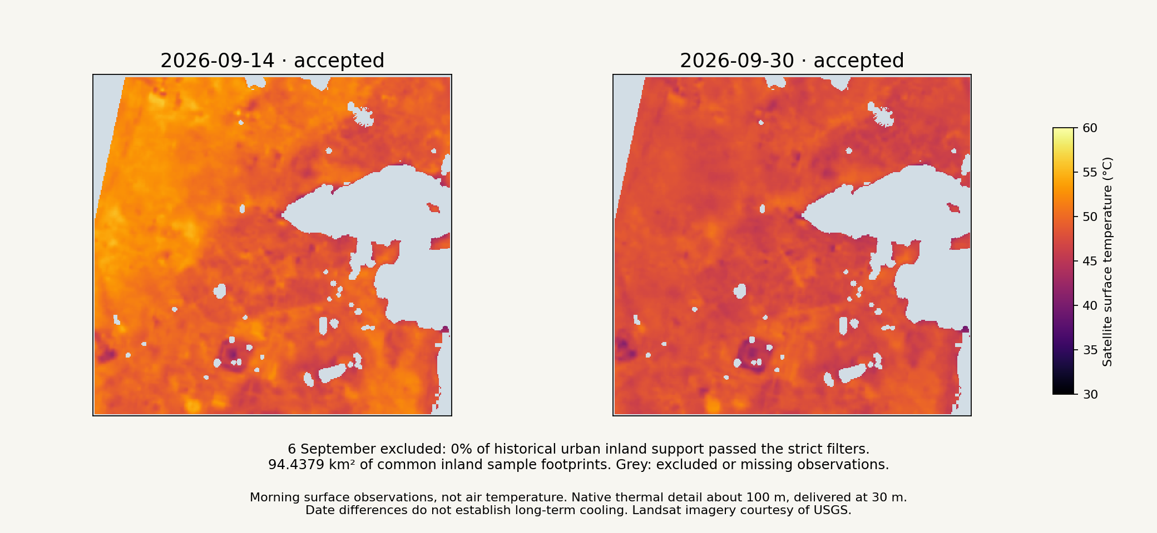
Matched surface-temperature observations
94.4379 km² of common inland sample footprints across the broad study window.
Notes:
Source: results/multidate-temperature.png and coastal-multidate-summary.json. The two accepted dates share screened support. Footprint is observed sample area, not total built-up city area. Surface temperature is not air temperature or heat-health risk. Updated display uses the two unchanged common-temp rasters with a common 30–60 °C scale. The rejected 6 September date is explained in text instead of an empty map; its exclusion record is preserved.

Slide 8
Three examples for site investigation
Case study | Surface °C* | Green %* | Buildings % | Rank range
V04-23 | 50.4 | 0.0 | 2.3 | 1-14
V28-17 | 50.0 | 0.0 | 0.1 | 1-23
V18-26 | 47.47 | 0.0386 | 0.0 | 203–336
Bus stop: waiting-area shade. Stadium: event use. Jogging route: reported lack of path shade. Photos received; use and detailed shade unmeasured.
Team-selected examples, not the top three ranks. V18-26 ranks 275/373; hospital land stays in the full results. Visits do not measure use or shade.
*Means of date-level cell summaries. V18-26: 48.02/46.92°C; 72% coverage. Scenario ranges are not confidence intervals.
Notes:
Source: results/planning-summary.json, planning-sensitivity.csv and README section 8. Green-pixel share is thresholded NDVI, not subpixel vegetation fraction. Building coverage is contributed and incomplete. Candidate retained sample footprint totals 31.8195 km². Local observations: docs/Local-Review.md; Nasser confirms site visits; detailed assessment pending. V04-23 maxima are 0.26262 and 0.24985; matched-support shares at diagnostic threshold 0.20 are 2.7222% and 0.3889%. Nasser confirms roadside trees and unchanged physical conditions relative to September 2026 from site visits; exact visit dates were not supplied. This does not validate the optical threshold or vegetation health. Scenario ranks remain unchanged; no unique certified intervention site. The fixed score weights remain 50% heat, 30% inverse green, 20% mapped buildings.

Slide 9
Reproducibility and reference checks
The package includes 35 hashed input files, source metadata and pinned Python 3.12 dependencies.
Clean GitHub execution passed through a normal Jupyter kernel: five cells, zero errors and all 35 input hashes verified.
NDVI >=0.30 at 24/25 grass references and 0/30 building references. All 30 coastal references are excluded from retained thermal support.
Contributed reference labels have conflicts. Human confirmation and independent thermal validation remain pending.
Notes:
Source: README sections 6 and 8, reference-samples.csv, notebook-verification.json when available. 20/30 coastal references agree with the spectral/QA screen. All 30 OSM water-polygon references disagree, with some contributed polygons spanning dry land. These positive-only agreement tests do not establish overall accuracy. Reproducibility does not establish scientific accuracy. Normal-kernel verification: Repository URL to be supplied separately Source commit 9781b95a46d86eb858ae9714ee53198ad22cfb6c. The executed notebook was retrieved from artifact 11328001190. All seven regenerated CSV tables match the supplied baseline byte for byte. These are rule-agreement checks on contributed positive reference points, not overall accuracy. The separate local pixel audit reproduces the baseline V04-23 result; it is not independent thermal or vegetation calibration.

Slide 10
Potential impact and incubation next steps
Completed: satellite screening, sensitivity checks, local examples and preliminary review of 18 sites across four dates.
Proposed pilot: planner feedback and field shade/use/access checks; evaluate shortlist usefulness and feasibility.
Limited Dynamic World experiment: common coverage 30.94% (50% gate). Independent scientific validation pending; 2023 deferred.
The current PoC does not measure urban expansion, health risk, causal cooling or long-term warming.
Notes:
Proposed next-stage activities, not completed work. See README sections 1, 2 and 8. A planner partnership, field validation and suitable imagery are dependencies; no partner agreement or funded incubation is claimed. No additional thermal date or historical change measurement was added in this local-review revision.

Slide 11
Team responsibilities
Nasser Alhuri: team coordination, site-visit confirmation and submission.
Abdulrahman Almohannadi: supplied 11 photos + one video; project review remains pending.
Mohammed Almarri: rehearse the live pitch (up to 10 min) and 5 min Q&A.
Majed Alkuwari: review slides and explain the limitations.
Ali Alkubaisi: rehearse the offline demo and prepare five-minute judge Q&A.
Photographed-site visits and supplied media collection confirmed by Nasser. Detailed assessment, member reviews and rehearsals remain pending.
Notes:
Nasser selected responsibilities on 5 October 2026. Abdulrahman supplied the observations in the teammate notes, recorded 6 October 2026. Nasser reports visiting the sites and confirms the described physical situation is the same as in September 2026. Exact visit dates were not supplied; detailed measurements remain pending. Other members retain the assigned responsibilities, without claimed completion. Repository visibility verified public; submission requires final approval.

Slide 12
Data attribution and sources
Actual sources: Copernicus Sentinel, Landsat (USGS), WorldCover 2021, OSM; separate experimental Dynamic World exports (2021, 2026).
Credits: modified Copernicus Sentinel data (2026); Landsat courtesy USGS; WorldCover CC BY 4.0; OSM ODbL.
Dynamic World, CC BY 4.0: This dataset is produced for the Dynamic World Project by Google in partnership with National Geographic Society and the World Resources Institute.
Field photos: Abdulrahman Almohannadi, 8 October 2026, shared 13:00–14:00 Qatar (UTC+3) window. Confirmed by Nasser, not EXIF; exact per-file times Unknown.
Modified Copernicus Sentinel data (2021, 2026). Full sources, licences and experimental limits accompany the package. Code: MIT.
Notes:
Sources: README sections 3 and 10, DATA-LICENSES.md, scene.json, landsat-scene.json and metadata. These are dataset attributions, not claims of field validation. Instructor recommended Copernicus Browser (https://browser.dataspace.copernicus.eu/ ; official documentation checked: https://documentation.dataspace.copernicus.eu/Applications/Browser.html), NASA Earthdata supplied dashboard link (https://earthdata.nasa.gov/dashboard ; exact destination unconfirmed), Bellingcat geolocation toolkit (https://bellingcat.gitbook.io/toolkit/categories/geolocation ; checked). NASA Worldview was an additional suggestion, not the instructor exact link. No data provenance was changed to these portals. Full supplied instructor links and verification status are in docs/Discovery-Resources.md. Earth Search remains optical download provenance and Planetary Computer thermal provenance. WorldCover DOI and OSM licence above are retained. Street View reference is linked, capture March 2023; no Google imagery redistributed.

