Slide 1

information about used cars
Prepared by: Nasser Rashed Al-Quraini

Slide 2
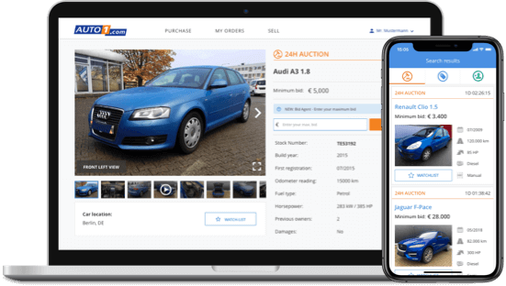
Abstract
object
Questions about the data
Design
Challenges in the project
Algorithms
Tools

Slide 3
Description
This dataset contains information about used cars.
This data can be used for a lot of purposes such as price prediction to exemplify the use of linear regression in Machine Learning The columns in the given dataset are as follows :
Mileage
Engine
max_power
torque
Seats
name
Year
selling_price
km_driven
Fuel
seller_type
Transmission
Owner

Slide 4
Design
1-What are the most popular cars on the market, Diesel or Petrol?
2-What kind of car is the highest offer for sale?
3-What are the most popular cars, Manual or Automatic?
4-What types of cars can carry the largest number of passengers?
5-The car with the most kilometers?

Slide 5
Challenges in the project
The data was selected from https://www.kaggle.com/nehalbirla/vehicle-dataset-from-cardekho? At first I reviewed the data and cleaned the data, then I found about 250 Nulls and I projected it because it would not have a significant impact on the data. Then I projected a column because I did not see it useful and there is a column with the same meaning. Then I answered the first question and made an illustration for it And on this to the last questions, I modified the title of the drawing, the type of font and the color…

Slide 6
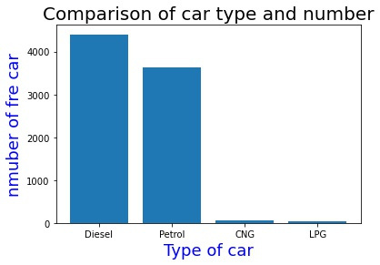
1-What are the most popular cars on the market ?
as in the figure
Diesel is the most common
car, I think because it is cheaper
than others, and this gives an
indication that diesel cars are better for sal

Slide 7
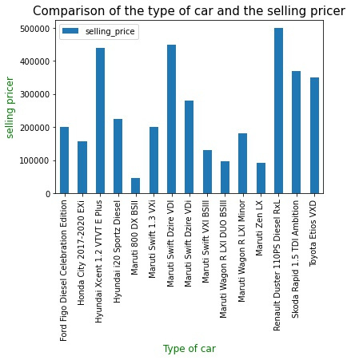
2-What kind of car is the highest offer for sale?
The Renault Duster 110PS Diesel RxL car is the most expensive offered for sale, as in the figure, at a value of
$500,000 , and it is a diesel type, and this is inferred from the previous question

Slide 8
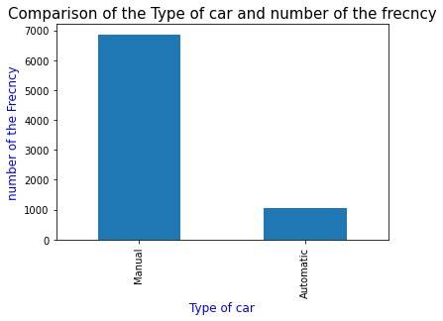
3-What are the most popular cars, Manual or Automatic?
The data shows that people prefer the manual car, and it is possible that the reason is due to the determination of the manual car and the pleasure in driving, and this increases the customer's desire for it.

Slide 9
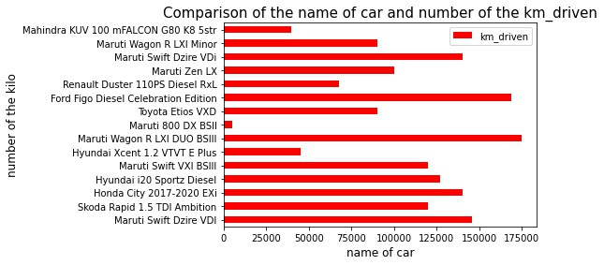
4-What types of cars can carry the largest number of passengers?
The figure shows the number of kilometers that the car traveled, the higher the number, the lower the value of the car

Slide 10
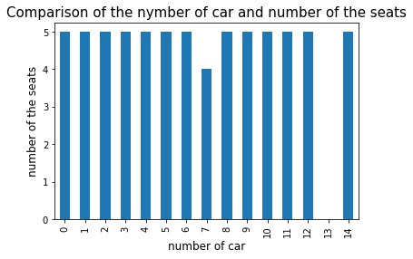
5-The car with the most kilometers?
Customers differ in their desire for the number of seats in the car, and as in the figure, the number of 5 seats is the most desired among customers, and we can consider it the best number among all

Slide 11
Tools
Pandas for data manipulation
Scikit-learn for modeling.
re for clean data.
Matplotlib for plotting.
streamlit for interactive visualizations.
powerpoint.

Slide 12
Thank You

