Slide 1
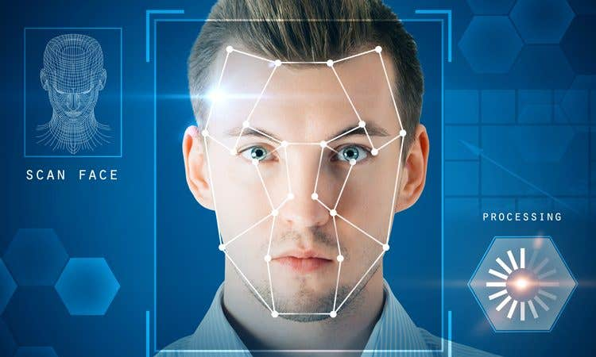
Face recognition with Keras

Slide 2
TABLE OF CONTENTS
*
*
*
Introduction
Design
*
CNN model
Exploration and Pre-processing
*
*
tools
conclusion

Slide 3
Introduction

Slide 4
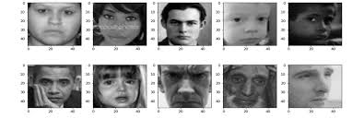
Introduction
In this study, face detection was performed from the images in the LFW data set.
Before face detection in LFW images, multiple face detection performed in single images.
Desired number of images are taken from the zip file in the LFW data set. Then the face detection was made from these images.

Slide 5

Design

Slide 6
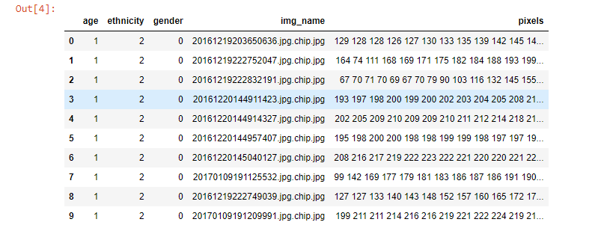
Dataset
Dataset source:
Size of Data:
Number of rows: 23705 Number of columns: 5
From Kaggle websit

Slide 7

Exploration and Pre-processing

Slide 8
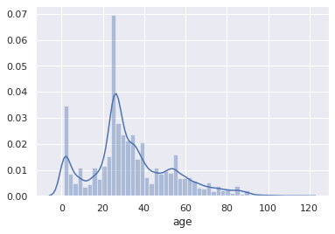
Age distribution

Slide 9
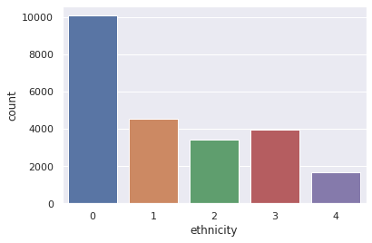
So, there are three targets:
Age: range from 1 to 116 Ethnicity: 0 - White, 1 - Black, 2 - Asian, 3 - Indian, 4 - Other Gender: 0 - male, 1 - female

Slide 10
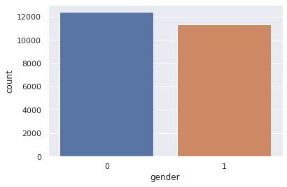

Slide 11
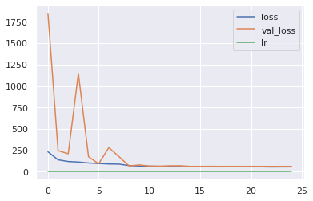

Slide 12
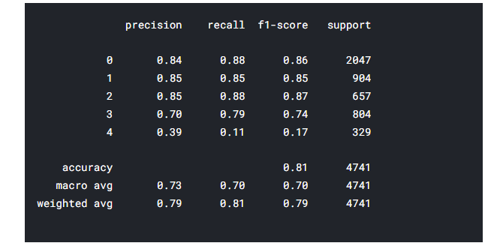
Model

Slide 13











TOOLS
Python
Github
Power Point
Zoom

Slide 14
conclusion

Slide 15
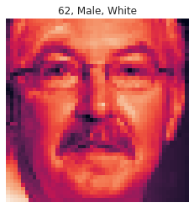
conclusion
This project presents a prediction of age, gender and ethnicity, where the images are categorized into a specific number based on the learning of the deities, this helps to strengthen future operations and studies.

Slide 16
THANKS!
Do you have any questions?
Nasser rashed Al-Quraini

