Slide 1
Tableau Dashboard Blueprint
Segment 2 Deliverable

Slide 2
Dashboard Overview Connect biometric and college data with the NBA stats that show the most prominent trends (Examples below)
Weight vs. NCAA ftpg
Draft age vs. NCAA games
Win Share/48 vs. NCAA ppg
College vs. position vs. NCAA_3ptapg
Agility vs. NCAA_3ptpct
Wing Span vs. NCAA_3ptpg

Slide 3
Description of tools and interactive elements NBA data Used to create final dashboard
NBA__3ptapg | NBA_ft_per_g | NCAA_fgpct
NBA__3ptpct | NBA_fta_p_g | NCAA_fgpg
NBA__3ptpg | NBA_g_played | NCAA_ft
NBA_efgpct | NBA_ppg | NCAA_ftapg
NBA_fg% | NCAA__3ptapg | NCAA_ftpg
NBA_fg_per_game | NCAA__3ptpct | NCAA_games
NBA_fga_per_game | NCAA__3ptpg | NCAA_ppg
NBA_ft% | NCAA_fgapg
Set of interactive elements #1: NBA stats
These interactive elements will be used to determine player NBA success and
Tools: Tableau worksheets, combined dashboard, and final presentation in stories. In addition, setting our data in correct data panes as measures vs. dimensions.

Slide 4
Description of tools and interactive elements College and Biometric data to create final dashboard
Height_in_feet | weight | WingSpan
college | Years_played | Standing_vert
height | Draft_age | Max_vertical
position | WinShare/48 | Agility
Set of interactive elements #2: College and biometric data
These elements will be used against the NBA stats to determine and visualize trends
Tools: Tableau worksheets, combined dashboard, and final presentation in stories. In addition, setting our data in correct data panes as measures vs. dimensions.

Slide 5
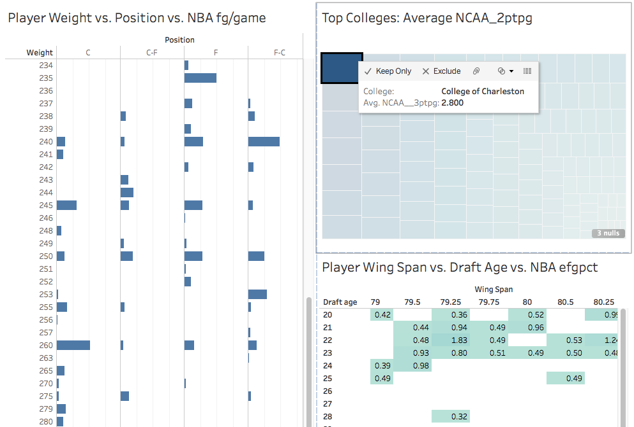
Dashboard draft Display the most prominent trends between interactive elements: NBA stats & college/biometric data
Graphs will be generated using Marks, Filters, and Analytics functions of Tableau.
Next step: Determine top 4-6 most evident trends of NBA success from biometric/college data (slide 2)
Select graphs that demonstrate combinations of biometric and college data consistent with a trend for a particular NBA stat.

