Slide 1
MULTI-AGENT ANALYTICS SYSTEM
Optimizing Operations with High-Fidelity Weather Intelligence
EXECUTIVE DECISION DECK
Analysis for Business Decision-Makers
June 26, 2026

Slide 2
Foundation: A Complete, High-Quality Dataset Spanning 17 Years
148,320 hourly records provide a robust, clean basis for modeling solar radiation and its key weather drivers.
148320
8
CLRSKY_SFC_SW_DWN
Rows
Columns
Target
What the data represents
Quality note
- weather
- Key fields include YEAR, MO, DY, HR, CLRSKY_SFC_SW_DWN, T2M, RH2M, WS10M
- Target field is CLRSKY_SFC_SW_DWN
- Dataset has 148,320 hourly weather records from 2007 to 2023 with no missing values or duplicates.
- Combine YEAR, MO, DY, HR into a single datetime column for time series analysis
- Investigate outliers in T2M and WS10M for data validity or extreme weather events
- YEAR, MO, DY, HR are discrete numeric columns representing date and time components...
Optimizing Operations with High-Fidelity Weather Intelligence
2 / 12

Slide 3
Market Context: Weather Data is a Critical Input for Energy, Agriculture, and Logistics
Short-range forecasting drives daily operations; solar radiation prediction is directly linked to renewable energy yield and outdoor activity scheduling.
- Short-range weather forecasting (1-3 days) holds a 34.24% market share in 2026 and is expected to depict the
- The short-range forecasting segment is anticipated to witness a significant CAGR of over 7% from 2026 to 2033
- Extreme weather is ranked among the top risks for global business in 2026, just behind geopolitical conflict, per
- Extreme weather events are pressing global risks that necessitate business strategies for climate volatility and...
Why it matters
Short-range forecasting drives daily operations; solar radiation prediction is directly linked to renewable energy yield and outdoor activity scheduling.
Optimizing Operations with High-Fidelity Weather Intelligence
3 / 12

Slide 4
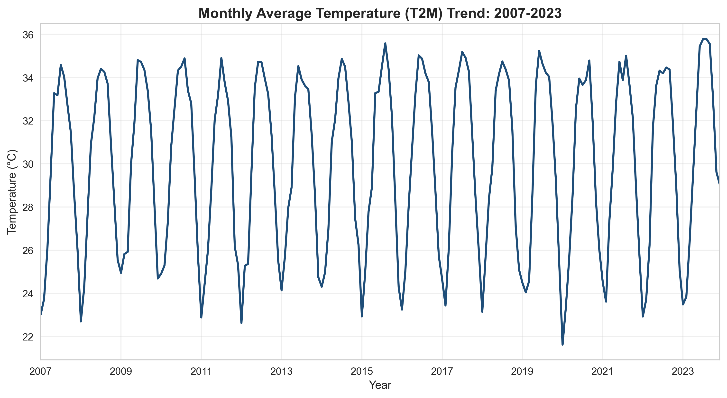
Monthly temperature shows warming trend from 2007-2023 with seasonal cycles
Insight
Monthly temperature shows warming trend from 2007-2023 with seasonal cycles.
- Monthly temperature shows warming trend from 2007-2023 with seasonal cycles
Optimizing Operations with High-Fidelity Weather Intelligence
4 / 12

Slide 5
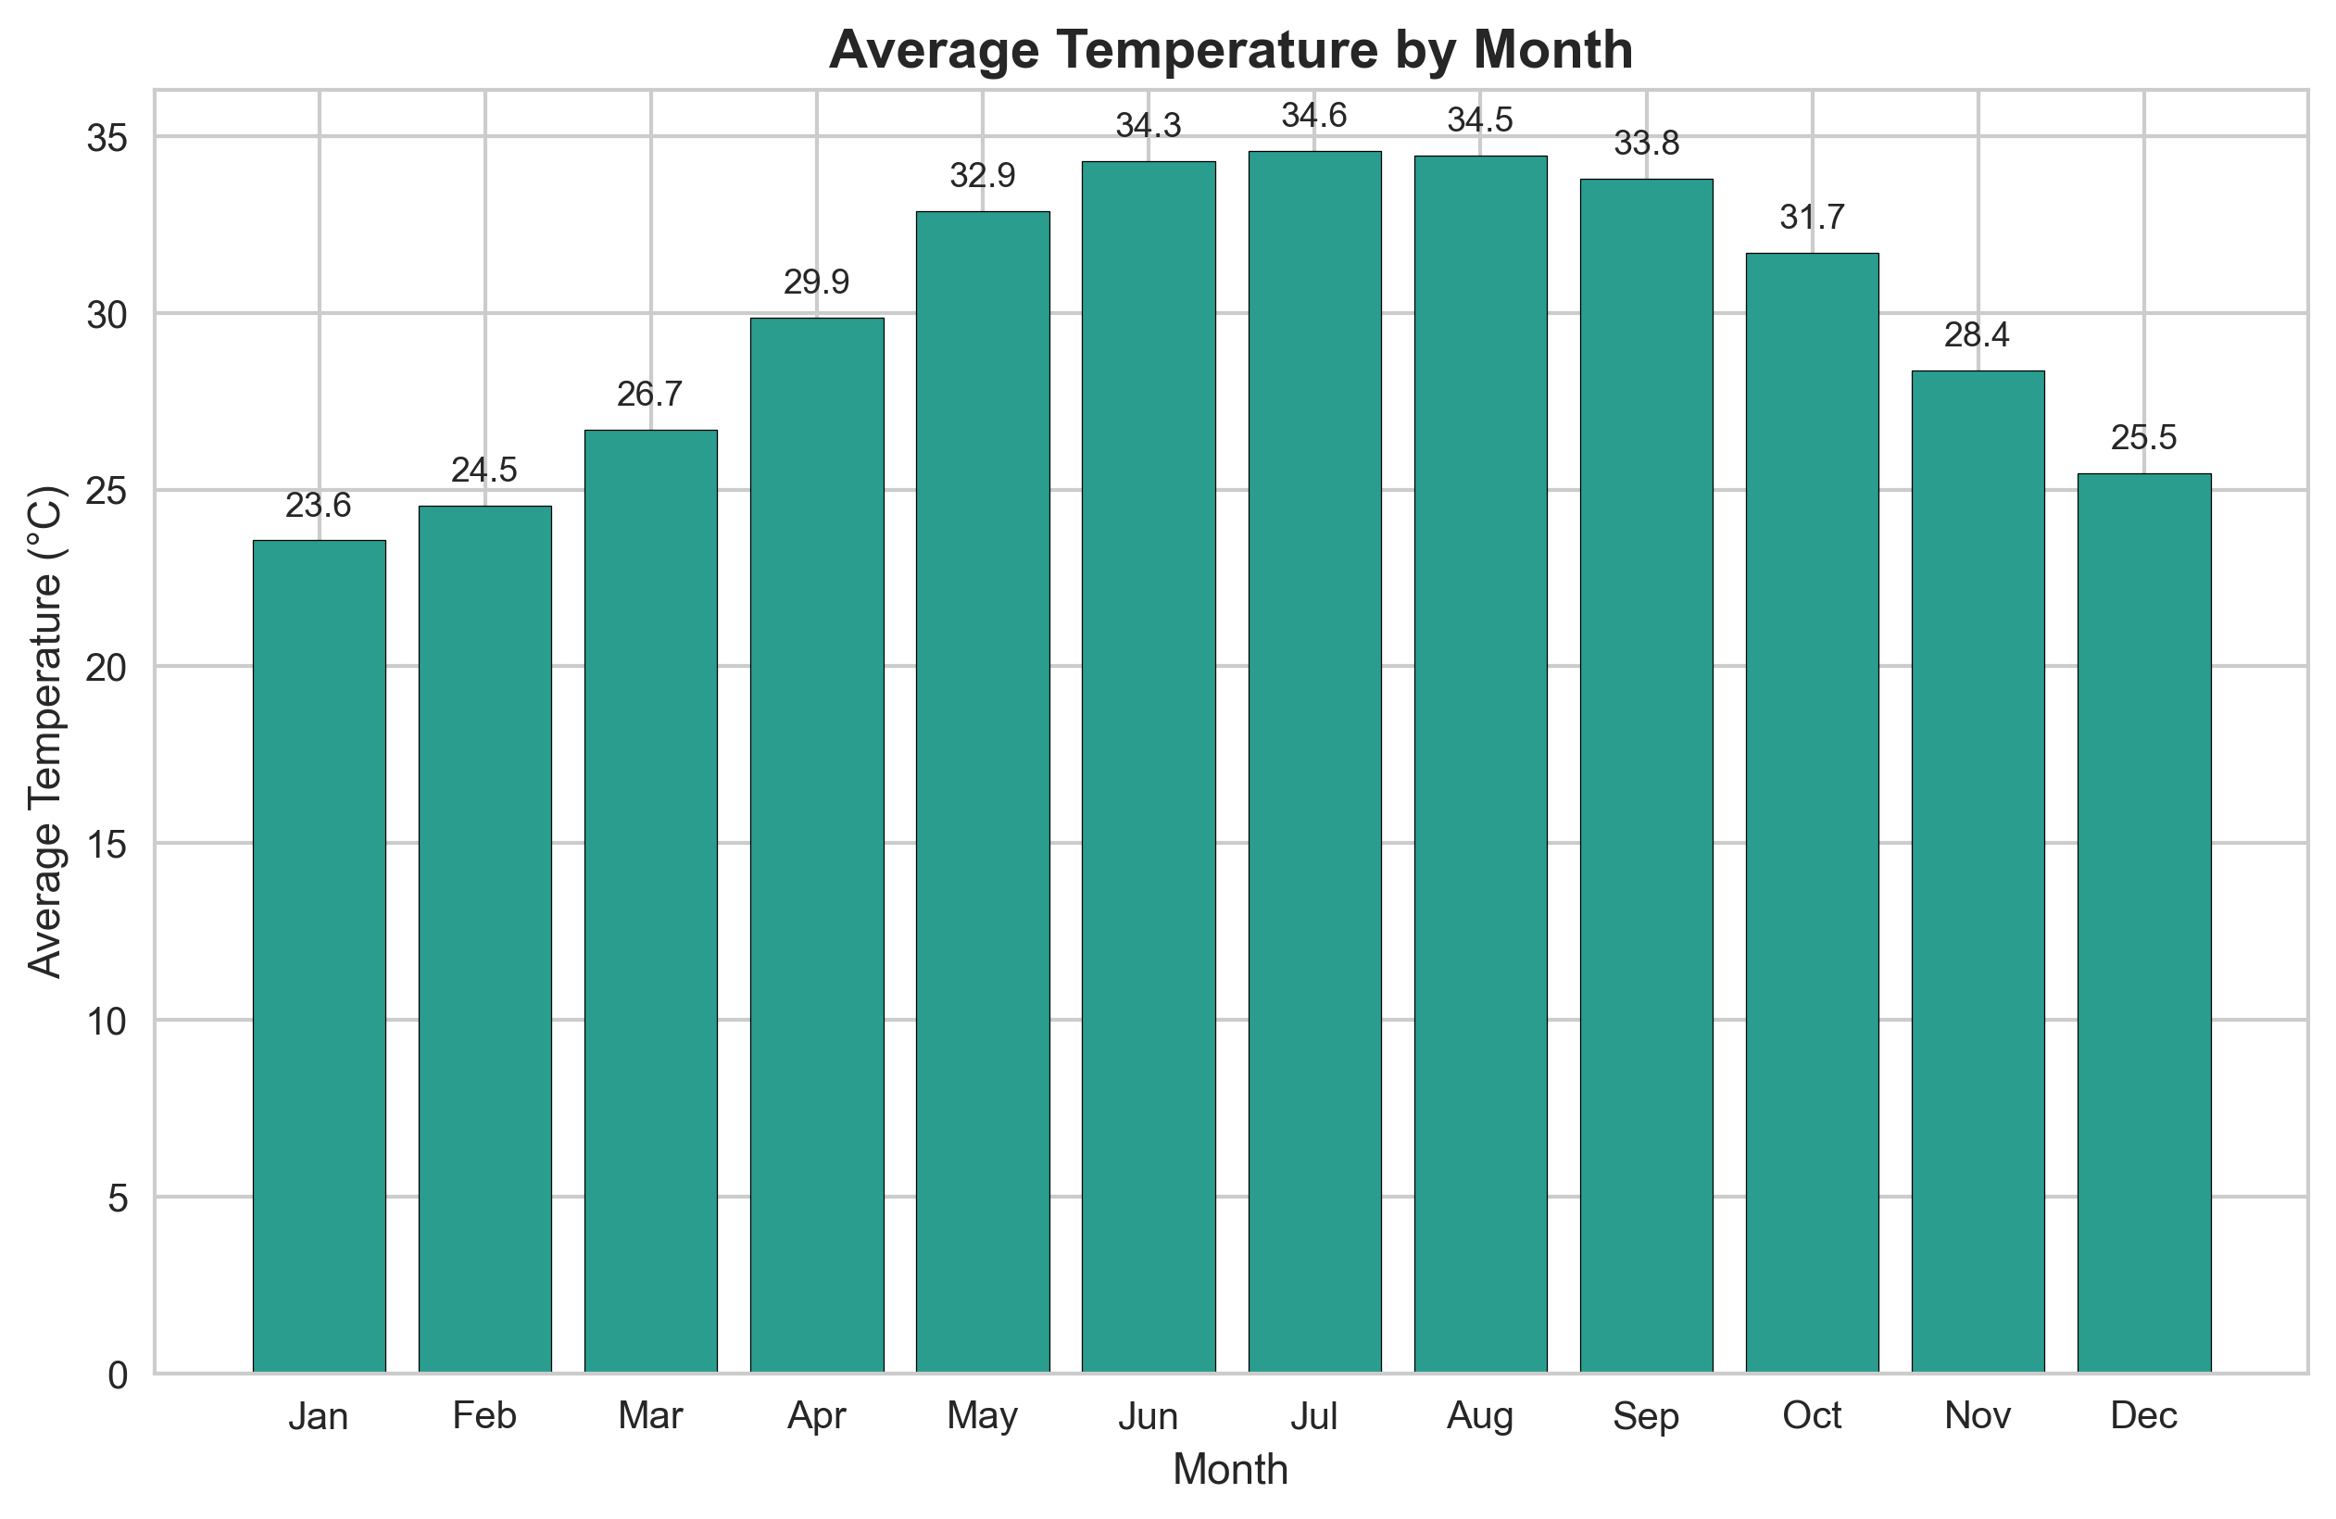
Clear seasonal pattern with peak temperatures in summer months (June-August)
Readout
Clear seasonal pattern with peak temperatures in summer months (June-August).
- Clear seasonal pattern with peak temperatures in summer months (June-August)
Optimizing Operations with High-Fidelity Weather Intelligence
5 / 12

Slide 6
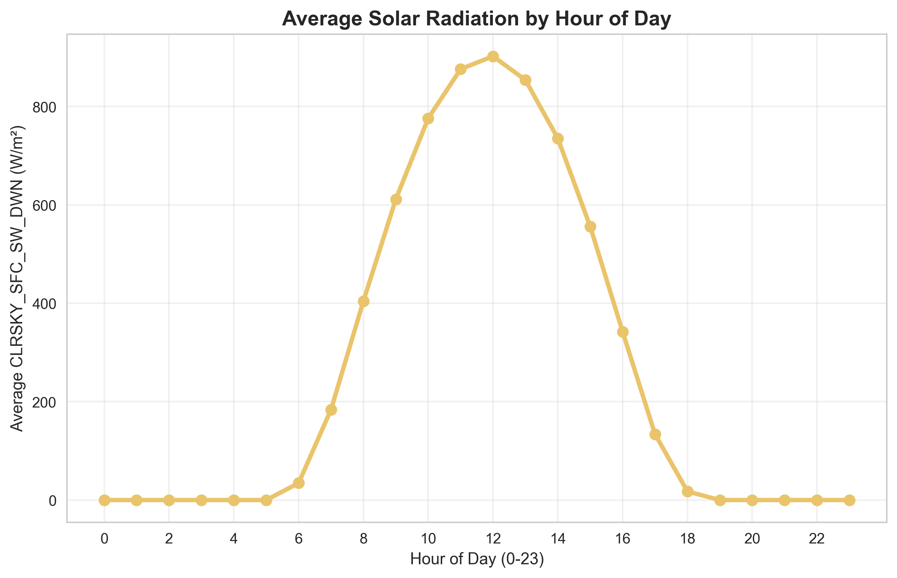
Solar radiation follows expected diurnal cycle, peaking at midday hours
Insight
Solar radiation follows expected diurnal cycle, peaking at midday hours.
- Solar radiation follows expected diurnal cycle, peaking at midday hours
Optimizing Operations with High-Fidelity Weather Intelligence
6 / 12

Slide 7
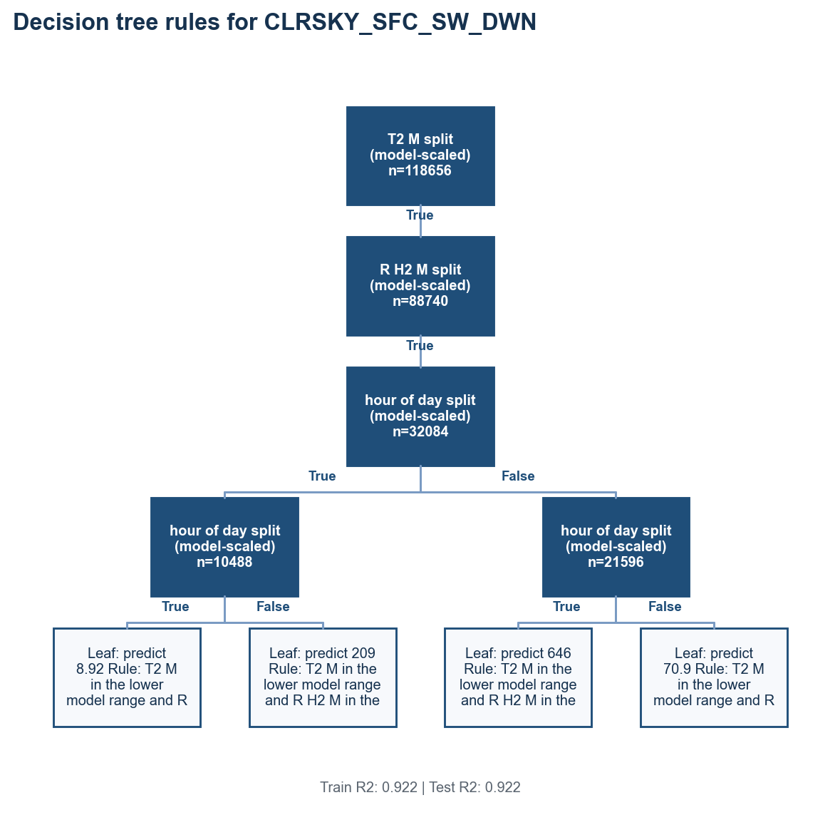
Exploratory tree splits on T2M, RH2M, and hour of day
Insight
Exploratory screening only: validate precision, recall, F1, and support before operational use.
- Exploratory tree splits on T2M, RH2M, and hour of day
- Exploratory screening only: validate precision, recall, F1, and support before operational use.
- Solar Radiation Prediction Rules
Train R2: 0.922 | Test R2: 0.922
Optimizing Operations with High-Fidelity Weather Intelligence
7 / 12

Slide 8
Decision tree rules summarize model logic
Exploratory screening only: validate precision, recall, F1, and support before operational use.
Finding 1
Finding 2
Decision tree rules summarize model logic
Exploratory screening only: validate precision, recall, F1, and support before operational use.
Optimizing Operations with High-Fidelity Weather Intelligence
8 / 12

Slide 9
Translate tree rules into intervention segments
Use model rules to define segments, channels, and monitoring criteria for validation.
Finding 4
Finding 5
Finding 6
Segment records by model-extracted rule fields: T2M, RH2M, hour of day
Use owner review as the channel for high-risk rule segments
Monitor precision, recall, F1, and positive-class support before scaling
Optimizing Operations with High-Fidelity Weather Intelligence
9 / 12

Slide 10
Recommendations: Deploy Forecasting Tool and Rule-Based Scheduler
Prioritize implementing the high-accuracy model for solar energy and a simplified scheduler for outdoor operations
Priority 1
Priority 2
Priority 3
Action: Deploy the regression model for day-ahead solar radiation forecasting to
Action: Develop a simplified, rule-based scheduling tool for outdoor operations
Action: Initiate a data collection and model replication project for two adjacent
Track pilot outcome, adoption, guardrails, and stop/go criteria before scaling.
Track pilot outcome, adoption, guardrails, and stop/go criteria before scaling.
Owner: business
Validation required
Validation required
Validation required
Optimizing Operations with High-Fidelity Weather Intelligence
10 / 12

Slide 11
Limitations: Geographic Specificity and Clear-Sky Focus Require Managed Expansion
The model's high performance is tied to a single location and predicts ideal conditions, not actual weather
Limitation
Limitation
Exploratory screening only: validate precision, recall, F1, and support before operational use
The model is geographically specific to a single point (021d49N, 039d18E)
Limitation
Limitation
The model predicts clear-sky radiation (CLRSKY_SFC_SW_DWN), not actual radiation under cloudy conditions
The dataset ends in December 2023. Future climate trends or anomalies may alter underlying
Optimizing Operations with High-Fidelity Weather Intelligence
11 / 12

Slide 12
Summary: Actionable Weather Intelligence from a Robust, Interpretable Model
Implement the high-accuracy solar radiation forecast and rule-based scheduler to reduce uncertainty in energy and outdoor operations.
- Temperature shows clear warming trend and seasonal cycles over 17-year period
- Immediately deploy the high-accuracy solar radiation forecasting model for solar energy operations in the original
- The weather data analysis has delivered a robust, interpretable predictive model that directly addresses the need
Generated by the Multi-Agent Analytics System
12 / 12

