Slide 1
Using the Zomato Kaggle Dataset to evaluate the best location for fast food restaurants in Gurgaon
Nastaran Moghimi

Slide 2
Introduction
Gurgaon is a city just southwest of New Delhi in northern India. Gurgaon has become a leading financial and banking center in India after Mumbai and Chennai. The city's economic growth story started when the leading Indian automobile manufacturer Maruti Suzuki India Limited established a manufacturing plant in Gurgaon in the 1970s. Today, Gurgaon has local offices for more than 250 Fortune 500 companies. Gurgaon is categorized as very high on the Human Development Index, with an HDI of 0.889 (2017), which is also the highest in India.

Slide 3
Introduction
Also known as the ‘Millenium City of India’, Gurgaon is abundant with shopping malls, tech companies, and hotels, but the city’s street food scene is also impeccable. Given that Gurgaon is a city filled with tech companies and businessmen who are extremely busy throughout the day, we will be investigating the best neighborhoods for fast food restaurants in Gurgaon where businessmen can get their food on the go.

Slide 4
Objectives
Questions that can be answered upon the completion of this project
What is best location in Gurgaon for Fast Food ?
Which areas have large number of Fast Food restaurants ?
Which all areas have the least number of restaurants ?
What is the best place to stay if one prefers Fast Food ?
What places are have the best restaurant in Gurgaon?

Slide 5
Data
For this project we will use the following data :
- Data about Gurgaon restaurants which contains their locality, restaurant name, rating, latitude and longitude.
- The source for this data will be the Zomato Kaggle Dataset: "https://www.kaggle.com/shrutimehta/zomato-restaurants-data"
- Description : This data set contains the required information. Zomato API Analysis is one of the most useful analysis for foodies who want to taste the best cuisines of every part of the world.
- We also need to know the nearby places (restaurants) in each neighborhood of Gurgaon.
- Our data source for this is the Fousquare API : "https://developer.foursquare.com/"
- We will use this API to get all the venues in each neighborhood.

Slide 6
Approach
Collect the Gurgaon city data from the Zomato Kaggle Dataset
• Then, using the FourSquare API find all venues for each neighborhood.
• Filter out all venues that are nearby by locality.
• Using aggregative rating for each restaurant to find the best places.
• Visualize the ranking of neighborhoods using the folium library.

Slide 7
The Results

Slide 8
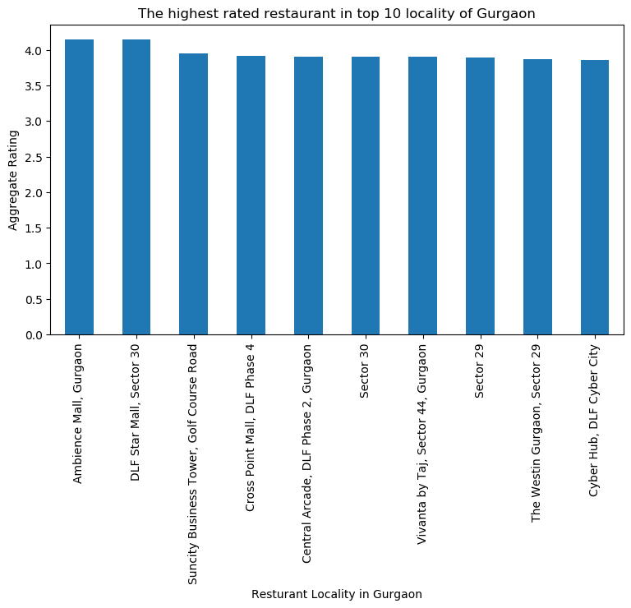

Slide 9
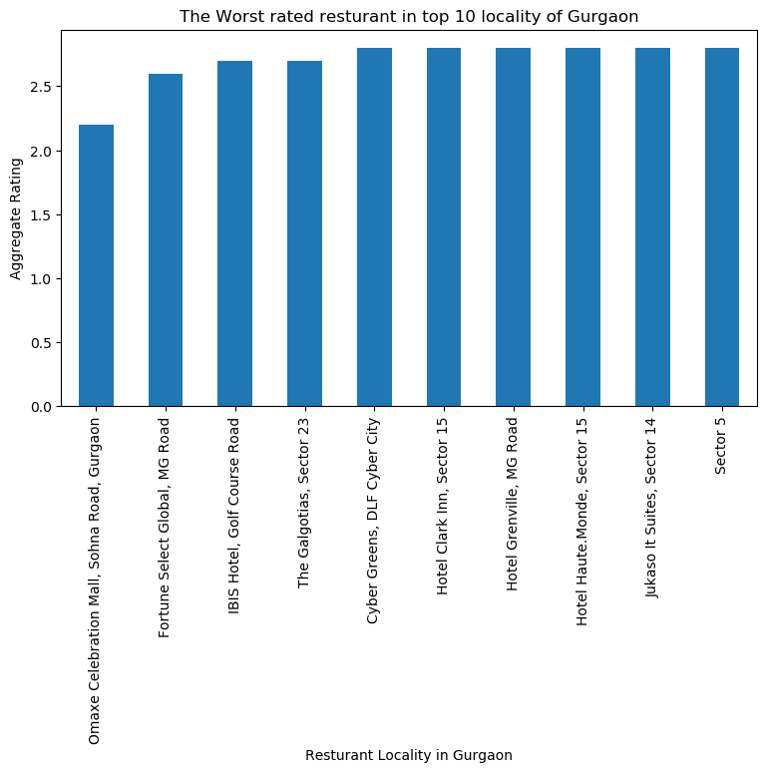

Slide 10
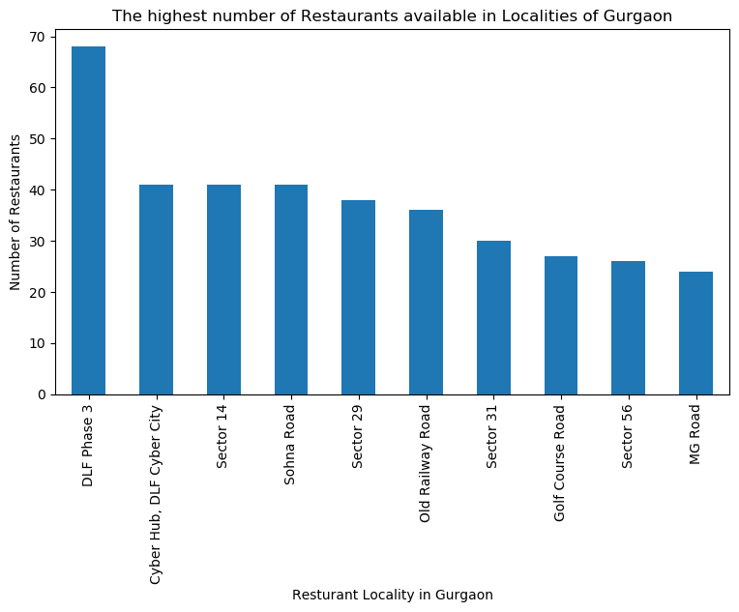

Slide 11
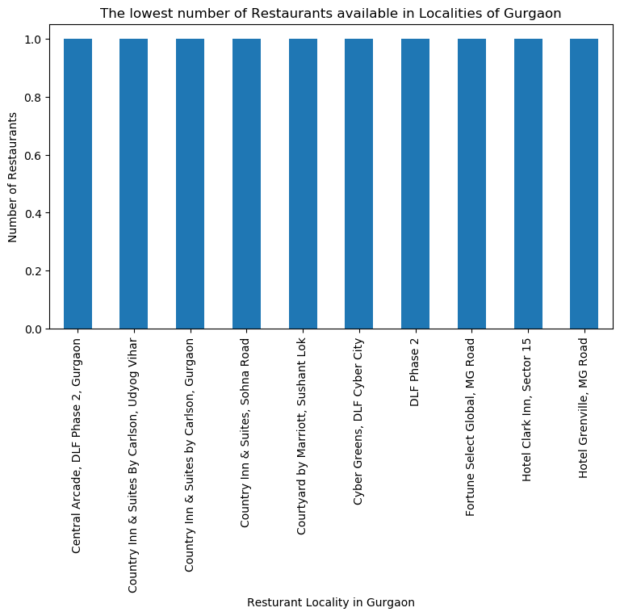

Slide 12
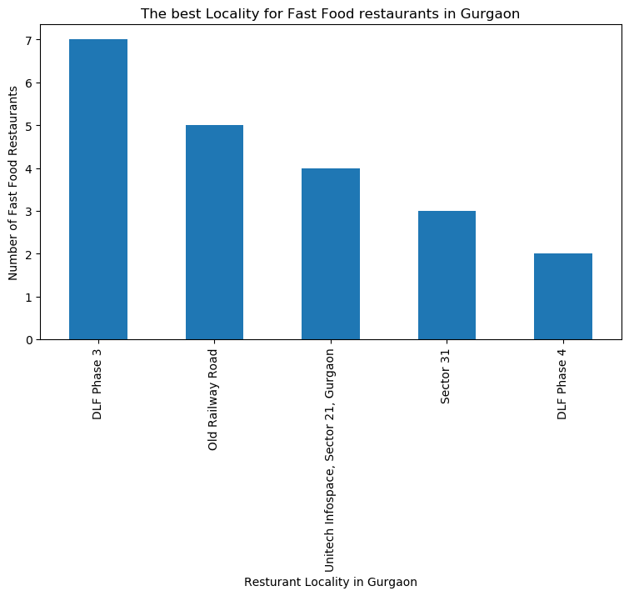

Slide 13
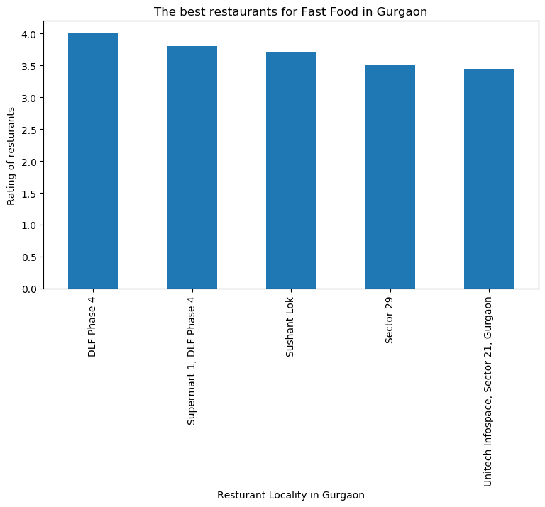

Slide 14
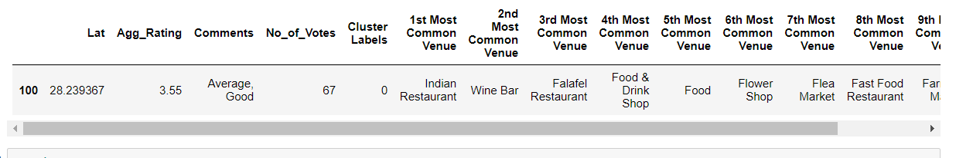
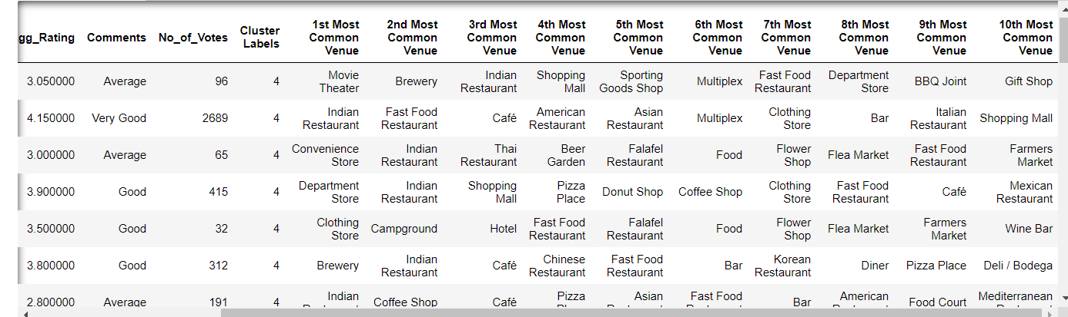
Cluster 1 and 5:

Slide 15
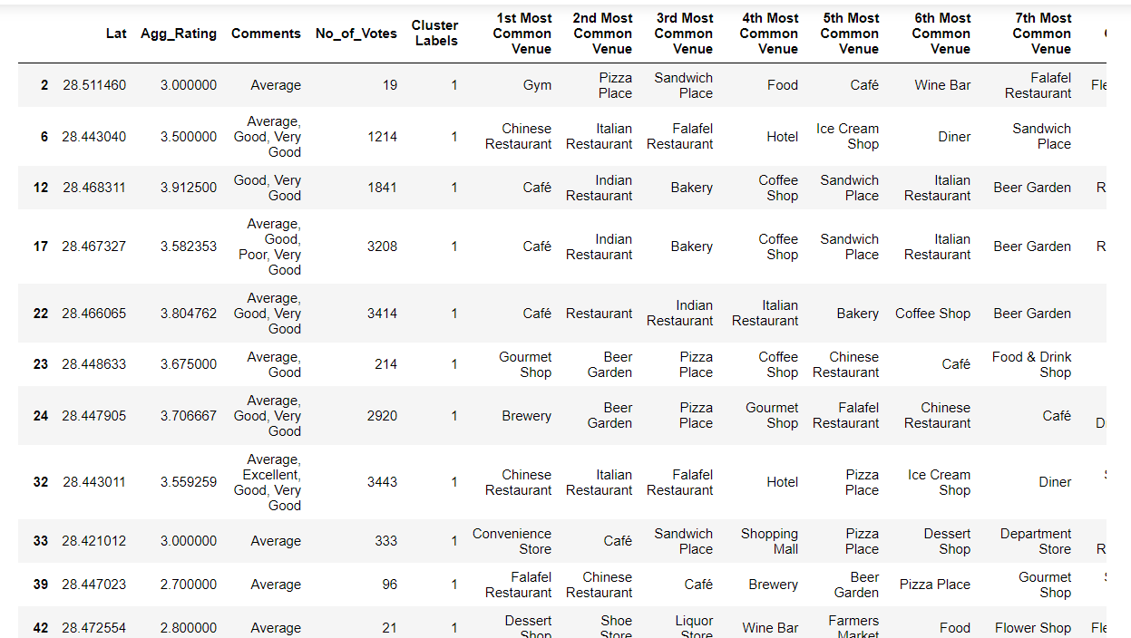
Cluster 2:
It is most recommended for cafes, pizza shops and fast food.

Slide 16
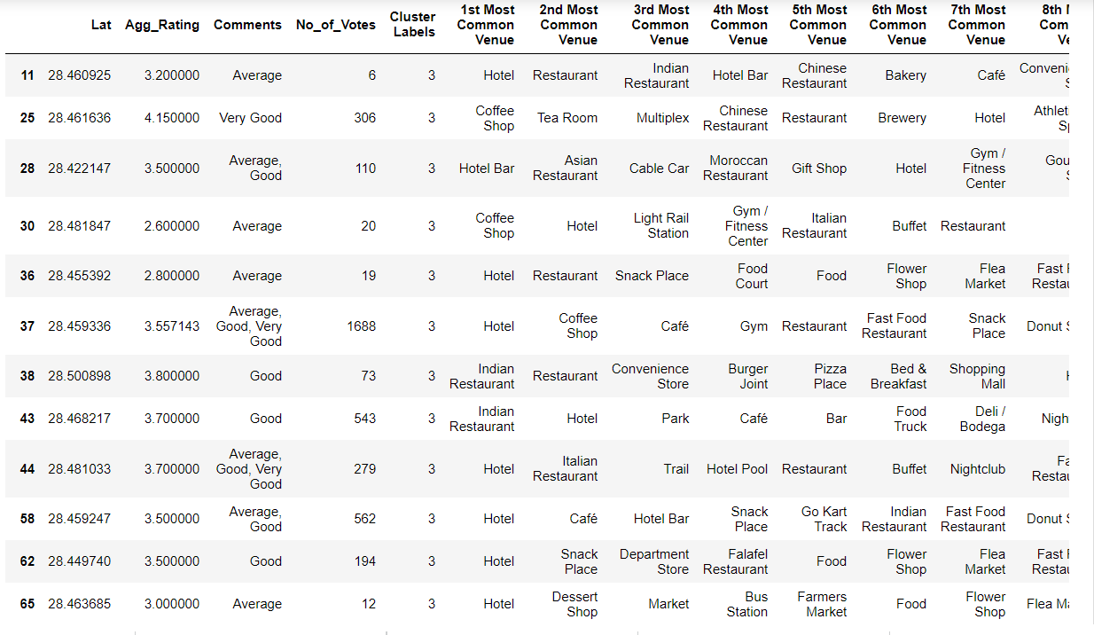
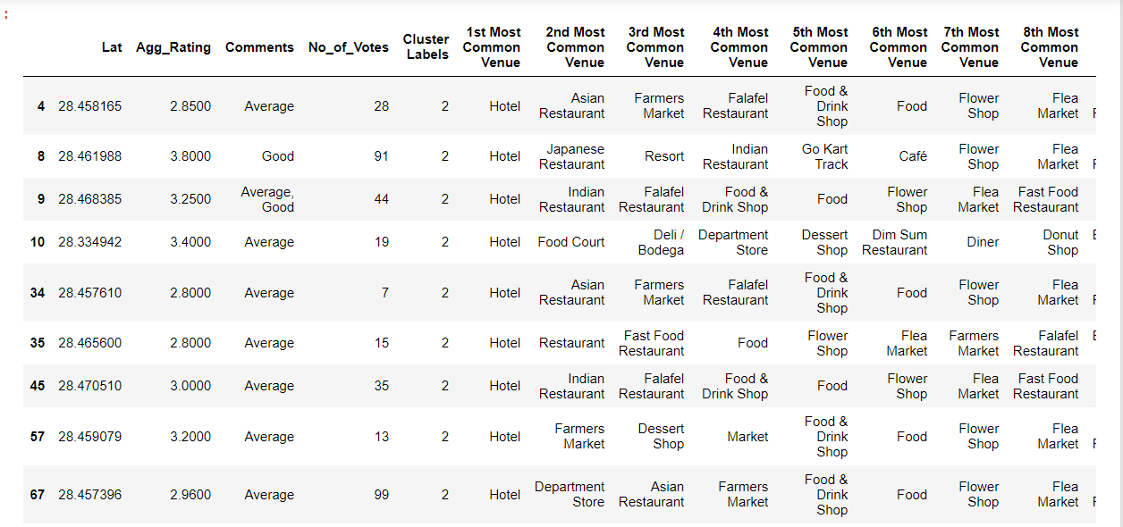
Cluster 3 and 4:
Most recommended for hotels

Slide 17
Conclusion
• DLF Phase 3 and Old Railway Road are the best localities for fast food. • DLF Phase 3 has the best fast food restaurant. • DLF Phase 3, Cyber Hub and Sector 14 has the highest number of restaurants and would be a good neighborhood for someone who likes to eat out. • The best restaurants are available in the Ambience Mall area in Gurgaon.

