Slide 1
Chapter 3: Processes

Slide 2
Chapter 3: Processes
Process Concept
  Process State
  Process Control Block (PCB)
  Threads
Process Scheduling
  Representation of Process Scheduling
  Context Switch
Operations on Processes
  Process Creation
  Process Termination
Interprocess Communication
  Producer-Consumer Problem
  Interprocess Communication – Message Passing
  Direct Communication
  Indirect Communication
Synchronization

Slide 3
Objectives
Identify the separate components of a process and illustrate how they are represented and scheduled in an operating system.
Describe how processes are created and terminated in an operating system, including developing programs using the appropriate system calls that perform these operations.
Describe and contrast interprocess communication using shared memory and message passing.
Design programs that uses pipes and POSIX shared memory to perform interprocess communication.
Describe client-server communication using sockets and remote procedure calls.
Design kernel modules that interact with the Linux operating system.

Slide 4
Process Concept
The OS (Operating System) runs many programs, and each running program becomes a process.
  A program = Passive (just a file on disk)
  A process = active (running in memory)
Process – a program in execution; process execution must progress in sequential fashion
Parts of a Process : A process is not just code — it has multiple components in memory
  The program code, also called text section
  Current activity including program counter, processor registers
    Program Counter (PC) :tells which instruction is executing right now
    Registers → small fast storage used by CPU
  Stack containing temporary data
    Function parameters, return addresses, local variables
  Data section containing global variables
    Variables that exist throughout the program
  Heap containing memory dynamically allocated during run time

Slide 5
Threads
A thread is: A smallest unit of execution inside a process
A process can have one or multiple threads
So far, process has a single thread of execution
Consider having multiple program counters per process
  Multiple locations can execute at once
    Multiple threads of control -> threads
Must then have storage for thread details, multiple program counters in PCB
Explore in detail in Chapter 4
Real-Life Example
Think of a web browser:
One process (Chrome)
Multiple threads:
    Load page
    Play video
    Handle user input
Concept | Description
Process | Big container
Thread | Execution unit inside process

Slide 6
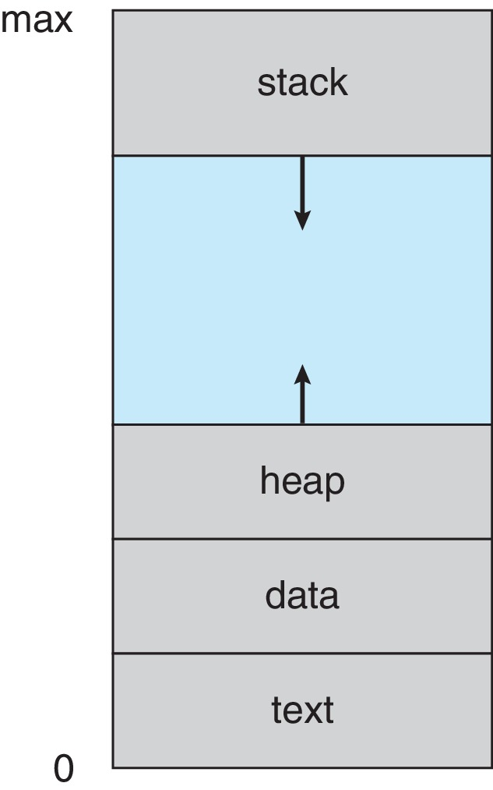
Process in Memory
HIGH ADDRESS (max)
-----------------
| STACK | ↓ grows down
| |
| Free space |
| |
| HEAP | ↑ grows up
| DATA |
| TEXT |
-----------------
LOW ADDRESS (0)

Slide 7

Process State
As a process executes, it changes state
  New: The process is being created
  Running: Instructions are being executed
  Waiting: The process is waiting for some event to occur
  Ready: The process is waiting to be assigned to a processor
  Terminated: The process has finished execution
It is important to realize that “Only one process (or thread) can run on a single CPU core at a time, but modern systems with multiple cores can run multiple processes in parallel.”. Many processes may be ready and waiting,

Slide 8
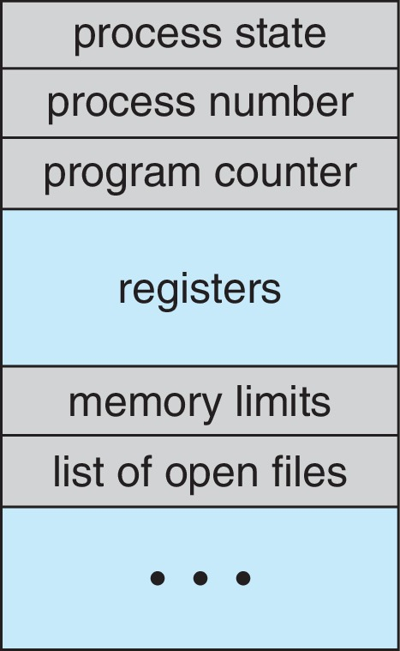
Process Control Block (PCB)
PCB : all information about a process, Stored in OS memory
Used for: Process management, Context switching
Information associated with each process (also called task control block)
Process state – running, waiting, etc
Program counter – location of instruction to next execute
CPU registers – contents of all process-centric registers
CPU scheduling information- priorities, scheduling queue pointers
Memory-management information – Memory assigned to process
Accounting information – CPU used, clock time elapsed since start, time limits
I/O status information – I/O devices allocated to process, list of open files

Slide 9
Process Scheduling
What is Process Scheduling?
  The way the Operating System chooses which process gets the CPU
  Maximize CPU use, quickly switch processes onto CPU core
Process scheduler selects among available processes for next execution on CPU core
Maintains scheduling queues of processes
The OS organizes processes into queues (lists)
Job Queue: As processes enter the system, they are put into a job queue, which consists of all processes in the system
  Ready queue – a set of all processes residing in main memory, ready and waiting to execute
  Wait queues – set of processes waiting for an event (i.e. I/O)
  Processes migrate among the various queues
    Processes move between queues

Slide 10
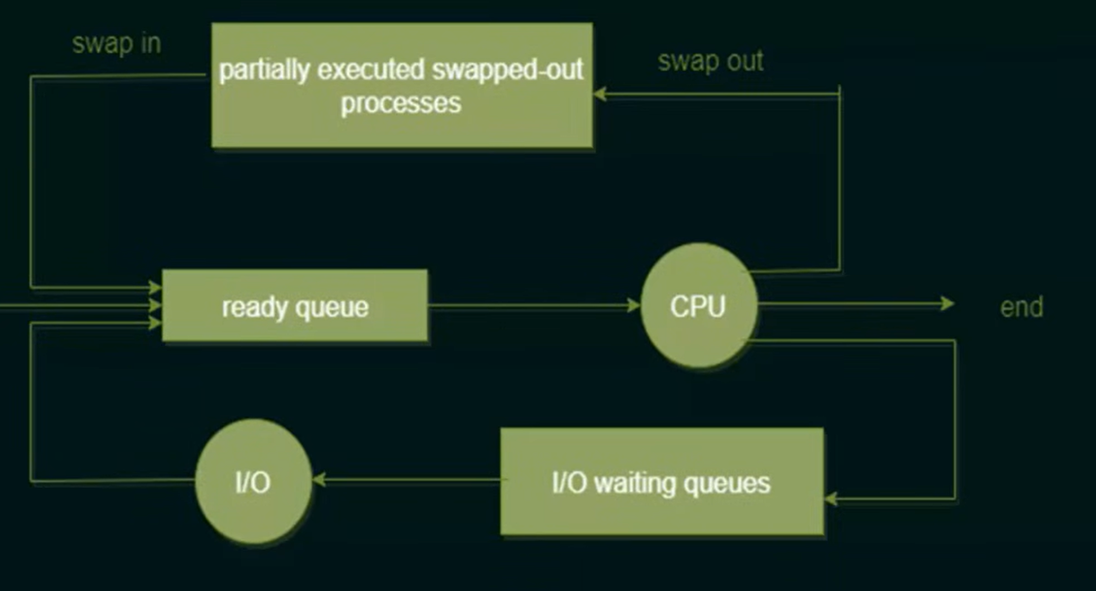
Representation of Process Scheduling

Slide 11
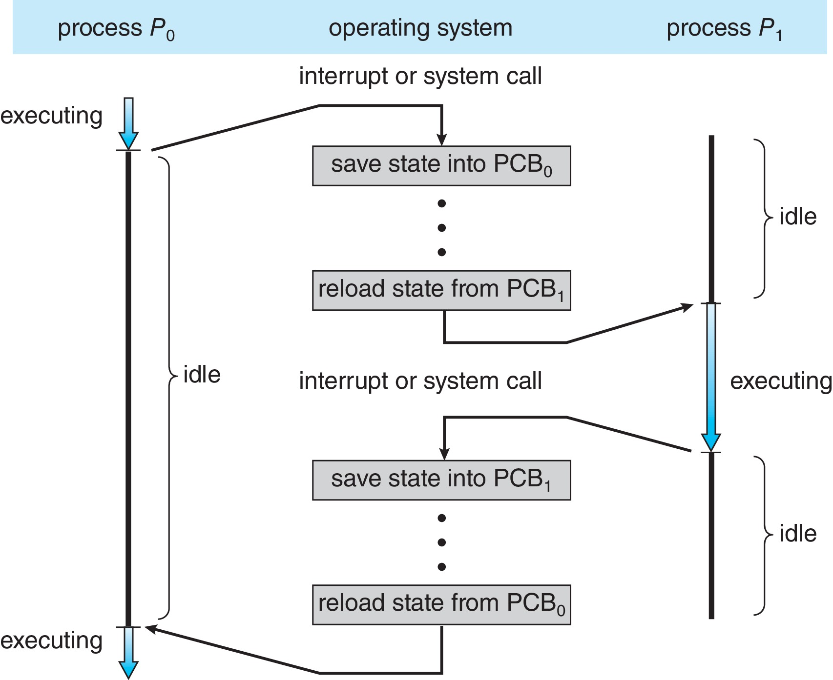
Context Switch
A context switch occurs when the CPU switches from one process to another.
When CPU switches to another process, the system must save the state of the old process and load the saved state for the new process via a context switch
Context of a process represented in the PCB
Context-switch time is overhead; the system does no useful work while switching
  The more complex the OS and the PCB ➔ the longer the context switch
Time dependent on hardware support
  Some hardware provides multiple sets of registers per CPU ➔ multiple contexts loaded at once

Slide 12
Operations on Processes
System must provide mechanisms for:
  process creation
  process termination
Process Creation
1. Parent & Child Processes
  Parent process create children processes, which, in turn create other processes, forming a tree of processes
2. Process ID (PID)
  Generally, process identified and managed via a process identifier (pid)
3. Resource Sharing Options
  Parent and children share all resources : Option 1: Share Everything
  Children share subset of parent’s resources :Share Some (Most common)
  Parent and child share no resources Option 3: Share Nothing
4. Execution Options
  Parent and children execute concurrently :Option 1: Run Together (Concurrent)
  Parent waits until children terminate :Option 2: Parent Waits

Slide 13
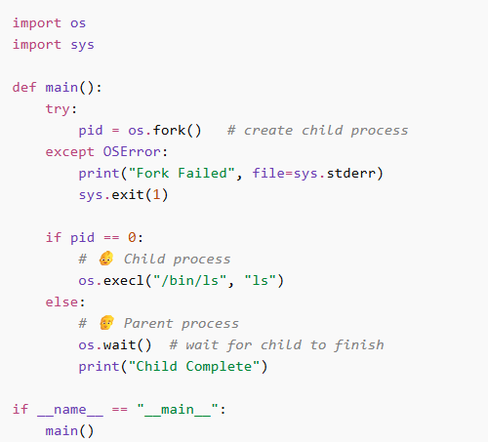
python Program Forking Separate Process

Slide 14
Process Termination
What is Process Termination? When a process finishes execution and is removed from memory
1. Normal Termination (exit)
  Process executes last statement and then asks the operating system to delete it using the exit() system call.
  2. Return Status to Parent
  Returns status data from child to parent (via wait())
  3. Resource Deallocation
    Process’ resources are deallocated by operating system
4. Parent Terminates Child (abort)
Parent may terminate the execution of children processes using the abort() system call. Some reasons for doing so:
1. Child uses too many resources
    Child has exceeded allocated resources
  2. Task no longer needed
    Task assigned to child is no longer required
  3. Parent is terminating (Kill child if parent dies)
    The parent is exiting and the operating systems does not allow a child to continue if its parent terminates

Slide 15
Process Termination-cont
1. Cascading Termination : If parent dies → all children also die
  cascading termination. All children, grandchildren, etc. are terminated.
  The OS may automatically terminate all its children.
2. wait() System Call : Parent waits for child to finish
The parent process may wait for termination of a child process by using the wait()system call. The call returns status information and the pid of the terminated process
pid = wait(&status);
3. Zombie Process
  If no parent waiting (did not invoke wait()) process is a zombie
4. Orphan Process
If parent terminated without invoking wait , process is an orphan
  Parent process terminates & Child is still running
Type | Situation | Result
Normal | Child ends + parent waits | Clean exit
Zombie | Child ends + parent NOT wait | Stays in table
Orphan | Parent ends first | Child adopted by OS

Slide 16
Interprocess Communication
Interprocess Communication (IPC) — how processes communicate and work together.
Types of Processes
  Processes within a system may be independent or cooperating
Independent Process : Does NOT interact with others, Works alone
Cooperating Process
  Cooperating process can affect or be affected by other processes, including sharing data (Browser + server)
Reasons for cooperating processes:
  Information sharing :Share data between processes
  Computation speedup : Split work → faster execution
  Modularity : Break system into smaller parts
  Convenience : Easier for users Example: copy-paste between apps
Cooperating processes need interprocess communication (IPC)
Two models of IPC
  Shared memory : Processes share a common memory space
  Message passing :Processes send messages to each other

Slide 17
Producer-Consumer Problem
Two types of processes:
  Producer :Produces data (items)
  Consumer : Uses (consumes) that data
  They share a buffer (storage area)
Types of Buffer
  unbounded-buffer places no practical limit on the size of the buffer
    Buffer can grow infinitely, Producer never waits
    Problem: Can use too much memory
  bounded-buffer assumes that there is a fixed buffer size
    If buffer is full → Producer must wait
    If buffer is empty → ❌ Consumer must wait

Slide 18
Interprocess Communication – Message Passing
What is Message Passing? A way for processes to communicate by sending messages, not by sharing memory
Mechanism for processes to communicate and to synchronize their actions
Message system – processes communicate with each other without resorting to shared variables
How Communication Happens :provides two operations:
  send(message) One process sends data
  receive(message) Another process receives data
The message size is either fixed or variable
  Fixed size → same length always
  Variable size → different lengths

Slide 19
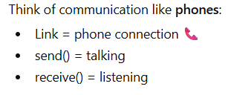
Message Passing (Cont.)
If processes P and Q wish to communicate, they need to:
  Step 1: Create a Link : Establish a communication link between them
  Step 2: Send & Receive : Exchange messages via send/receive
    One process uses: send() Other uses: receive()
Implementation issues:
  How are links established?
    Automatically by OS? Or manually by programmer?
  Can a link be associated with more than two processes?
    Yes (many-to-many) Or only one-to-one
  How many links can there be between every pair of communicating processes?
    One link per pair? Multiple links?
  What is the capacity of a link?
    How many messages it can hold: Limited (bounded) or Unlimited (unbounded)
  Is the size of a message that the link can accommodate fixed or variable?
    Fixed size or Variable size
  Is a link unidirectional or bi-directional?
    Unidirectional : One way only
    Bidirectional : Both ways

Slide 20
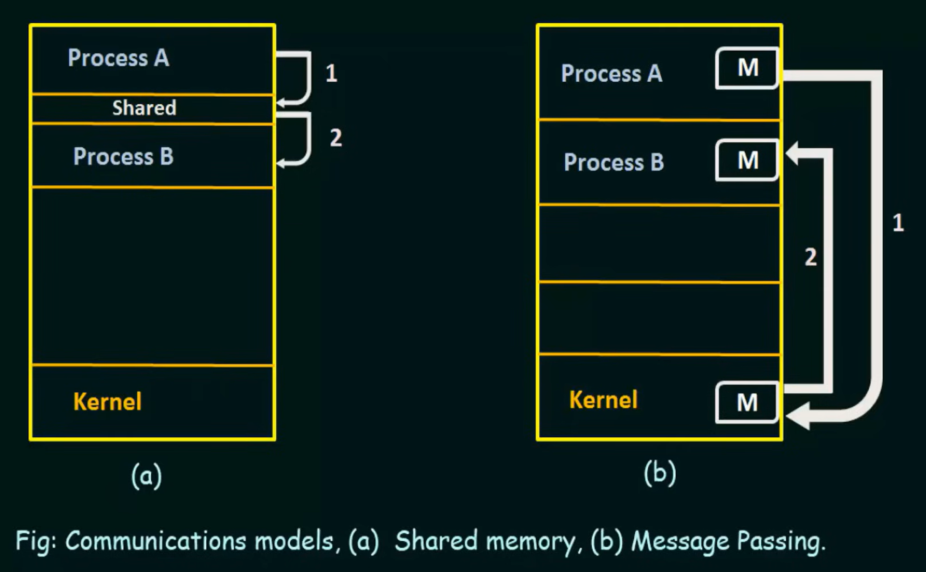

Slide 21
Direct Communication
What is Direct Communication? Processes send messages directly to each other by name , No intermediate channel needed
Processes must name each other explicitly:
  send (P, message) – send a message to process P
  receive(Q, message) – receive a message from process Q
Properties of communication link
  Links are established automatically : 1. Links are Automatic
    OS creates the connection automatically
    No need to manually create link
  2. One Pair Only : A link is associated with exactly one pair of communicating processes , One link = exactly two processes
  3. One Link Between Pair : Only one connection between two processes
    Between each pair there exists exactly one link
  The link may be unidirectional, but is usually bi-directional

Slide 22
Indirect Communication
What is Indirect Communication?
  Instead of sending messages directly to a process:
    Processes send messages to a mailbox (port)
    Then another process reads from that mailbox
What is a Mailbox? A shared message container used for communication
  Each mailbox has a unique id
  Processes can communicate only if they share a mailbox
Properties of communication link
  1. Must Share Mailbox
    Link established only if processes share a common mailbox
  2. Link is via Mailbox
  A link may be associated with many processes
  3. Many Processes Allowed
  Each pair of processes may share several communication links
  4. Direction
  Link may be unidirectional or bi-directional

Slide 23
Indirect Communication
Mailbox sharing
  P₁, P₂, and P₃ share mailbox A
  P₁, sends; P₂ and P₃ receive
  Who gets the message?
  Race condition / selection problem
Solutions
  1. Limit to Two Processes
    Allow a link to be associated with at most two processes
  2. One Receiver at a Time
    Allow only one process at a time to execute a receive operation
  3. OS Chooses (Arbitrary Selection)
  Allow the system to select arbitrarily the receiver. Sender is notified who the receiver was.
    OS decides : Either P₂ or P₃ gets the message
    Then : Sender is informed who received it

Slide 24
Synchronization
What is Synchronization? Coordinating processes so they communicate at the right time
Two Types of Communication
Message passing may be either blocking or non-blocking
Blocking is considered synchronous (Processes must wait)
  Blocking send -- the sender is blocked until the message is received
  Blocking receive -- the receiver is blocked until a message is available
Non-blocking is considered asynchronous (Processes do NOT wait)
  Non-blocking send -- the sender sends the message and continue
    Sender → send → continue (no waiting)
  Non-blocking receive -- the receiver receives:
    If message exists → gets it
    If not → gets null and continues
    Different combinations possible
  If both send and receive are blocking, we have a rendezvous
    Sender waits, Receiver waits They meet at same time This is called : rendezvous

Slide 25
End of Chapter 3

