Slide 1
Error Frame Format
AGENDA
Understanding Error Frame
What is Error flag and its types
What is basic error frame and complete error frame
How is error frame formed on the bus
Different Use cases to demonstrate formation of error frame on bus.
Shyam Bhat
VicharaVandana

Slide 2
Error Frame
Error Frame is one of the 4 frame types given in the CAN protocol
Error Frame Signals to other nodes on the network that current Data frame is erroneous.
Any of the 5 CAN error upon detection by a node will result in destroying current data frame by overlap of Error frame
To understand Error frame format we have to understand below three aspects:
Error Flag (Active and Passive)
Basic Error Frame
Complete Error Frame

Slide 3
Error Flag
When a node detects any CAN error, it knows that the current Data frame is not valid. So the node has to signal other nodes on the network.
The Node signals the error to remaining nodes by a flag. This is called Error flag.
Error Flag has to be noticed by all other Nodes and not be mistaken to be normal frame bits.
So the format of a Error flag is chose in a way that such format cannot exist anywhere in a normal data frame. → Violation of Bit stuffing rule.
So Error Flag is 6 consecutive bits of same polarity. Depending on Polarity of bits, there are two kinds of Error Flag
Active Error Flag : 6 consecutive dominant bits (000000)
Passive Error Flag : 6 consecutive recessive bits (111111)

Slide 4
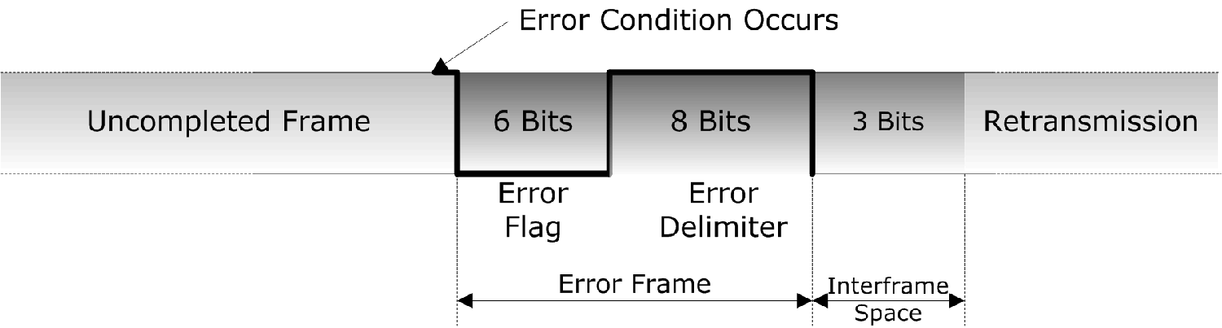
Basic Error Frame
A Basic Error frame consists of 3 parts:
6 bits of Error flag field
Active error flag : all dominant bits
Passive error flag : all recessive bits
8 recessive bits of Error delimiter field. (1 + 7)
3 recessive bits of Inter-frame space field.

Slide 5
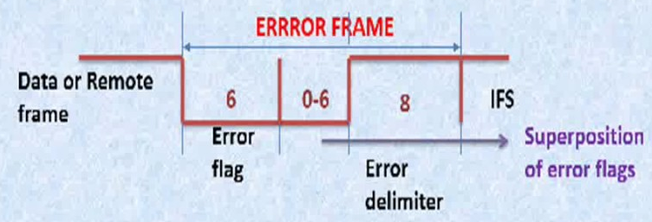
Complete Error Frame
Error Frame on CAN bus is combination of multiple basic Error frames by various nodes. Superposition of all Basic error frames forms complete error frame on bus.
After Error flag, 1st bit of Delimiter is sent by node. If it monitors a Dominant bit then it waits till a recessive bit is monitored on the bus and then send remaining 7 delimiter bits. Else if it monitors Recessive bit then sends remaining 7 Delimiter bits directly

Slide 6
Rx Detect – Active Flags
Bit Error
Some Rx Error
Stuff Error
Error Flag
Error Delimiter
Intermission

Slide 7
Rx Detect – Passive Flags

Slide 8
Tx Detect – Passive Flag

Slide 9
Points to Remember
Error frame signals the nodes that Data frame is invalid and hence not to process it.
Error frame always is sent in between a data frame destroying it on the bus.
Error frame consists of Error flag, delimiter and intermission.
Error flag is designed based o violation of Bit-stuffing Rule
Error flag can be active error flag or passive error flag.
Passive error flag from a node can destroy only the data frames the node transmits
Active error flag from a node can destroy the data frame the node transmits and receives.
Base error frames from various nodes together forms full error frame on the CAN bus
Once the error frame is finished the data frame shall be retransmitted again.

Slide 10


