Slide 1
CAN FD Introduction
AGENDA
What is CAN FD protocol
Improvements compared to CAN protocol
Shyam Bhat
VicharaVandana

Slide 2
What is CAN-FD
CAN-FD is a communication protocol based on CAN.
Can-FD is an improvement over CAN.
Modern CAN controllers support both CAN and CAN-FD frames
Note: CAN-FD is not an substitute for CAN protocol. A single Automotive network can have both CAN frames and CAN-FD frames.
So CAN-FD protocol must be compatible with CAN protocol.

Slide 3
Advantages of CAN-FD over CAN
DATA: CAN-FD frame can carry upto 64 bytes of data where as CAN carries 8 bytes
SPEED: CAN-FD frame maximum speed upto 5Mbps whereas CAN frame upto 1Mbps.
Note: CAN-FD has dual speed (Bit rate). Data and CRC fields can be transmitted with higher speed. Remaining fields of the frame will be transmitted with lower speed same as CAN speed. This concept will be more clear in coming slides.

Slide 4
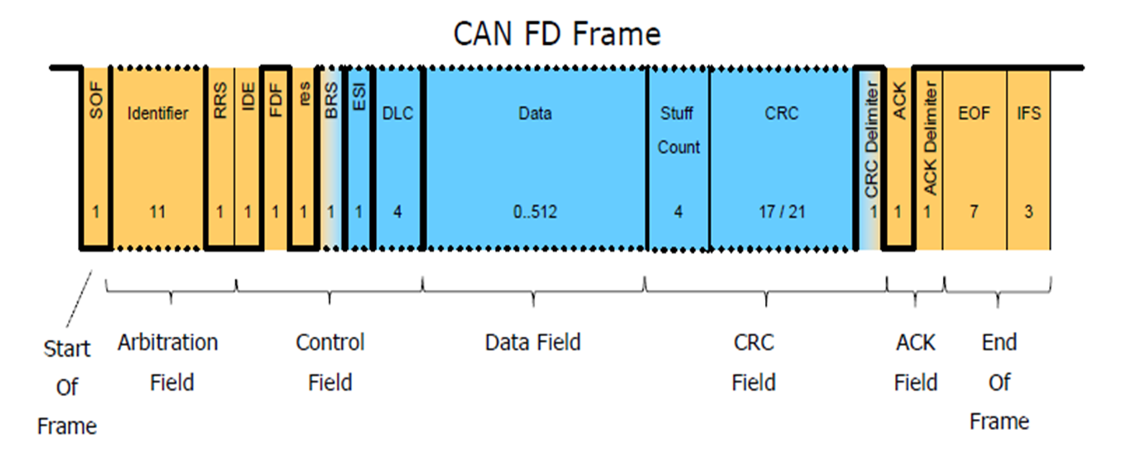
Data Frame Format

Slide 5


