Slide 1


Faculty of Economic Sciences
Project Proposal
Moscow
2025
Research and Modeling of Accident Frequency and Severity on Toll Highways in Russia
Author: Anastasia Kolesnikova,
group BEC216
Scientific supervisor: Ivan Stankevich,
Assistant Professor, Department of Applied Economics

Slide 2
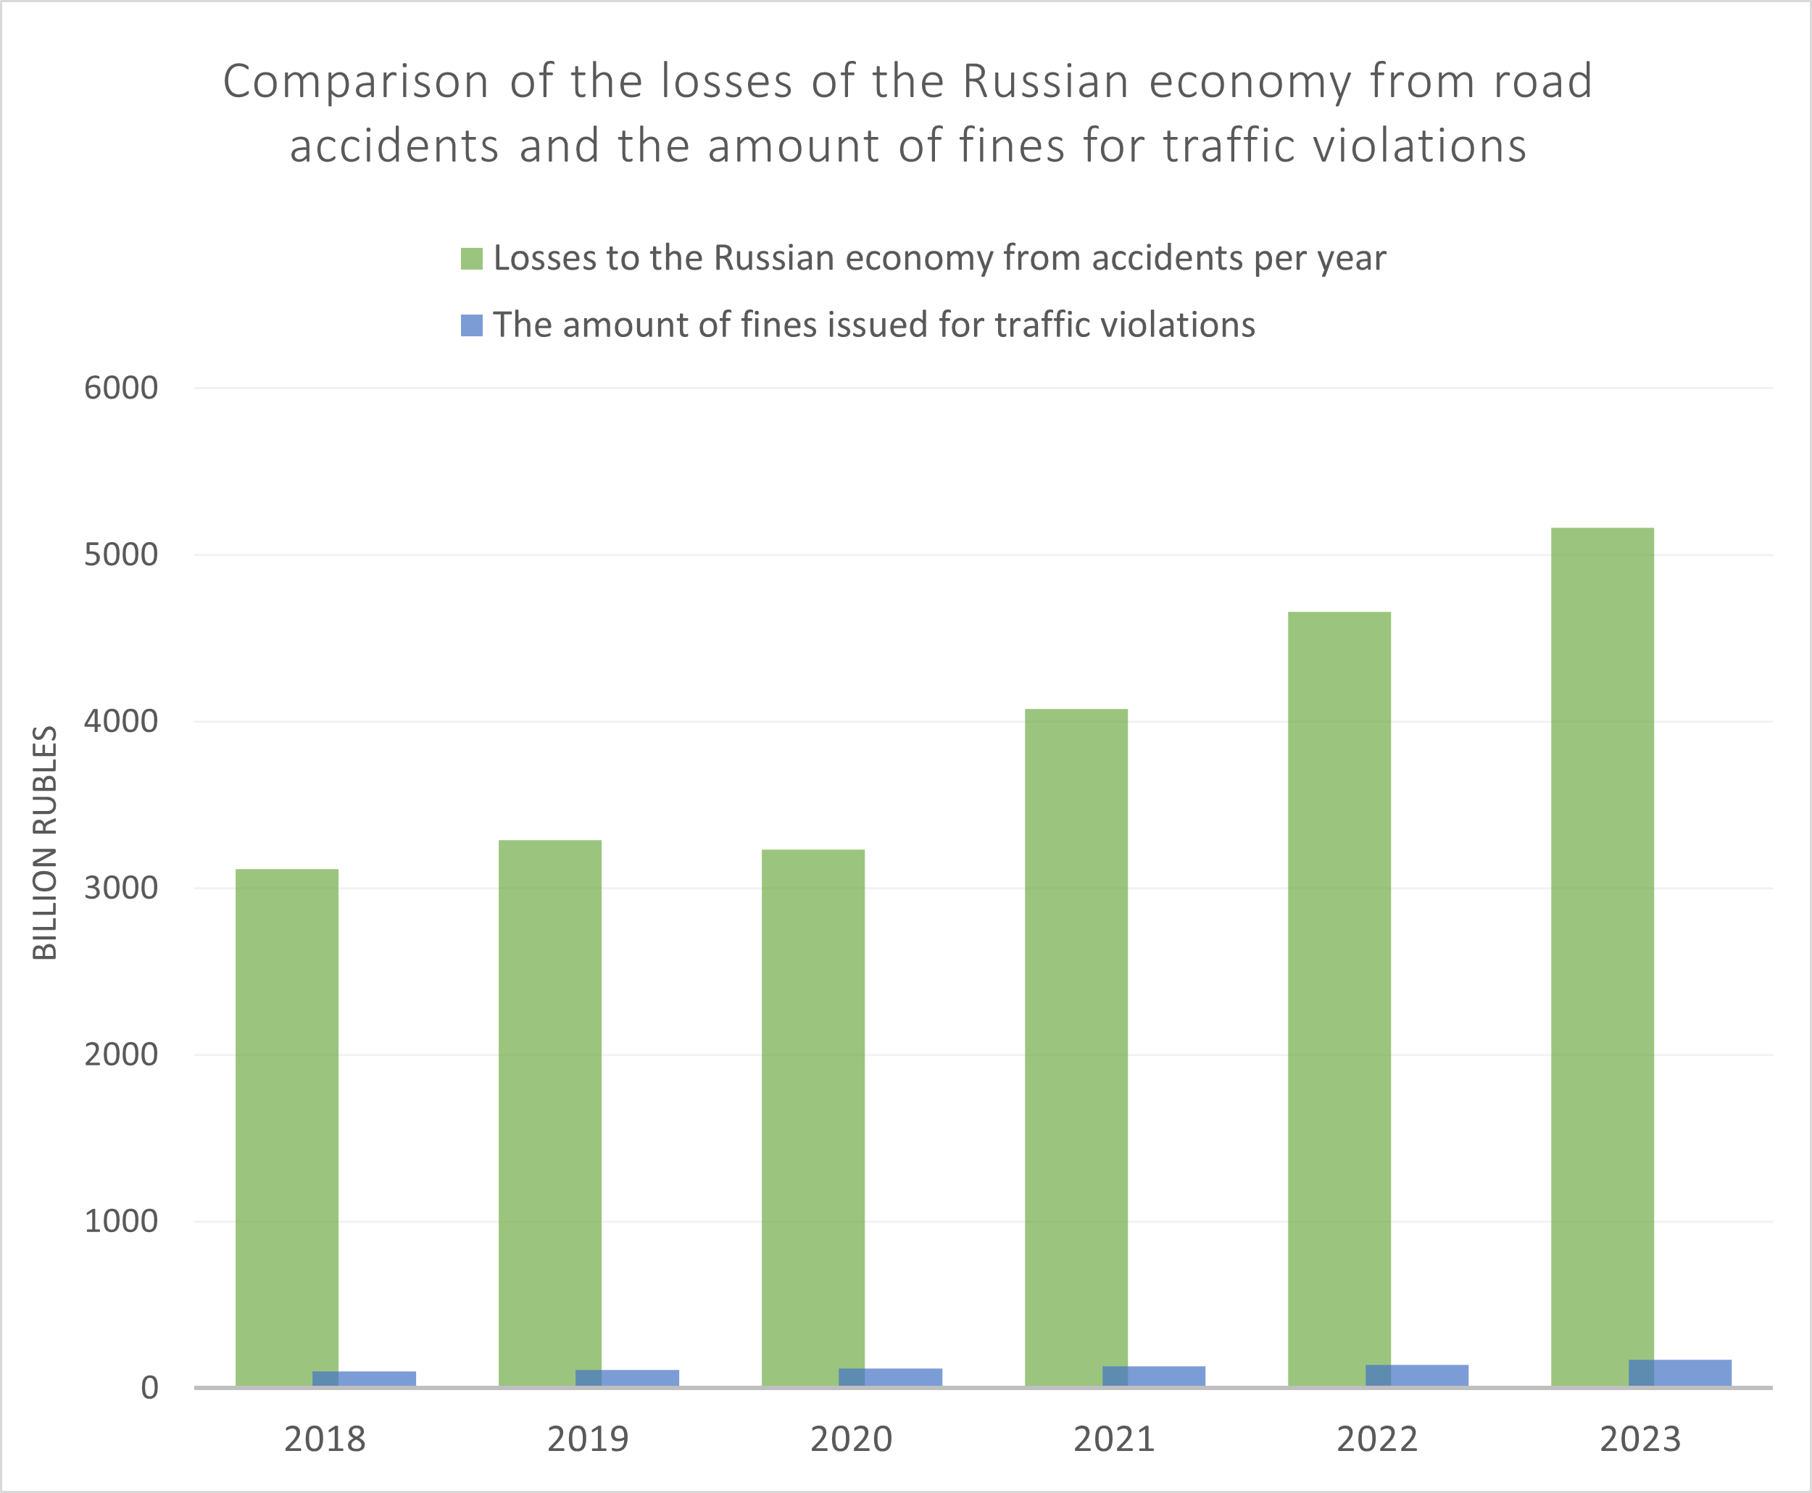
Faculty of
Economic Sciences
Project Proposal
Moscow, 2025
2
Relevance of the Study
Mortality and injuries resulting from road traffic accidents lead to economic losses amounting to 2% to 5% of a country’s GDP.
On average, 3% of global GDP is lost due to fatalities and injuries caused by road traffic accidents.
The issue of road safety on toll roads and the economic benefits of investing in the development of the toll road system in Russia has not been studied comprehensively

Slide 3
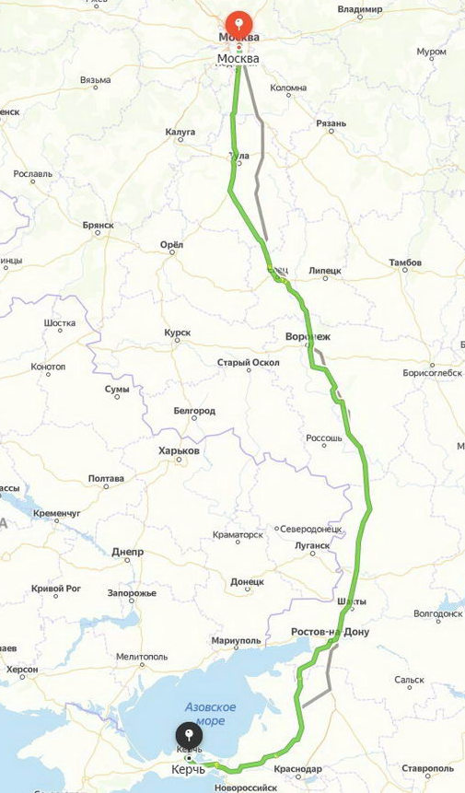
Faculty of
Economic Sciences
Project Proposal
Moscow, 2025
3
Research Objectives and Tasks
Research question:
«How does road type (toll vs. free) affect the frequency and severity of traffic accidents in Russia?»
Research tasks:
Collect, preprocess, and analyze traffic accident data for toll and free roads in Russia.
Test the hypotheses using econometric methods and machine learning techniques.
Identify the key factors influencing accident rates and compare them for toll and free roads.
Identify "hot spots" and analyze whether key accident factors change in dangerous zones.
Build a model to predict the likelihood of accidents in dangerous zones on toll and free roads.

Slide 4
Faculty of
Economic Sciences
Project Proposal
4
Moscow, 2025
Literature Review and Theory
The introduction of tolls may lead to an increase in the number of accidents, as drivers start using alternative, less safe roads (Alfredo Marvão Pereira et al. (2020)
The accident rate on toll roads is significantly influenced by factors such as the number of lanes, shoulder width, the presence of high-risk areas, and the distance to rest areas (Kristianto Kristianto, Carunia M. Firdausy, Najid Najid, Toni Hartono Bagio, 2024)
The cost of preventing accidents is higher than the revenue from toll collection, while reducing toll rates could increase traffic on toll roads, potentially decreasing the number of accidents by redistributing traffic from less safe routes. (Zapico Emma, Baños-Pino José F., Mayor Matías, 2024)

Slide 5
Faculty of
Economic Sciences
Project Proposal
Moscow, 2025
5
Research Hypotheses
Hypothesis 1.1:
«The average number of traffic accidents per month on toll roads is lower than on alternative free roads»
Hypothesis 1.2:
«The factors influencing the number of traffic accidents differ for toll and free roads»
Hypothesis 2.1:
«The probability of a more severe outcome of traffic accidents is lower on toll roads than on alternative free roads»
Hypothesis 2.2:
«The factors influencing the severity of traffic accidents differ for toll and free roads»
Research Data
Data source: Official website of the State Traffic Safety Inspectorate of the Ministry of Internal Affairs of Russia
Data description: The statistics include data from all regions of Russia, covering the period from the beginning of 2015 to mid-2024
Number of observations: 1,400,915 (1.4 million) accidents

Slide 6
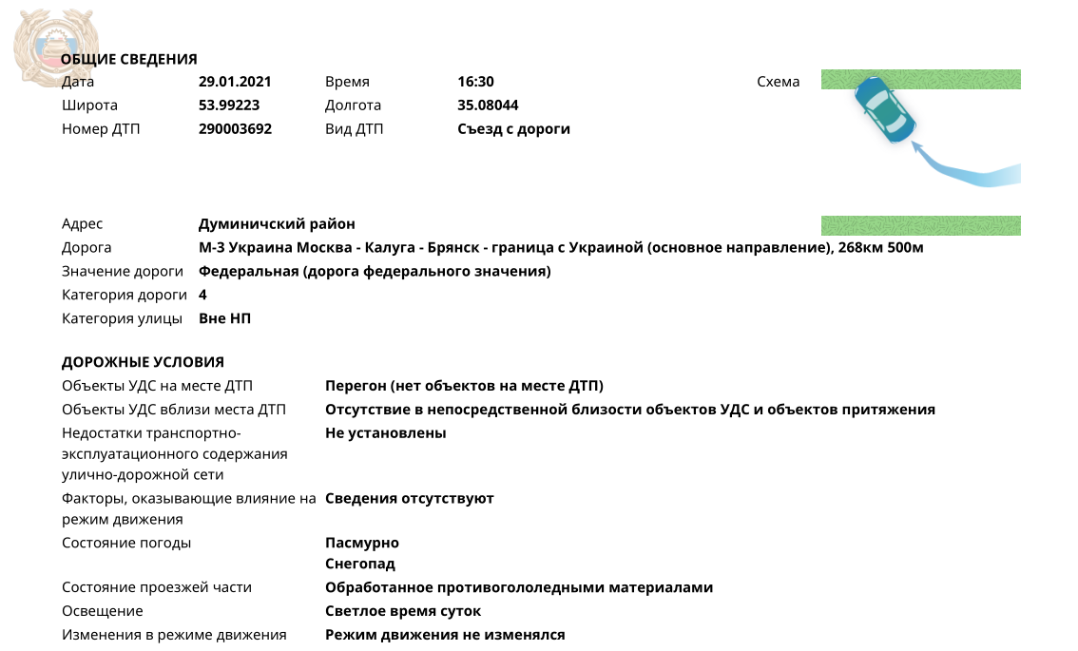
Faculty of
Economic Sciences
Project Proposal
Moscow, 2025
6
Data Description

Slide 7
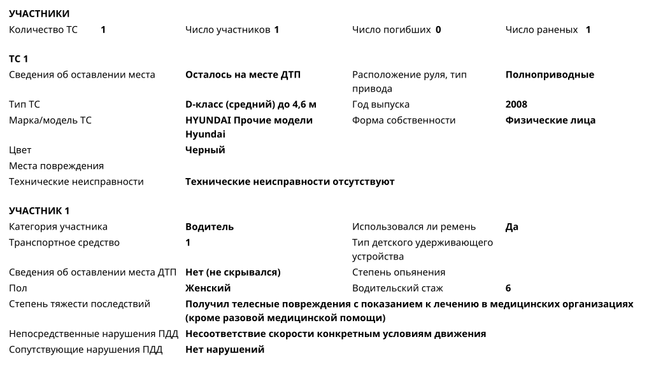
Faculty of
Economic Sciences
Project Proposal
Moscow, 2025
7
Data Description
Panel data, where the observation is represented by a road section × month, indicating the number of accidents that occurred during that period (about 20-30 thousand observations)
Time-location data, where each observation is an accident with information on time, geographical coordinates, and several other features (about 1 million observations)

Slide 8

Faculty of
Economic Sciences
Project Proposal
Moscow, 2025
8
Methods
For testing hypothesis (1.1) and (1.2):
Panel regression model with FE:
FE Negative Binomial Regression:
Machine learning methods such as Random Forest Regressor and Gradient Boosting (using MAE/MSE metrics) with SHAP analysis or feature importance
For testing hypothesis (2.1) and (2.2):
Multinomial Logit (MNL) regression:
Machine learning methods such as Random Forest Regressor and Gradient Boosting (using Accuracy and F1-score metrics) with SHAP analysis or feature importance
$$Y_{it}= β_{0}+β_{1}{Toll}_{i}+β_{2}X_{it}+ α_{i}+ γ_{t}+ ε_{it}$$
$$P\left(Y_{i}=k\right) = \frac{e^{β_{k}X_{i}}}{1+\sum_{j=1}^{K}{e^{β_{j}X_{i}}}}$$
$$\ln{Y_{it}}= β_{0}+β_{1}{Toll}_{i}+β_{2}X_{it}+ α_{i}+ γ_{t}+θ+ ε_{it}$$

Slide 9
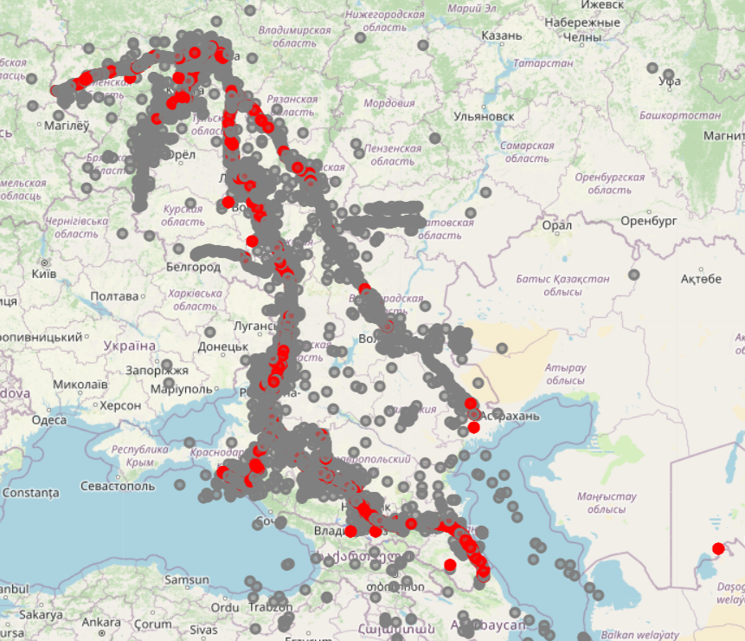
Faculty of
Economic Sciences
Project Proposal
Moscow, 2025
9
Methods
The key factors influencing accidents may differ from the overall sample on high-accident sections, so the next step will be to identify "hot spots"
DBSCAN clustering algorithm
Predicting the probability of accidents on these dangerous sections of different types of roads (toll vs. free) using negative sampling

Slide 10
Faculty of
Economic Sciences
Project Proposal
Moscow, 2025
10
Results Anticipated
The number of accidents on toll roads is indeed lower compared to free roads, but the severity of outcomes may be higher due to higher speed limits.
The key factors influencing road safety include infrastructure quality, weather conditions, lighting, and traffic density.
The results of the study will make it possible to offer recommendations for improving safety on both toll and free highways.

Slide 11
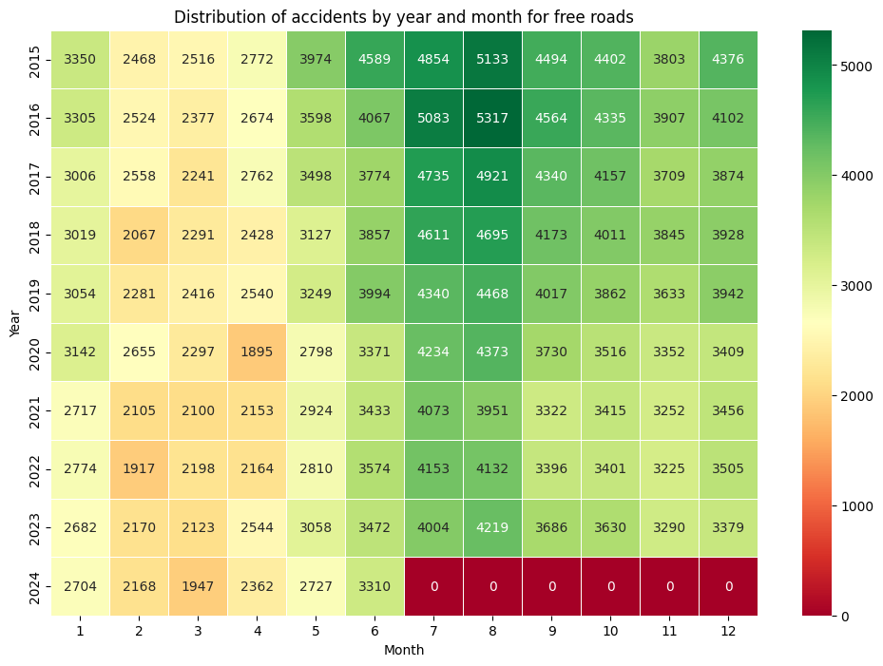
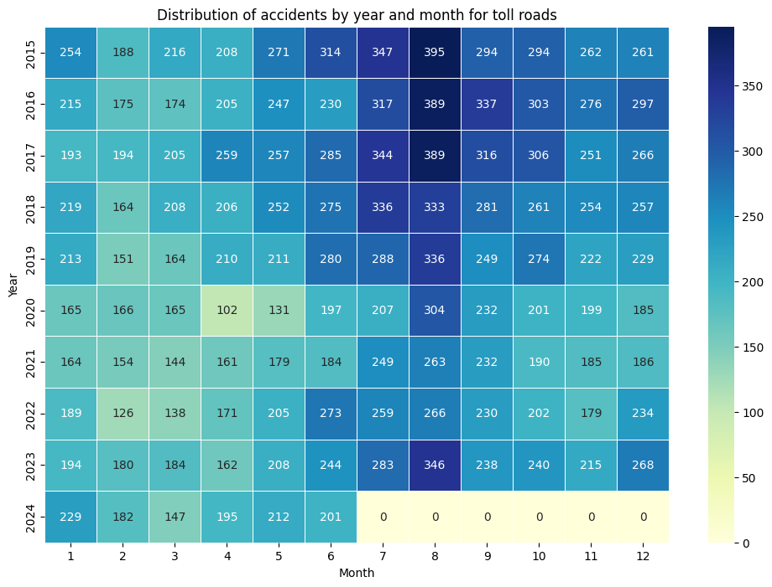
Faculty of
Economic Sciences
Project Proposal
Moscow, 2025
13
Appendix

Slide 12
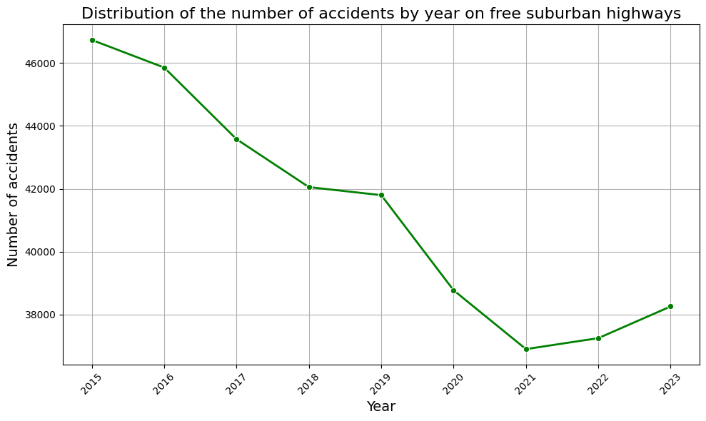
Faculty of
Economic Sciences
Project Proposal
Moscow, 2025
11
Appendix

Slide 13
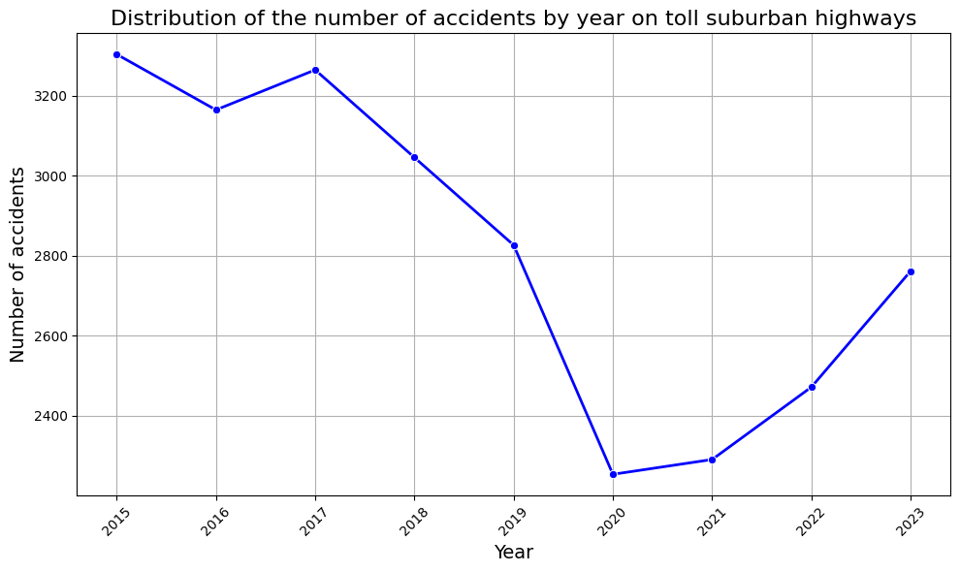
Faculty of
Economic Sciences
Project Proposal
Moscow, 2025
12
Appendix

Slide 14


