Slide 1

Key Logger: Your Invisible Watchdog
A key logger is a powerful software tool that silently records every keystroke made on a computer, providing invaluable insights into user activity and potential security risks.
by SHAIK YARRABALLI NASURUDDIN

Slide 2
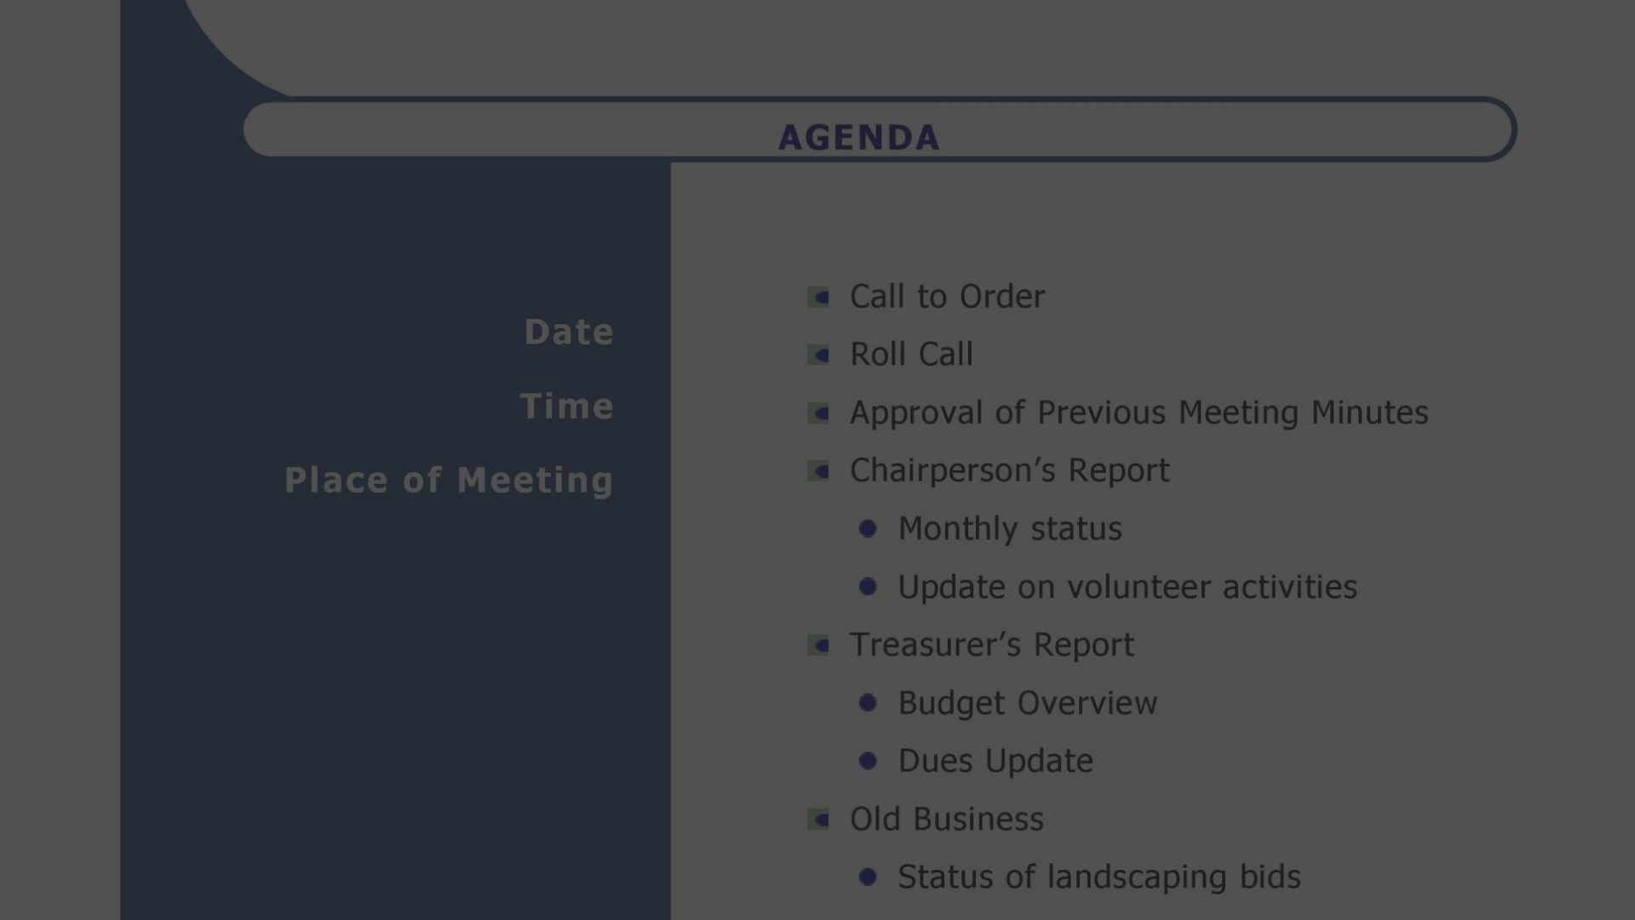
Agenda
1
Problem Statement
2
Project Overview
3
End-User Profiles
Identify and mitigate security vulnerabilities within an organization.
Develop a key logging solution to monitor user activity and activity patterns.
IT administrators, security teams, and compliance officers.

Slide 3
The Problem Statement
Security Risks
Compliance Concerns
Productivity Challenges
Insider threats, data breaches, and unauthorized access pose significant risks to organizations.
Strict regulations require comprehensive monitoring and reporting of user activities.
Inefficient use of company resources and time can impact overall productivity.

Slide 4

Project Overview
1
Keystroke Capture
Develop a key logging solution to record all user input, including passwords, chat messages, and document contents.
2
Activity Monitoring
Analyze user behavior patterns to identify potential security risks and productivity issues.
3
Reporting & Alerts
Generate comprehensive reports and set up customizable alerts to notify administrators of suspicious activities.

Slide 5



End-User Profiles
IT Administrators
Security Teams
Compliance Officers
Maintain network security and monitor user activities for potential breaches.
Investigate security incidents and ensure compliance with industry regulations.
Ensure the organization adheres to applicable laws and internal policies.

Slide 6
Our Solution and Its Value
Comprehensive Monitoring
Advanced Analytics
Our key logger captures every keystroke, providing a complete audit trail of user activities.
Sophisticated algorithms analyze user behavior patterns to identify potential security risks and productivity issues.
Customizable Alerts
Streamlined Reporting
Users can set up custom alerts to receive real-time notifications of suspicious activities.
Detailed reports help organizations maintain compliance and make informed decisions.

Slide 7




The Wow Factor
Invisible Monitoring
Proactive Security
Improved Productivity
Our key logger operates silently in the background, ensuring users are unaware of its presence.
By identifying potential threats early, organizations can take preemptive actions to mitigate risks.
Identifying and addressing unproductive user behaviors can lead to significant improvements in overall efficiency.

Slide 8
Modeling and Implementation
Architecture
Modular design with a lightweight agent and a centralized management console
Deployment
Can be installed on individual workstations or deployed across the entire network
Data Storage
Encrypted and secure storage of user activity logs, with configurable retention policies
User Privacy
Strict access controls and compliance with data protection regulations

Slide 9

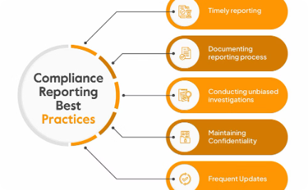
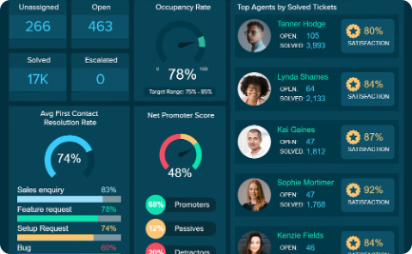
Results and Benefits
Improved Security
Regulatory Compliance
Increased Productivity
Key logger data helps identify and mitigate security vulnerabilities, reducing the risk of data breaches and unauthorized access.
Detailed user activity logs and reports ensure organizations meet stringent compliance requirements.
Analyzing user behavior patterns allows organizations to optimize workflows and identify areas for improvement.

Slide 10
GITHUB LINK:
https://github.com/Nasuruddin143/Cyber-security-internship.git

