Slide 1
ParcelTrack Lite
Week 5 checkpoint
Naszrul / Zikri / Syauqi
22 October 2026
Frontend prototype and implementation plan
Notes:
Naszrul | About 25 seconds.
We are presenting ParcelTrack Lite for the RapidExpress case study. Today is our Week 5 checkpoint, and final submission is in Week 14. We will show module ownership, the selected stack, our initial database design, an interface for each module, security requirements, and our next steps. The demonstration uses synthetic browser data. It does not yet implement the backend or cloud system.
Source: team checkpoint deliverables and timeline supplied in the project discussion; ParcelTrack_Lite_Case_Study.docx sections 4 and 10.

Slide 2
Module allocation
Owner | Module | Main responsibility
Naszrul | M1 | Login and User Management
Zikri | M2 | Parcel Registration and Public Tracking
Syauqi | M3 | Delivery Update and Admin Dashboard
Shared data model, API contracts, integration and test evidence
02
Notes:
Naszrul | About 35 seconds.
Naszrul owns login and user management, Zikri owns parcel registration and public tracking, and Syauqi owns delivery updates and the Admin dashboard. Each member also owns their module's tests and explanation. We share the data model and integration contracts so that our three contributions form one application. The separate lecturer allocation sheet needs our full names and matric numbers.
Source: team allocation confirmed 21 October; case study section 4.

Slide 3
Development stack and hosting
React + TypeScript
FastAPI
PostgreSQL
Seller, Rider, Admin
and public interfaces
Shared authenticated APIs
SQLAlchemy + Alembic
Private database
Row level security
Planned deployment: Docker Compose on AWS EC2 with HTTPS
Prototype today: React and synthetic browser data
FastAPI/PostgreSQL variation: lecturer acceptance unverified
03
Notes:
Naszrul | About 40 seconds.
We selected React for the interfaces, FastAPI for one shared Python backend, and PostgreSQL in Docker. SQLAlchemy and Alembic will support database access and migrations. AWS is our chosen hosting provider, with one EC2 instance running Docker Compose as the current proposal. The database will remain private, behind the application. These backend and cloud components are planned. The source brief names other framework and database combinations, so acceptance of FastAPI and PostgreSQL still needs confirmation.
Source: docs/shared/decision-register.md D-01 to D-03 and EXT-02/04; source briefing slide 11 and case study section 6.

Slide 4
Initial entity relationship diagram
1 to many
ParcelStatusHistory
User
Seller: 1 to many
Rider: 0..1 to many
Parcel
parcel_id / changed_by_id
status / changed_at
id (PK) / role
username / password_hash
is_active / session_version
id (PK) / tracking_number
seller_id / assigned_rider_id
recipient fields / weight
current_status / version
DeliveryProof
parcel_id (unique FK)
private storage key / metadata
AuditEvent
1 to 0..1
actor_id / target_user_id / parcel_id (nullable FKs)
event_type / outcome / occurred_at / safe_details
Conceptual design. Session and rate-limit infrastructure omitted.
04
Notes:
Zikri | About 50 seconds.
Our initial ERD has five business entities: User, Parcel, ParcelStatusHistory, DeliveryProof and AuditEvent. Seller and Rider are roles in the same User table. A parcel has one Seller and may have one assigned Rider. Each parcel has one or more history records and zero or one proof record. AuditEvent records account and parcel actions, including failed login attempts where the actor may be unknown. Public visitors do not need accounts. Session and rate-limit tables are additional infrastructure, omitted from this conceptual diagram. This is a design, not a deployed schema.
Source: docs/initial-erd.md and docs/shared/system-contract.md.

Slide 5
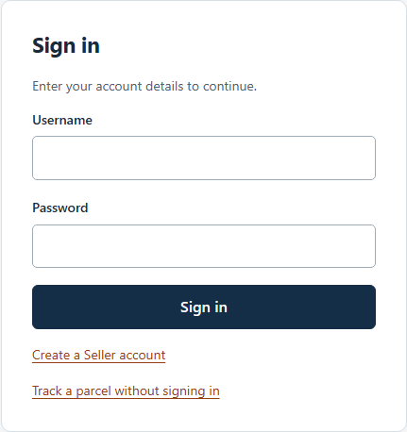
M1 Login and User Management
Owner: Naszrul
Username/password sign-in and role pages
Seller registration and Rider management
Authentication is simulated
Frontend prototype / synthetic data / backend enforcement planned
05
Notes:
Naszrul | About 30 seconds before the live demo.
This is the M1 interface. It uses a regular username and password form, generic failure messages and different landing pages for Sellers, Riders and Admins. Other screens show Seller registration, Rider management and password change. Test credentials are in the presenter guide, not on the product screens. Authentication is still simulated in the browser. Newly entered passwords exist only in page memory and reset on refresh. The final project will connect to FastAPI sessions, Argon2id hashing, CSRF protection and server authorization.
Source: checkpoint-demo frontend; case study section 4.1. Screenshot captured from the current interface.

Slide 6
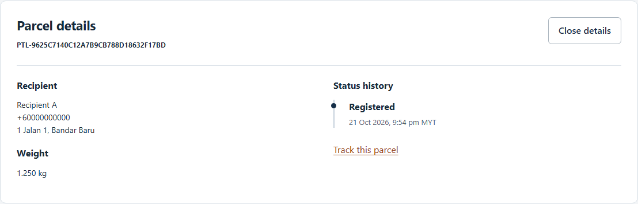
M2 Parcel Registration and Tracking
Owner: Zikri
Recipient, phone, address and weight
Parcel list, search and status history
Sample records persist in this browser
Frontend prototype / synthetic data / backend enforcement planned
06
Notes:
Zikri | About 30 seconds.
M2 provides a parcel registration form, a Seller parcel list, search, detail and public tracking. The prototype checks form values and generates a tracking token for each new parcel. Browser storage keeps the sample parcel when the page is refreshed, while the demo sign-in clears. This demonstrates the proposed interaction. The production implementation will replace browser state with PostgreSQL through authenticated APIs and enforce Seller ownership on the server and through RLS.
Source: checkpoint-demo; case study section 4.2; docs/modules/module-2-parcels. Screenshot captured from this prototype.

Slide 7
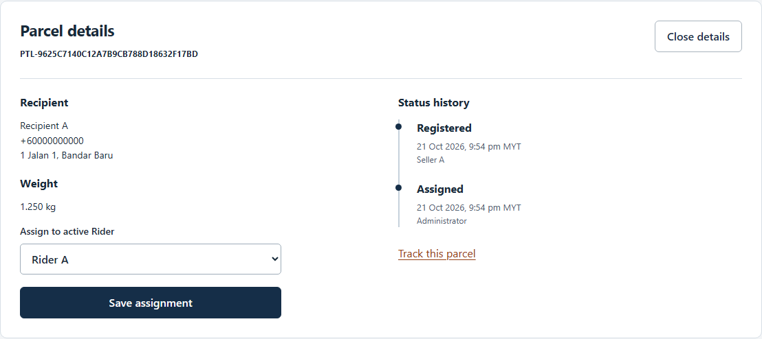
M3 Delivery Update and Dashboard
Owner: Syauqi
Admin assignment and five status counts
Rider list, delivery outcome and proof
One shared parcel lifecycle
Frontend prototype / synthetic data / backend enforcement planned
07
Notes:
Syauqi | About 35 seconds.
M3 shows Admin assignment and a dashboard with the five parcel statuses. The Rider interface starts delivery and records Delivered or Failed with a sample image. Assignment, status history and counts use the same browser data, so the interfaces demonstrate one coherent workflow. The final server must validate transitions, verify the assigned active Rider and store proof images privately. Admin assignment must not grant permission to perform Rider status updates.
Source: checkpoint-demo; case study sections 4.3 and 5. Screenshot captured from this prototype.

Slide 8
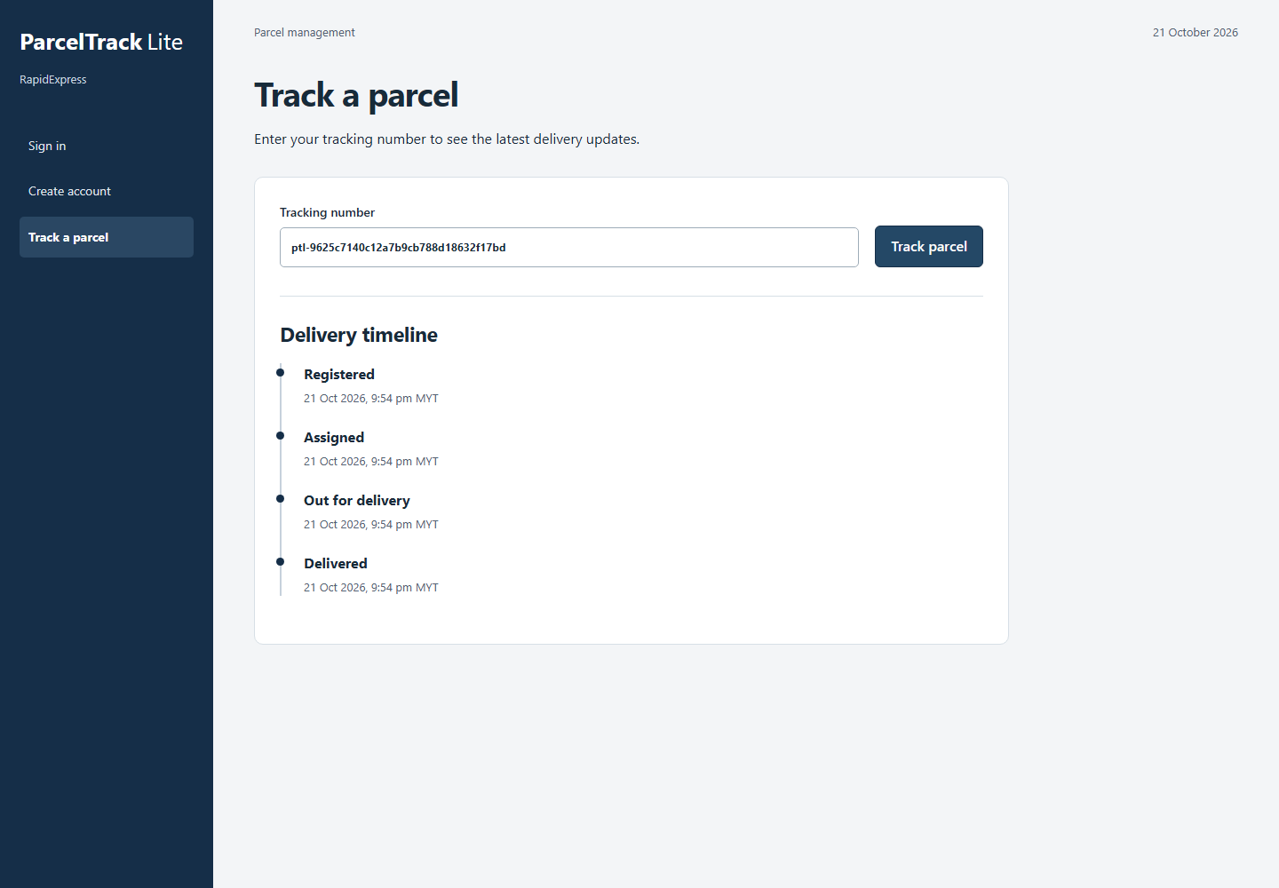
Public tracking interface
No sign-in required
Tracking token identifies the parcel
Only status and timestamps appear
Production privacy checks are planned
Frontend prototype / synthetic data / backend enforcement planned
08
Notes:
Zikri | About 30 seconds.
A visitor can enter the tracking token without signing in. The displayed result includes status and timestamps, without recipient details, actor identity or proof links. In this frontend prototype the complete synthetic data set still exists in browser storage. Therefore the screenshot demonstrates the intended public view, not a proven privacy boundary. The final implementation will use a restricted server lookup and a field allowlist, with rate limiting and privacy tests.
Source: checkpoint-demo; case study section 4.2; docs/shared/system-contract.md A13. Screenshot captured from this prototype.

Slide 9
Security requirements
Policy | Requirement for the final system
P1 | Server role checks, ownership and Rider disablement
P2 | 10+ character passwords, hashing and compromise reporting
P3 | Minimal public data and 12-month delivery-data retention
P4 | Secrets outside source, synthetic tests and generic errors
P5 | Safe audit events and incident reporting within one hour
Server controls are planned. Prototype checks do not prove security.
09
Notes:
Syauqi | About 50 seconds.
Our five policies guide implementation. P1 requires individual accounts, least privilege and same-day disablement of departing Riders. P2 requires passwords of at least ten characters and prompt compromise reporting. P3 limits recipient data to delivery and requires deletion or anonymization twelve months after delivery under the case-study policy. P4 requires safe secrets, synthetic test data and generic user errors. P5 requires login and status audit events without passwords or full addresses, and incident reporting within one hour. Controls include server role checks, RLS, hashing, CSRF, parameterized queries, restricted public responses and private image validation. These server controls are planned and have not been proven by the prototype.
Source: case study sections 5, 8 and 9; docs/security-tests.md.

Slide 10
Completed work and current challenges
Ready: allocation, ERD, shared contracts and module plans
Ready: three module interfaces and integrated sample workflow
Checked: 6 prototype tests and 19 browser checkpoints
Next: real APIs, database enforcement and AWS deployment
Challenges: shared contracts, stack acceptance and AWS access
10
Notes:
Naszrul | About 45 seconds.
We have confirmed ownership, selected our stack, published the initial ERD and prepared coherent module plans with test cases and handoffs. We now have runnable React interfaces for the checkpoint and a repeatable sample parcel journey. The prototype builds and its six domain tests and nineteen browser smoke checkpoints pass. These are not results for the final backend suite. Current challenges are keeping shared models consistent, obtaining stack acceptance and AWS access, and replacing browser simulations with verified server behaviour. Branch protection has been prepared but its application remains unverified.
Source: repository planning commit 9dd50f9; local checkpoint prototype build and recorded frontend QA. Full planned test suite is not executed.

Slide 11
Proposed route to Week 14
Teaching week | Proposed milestone
6 | PH1: shared foundation and test harness
7 | PH2: real authenticated module slices
8-9 | PH3: full functionality and early AWS smoke
10-12 | PH4-PH5: security regression and AWS operations
13-14 | PH6: evidence, rehearsal and final submission
Proposed schedule. Confirm the Week 14 calendar date.
11
Notes:
Syauqi | About 40 seconds.
This is our proposed schedule, not completed work. Week 6 establishes FastAPI, PostgreSQL roles, migrations and the test harness. Week 7 connects real authenticated module slices. Weeks 8 and 9 complete the functions and attempt an early AWS deployment. Weeks 10 through 12 focus on security regression, storage, recovery and the integrated cloud deployment. Week 13 prepares evidence and rehearsal, and Week 14 is final submission. We will confirm the Week 14 calendar date and update this schedule with actual progress. AI agents can assist implementation, while each member reviews, tests and understands their module.
Source: team timeline (Week 5 now, Week 14 final); docs/shared/phase-framework.md. Week mapping is a proposed checkpoint schedule.

Slide 12
Live demonstration
Naszrul: sample sign-in and role interface
Zikri: create parcel and retain its token
Syauqi: assign, start delivery and record outcome
Zikri: public tracking of the same parcel
Reset sample data before each rehearsal
github.com/Naszrul-NZL/ParcelTrack-Lite
12
Notes:
All presenters | Approximately five minutes.
Open the local browser. First explain verbally that it is a Week 5 frontend prototype with synthetic data. Before rehearsal, press Alt+Shift+R and confirm Restore data. Naszrul signs in with username seller.a and test password DemoOnly10!, optionally showing one failed attempt first. Zikri submits an empty parcel form, creates a fictional parcel and copies its token. Syauqi signs in as admin, assigns the parcel to Rider A, then signs in as rider.a, starts delivery and records Delivered using the included sample-proof.png. Finally sign out and let Zikri open Track a parcel and paste the token. Refer to demo-guide.md for credentials, recovery and optional examples. The screenshot slides provide a fallback if the live browser is unavailable.
Repository: https://github.com/Naszrul-NZL/ParcelTrack-Lite. Source: checkpoint prototype and demo-guide.md.

