Slide 1
Pacman Game

Slide 2

Introduction to the Pacman Game
Welcome to the Pacman Game! In this code, we have a single round of the game where you control Pacman to collect food while avoiding ghosts. The code provided allows you to play the game on your computer.
What are key Elements in the game
1) Pac-Man is the main character and the player's avatar in the game.
The objective of Pac-Man is to navigate through a maze and eat all the pellets or dots to advance to the next level.
Pac-Man is controlled by the player and can move in four directions: up, down, left, and right.
The player must avoid the Ghosts, as coming into contact with them will result in losing a life.

Slide 3

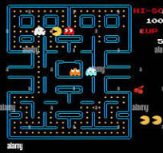
2) Ghosts:
The Ghosts are the antagonists in the game and are programmed with individual personalities and behaviors.
There are four Ghosts in the game, each with a different color: blue, yellow, pink, and red.
The Ghosts' primary objective is to catch and eliminate Pac-Man.
The Ghosts have different movement patterns and strategies, making them challenging to avoid.
3) Board - The Board refers to the maze or playing field where the game takes place.
The maze is filled with pellets or dots that Pac-Man needs to eat to complete each level.
The maze layout remains the same throughout the game, but the levels become progressively more challenging.
The Board also includes tunnels on the left and right edges of the screen, which act as shortcuts for both Pac-Man and the Ghosts.

Slide 4
objective
The objective of the game is to collect all the food on the playfield. You control Pacman using the arrow keys. Use the up arrow key to move Pacman up, the down arrow key to move Pacman down, the left arrow key to move Pacman left, and the right arrow key to move Pacman right.

Slide 5
Valuable skills and concepts
Programming fundamentals: This project allows you to practice fundamental programming concepts such as variables, loops, conditionals, functions, and arrays. You will gain hands-on experience in applying these concepts to solve a real-world problem.
Game development: Creating a game involves unique challenges compared to other types of software development. You will learn about game mechanics, handling user input, updating game state, and creating an interactive experience.
Problem-solving: Throughout the project, we will encounter various challenges and obstacles that need to be overcome. This will enhance our problem-solving skills as we analyze problems, break them down into smaller steps, and devise solutions.
Algorithmic thinking: As you work on the movement of the Pacman character and the ghost characters, you will need to think algorithmically to determine the appropriate logic for their behavior. This will improve your abilityto think algorithmically and design efficient solutions.
Debugging and troubleshooting: Developing a project like this often involves encountering bugs and issues. You will learn how to debug and troubleshoot your code to identify and fix problems, improving your ability to handle errors and unexpected behavior.
User interface design: The game requires a user interface to display the playfield and interact with the player. You will gain insights into designing user-friendly interfaces and providing a smooth and engaging experience for the player.

Slide 6
Game Mechanics
Game Board: The game board is represented by a 2D array called board_array. Each element in the array represents a specific tile on the game board. The values in the array determine the type of tile, such as walls, pellets, or empty spaces.
Drawing the Game Board: The drawBoard() function is responsible for drawing the game board on the screen. It uses OpenGL functions to draw different shapes based on the values in the board_array. For example, it draws walls as rectangles and pellets as small circles.
Rendering: The drawScene() function is the display callback function that is called whenever the window needs to be redrawn. It clears the color buffer, sets up the projection matrix, and calls the drawBoard() function to draw the game board.
Initialization: The initRendering() function is responsible for initializing the rendering settings and other OpenGL configurations. It sets the clear color, enables depth testing, and sets the shading model to smooth.

Slide 7
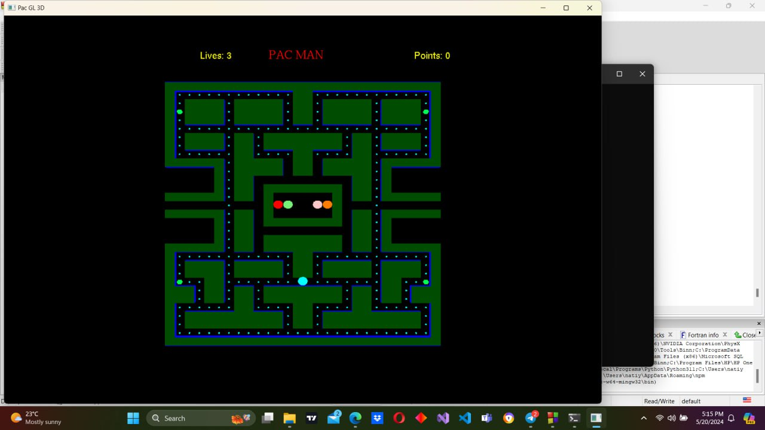
Play Area
We define the size of the play field using const int BOARD_X and const int BOARD_Y which is (31,28)
we have a 2D array called board_array. This array is
used to represent the game board. It has dimensions
BOARD_X by BOARD_Y, which means it has 31 rows and 28
columns. The array is initialized with specific values that represent
the layout of the game board.
The values inside the double curly braces represent the
elements of the array. Each row is enclosed in curly braces and
separated by commas. Within each row, the elements are separated by commas as well.
By initializing the array with these specific values, you are setting up the initial layout of the game board. Each element in the array represents a specific tile or object that will be used in the game.

Slide 8
we have another 2D array called pebble_array. This array represents the pebbles on the game board. It has the same dimensions as the board_array, which are determined by the BOARD_X and BOARD_Y constants.
The array is initialized with specific values that represent the presence or absence of pebbles on each tile of the game board. Each element in the array corresponds to a specific tile on the game board.
For example, the first row of the array is {0,0,0,0,0,0,0,0,0,0,0,0,0,0,0,0,0,0,0,0,0,0,0,0,0,0,0,0}. This row represents the top row of the game board, and each element represents whether there is a pebble (value of 1) or no pebble (value of 0) on that tile.
By initializing the pebble_array with these specific values, you are setting up the initial presence or absence of pebbles on the game board.

Slide 9
Board
void Draw(void): This function is responsible for drawing the game board elements using OpenGL commands. The function starts by setting the color to magenta (glColor3f(1,0,1)). It then uses two nested loops to iterate through the board_x and board_y/2 dimensions to draw the top half of the board. Within the loops, the function sets the color to blue (glColor3f(0,0,1)). It uses glPushMatrix to push the current matrix and translate it to the board position. The function then applies translations and rotations based on the tile type from the board_array. It scales and translates the matrix to the appropriate position and calls the display list (glCallList) to draw the optimized tile graphic. If the tile type requires an additional element on top, it translates the matrix and calls the display list again. After drawing the tiles, the function checks if there are pebbles on the board (tp_array[ISO][j] > 0) and draws them as spheres. The function then repeats the process for the bottom half of the board, using a different loop and starting the iteration from the bottom row.
bool Open(int a, int b): This function checks the value at the given position in board_array and returns true if it's open (value greater than 0), otherwise false. The function checks if the value at board_array[b][a] is greater than 0. If the condition is true, it means the position is open, so the function returns false. If the condition is false, it means the position is not open, so the function returns true.
void specialDown(int key, int x, int y): This function handles special key press events. If the start_timer is greater than 0, it decrements the timer. The function sets the ckey based on the key pressed. It then handles movement based on the key pressed, the angle1, and the open positions on the board. If the movement is possible (determined by the Open function), the animate flag is set to true and the angle1 is updated accordingly.

Slide 10
void P_Reinit(): This function is responsible for resetting Pacman's position and state variables to restart gameplay.It sets the initial position (a and b), angle (angle1), and animation state for Pacman. It calls the Pac() function to draw Pacman.
void G_Reinit(void): This function handles resetting the ghosts, including their positions, timers, speeds, and colors. It sets the start_timer to 3. It initializes an array start_x with the initial starting positions for each ghost. It initializes a 2D array ghost_colors with the RGB values for each ghost's color. It loops through each ghost and resets their properties, positions, and colors based on the start_x and ghost_colors arrays. It assigns specific properties and colors to each ghost based on their index. It also sets the jail_timer and max_speed for each ghost. Finally, it colorizes the ghosts by dividing the RGB values by 255.
void renderBitmapString(float x, float y, void *font, char *string): This function is defined to render a string using a specified font at the given position. It takes the position (x and y), font type, and a string as parameters. It sets the raster position using glRasterPos2f. It then iterates through the characters in the string and uses glutBitmapCharacter to render each character using the specified font.
void Write(char *string): This function is defined to write a string using the Helvetica 18 font. It takes a string as a parameter. It iterates through the characters in the string and uses glutBitmapCharacter to write each character using the Helvetica 18 font.
void print(char *string): This function is defined to print a string using the Times Roman 24 font. It takes a string as a parameter. It iterates through the characters in the string and uses glutBitmapCharacter to print each character using the Times Roman 24 font.

Slide 11
void create_list_lib(): This function is responsible for creating display lists for different walls in the game maze.It starts by generating a unique display list ID using glGenLists(1) and assigns it to list[1]. It then begins defining the display list using glNewList(list[1], GL_COMPILE). Inside the display list, it defines a quad (wall) for the north wall of the maze using glBegin(GL_QUADS) and specifies the vertices and color. After defining the quad, it ends the glBegin and glEnd blocks and ends the display list using glEndList(). This process is repeated for list[2], list[3], and list[4], each defining different walls of the maze.
void init(): This function is responsible for setting up lighting, perspective projection, and the camera position. It enables lighting and sets up the ambient and diffuse lighting properties. It enables color material and sets the color for the light. It enables normalization and sets the projection matrix using gluPerspective. It sets the modelview matrix using gluLookAt to position the camera.
void erase(): This function is defined to draw a polygon for erasing purposes, but the function body is empty. It sets the color to a dark red shade. It defines a polygon using glBegin(GL_POLYGON) and specifies the vertices. It ends the polygon using glEnd().

Slide 12
Player Movement
void keys(): This function is used to handle keyboard inputs and perform certain actions based on the keys pressed.
void mykey(unsigned char key, int x, int y): This function handles regular key press events. If the start_timer is greater than 0, it decrements the timer.The function does not have any additional functionality beyond thatbool .
Open(int a, int b): This function takes in two integer parameters a and b and returns a boolean value. It is used to check if a specific position on the game board is open or not. The function likely checks the tp_array to determine if the specified position is empty or contains an obstacle. If the position is open, the function returns true; otherwise, it returns false.
void Move(): This function is responsible for handling the movement of the player character (Pacman) based on key inputs. It updates the position of the character (a and b variables) based on the current angle of movement (angle1 variable) and the speed (speed1 variable). The function checks for different key inputs (UP, DOWN, LEFT, RIGHT) and updates the animate flag and the angle of movement accordingly. It also calls the Open() function to check if the next position is open before allowing the movement.
void Pac(void): This function is responsible for drawing the Pacman character on the screen. It uses OpenGL functions to set the color, translate the position, and draw a solid sphere representing Pacman. The position of Pacman is determined by the a and b variables, which are updated in the Move() function.

Slide 13
Ghost
class Ghost: This line declares a class named Ghost. It is used to define the properties and behaviors of a ghost character in the game.
Ghost::Ghost(double tx, double ty): This is the constructor of the Ghost class. It is called when a new Ghost object is created. The constructor takes in two parameters tx and ty, which represent the initial position of the ghost. Inside the constructor, the initial position, angle, speed, color, and other properties of the ghost are set.
Ghost::~Ghost(void): This is the destructor of the Ghost class. It is called when a Ghost object is destroyed. In this case, the destructor is empty, indicating that there is no specific cleanup required for the Ghost object.
void Ghost::Move(): This member function is responsible for moving the ghost. It updates the position of the ghost based on its current angle of movement (angle) and speed (speed). The cos() and sin() functions from the math library are used to calculate the new position based on the angle.
void Ghost::Update(void): This member function is responsible for updating the state of the ghost. It handles various behaviors and conditions of the ghost, such as changing direction at the edges of the game board, handling the ghost's movement in and out of jail, managing the ghost's edibility, and sending the ghost to jail when eaten.

Slide 14
void Ghost::Chase(double tx, double ty, bool* open_move): This member function is used to implement the behavior of the ghost chasing the player character (Pacman). It takes in the target position (tx and ty) and an array of boolean values (open_move) representing the available movement directions for the ghost.
bool Ghost::Catch(double tx, double ty): This member function is responsible for collision detection between the ghost and Pacman. It takes in the position of Pacman (px and py) and returns a boolean value indicating whether a collision has occurred. The function checks if the distance between the ghost and Pacman is within a small range (0.2 units) in both the x and y directions. If the condition is true, it means that the ghost and Pacman are close enough to collide, so the function returns true. If the condition is false, it means that there is no collision, so the function returns false.void Ghost::Reinit(void): This member function is used to reset the properties of the ghost to their initial state. It is called when the game is reset or when a new level starts. It sets the edible and in_jail flags to false and resets the angle of the ghost.
void Ghost::Vulnerable(void):his member function is called when Pacman eats a super pebble, which makes the ghosts vulnerable. It changes the state of the ghost to a vulnerable state, where it can be eaten by Pacman. The function first checks if the ghost is not already in the vulnerable state (!(edible)). If the condition is true, it means that the ghost is not vulnerable yet, so the function proceeds to change the angle of the ghost by adding 180 degrees to its current angle and taking the modulo 360 to keep it within the valid range. The function also sets the speed of the ghost to its maximum speed. It then sets the edible flag to true, indicating that the ghost is now vulnerable. The edible_timer is set to the maximum time the ghost can remain vulnerable
void Ghost::Draw(void): This member function is used to draw the ghost on the screen using OpenGL functions. It sets the color of the ghost and uses OpenGL functions to draw the ghost's shape.
void Ghost::game_over(void): This member function is used to handle the game over condition when the player loses all their lives.

Slide 15
Main Function
int main(int argc,char **argv): The main function where the program execution starts.
It initializes GLUT and sets up the display mode, window size, and position.
It creates the window with the title "Pac GL 3D".
It calls the init() function to set up lighting, projection, and camera.
It sets the display function to RenderScene.
It calls the create_list_lib() function to create the display lists for maze walls.
It sets the keyboard and special key functions to handle user input.
It enables depth testing.
It initializes and sets the properties for the ghost objects.
It initializes the teleport array and sets the number of remaining pebbles.
It sets the shading model to smooth.
It enters the main loop using glutMainLoop() to handle events and update the display.

Slide 16


