Slide 1
AGENTIC WEARABLE EARLY WARNING
Wearable
Health Agent
01
Watch readings
A nightly view of sleep heart rate
↓
02
Your own normal
A nightly sleep heart-rate monitor that looks for a lasting change, then investigates only when a question may help.
Compare with recent personal nights
↓
03
A bounded investigation
RESEARCH PROTOTYPE
Ask only if the answer may change what happens next
Not a diagnosis tool or medical device
20-minute project overview
Notes:
Introduce WHA as an engineering research prototype. It watches sleeping heart rate against a personal baseline and opens a bounded investigation after repeated high nights. It does not diagnose or replace care. Sources: README.md; docs/DISCLOSURES.md; docs/ARCHITECTURE.md.

Slide 2
PROBLEM
Heart rate is a signal, not an explanation
A higher night can have more than one cause.
ONE READING
POSSIBLE CONTEXT
A change from your usual level
Recent exercise
Sleep change
higher night
Stress or illness
Other personal context
your usual band
That is why WHA compares nights and gathers context before it responds.
The watch detects a difference. It cannot tell what caused it.
WEARABLE HEALTH AGENT
02 / 20
Notes:
A wrist sensor shows a body measurement, not its cause. The project treats an elevated sleeping heart rate as a prompt for further context, not as proof of illness. Sources: README.md; docs/ARCHITECTURE.md; docs/RESEARCH-AGENTIC-TRIAGE.md.

Slide 3
PURPOSE
Track change, gather context, keep the limits clear
The system is built to notice sustained personal change, not to name a disease.
1
2
3
Notice
→
Investigate
→
Ask only if useful
Compare sleeping heart rate with the person's own recent nights.
Combine the signal with context and local health information.
Pause for a short answer when it could change the conclusion.
It checks sleeping heart rate only. It cannot monitor daytime health, detect sleep apnoea, or diagnose. Normal readings do not prove someone is well.
If someone feels unwell, contact a clinician or emergency services. Do not wait for the system.
WEARABLE HEALTH AGENT
03 / 20
Notes:
WHA checks sleeping heart rate for a sustained change. It does not monitor daytime health, detect sleep apnoea, diagnose, or prove that a person is well. Symptoms can remain open even when heart rate is normal. Anyone who feels unwell should contact a clinician or emergency services without waiting for the system. Sources: README.md; docs/DISCLOSURES.md; USER-GUIDE.md; docs/DESIGN-SYMPTOM-TIMELINE.md.

Slide 4
ARCHITECTURE
Five stages turn a nightly change into a review
Fixed rules control when an AI investigation may start and what it is allowed to do.
1
2
3
4
5
→
→
→
→
Wearable data
Night signal
Alert gate
AI investigator
Review
Heart rate, sleep, context
Quality checks and baseline
Two red nights in a row
Read-only tools and local sources
Dashboard, question, or quiet
SAFETY FLOOR
Fixed safety rules run first and can raise urgency. The AI cannot lower it.
Nightly scores run locally without internet or AI. If the model is unavailable, scoring continues while investigations pause. The browser dashboard and Telegram use the local service.
WEARABLE HEALTH AGENT
04 / 20
Notes:
The data path runs from the wearable through a phone bridge into a local service and browser dashboard. Nightly scoring uses fixed local rules and runs without internet or an AI model. If the AI model is unavailable, scoring and status updates continue, while conversations and investigations pause. Telegram can deliver questions. Fixed safety rules run before the agent and can raise urgency, but the agent cannot lower it. Sources: README.md; docs/ARCHITECTURE.md; USER-GUIDE.md; docs/demo/README.md; docs/DISCLOSURES.md.

Slide 5
DATA
One main signal, several supporting inputs
Only sleeping heart rate drives the nightly alert. Other inputs add context or safety checks.
SUPPORTING CONTEXT
MAIN SIGNAL
Sleep interval and data coverage
Sleeping
heart rate
Recorded exercise and its timing
Steps and symptom answers
One median value for each usable night
Optional blood oxygen readings
Compared with the same person's recent baseline
Watch → phone bridge → local service → dashboard or Telegram
WEARABLE HEALTH AGENT
05 / 20
Notes:
The demo uses a Health Connect compatible phone bridge and a local HTTP service. The backend listens on 127.0.0.1:8500 and the dashboard is served locally at 127.0.0.1:8443. Steps and optional SpO2 are not substituted for missing heart-rate data. Sources: USER-GUIDE.md; docs/ARCHITECTURE.md; docs/demo/README.md.

Slide 6
SIGNAL CALCULATION
How raw readings become one night value
A night is used only when its sleep window and heart-rate coverage are good enough.
1
2
3
Find sleep
→
Filter readings
→
Take the median
Use recorded sleep spans and leave awake gaps out.
Keep heart rates from 25 to 220 beats per minute.
Use the middle value so a few spikes have less influence.
MINIMUM COVERAGE
No sleep record?
Need 180 minutes of data; otherwise skip the night.
Use local midnight to 7 am and label it as a fallback.
WEARABLE HEALTH AGENT
06 / 20
Notes:
The feature builder removes wake periods when sleep data is available. It rejects implausible heart-rate values and requires three hours of coverage. When no sleep interval is recorded, the clock fallback is explicitly labeled. Sources: docs/ARCHITECTURE.md; USER-GUIDE.md; src/wha/detect/baseline.py; src/wha/detect/detector.py.

Slide 7
BASELINE MATH
The reference is personal and builds over time
The system uses up to 28 prior usable nights. Alerts wait until at least 7 personal nights exist.
BASELINE CENTRE
WHAT MAD MEANS
w = n / (n + 7)
Median distance from the median
n is the usable nights count. w gives more weight to personal data as it grows.
It measures how much this person's nights usually vary. The factor 1.4826 puts the scale on a familiar standard-deviation scale.
With 7 or more: centre = personal median
With fewer: w × personal median + (1 − w) × 62.75 bpm
The 62.75 bpm centre prior and 3.71 bpm spread prior are engineering inputs, not clinical cutoffs.
Scale = max[w × (1.4826 × MAD) + (1 − w) × 3.71, 1.5] bpm
Separate public-data analyses: 525 students for the centre prior; 107 people for within-person spread.
WEARABLE HEALTH AGENT
07 / 20
Notes:
n is based on usable nights, excluding tonight. The baseline uses a 28-night lookback. The personal centre is the median once at least seven nights exist; before that it is blended with 62.75 bpm. Scale is a shrinkage blend of 1.4826 times the median absolute deviation and a 3.71 bpm prior, with a 1.5 bpm floor. The 62.75 bpm value came from a sample of 525 first-year students. The 3.71 bpm within-person value came from an engineering re-analysis of 107 people. Neither is a clinical standard. Sources: src/wha/detect/baseline.py; docs/ARCHITECTURE.md; experiments/README.md.

Slide 8
ALERT MATH
Subtract only what the system can verify
The residual change, not the raw heart rate, determines the nightly colour.
Night median
−
Baseline centre
=
Deviation
Exercise adjustment
this night's middle value
your recent personal level
change from baseline
Only recorded activity in the 6 hours before sleep
RESIDUAL = deviation − recorded exercise adjustment
GREEN
YELLOW
RED
under 3 bpm
3 to under 4 bpm
4 bpm or more
Episode rule: at least 7 usable personal nights and 2 RED nights in a row.
Recorded exercise offset by time before sleep: 2.91, 1.87, or 1.58 bpm for the 0 to 2, 2 to 4, or 4 to 6 hour band.
WEARABLE HEALTH AGENT
08 / 20
Notes:
Deviation is nightly median minus baseline centre. Only a recorded exercise session within six hours before sleep is adjusted: 2.91 bpm for 0 to 2 hours, 1.87 bpm for 2 to 4 hours, and 1.58 bpm for 4 to 6 hours. The residual is deviation minus that adjustment. Green is below 3 bpm, yellow is 3 to below 4 bpm, and red is 4 bpm or more. An episode needs two consecutive red nights and at least seven usable nights. Sources: src/wha/detect/detector.py; src/wha/detect/baseline.py; docs/ARCHITECTURE.md.

Slide 9
WORKED EXAMPLE
A red night is a trigger to watch, not an instant alert
Example from the project: baseline 61 bpm, night median 66 bpm, no exercise adjustment.
66 bpm − 61 bpm
=
RESIDUAL +5 bpm
→
WAIT FOR THE NEXT NIGHT
deviation = +5 bpm
RED
One red alone does not open an episode.
− 0 bpm exercise offset
1
2
Night 1: RED
Night 2: RED
No episode yet
Episode opens
WEARABLE HEALTH AGENT
09 / 20
Notes:
This is the documented worked example. At 61 bpm baseline and 66 bpm night median, with no exercise adjustment, the residual is +5 bpm, so the night is red. A second consecutive red night opens the episode. Sources: docs/ARCHITECTURE.md; src/wha/detect/detector.py.

Slide 10
CAUSE MODEL
The model weighs several possible explanations together
It can represent more than one possible cause at the same time.
P(cause | evidence) ∝ P(evidence | cause) × P(cause)
Start with prior rates, then update as readings, context, and answers arrive.
Prior rates
Night pattern
Context and answers
How common a cause is in the model's input data
How the heart-rate change behaves over time
Exercise, symptoms, and other recorded details
12 causes create 4,096 combinations. Probe likelihoods are assumed, not clinical probabilities.
WEARABLE HEALTH AGENT
10 / 20
Notes:
The Bayesian belief model enumerates all 2^12 combinations in log space, including the state where none of its listed causes applies. Causes can co-exist. It updates from prior rates, nightly residual patterns, context, and user answers. Every probe likelihood is marked assumed in the project configuration. These beliefs help prioritize investigation and are not calibrated clinical probabilities. Sources: docs/ARCHITECTURE.md; docs/RESEARCH-AGENTIC-TRIAGE.md; causes.yaml.

Slide 11
AI AGENT
The agent investigates inside fixed limits
The model chooses the next allowed read-only step. Rules still control safety and urgency.
1
2
3
4
5
6
→
→
→
→
→
Preload
Investigate
Update belief
Decide
Pause or resume
Critique and review
Read known facts
Choose an allowed tool
Reweigh possible causes
Ask or conclude
Wait for the person
Check the draft result
WHAT IT CAN DO
WHAT IT CANNOT DO
Read approved local data, retrieve health passages, ask a bounded question, and explain its reasoning.
No open-web browsing, arbitrary writes, diagnosis, emergency decision, or lowering the safety level.
Up to 25 tool calls per episode; graph recursion is capped at 40 steps.
WEARABLE HEALTH AGENT
11 / 20
Notes:
The LangGraph state graph preloads information, investigates, updates the belief state, decides whether to ask or conclude, then critiques and reviews. Questions can pause and resume through SQLite. Tool access is a read-only allow-list, capped at 25 calls for an episode, with an overall graph recursion cap of 40. Safety code, not the model, owns urgency. Sources: docs/ARCHITECTURE.md; docs/RESEARCH-AGENTIC-TRIAGE.md; docs/DISCLOSURES.md.

Slide 12
QUESTION POLICY
Ask only when the answer could change what happens next
Expected value of sample information (EVSI) estimates how much an answer may improve the next decision, minus the cost of interrupting someone.
EVSI
ASK IF EVSI > 0.15
= best expected decision value with the answer
0.15 is the tuned cost assigned to one interruption.
− best expected decision value without it
SIMULATED DECISION COSTS
A weekly cap of 2 unsolicited prompts is a backstop. It did not bind in the policy simulation.
False alarm -1
1 / (1 + 9) = 10%
Missed illness -9
Derived alert decision cutoff
40 simulated cases: questions recovered the planted cause in 67.5%, vs 50% with no questions. Answers were always truthful and immediate. Costs are design assumptions, so this is not evidence about real people.
WEARABLE HEALTH AGENT
12 / 20
Notes:
Expected value of sample information estimates whether an answer improves the best expected decision enough to justify interrupting someone. The policy asks when that value exceeds 0.15. Its utility assigns -1 to a false alarm and -9 to a missed illness, giving 1/(1+9)=10% as the derived decision cutoff. These costs, thresholds, cause rates, and answer likelihoods are design assumptions, not clinical or measured user preferences. In 40 computer-generated cases, the policy recovered the injected cause label in 67.5% of cases versus 50.0% for never asking. A simulated person answered every question truthfully, immediately, and with perfect recall. This tests whether the code recovers a label planted by its own simulation. It says nothing about real people. The weekly cap of two unsolicited prompts is a backstop and was not reached in this simulation. Sources: docs/ARCHITECTURE.md; docs/RESEARCH-AGENTIC-TRIAGE.md; experiments/README.md; experiments/detection/RESULTS.md; experiments/policy-simulation/README.md.

Slide 13
SAFETY
Fixed safety rules outrank the AI
Safety checks run first. The model may add a concern, but cannot remove one.
THREE LEVELS OF CONTROL
OPTIONAL SpO2 RULE
A
Urgent phrases
A direct safety phrase can trigger urgent guidance.
92% or less
urgent
B
Symptoms and persistence
93% to 94%
same-day review
Symptoms stay open with normal heart rate. Close on reported recovery or 7 days without updates.
Needs 10 overnight readings. Higher readings do not mean all clear.
C
AI follow-up flags
The model can add a flag, never lower a fixed level.
Thresholds come from home oximetry guidance for people already diagnosed with COVID. Wrist SpO2 may overestimate. They are not validated here.
WEARABLE HEALTH AGENT
13 / 20
Notes:
Fixed safety rules run before the model. Tier A uses urgent phrases, Tier B uses symptom combinations and persistence, and Tier C model flags can only add concerns. A reported symptom stays open across nights; one normal heart-rate night or one night of silence does not close it. Follow-up ends when the person reports recovery or after seven days without an update. Chest pain intake gathers five Marburg Heart Score items, but the score is not intended for emergency presentations. Optional oxygen thresholds are 92% or less for urgent guidance and 93 to 94% for same-day review, with ten overnight readings required. These thresholds come from NHS England's home oximetry pathway for people already diagnosed with COVID. Consumer wearable SpO2 can overestimate. This project has no clinical validation, and higher readings are not an all-clear. Sources: docs/ARCHITECTURE.md; docs/DISCLOSURES.md; docs/DESIGN-SYMPTOM-TIMELINE.md; NHS England COVID Oximetry @home pathway cited by the project.

Slide 14
RAG
Local health sources give the model something to check
Retrieval-augmented generation means: find relevant passages first, then ask the model to answer.
Question
Search
Rank
Passages
What does this symptom mean?
→
Words and text meaning
→
Combine the results
→
Best 8 go to the model
HOW SEARCH WORKS
Find exact words and similar meaning, combine both result lists, then send the 8 best passages to the model.
1,013 English MedlinePlus topics plus local method and safety documents. No open-web search. The corpus must be fetched and is about 32 MB.
WEARABLE HEALTH AGENT
14 / 20
Notes:
The local retrieval system searches project-pinned health and method documents. In technical terms it combines BM25 keyword search with 384-dimensional text embeddings using rank fusion, then passes the 8 best passages to the model. The audience-facing version describes exact-word search and similar-meaning search. The corpus contains 1,013 English MedlinePlus topics plus local method and safety documents. It must be fetched, and the model does not use open-web search. Sources: README.md; docs/ARCHITECTURE.md; docs/CORPUS-VERIFICATION.md; docs/DISCLOSURES.md.

Slide 15
GROUNDING
A source check confirms the words are present
The system checks for a quoted support span before it labels a sentence as sourced.
MODEL CLAIM
IF THE SPAN IS MISSING
The answer must include a support span from a retrieved passage.
The sentence loses its source-supported label.
→
The code normalizes the text and checks whether that span appears in the passage.
The dashboard also marks general model knowledge that did not come from a retrieved source.
A matching span proves the words are in the passage. It does not prove the full answer describes it fairly.
WEARABLE HEALTH AGENT
15 / 20
Notes:
The grounding check asks the model to return an exact support span. Code normalizes the strings and requires the span to appear in the retrieved passage. Unsupported claims lose the source-supported label. This checks that words are present, not that the surrounding paraphrase is faithful. The UI exposes when an answer came from the model's general knowledge. Sources: docs/ARCHITECTURE.md; docs/CORPUS-VERIFICATION.md; docs/DISCLOSURES.md.

Slide 16
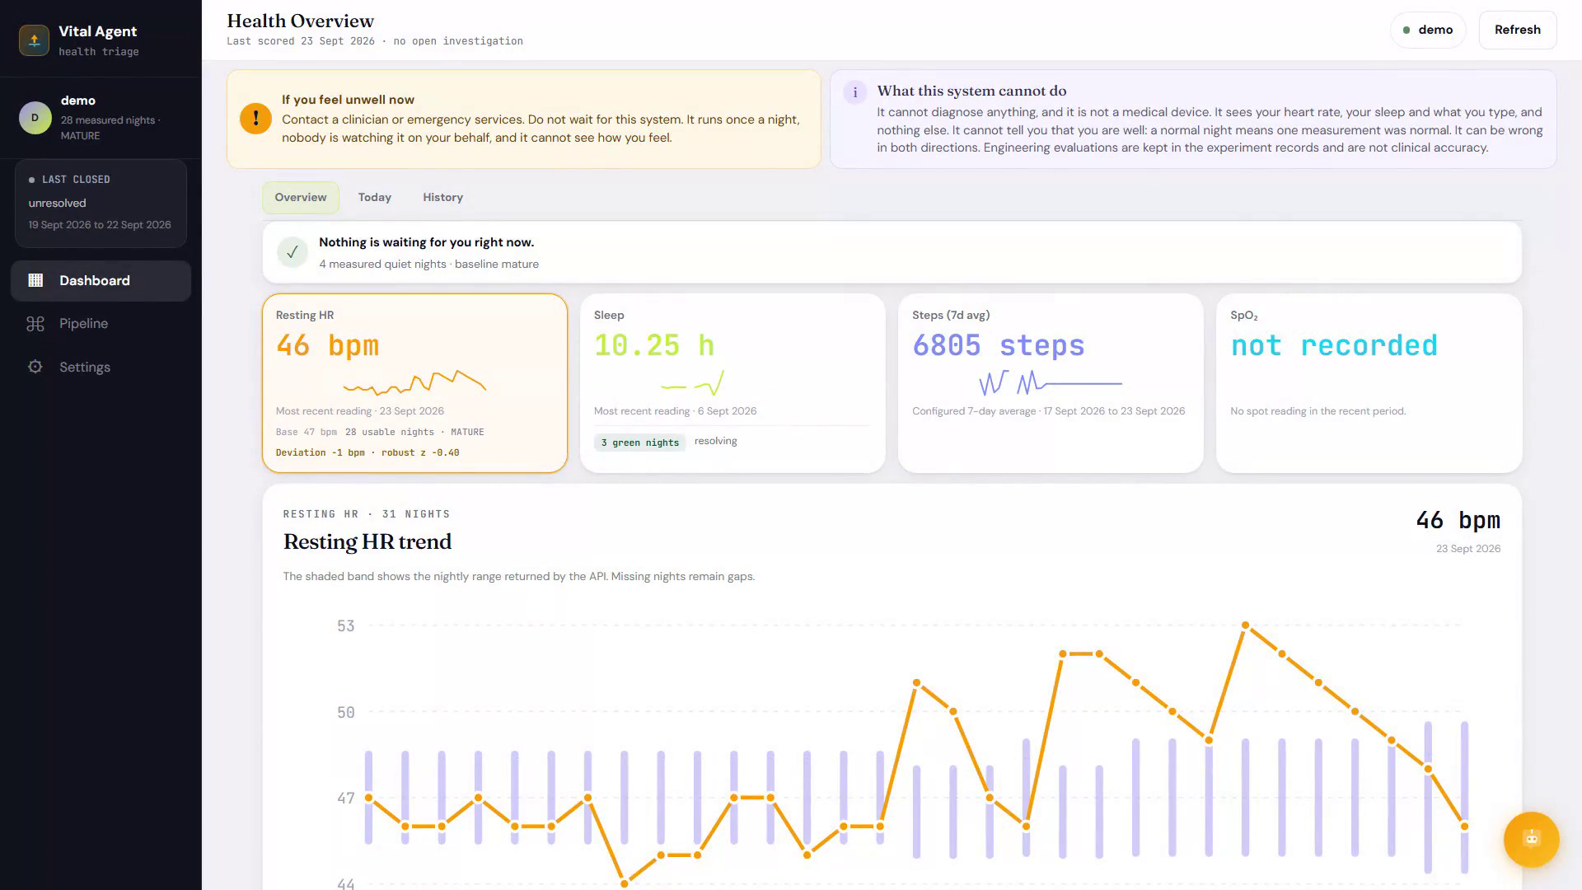
LIVE DEMO
The dashboard shows signal, status, and limits together
A real interface view from the demo video. The displayed subject and illness timeline are simulated.
OVERVIEW
Current state
Shows whether a check ran and whether an investigation is open.
HISTORY
Night by night
Trend and baseline help explain why one night changed.
LIMITS
The screen states this is not a diagnosis or medical device.
Demo footage: 20:55
WEARABLE HEALTH AGENT
16 / 20
Notes:
This is the dashboard in the 20:55 portion of docs/demo/wha-demo.mp4. It shows the demo subject, current status, four summary measures, a resting heart-rate trend, and an explicit limitations notice. Do not interpret its readings as patient evidence. Sources: docs/demo/wha-demo.mp4 (20:55); USER-GUIDE.md; docs/ARCHITECTURE.md.

Slide 17
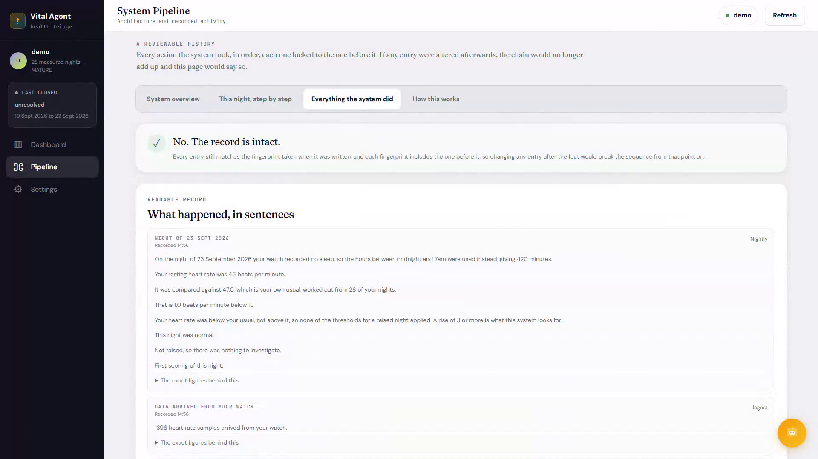
REVIEW TRAIL
Every nightly decision can be inspected
The current Pipeline screen shows the ordered record and tells you if an entry has changed.
21 NUMBERED STEPS
From watch data to conclusion
Steps show the calculation, fixed rules, AI tools, and user answers in order.
CHECK FOR CHANGES
Each entry has a digital fingerprint linked to the one before it. Changing an entry breaks the chain.
The chain records actions and refusals. It does not prove the health conclusion is correct.
WEARABLE HEALTH AGENT
17 / 20
Notes:
This is the current React and Vite Pipeline screen in docs/demo/wha-demo.mp4 at 11:46, not the archived Streamlit screen. The page shows the audit record in order and reports whether the stored hash chain still matches. A matching chain shows that recorded entries have not changed since they were written. It does not prove that the health conclusion is correct. Sources: docs/ARCHITECTURE.md; USER-GUIDE.md; docs/demo/README.md; docs/demo/wha-demo.mp4 (11:46).

Slide 18
DEMO HARNESS
A live interface runs on a simulated illness timeline
The harness checks a predicted result before it shows each demo day.
4 AUG
23 SEP 2026
Seed
Warm up
Illness and recovery
Resolve
7 read-only watch nights
27 generated nights to build baseline
Simulated from 7 to 23 Sep
Generated recovery nights
WHAT IS LIVE
WHAT IS SIMULATED
Dashboard and agent wording are live. The agent uses the real local source corpus.
Illness timeline and most baseline warm-up nights. The demo uses a separate subject and working database copy.
Mismatch check: stop on the first day where observed output differs from the forecast.
Runbook record: 5 halts; 4 exposed confirmed product defects.
WEARABLE HEALTH AGENT
18 / 20
Notes:
The film covers 4 Aug to 23 Sep 2026. Seven nights from the author's watch data are copied read-only into the demo subject, followed by 27 generated warm-up nights. The illness and recovery timeline is simulated through a Health Connect compatible mock bridge. Dashboard and agent wording are live, generated by the real model against the local corpus, not prerecorded. The harness forecasts each day's result before the run and halts on a mismatch; its runbook records five halts, four confirmed product defects. The server uses a working copy of data/demo_film.sqlite, disables the scheduler, and keeps the subject isolated. Sources: docs/demo/README.md; docs/RUNBOOK-SIMULATION.md; tools/demo_film/build.py; docs/demo/wha-demo.mp4.

Slide 19
EVALUATION
Earlier alerts in one Fitbit dataset
This pattern does not show that the system would help people in real use.
PEOPLE ALERTED FROM 7 DAYS BEFORE THROUGH 3 DAYS AFTER SYMPTOMS
WHA re-analysis
66.7%
Published NightSignal
66.7%
Random timing, same alert count
34.2%
DATA AND LEAD TIME
120 Fitbit participants, 8,508 nights, 30 labelled COVID cases, 76 without an illness label. Median alert: 3.0 days before symptoms vs 1.5 for NightSignal. Among the 76 without an illness label: one investigation every 4.9 person-weeks.
Only 32 of 120 had sleep-stage data, so most were scored by clock time.
One cohort and device. Retrospective, not peer reviewed. No patients were warned or treated.
WEARABLE HEALTH AGENT
19 / 20
Notes:
The reported person-level sensitivity was 66.7% for WHA and the published NightSignal comparator, versus 34.2% for random alert timing at the same alert rate. The window was seven days before through three days after symptom onset. In this cohort, WHA's median alert was 3.0 days before symptoms, compared with 1.5 days for NightSignal. The public Mishra et al. 2020 Fitbit dataset contained 120 people and 8,508 nights; 7,865 nights met the coverage floor. The analysis used 30 labelled COVID cases and 76 people with no illness label. Among those 76, the system opened one investigation every 4.9 person-weeks. Only 32 of 120 participants had sleep-stage data, so this re-analysis used clock times to define the sleep window for most people. The product uses the main sleep session recorded by the watch when available, and falls back to 00:00 to 07:00 when the watch records no sleep. The cohort scores are therefore not a direct test of the exact window used by the product. In a separate comparison of 21 people with sleep-stage data, night-to-night variation was smaller for 6, larger for 5, and unchanged for 10. The sleep window matters most for people whose sleep falls far outside clock hours. This is one device and one illness, an engineering re-analysis that is not peer reviewed. No patients were warned or treated and no health outcome changed. Separately, the question-policy simulation uses 40 synthetic cases and perfect immediate truthful responders, so it does not show user benefit. Sources: experiments/README.md; experiments/detection/RESULTS.md; experiments/detection/COMPARED-TO-NIGHTSIGNAL.md; experiments/policy-simulation/README.md; docs/DESIGN-SLEEP-WINDOW.md; Mishra et al. (2020) dataset as cited in the project.

Slide 20
WHAT IS BUILT
A complete prototype, with important proof still ahead
The project demonstrates an inspectable design. It does not establish that the system is safe or effective for patients.
BUILT IN THE REPOSITORY
STILL UNPROVEN
Wearable-to-dashboard data path
Accuracy across real people, devices, and conditions
Personal night baseline and two-night alert rule
Clinical safety and effects on health outcomes
Deterministic safety floor
Whether questions are useful and acceptable over time
Bounded AI agent and local retrieval
How well assumed cause rates and probe likelihoods reflect reality
Source-span checks, audit record, and demo harness
Use it to explain and evaluate the engineering, not to make a healthcare decision.
WEARABLE HEALTH AGENT
20 / 20
Notes:
Close by separating what is implemented from what is established. The repository contains a data path, deterministic detection and safety logic, a bounded investigator, local retrieval and source checks, an audit trail, and a simulated live demo. It does not contain patient outcome evidence or clinical validation. Sources: README.md; docs/DISCLOSURES.md; experiments/README.md; docs/RESEARCH-AGENTIC-TRIAGE.md.

