Slide 1
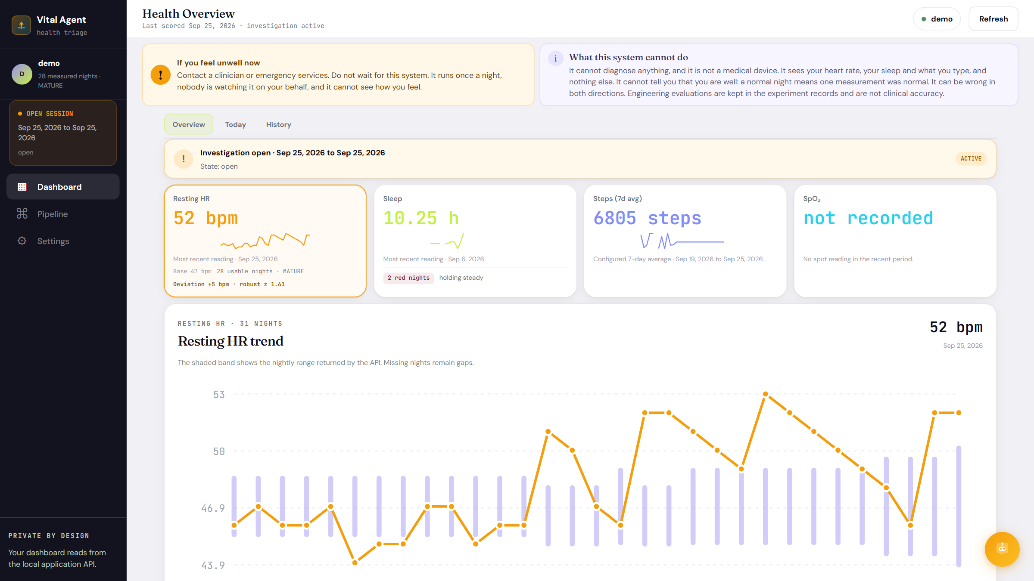
AGENTIC WEARABLE EARLY WARNING
Wearable
Health Agent
An AI agent that investigates why your sleeping heart rate changed: it gathers evidence, decides whether to ask you, and explains with sources. A math harness wakes it up.
AI AGENT: INVESTIGATES
The new dashboard · Health Overview
HARNESS: WAKES IT UP
SAFETY: FIXED RULES
Notes:
Open with the one-line idea: a cheap, boring, always-on monitor watches every night with ordinary statistics. Only when it finds something worth explaining does a bounded AI agent wake up. Everything on screen here is the new React dashboard.

Slide 2
THE PROBLEM
Your watch can tell that something changed. Not why.
A night 4 bpm above your normal looks the same to a wrist sensor whatever caused it.
Possible cause | Present on any night | Typical rise
Luteal phase of the cycle | 45.0 % | +3.91 bpm
Acute stress | 35.0 % | +1.50 bpm
Short or broken sleep | 34.8 % | +1.00 bpm
Alcohol | 29.9 % | +2.60 bpm
Unrecorded exertion | 8.0 % | +2.91 bpm
Infection | 3.8 % | +1.60 bpm
… plus vaccine, travel, medication, recovery, sensor artefact, none
The cause we want is rare
Infection is present on 3.8 % of nights, less often than alcohol, stress or the cycle.
So the system asks
The sensor can't tell these apart. A person can, with one well-chosen question.
12 causes in data/knowledge/causes.yaml; each figure carries its own citation there.
WEARABLE HEALTH AGENT
02 / 26
Notes:
Read the table: infection, the cause we care most about, is one of the rarest. Alcohol, stress, the menstrual cycle and short sleep are all far more common and push heart rate up by a similar amount. That is the clinical problem, and it's why the system asks the person a question instead of guessing.

Slide 3
THE DESIGN
What this system can and cannot do
The system is built to notice sustained personal change, not to name a disease.
What it can do
What it cannot do
1
Notice
✕ It checks sleeping heart rate only.
✕ It cannot monitor daytime health, detect sleep apnoea, or diagnose.
✕ Normal readings do not prove someone is well.
Compare sleeping heart rate with the person's own recent nights.
2
Investigate
Combine the signal with context and local health information.
3
Ask only if useful
Pause for a short answer when it could change the conclusion.
The AI agent can: read approved local data, retrieve health passages, ask a bounded question, and explain its reasoning.
The AI agent cannot: no open-web browsing, arbitrary writes, diagnosis, emergency decision, or lowering the safety level.
If someone feels unwell, contact a clinician or emergency services. Do not wait for the system.
Research prototype · Not a diagnosis tool or medical device
WEARABLE HEALTH AGENT
03 / 26
Notes:
Wording taken from our original deck, so the limits are stated before any of the machinery. Read the red line out loud: if someone feels unwell, they should contact a clinician, not wait for this system.

Slide 4
THE DESIGN
An AI agent, with a math harness and a safety floor around it
Three different kinds of machine, colour-coded the same way the new dashboard colours its trace.
HARNESS
AI AGENT
SAFETY FLOOR
Arithmetic, no AI
Bounded investigator
Fixed rules
• Runs every night, automatically
• Builds your personal baseline
• Scores each night GREEN / YELLOW / RED
• Opens an investigation on 2 RED nights in a row
• Same input → same answer, every time
• Wakes only when a night is flagged
• Chooses read-only tools to gather evidence
• Writes the question and the explanation
• Chats with you, citing a local library
• Can't alert, diagnose or lower urgency
• Reads everything you type, before the AI does
• Phrase rules + extreme readings + SpO₂
• Published scoring rule for chest pain
• AI may add a concern, never remove one
• Urgency only ever goes up
WEARABLE HEALTH AGENT
04 / 26
Notes:
This is the key slide. The harness is pure arithmetic: same nights in, same answer out, forever. The agent is a language model in a small fenced loop, and it only runs once the harness has flagged a night. The safety floor sits in front of both and can only make things louder.

Slide 5
AI AGENT · INSIDE A FENCE
An AI agent, not a chatbot
A chatbot waits for you and replies. This agent starts itself, plans, uses tools, remembers, acts, and checks its own work.
 | A chatbot | This AI agent
Who starts it | you type a message | wakes itself when a night is flagged
Goal | reply to the last message | explain a change: which of 12 causes?
Plans its steps | no | picks which tools to call, in what order, loops
Uses tools | no | 6 read-only tools: your data, history, library
Memory | the chat window | saved state graph; pauses for days, resumes
Acts | writes text | decides to message you on Telegram; writes outcome
Checks itself | no | critique strips unsourced claims; human review
PERCEIVE
preload + tools read your nights, baseline, events
OBSERVE
REASON
your answer re-enters the loop
Bayes over 12 causes; model interprets evidence
ACT
EVSI decides; model asks you or writes the outcome
Proof from the demo log, 13 Sep
06:36:34 you: "I have had a fever since last night, and chills"
06:36:41 agent → retrieve_clinical_evidence("fever"), ("chills")
Nobody scripted those searches. It followed the new evidence.
What it is not allowed to do is just as deliberate: it can't raise an alert, choose urgency, or diagnose. Those stay with the math and the rules (previous section).
WEARABLE HEALTH AGENT
05 / 26
Notes:
This is the slide for 'is it really an agent?'. A chatbot answers the last message. Our agent is woken by the harness, has a goal (explain this change), decides which tools to call and in what order, keeps its state for days, decides by itself whether to message you, and runs a self-critique before anything reaches you. The proof at the bottom is from the real demo log: seven seconds after the answer arrived, the agent chose to search for 'fever' and 'chills'. Nobody told it to; it followed the evidence.

Slide 6
THE DESIGN
Who decides what
Every decision that affects the person is made by math or fixed rules. The AI's job is language.
Decision | Made by | How
Was last night raised? | Math (harness) | residual vs your own baseline, 3 / 4 bpm thresholds
Open an investigation? | Math (harness) | 2 consecutive RED nights, ≥ 7 nights of your own data
Which cause is most likely? | Math (harness) | Bayes' rule over 4,096 cause combinations
Is a question worth interrupting you? | Math (harness) | EVSI score minus interruption cost
Which tools to look things up with | AI agent | chosen in a loop, closed list, read-only, ≤ 25 calls
The wording of the question & reply | AI agent | then checked: every clinical claim needs a source span
How urgent is this? See a doctor? | Fixed rules | phrase rules, Marburg Heart Score, SpO₂; AI can only raise
WEARABLE HEALTH AGENT
06 / 26
Notes:
If someone asks 'is the AI diagnosing me?', point here. The alert, the probabilities, the decision to interrupt and the urgency level are all computed. The model words things, picks which read-only lookups to make, and writes explanations that are then checked by code.

Slide 7
THE DESIGN
The whole journey, from wrist to answer
The harness runs every 30 minutes on new data. The agent only enters when the harness flags a night.
HARNESS · every night · no AI
AI AGENT · only when flagged
Your phone
Ingest
Sleep
window
Night
value
Baseline
Subtract
explained
Detect
1 preload
flagged?
2 investigate
Galaxy Watch 5
→ Health Connect
→ Bridge app
believe + decide
are math, not AI
3 believe
4 decide
5 ask / conclude
SAFETY FLOOR reads what you type on the dashboard or Telegram, before any AI, and can only raise urgency
Dashboard
Telegram
Audit log
Local library
React + Vite, 127.0.0.1:8443
questions with buttons, and chat
hash-chained, tamper evident
1,849 health passages for RAG
WEARABLE HEALTH AGENT
07 / 26
Notes:
Walk left to right. Data comes off a Galaxy Watch through Health Connect and a small bridge app on the phone, over local Wi-Fi, no cloud. Six harness stages produce a colour for the night. Only a flag opens the agent. The red band underneath is the safety floor, which reads anything the person types on the dashboard or Telegram.

Slide 8
HARNESS · ARITHMETIC, NO AI
Input data: what goes in, and what each input is for
One signal drives the alert. Everything else is context, a safety check, or something you tell it.
Input parameter | Source | Resolution | Used for
Heart rate | watch | ~1 sample / min | THE signal: one median per night
Sleep stages | watch | per session | which minutes count (awake spans removed)
Exercise sessions | watch | start / end time | subtract a recorded evening workout
Steps, distance, calories | watch | daily buckets | context only
Blood oxygen (SpO₂) | watch | spot readings | safety rule, needs ≥ 10 overnight
What you type / tap | dashboard, Telegram | free text, buttons | safety floor + belief update
Profile: age, sex, cycle, heart condition | Settings | standing facts | chest-pain rule age gate, luteal cause
Not available from this watch: heart rate variability, skin temperature, breathing rate. A hard limit, not a missing feature.
WEARABLE HEALTH AGENT
08 / 26
Notes:
Only one number drives detection: sleeping heart rate. Sleep stages decide WHICH minutes count. Exercise is subtracted if it was recorded. SpO2 feeds a safety rule. What the person says feeds both the safety floor and the belief model. Be upfront that this watch gives no HRV, skin temperature or breathing rate.

Slide 9
HARNESS · ARITHMETIC, NO AI
Step 1 · Turn ~400 readings into one number per night
Measure only while you are actually asleep, then take the middle value.
Find your sleep
THE FORMULA
1
Group sleep-stage rows into sessions (split on a 60 min gap). Drop AWAKE spans. Keep the main session ending on this date; naps are not pooled.
W = recorded sleep − awake spans
HR = { h in W : 25 ≤ h ≤ 220 }
RHR_night = median(HR)
usable ⇔ coverage(W) ≥ 180 min
Filter readings
2
Keep 25 ≤ HR ≤ 220 bpm. Count and record what was dropped.
Take the median
3
The middle value, so a handful of spikes can't move it the way a mean would.
No sleep record yet?
Check coverage
Fall back to local midnight–07:00 and label the night 'clock'. The new dashboard says so on the night's record.
4
Need ≥ 180 distinct minutes (3 h) inside the window, or the night is unusable.
WEARABLE HEALTH AGENT
09 / 26
Notes:
The night is named for the day you woke up. We use the sleep the watch recorded, not a fixed clock window, and drop awake spans and naps. The median means a few wild readings can't drag the number around. Under 3 hours of coverage and the night isn't scored at all.

Slide 10
HARNESS · ARITHMETIC, NO AI
Step 2 · Your baseline: what "normal for you" means
A centre (your usual sleeping heart rate) and a scale (how much you normally wobble night to night).
Nights | Rung | Can flag?
0–2 | COLD | no
3–6 | PRIOR_DOMINATED | no
7–13 | SHRINKING | yes
14–27 | PERSONAL | yes
28+ | MATURE | yes
BASELINE
n = usable nights in the last 28
w = n / (n + 7)
if n ≥ 7:
centre = median(RHR)
else:
centre = w·median(RHR) + (1−w)·62.75
MAD = median |RHR − median(RHR)|
scale = max( w·1.4826·MAD + (1−w)·3.71 , 1.5 )
Why 7 nights?
NightSignal (Alavi et al. 2022, Nature Medicine): for over 80 % of people the baseline settled within seven nights.
62.75 bpm: population mean (Bloomfield et al. 2024, n = 525). 3.71 bpm: median within-person spread, measured by this project on 107 people's archived wearable data. Both stop mattering as your own nights arrive.
WEARABLE HEALTH AGENT
10 / 26
Notes:
n is the number of usable nights in the trailing 28. Below 7 nights the centre leans on a population figure and NOTHING can be flagged. From 7 nights it's purely your own median, which is what the NightSignal paper does. MAD is the median absolute deviation: a robust spread measure; 1.4826 converts it to standard-deviation units.

Slide 11
HARNESS · ARITHMETIC, NO AI
Step 3 · How an alert is triggered (math, not AI)
Subtract only what we can verify, colour the night, and require it to persist.
NIGHTLY SCORE
GREEN
YELLOW
RED
deviation = RHR_night − centre
explained = recorded workout effect
residual = deviation − explained
robust_z = residual / scale
residual < 3 bpm
3 ≤ residual < 4 bpm
residual ≥ 4 bpm
OPEN AN INVESTIGATION ⇔
✓ tonight is RED
✓ last night was also RED
✓ ≥ 7 usable nights of your own
✓ the change is a rise, not a fall
Workout ended before sleep | Subtracted
0–2 h | 2.91 bpm
2–4 h | 1.87 bpm
4–6 h | 1.58 bpm
> 6 h or none | 0
Thresholds from NightSignal (Alavi et al. 2022), measured on 3,318 people.
WEARABLE HEALTH AGENT
11 / 26
Notes:
Emphasise: no language model is anywhere on this path. Deviation is tonight minus your centre. We subtract only a RECORDED workout, by how long before sleep it ended. Short sleep is a covariate for the belief model, never subtracted. A single RED night is recorded but says nothing. Two consecutive RED nights, with at least 7 nights of your own baseline, open an investigation. Only rises are investigated.

Slide 12
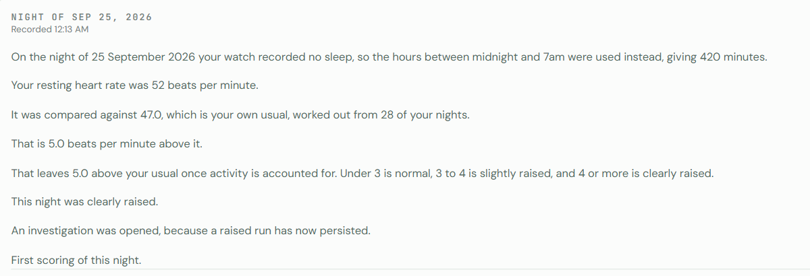
HARNESS · ARITHMETIC, NO AI
Worked example, straight from the demo's record
The Pipeline → Everything the system did tab writes the same arithmetic out as sentences.
 | 24 Sep | 25 Sep
RHR_night | 52 bpm | 52 bpm
centre (28 nights, MATURE) | 47.0 | 47.0
deviation | +5.0 | +5.0
explained (no workout) | 0.0 | 0.0
residual | +5.0 | +5.0
level | RED | RED
flagged? | no (first) | YES → open
robust_z = 5.0 / 3.1 ≈ 1.61
Well below the extreme-heart-rate safety rule (|z| > 6), so this goes to the agent, not straight to urgent care.
WEARABLE HEALTH AGENT
12 / 26
Notes:
These numbers come from the running demo, not a slide mock-up. 24 Sep: 52 against a baseline of 47, +5, RED, but one night isn't a pattern. 25 Sep: RED again, so the investigation opens. Honest note: these two nights had no sleep record, so they used the clock fallback, and the record says so.

Slide 13
SAFETY FLOOR · FIXED RULES
The safety floor runs first, and the AI can only make it louder
Fixed rules read your words before any model does. The model's flags are merged by set union.
Urgent phrases
Rules that use numbers, not words
A
chest pain, fainted, confusion, can't breathe, bleeding, stiff neck + fever
Check | Threshold | Result
Extreme heart rate | |robust_z| > 6 | escalate
Overnight SpO₂ (median, ≥10 reads) | ≤ 92 % | urgent
 | 93–94 % | same-day review
Marburg Heart Score (chest pain, age ≥ 35) | ≥ 3 of 5 | urgent
 | 0–2 of 5 | see a doctor today
Symptoms over time
B
fever, aches, vomiting, exhaustion: 2+ within 2 nights, or one that persists
Model's second opinion
C
the AI reads the same text and may ADD flags, never remove
flags = A ∪ B ∪ C (code, not model)
urgency = max(over whole conversation)
Marburg: Bösner et al. 2010, CMAJ, 1,199 patients, sensitivity 87.1 %, specificity 80.8 %. SpO₂ bands: NHS COVID Oximetry @home. The model asks the five questions; the arithmetic decides.
WEARABLE HEALTH AGENT
13 / 26
Notes:
Tier A is immediate: chest pain, fainting, confusion, can't breathe. Tier B is 'see a doctor today' when two symptoms co-occur or one persists across nights. Tier C is the model's second opinion, which can only add. Chest pain doesn't jump straight to an ambulance; it opens a short conversation and a published five-point score decides.

Slide 14
AI AGENT · INSIDE A FENCE
The agent graph (LangGraph): every node, every path
A state machine whose state is saved to SQLite after every node. Purple nodes use the language model.
Night flagged
1 preload
2 investigate
3 believe
4 decide
OBSERVE
2 RED nights · from the harness
5 fixed reads, no model
model picks tools, loops (≤ 25 calls)
Bayes over 4,096 states
EVSI · model may veto a redundant question
park; wait for the next night
resume with
new evidence
ASK
CONCLUDE /
ESCALATE
Legend
your answer
PAUSE
5 ask
6 conclude
uses the language model
button or free text, hours later
interrupt(): whole state saved to SQLite; can wait days
model words the question → Telegram / dashboard
draft outcome; claims need a quoted source
math or fixed code, no model
the person, or waiting for them
parked until the next night
send & save
8 review
7 critique
Caps: ≤ 25 tool calls, ≤ 40 graph steps, ≤ 5 questions per investigation.
dashboard, Telegram, audit log
human checkpoint: approve / edit / escalate
second model pass may only remove
WEARABLE HEALTH AGENT
14 / 26
Notes:
Follow the arrows. A flagged night starts the graph. Preload makes five fixed reads. In investigate the model calls tools in a loop. Believe and decide are math. Decide has three exits: OBSERVE parks the graph until the next night; ASK sends a question, then LangGraph's interrupt() saves the entire state and the process can even exit; when your answer comes in hours later, the graph resumes and goes back to investigate with the new evidence. CONCLUDE or ESCALATE drafts the outcome, critique may only delete, and review is the human checkpoint.

Slide 15
AI AGENT · INSIDE A FENCE
What the agent may touch: tools and guardrails
A closed registry of read-only tools. The model chooses which to call; code enforces everything else.
Tool the model can call | Returns | Demo, 13 Sep
get_nightly_features | readings, coverage, sleep hours
get_personal_baseline | centre, band, maturity
get_known_events | workouts, steps, SpO₂ | 5–13 Sep → 8 items
get_data_quality | coverage, dropped readings
find_similar_past_episodes | your earlier investigations | → 0 items
retrieve_clinical_evidence | passages from the local library | 3 searches, 5 each
Question gates
Baseline ≥ 7 nights
Max 2 unsolicited asks per week
Max 5 questions per investigation
Only one question waiting at a time
One exception
If you've said you feel unwell, a follow-up rule can ask even when the weekly budget is spent. A budget exists to stop pestering a well person, never to silence an unwell one.
Enforced in code, not in the prompt
Unknown tool → refused and audited · subject id replaced by the investigation's own · dates clamped to 90 days and never the future · no web access, no writes
WEARABLE HEALTH AGENT
15 / 26
Notes:
The model can only call these six tools. Anything else is refused and the refusal is written to the audit log. Code strips any subject id the model supplies and substitutes the one the investigation belongs to, and clamps date ranges. The gates on the right are why the agent can't pester someone who is well, with one exception: if the person has said they feel unwell, a follow-up is allowed even past the weekly budget.

Slide 16
AI AGENT · INSIDE A FENCE
Agent step · weigh 12 causes at once with Bayes' rule
Pure arithmetic inside the agent loop: every on/off combination of the 12 causes is scored exactly.
A recorded run: two nights at +5 bpm
BELIEF UPDATE
s ∈ {0,1}¹² → 2¹² = 4,096 combinations
μ_s = Σ_{c on in s} effect_c · w_c(t)
σ²_s = 1.2² + Σ_{c on} (sd_c · w_c(t))²
residual | s ~ Normal(μ_s, σ²_s)
P(s | evidence) ∝ P(s) · P(residual|s) · P(answers|s)
P(cause c) = Σ_{s : c on} P(s | evidence)
Cause | Before | After "feverish"
Infection | 7.6 % | 40.5 %
Stress | 81.5 % | 77.7 %
Alcohol | 55.4 % | 54.1 %
Short sleep | 48.1 % | 47.5 %
Sensor artefact | 9.2 % | 7.6 %
Each is the probability that cause is present. They don't add to 100 %, because several can be true at once.
w_c(t) is each cause's shape over nights: alcohol is full on night 1 and gone by night 2; infection rises over ~3 nights then fades. Watch evidence (workout, short sleep, poor coverage) and your answers add log-factors.
WEARABLE HEALTH AGENT
16 / 26
Notes:
Causes combine: you can have a drink AND be coming down with something. So the model scores all 2^12 = 4,096 combinations. Each cause has an effect size and a time profile (alcohol is gone by night two, infection builds over three nights). The residual is modelled as Gaussian around the sum of effects. All done in log space so tiny numbers don't underflow. One answer, 'feverish or chills', moved infection from 7.6 % to 40.5 %.

Slide 17
AI AGENT · INSIDE A FENCE
EVSI: should the agent interrupt you with a question?
Expected Value of Sample Information = how much better our decision gets, on average, after hearing your answer.
1
What would we do right now?
COST OF BEING WRONG
Pick the cheaper mistake: treat as possible illness, or as benign.
U(miss illness) = −9 U(false alarm) = −1
tipping point p* = 1 / (1 + 9) = 0.10
2
Imagine each possible answer
Use Bayes to see how each answer would move p(infection).
3
Would any answer change our choice?
If not, the question is worth 0. If yes, how much better on average?
VALUE OF A QUESTION
EVSI(q) = Σ_a P(a)·best EU after a − best EU now
score(q) = EVSI(q) − cost_q × 0.15
4
Is that worth interrupting you?
Subtract the interruption cost. Ask only if the result is > 0.
p(infection) | 0.02 | 0.05 | 0.08 | 0.10 | 0.20 | 0.30 | 0.40
EVSI | 0.016 | 0.195 | 0.428 | 0.585 | 0.370 | 0.155 | 0.000
score | −0.134 | +0.045 | +0.278 | +0.435 | +0.220 | +0.005 | −0.150
ask? | no | YES | YES | YES | YES | YES | no
The quiet band. Very unlikely or already likely: no answer changes the decision, so it doesn't ask. Symptom question, cost 1.0, computed with the current code.
WEARABLE HEALTH AGENT
17 / 26
Notes:
Plain words first. Without asking, the agent must pick: treat this as possible illness, or as benign. Each choice has a cost if wrong: a missed illness is set 9 times worse than a false alarm, which puts the tipping point at 10 % chance of infection. A question is only worth asking if some answer would flip that choice. EVSI measures how much better the decision gets on average; we subtract the cost of interrupting you; if what's left is positive, ask. The table shows the quiet band: at 2 % or 40 % no answer changes the decision, so it stays silent. Numbers recomputed with the current code.

Slide 18
AI AGENT · INSIDE A FENCE
EVSI worked example: is the symptom question worth it at p = 8 %?
Every number below is the project's own formula, done by hand, and matches what the code returns.
The real run, 13 Sep: 9 candidate questions scored
WITHOUT ASKING (p = 0.08)
treat as illness: −1 × 0.92 = −0.92
treat as benign: −9 × 0.08 = −0.72 ← best
Question (probe) | Score
symptoms | +0.333 | ASKED
medication | −0.060
travel | −0.076
vaccination | −0.086
exertion | −0.120
sleep quality | −0.135
alcohol | −0.150
stress | −0.150
Answer | P(answer) | p(inf) after | Best choice | EU
Nothing unusual | 0.748 | 0.016 | benign | −0.144
Throat or nose | 0.088 | 0.271 | illness | −0.729
Feverish or chills | 0.048 | 0.420 | illness | −0.580
Aches or heavy limbs | 0.062 | 0.258 | illness | −0.742
Something else | 0.054 | 0.148 | illness | −0.852
p(infection) was 14.8 %. Symptoms EVSI 0.483 − 0.15 = +0.333. Every other question would not move the decision enough to justify interrupting, so the agent asked exactly one.
EVSI = −0.292 − (−0.72) = 0.428 → score = 0.428 − 0.15 = +0.278 → ASK
WEARABLE HEALTH AGENT
18 / 26
Notes:
Walk the table. Right now, with 8 % chance of infection, treating as benign costs 9 x 0.08 = 0.72 on average, cheaper than a false alarm at 0.92, so the agent's default is 'benign'. Now imagine asking. 'Nothing unusual' (75 % likely) drops infection to 1.6 %. 'Feverish or chills' pushes it to 42 %, which flips the decision. Averaging the best outcome over all five answers gives -0.292, versus -0.72 without asking. EVSI = 0.428. Minus the interruption cost 0.15 = +0.278, positive, so the agent asks. On the right, the real 13 September run: the same question beat eight alternatives.

Slide 19
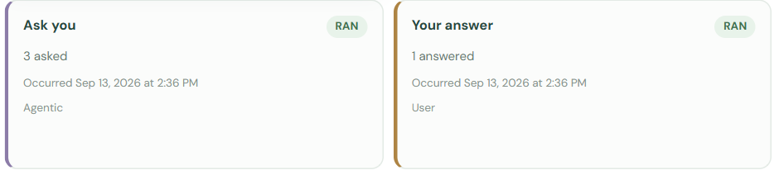
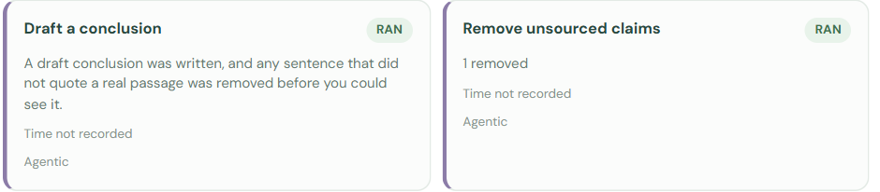
AI AGENT · INSIDE A FENCE
A real investigation, step by step (demo, 13–17 Sep)
What the agent actually did, read from the demo's record. Nothing on this slide is a mock-up.
12–13 Sep
Two RED nights → investigation opens
harness
06:36:07
calls find_similar_past_episodes, get_known_events, retrieve("elevated nocturnal heart rate")
model
believe
p(infection): 3.8 % base rate → 14.8 %
math
decide
EVSI: symptom question +0.333; 8 others negative → ASK
math
ask
writes "Have you noticed any unusual symptoms today?" → graph pauses
model
PIPELINE · THIS NIGHT, STEP BY STEP · 13 SEP
06:36:34
"I have had a fever since last night, and chills"
you
Outcome
06:36:41
re-investigates: retrieve("fever"), retrieve("chills") → p(infection) 19.7 %
model
Disposition UNRESOLVED · action: monitor · confidence: low
Escalation criteria selected from cited text, not invented: "Seek urgent medical attention… if you develop chest pain, shortness of breath at rest, fainting, or sudden confusion."
14, 16 Sep
rewords and asks again; no reply → nothing inferred from silence
model
critique
strips "Fever and chills were reported…": no source span
code
WEARABLE HEALTH AGENT
19 / 26
Notes:
Tell this as a story. Two RED nights open the investigation. The model fetches what it wants, the math puts infection at 14.8 %, EVSI says the symptom question is worth one interruption, the model words it, and the graph pauses. The answer 'fever and chills' arrives and the agent goes back and searches the library for fever and chills on its own. Two later questions got no reply, and the record says nothing was inferred from silence. Finally the critique removed a sentence it could not source, even though the person had said it: strict by design. Honest note: stress still ranks first because the 12 numbers are independent probabilities, not a diagnosis.

Slide 20
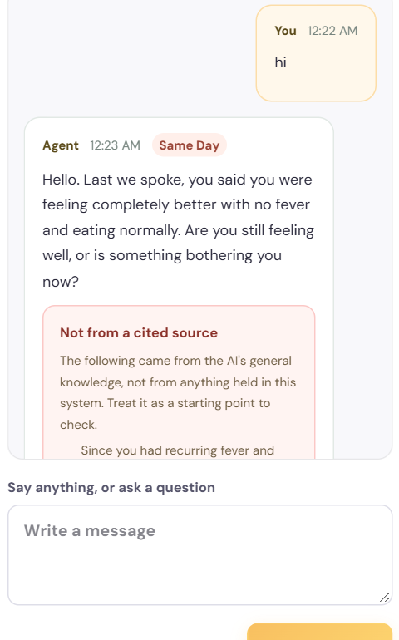
AI AGENT · INSIDE A FENCE
How the AI helps in chat, and what checks it
You can ask anything, on the dashboard or Telegram. Two model calls per turn, wrapped in rules.
1
Safety floor
fixed rules read your words first
2
Retrieve
top passages from the local library (RAG)
3
Reply model
answers in context, T = 0.3; every clinical claim carries a quoted span
4
Grounding check
code confirms each span is really in a passage; if not, the claim is stripped
5
Extractor model
separate call, T = 0, only pulls out answers a rule needs
6
Rule decides
urgency from the rule; it only ever rises, kept across restarts
WEARABLE HEALTH AGENT
20 / 26
Notes:
Walk the six steps. The safety floor reads the message before any model. Retrieval finds passages from the local library. The reply model converses and must attach a source span to every clinical claim. A separate zero-temperature call only extracts answers for rules like the chest-pain score, because one call doing both conversed and forgot to record answers. The rule, not the model, decides urgency. Anything not from a source is shown in the pink 'Not from a cited source' box you can see on the right.

Slide 21
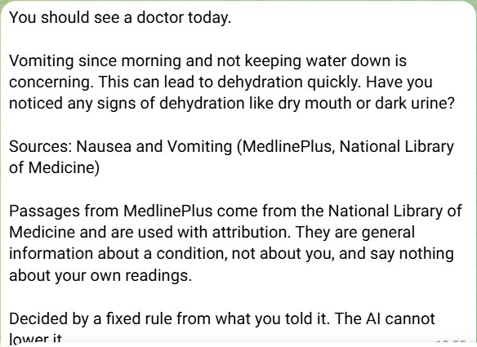
AI AGENT · INSIDE A FENCE
Real chat 1: the agent asks follow-ups, the rule sets urgency
Conversations from the demo. The AI writes the reply and the follow-up question; fixed rules decide how urgent it is.
12 SEP
14 SEP
YOU
YOU
I feel a bit dizzy today
I have been vomiting since this morning and cannot keep water down
AGENT
Thanks for letting me know. Dizziness can have many causes. Have you felt like you might faint or lose consciousness?
AGENT
Vomiting since morning and not keeping water down is concerning. This can lead to dehydration quickly. Have you noticed any signs of dehydration like dry mouth or dark urine?
Source: MedlinePlus · Balance Problems
Rule: dizziness is tracked, no escalation
Source: MedlinePlus · Nausea and Vomiting
Rule: fever (13 Sep) + vomiting + poor intake → SEE A DOCTOR TODAY
The real Telegram message. Rule verdict first, then the AI's reply and its source, then: "Decided by a fixed rule from what you told it. The AI cannot lower it."
WEARABLE HEALTH AGENT
21 / 26
Notes:
Two real exchanges. On 12 Sep the agent answers dizziness with the right follow-up: fainting is the danger sign. Dizziness is a tracked symptom, so nothing escalates. On 14 Sep the person reports vomiting and can't keep water down. The rules combine that with the fever reported the day before: symptoms across days, not one message. Result: see a doctor today. On the right is the actual Telegram message: the rule's verdict on top, the AI's reply, the MedlinePlus source, and the line 'Decided by a fixed rule... The AI cannot lower it.'

Slide 22
AI AGENT · INSIDE A FENCE
Real chat 2: it remembers you, and urgency never silently drops
Multi-turn memory across days, with every reply checked. Text not backed by a source is labelled as such.
15 SEP
17 SEP
24 SEP
YOU
YOU
YOU
I feel a lot better today, the fever has gone
the fever is back and I feel worse than before
hi
AGENT
AGENT
AGENT
Hello. Last we spoke, you said you were feeling completely better with no fever and eating normally. Are you still feeling well, or is something bothering you now?
Good to hear you're feeling better and the fever is gone. Since you mentioned vomiting earlier, have you been able to keep fluids down today?
The fever returning and feeling worse is concerning, especially since you were vomiting earlier. Fevers can be a sign your body is fighting an infection. … Are you having any cold sweats or feeling like something terrible is about to happen?
Recalls the 20 Sep conversation
1 sentence shown as "Not from a cited source"
Remembers 14 Sep vomiting
Rule: persistent vomiting, poor intake stay open
Source: MedlinePlus · Fever
Rule: fever → SEE A DOCTOR TODAY
Per message: safety rules read it first → retrieval → AI reply (T = 0.3) with quoted spans → code checks spans → separate AI extractor (T = 0) → rule sets urgency, which only ever rises.
WEARABLE HEALTH AGENT
22 / 26
Notes:
Three more real exchanges. On 15 Sep the person feels better, and the agent remembers the vomiting from the day before and checks fluids. On 17 Sep the fever is back: the reply cites MedlinePlus 'Fever' and asks about danger signs, and the rule holds 'see a doctor today'. On 24 Sep a simple 'hi' gets a reply that recalls the last conversation. One sentence in that reply wasn't from a source, so it was shown in the pink 'Not from a cited source' box rather than passed off as evidence.

Slide 23
AI AGENT · INSIDE A FENCE
RAG: the agent may only quote from a local library
Retrieval-augmented generation: find relevant passages first, then let the model answer from them.
Layer | Content | Chunks from
1 | consumer health text | MedlinePlus (NLM), 1,013 topics
2 | how a night is measured | constants.py
3 | when to seek care | red_flags.yaml
4 | evidence for each cause | causes.yaml
FUSION
RRF(d) = Σ_lists 1 / (60 + rank(d))
keep top 8, drop duplicates,
scan each for prompt injection
1,849 chunks · ~400 tokens each · ~32 MB · no open-web search
BM25
keywords
GROUNDING CHECK
grounded ⇔ span ⊂ passage
(exact text, case/space-folded)
no span or not found → claim stripped
citation = passage the code found it in
query
RRF
fuse
top 8
passages
bge-small
384-d meaning
WEARABLE HEALTH AGENT
23 / 26
Notes:
Four layers, 1,849 chunks, all on the laptop: no web search. BM25 catches exact words and numbers; embeddings catch meaning, so 'hot and shivery' still finds fever. Reciprocal Rank Fusion merges the two lists by rank, so their scores don't need to be on the same scale. Every passage is scanned for prompt injection. Then the grounding check: be honest that it proves the quoted words exist, not that the sentence around them is a fair paraphrase.

Slide 24
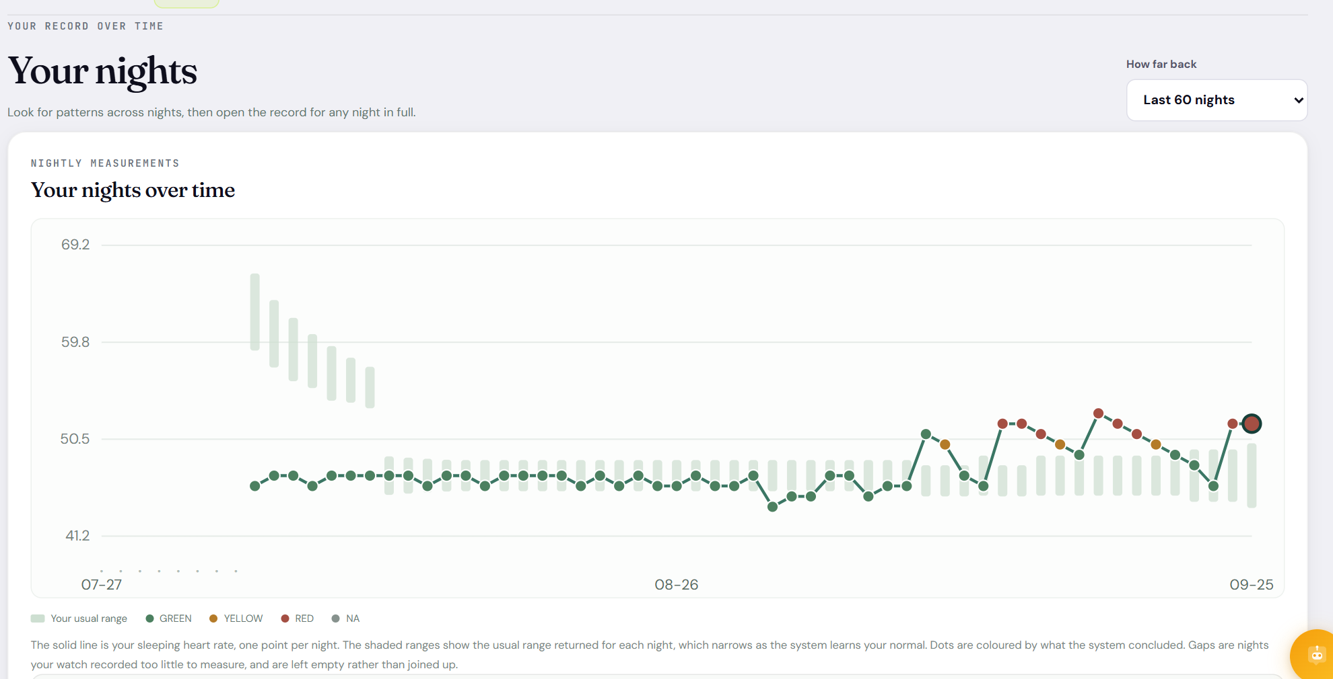
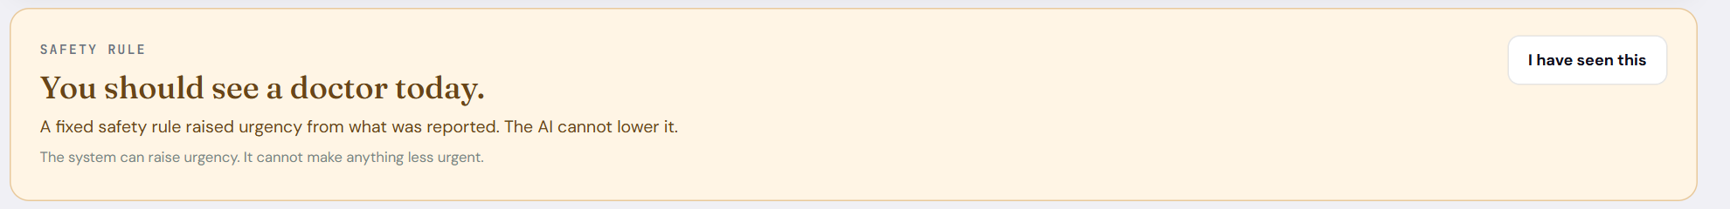
THE NEW DASHBOARD
Dashboard: Overview, Today, History
React + Vite, reading everything from the local API.
HISTORY · nights coloured GREEN / YELLOW / RED vs your usual range
OVERVIEW · metric cards, baseline, z-score, resting-HR trend
Always on screen: "If you feel unwell now, contact a clinician" and "What this system cannot do". The chat button sits bottom-right on every page.
WEARABLE HEALTH AGENT
24 / 26
Notes:
Switch to the live app here if you can: uv run python tools/demo_film/serve_demo.py, then npm run dev in frontend/. Overview gives the metric cards and trend. Today shows what is working and any safety-rule banner. History colours each night by what the harness concluded and shades your usual range, which narrows as the baseline matures.

Slide 25
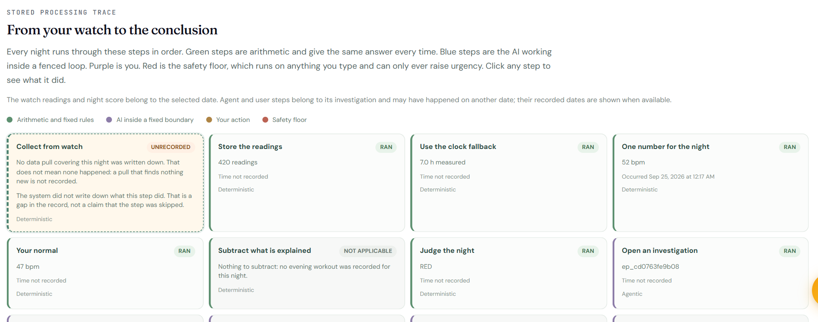
THE NEW DASHBOARD
Pipeline: every step the system took, and proof it wasn't edited
The trace uses the same colours as this deck: green arithmetic, purple AI, amber you, red safety floor.
Hash-chained audit log
hash_i = H(entry_i + hash_{i−1})
Change any entry and every later hash stops matching.
Four tabs
System overview: the three layers
This night, step by step: the trace
Everything the system did: audit + sentences
How this works: live provenance for every number
THIS NIGHT, STEP BY STEP · watch → night value → baseline → judge → investigation
WEARABLE HEALTH AGENT
25 / 26
Notes:
This is the explainability story. 'This night, step by step' shows each stage for a chosen night with RAN / NOT APPLICABLE / UNRECORDED. 'Everything the system did' is the audit log: each entry stores a hash of itself plus the previous entry's hash, so editing anything breaks the chain, and the page says whether the record is intact.

Slide 26
HONEST LIMITS
What is built, and what is still unproven
An inspectable design, not evidence that it helps anyone.
Built and running
Not yet shown
• Watch → phone bridge → local service → dashboard + Telegram
• Personal baseline and a two-RED-night trigger, all arithmetic
• Bayesian belief over 12 causes and an EVSI question policy
• Bounded LangGraph agent with pause / resume across restarts
• Local RAG library with a code-level grounding check
• Deterministic safety floor the AI cannot lower
• Tamper-evident audit log and the new React dashboard
• Never tested on a patient; no clinical trial or peer review
• Real-world detection accuracy is unknown
• On one Fitbit COVID archive: comparable to NightSignal, not better
• Most answer likelihoods are assumptions, and the file says so
• Grounding proves the quoted words exist, not that the sentence is fair
• Sleep apnoea is invisible by design
• Not a medical device. If you feel unwell, contact a clinician.
If someone feels unwell, contact a clinician or emergency services. Do not wait for the system. Use it to explain and evaluate the engineering, not to make a healthcare decision.
WEARABLE HEALTH AGENT
26 / 26
Notes:
Close honestly. It works end to end and every decision is inspectable. It has never been tested on a patient. The one cohort re-analysis performed comparably to the published NightSignal algorithm, not better. Many answer likelihoods in probes.yaml are assumptions.

