Slide 1
Gormsey Trihalomethane Compliance
Peter Prevos

Slide 2
Problem Statement
New guideline lowers the maximum value for THMs at the customer tap to 0.20 mg/l.
This report reviews historical data to assess the risk of non-compliance.
Assumes no operational changes are implemented.

Slide 3
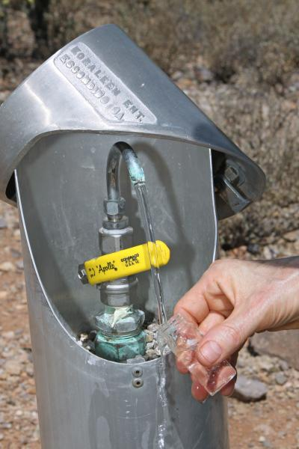
Methodology
Monthly samples are taken from customer taps in each town.
Data avalable between 2017-01-12 and 2018-12-20.
Fields:
Sample_No: Number of the sample
Date: Date the sample was taken
Sample_Point: Sample point asset number
Town: Town
Result: Test result
Sample tap.

Slide 4
Exploratory Analysis
Town | Samples
Bellmoral | 24
Blancathey | 24
Merton | 24
Paethsmouth | 24
Pontybridge | 24
Snake’s Canyon | 24
Southwold | 24
Strathmore | 24
Swadlincote | 24
Tarnstead | 24
Wakefield | 24
Summary sample numbers.

Slide 5
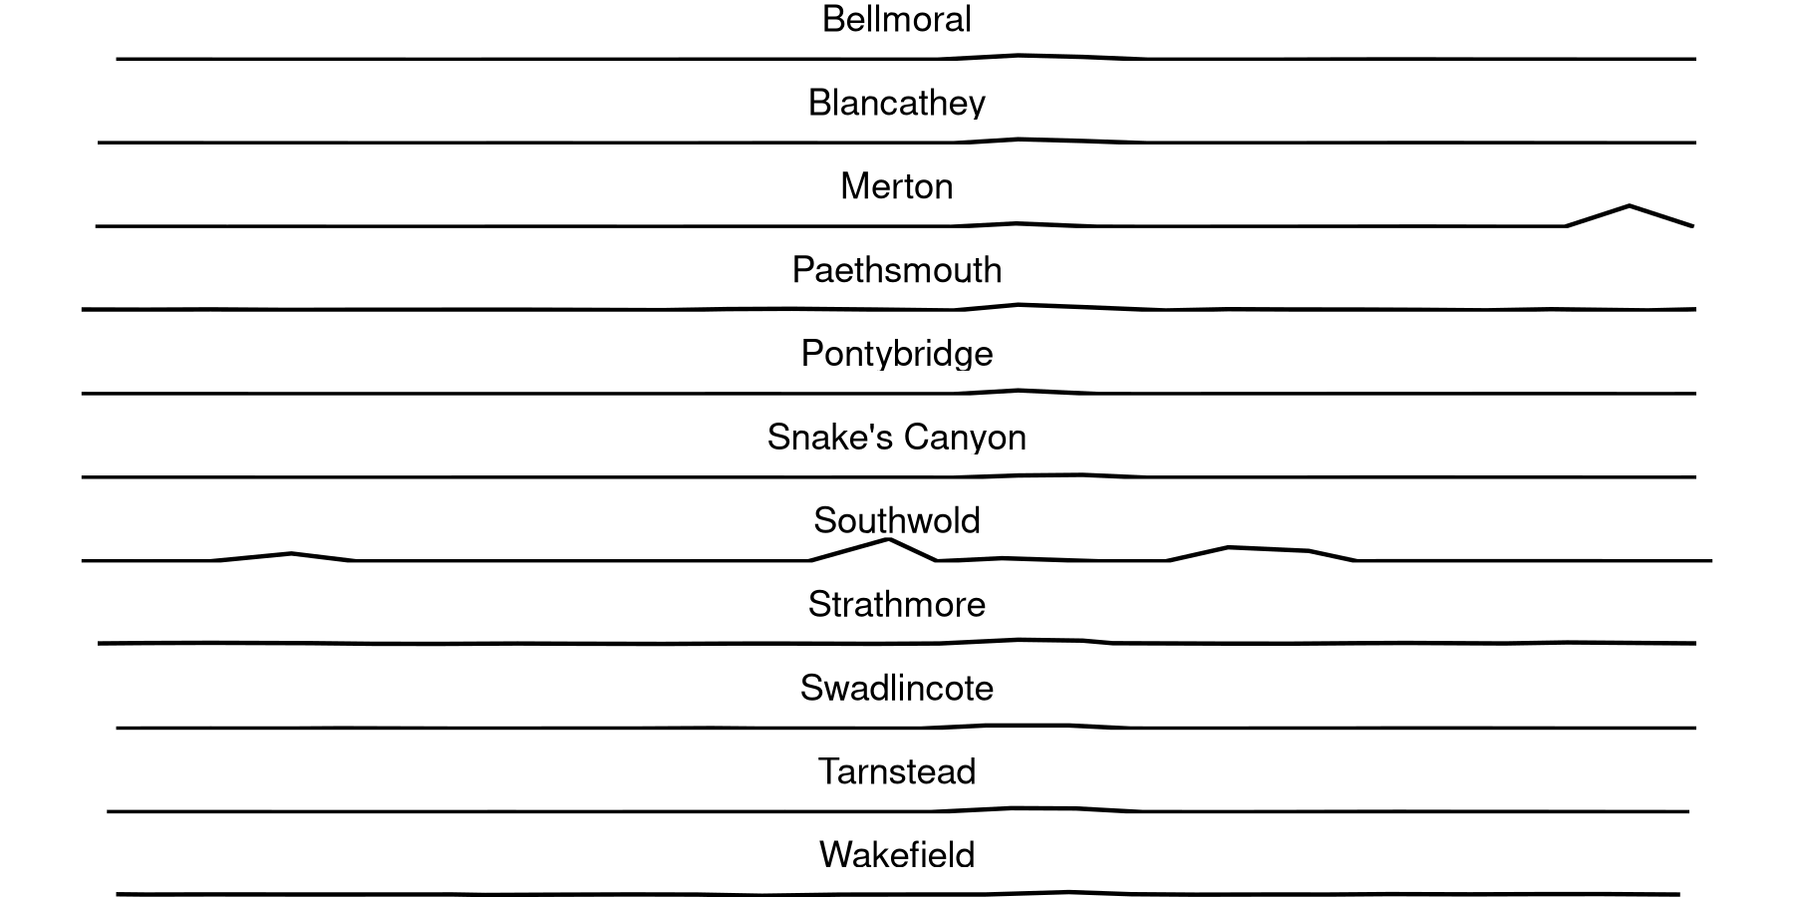
Trends

Slide 6
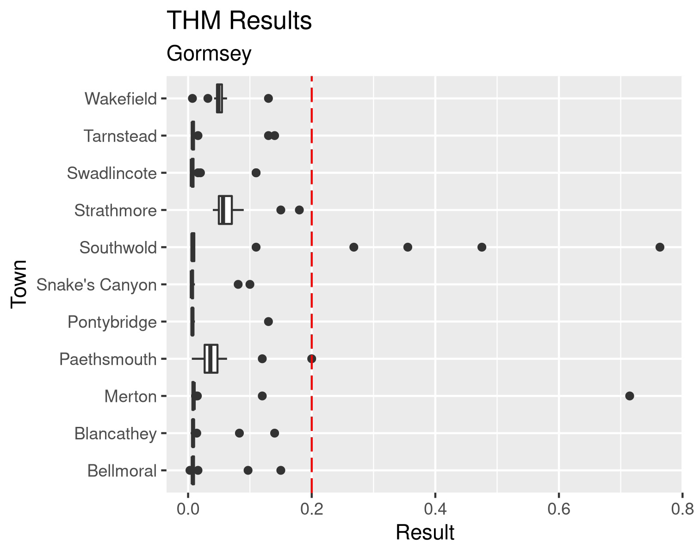
Analysis

Slide 7
Summary
5 samples exceeded the proposed new limit in Southwold, Merton

