Slide 1
EPWgen
Carlo Bianchi
09/12/2024

Slide 2

Issues with previous version
Too slow
Issues with data quality
No data above 60° Latitude
No data for past year
No rain/snow data
Superheavy repo

Slide 3
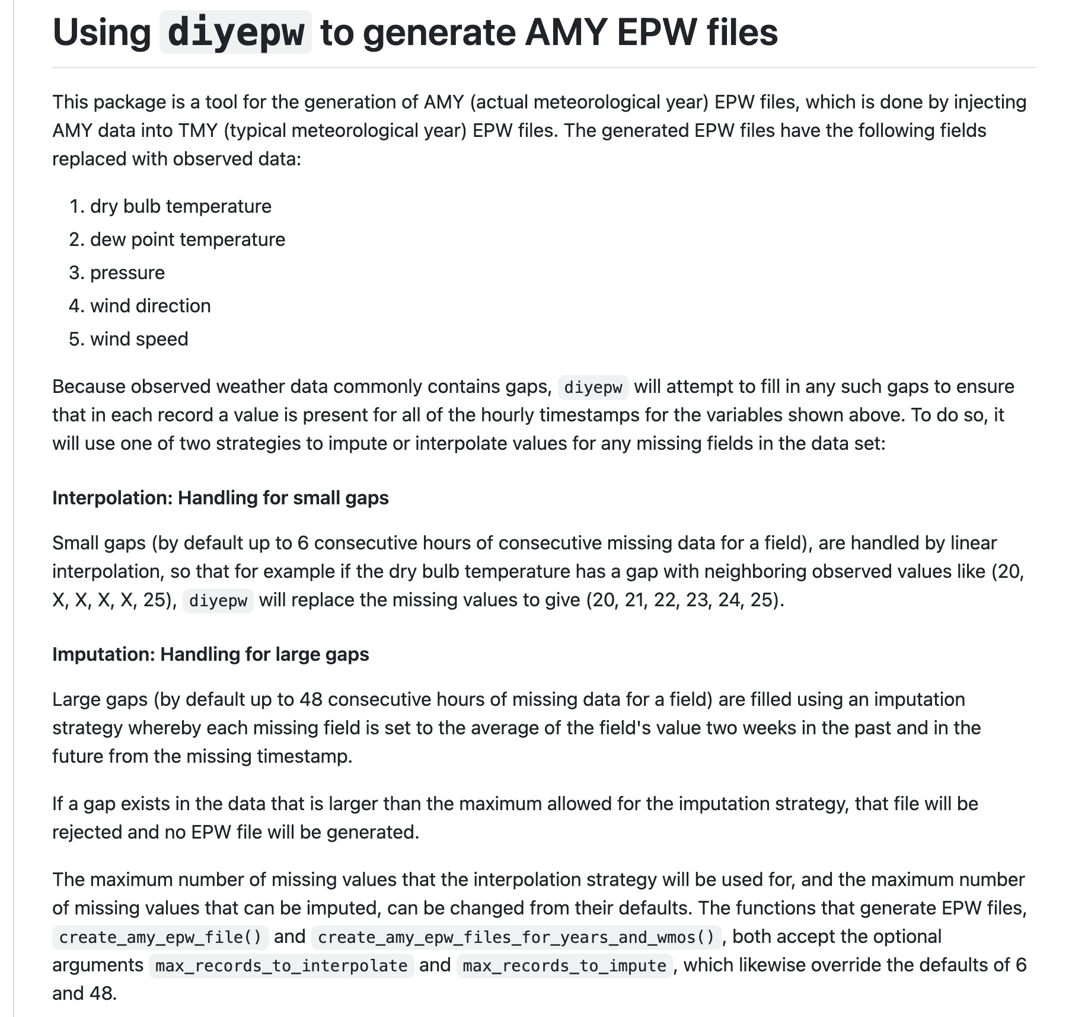
diyepw
Violates physics/psychrometry (TMY+AMY)
Quality control is minor or inexistent
No RH
Few data sources

Slide 4
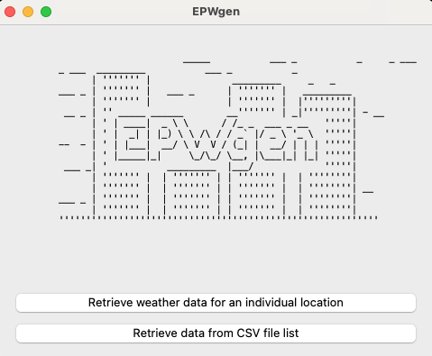
Solution: EPWgen
Switched from NSRDB to MERRA2
2) Using Meteostat to download data

Slide 5
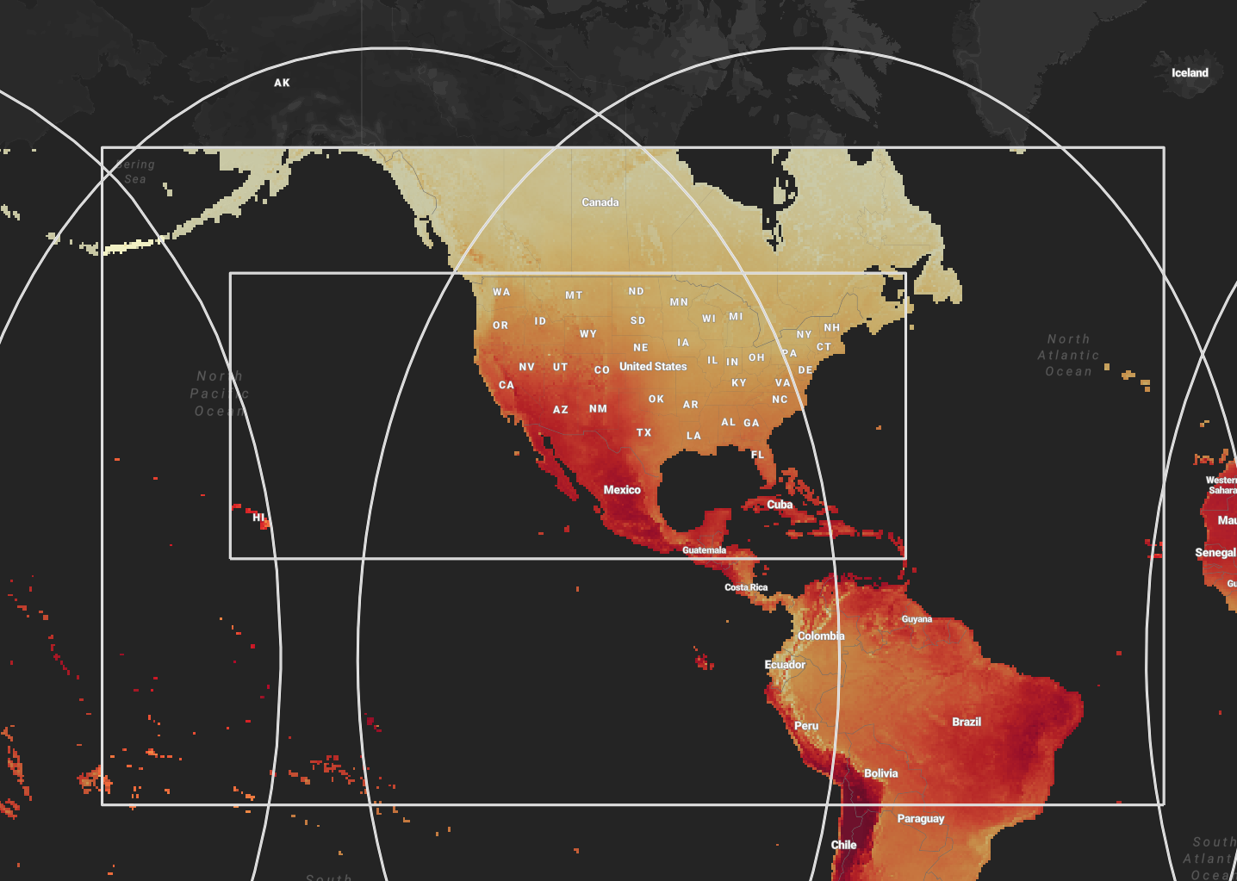
MERRA2
Upscaling from 4x4km to 50x50km cells, BUT:
Data available everywhere in the world (yes, also AK)
Data available almost real-time
MERRA-2 provides full EPWs. EPWgen uses that as a backbone and swaps in:
Tdb
Tdew
RH
P
Wdir
Wspeed
Rain
Snow

Slide 6
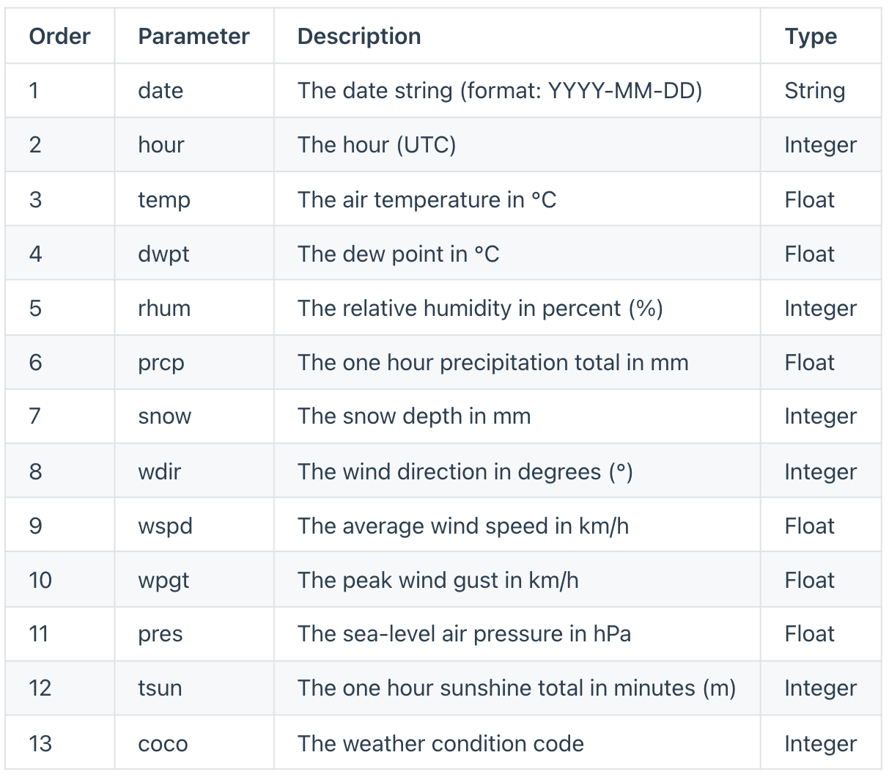
Meteostat
Free open library https://dev.meteostat.net/
Real-time data
Data Sources:
National weather service
Global dataset (ISD)
SYNOP reports
METAR reports
Model data (MOSMIX, Met.no)
MOSMIX: forecast model for filling gaps. No documentation but great performances (SHOW EXAMPLES)
~2700 locations rather than ~1200 (SHOW MAP)

Slide 7
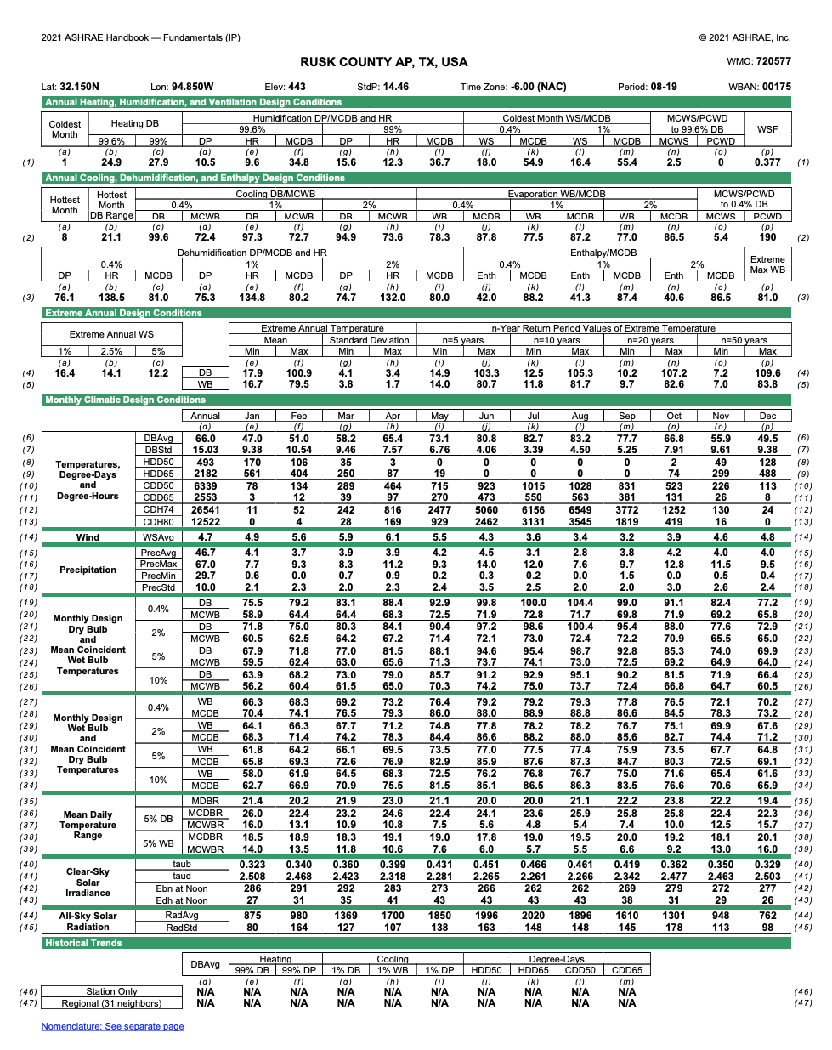
Design conditions
2021 Design conditions extracted from all published ASHRAE locations.
No DDYs/STATs creation
No Ground Temperatures in header
No typical/extreme period in the header

Slide 8
DEMO
1) Find the closest Meteostat
location with less than 3h gap within 100mi.
Input:
Latitude
Longitude
Year
Name
2) Gather the EPW for the selected station coordinates from MERRA2
Save EPW file and print out:
Station distance
HDD/CDD
3) Splice the two daframes
4) Insert the header with design conditions and other customized information

Slide 9
To summarize:
More locations
Quality check taken care
All the variables in the EPW filled with measured or modeled data
Data available for the last completed year
Data available everywhere
2021 design Conditions

Slide 10
Future editions/ideas
Integrate TMY/GaTMY
Provide the option to use ERA5 vs MERRA2
Use MERRA2 directly
Plot data or provide statistics
Create STAT file and/or DDYs
Allow use of 2013 design conditions
Let the user search by FIP code or ZIP code or something else
Anything else?

