Slide 1
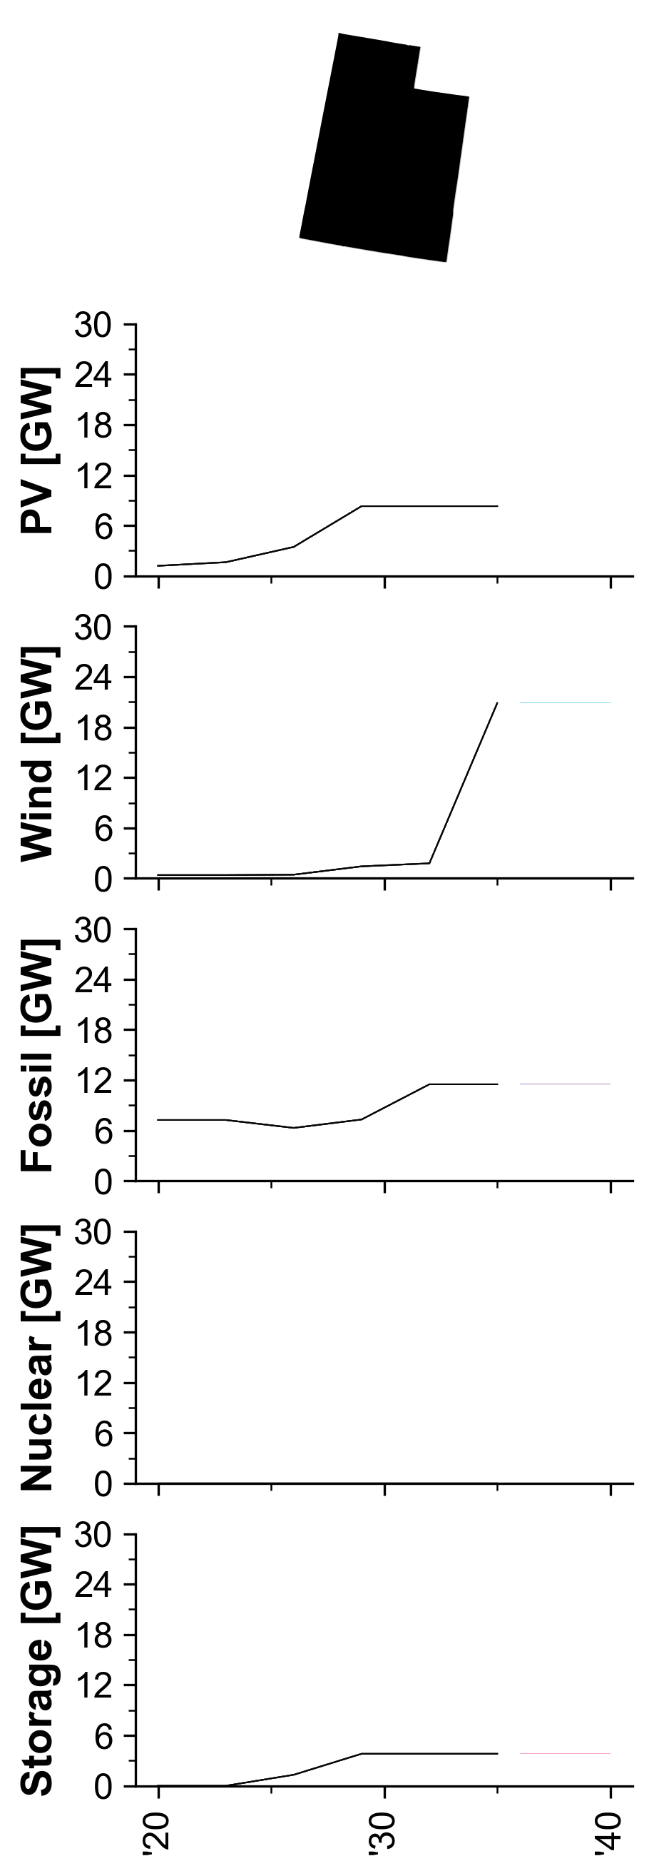
Capacity by Technology and Region

Slide 2
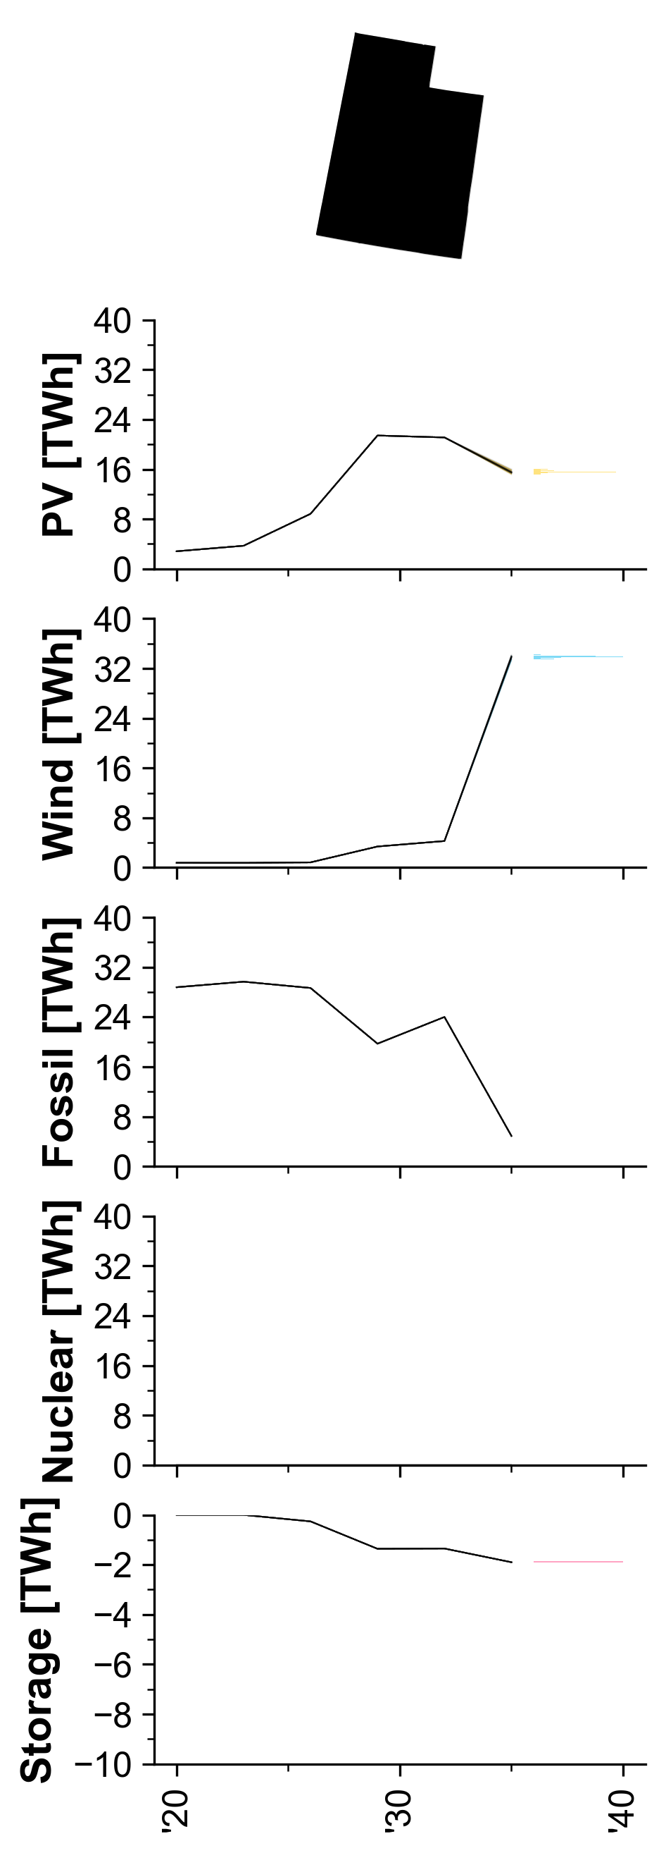
Generation by Technology and Region

Slide 3
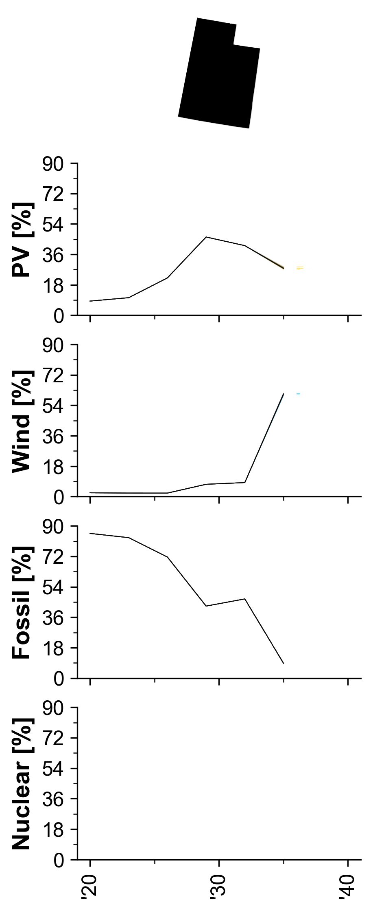
Generation Penetration by Technology and Region

Slide 4
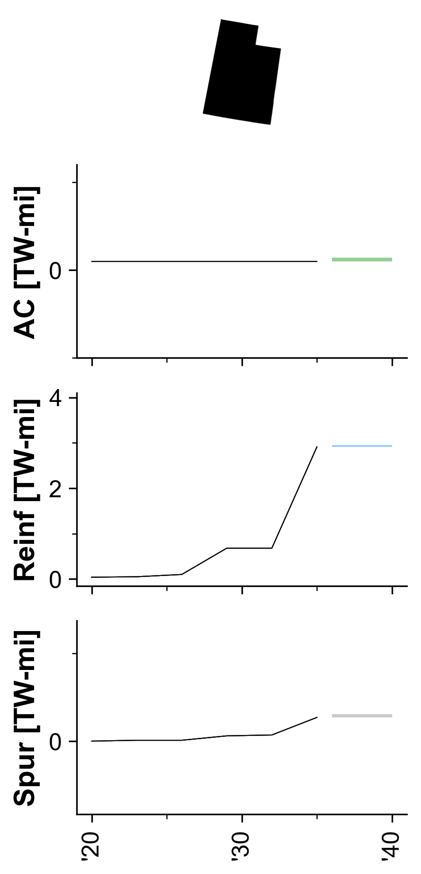
Transmission TW-Mile by Region

Slide 5
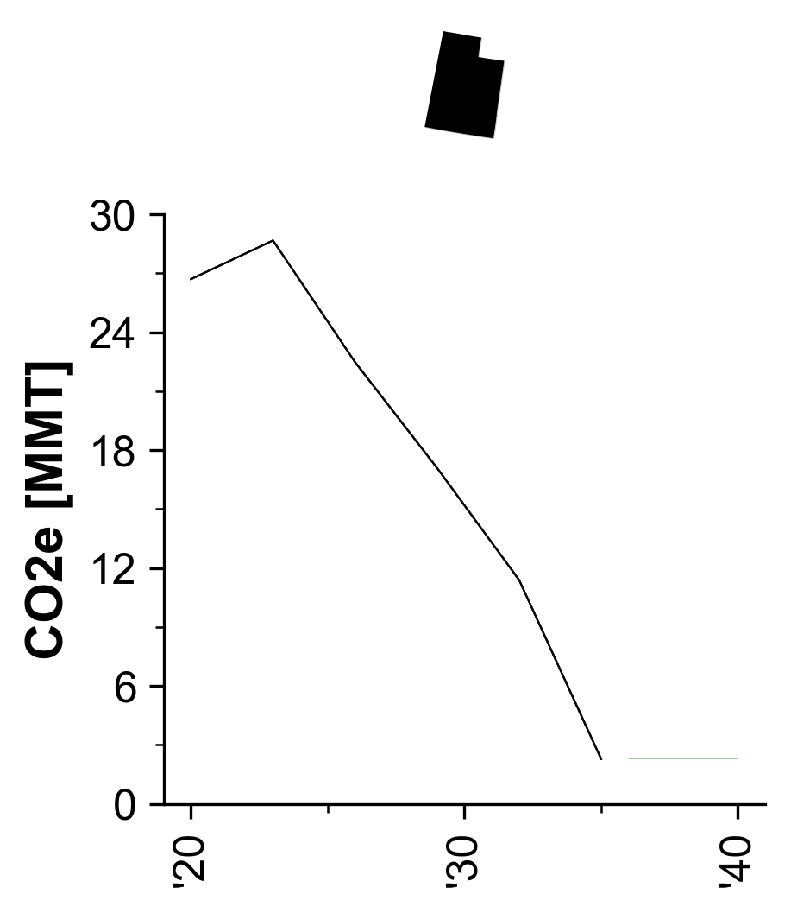
Emissions by Region

Slide 6
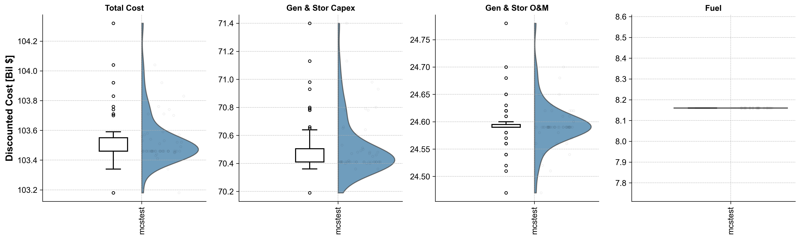
System NPV Comparison by Prefix

Slide 7
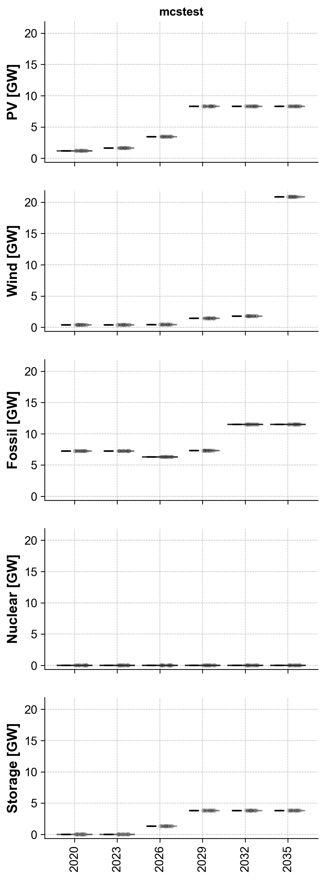
Technology Capacity by Year

Slide 8
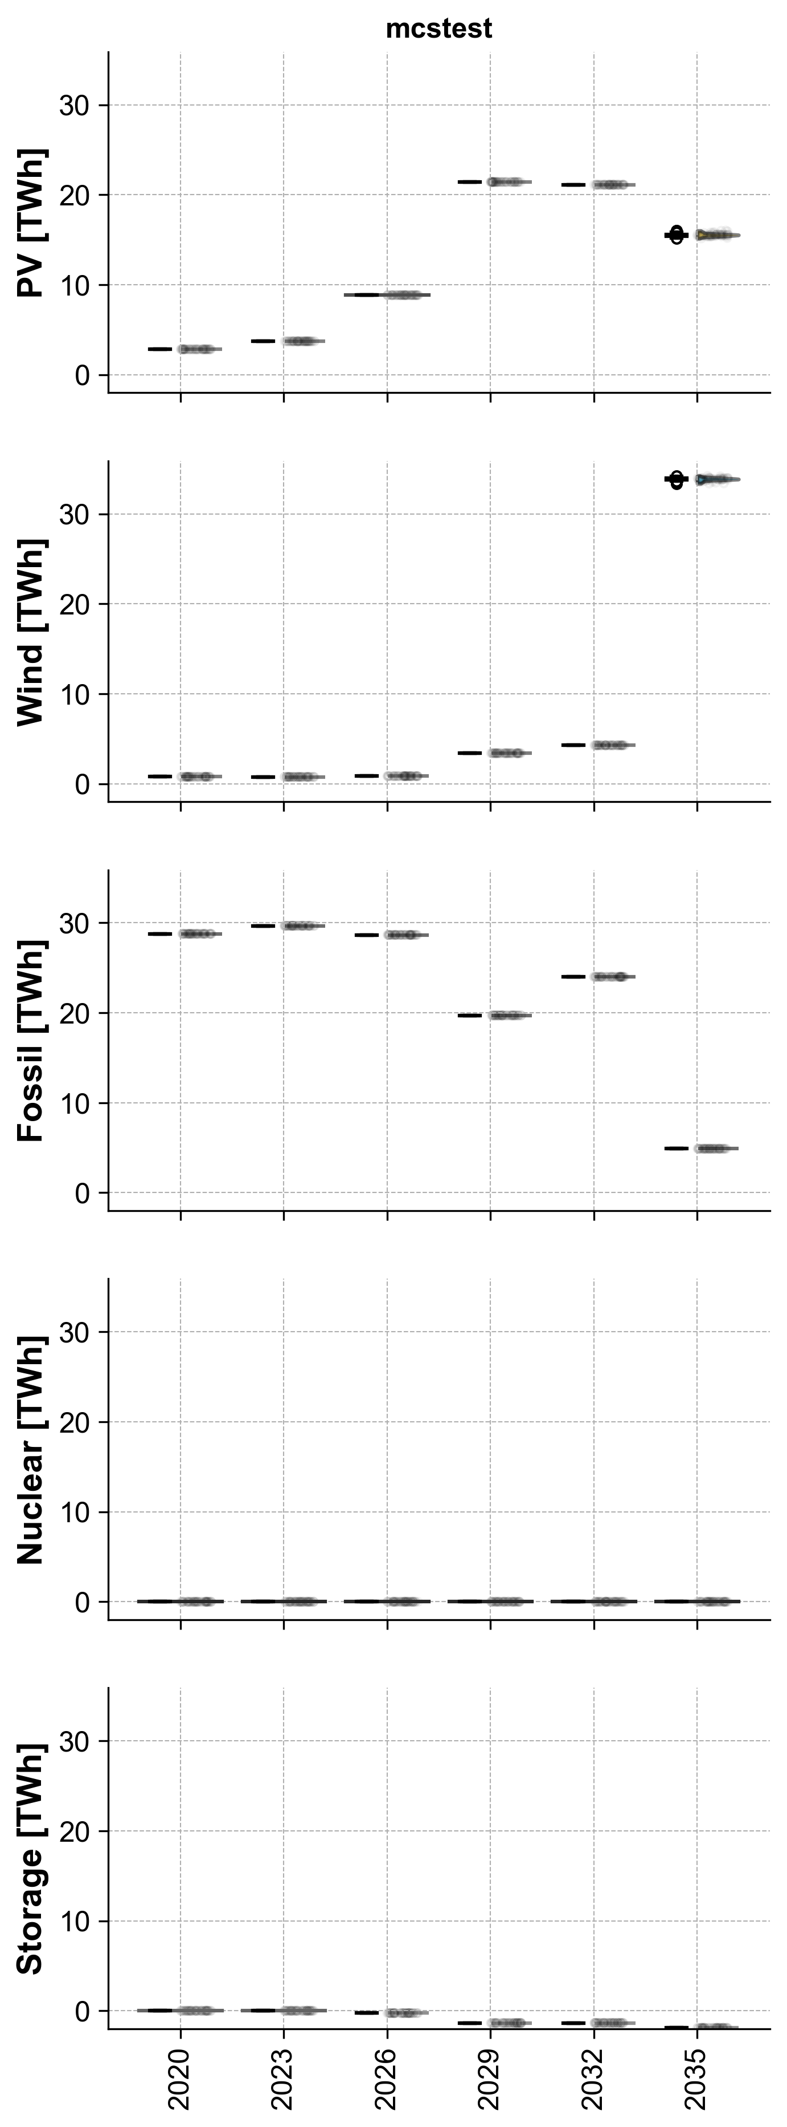
Technology Generation by Year

Slide 9
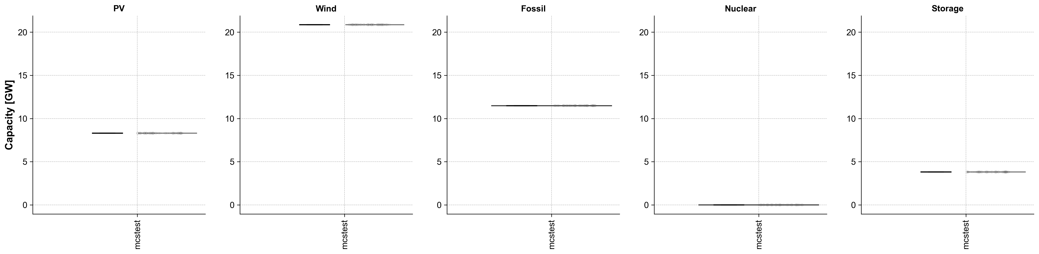
Technology Capacity in 2035

Slide 10
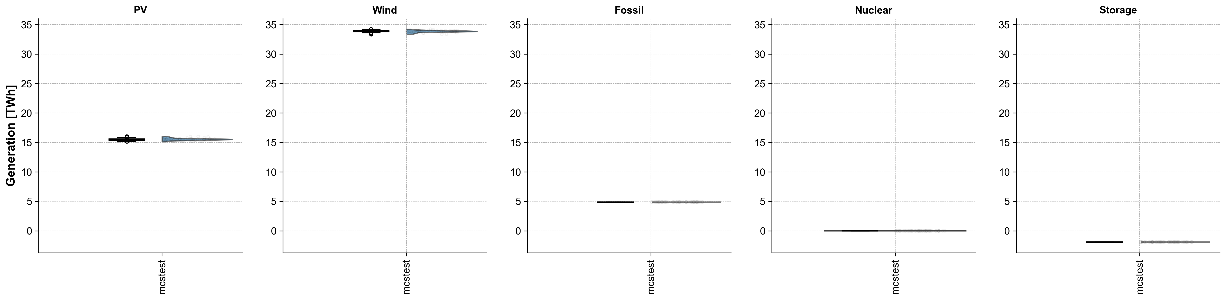
Technology Generation in 2035

