Slide 1
growth_factors3
File created on: 4/7/26 4:56:17 PM MDT

Slide 2
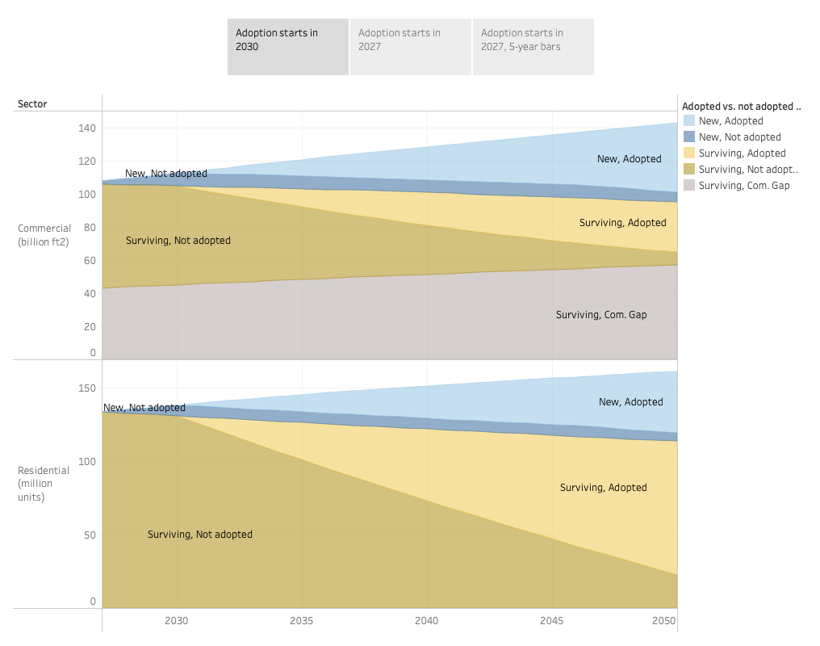

Slide 3
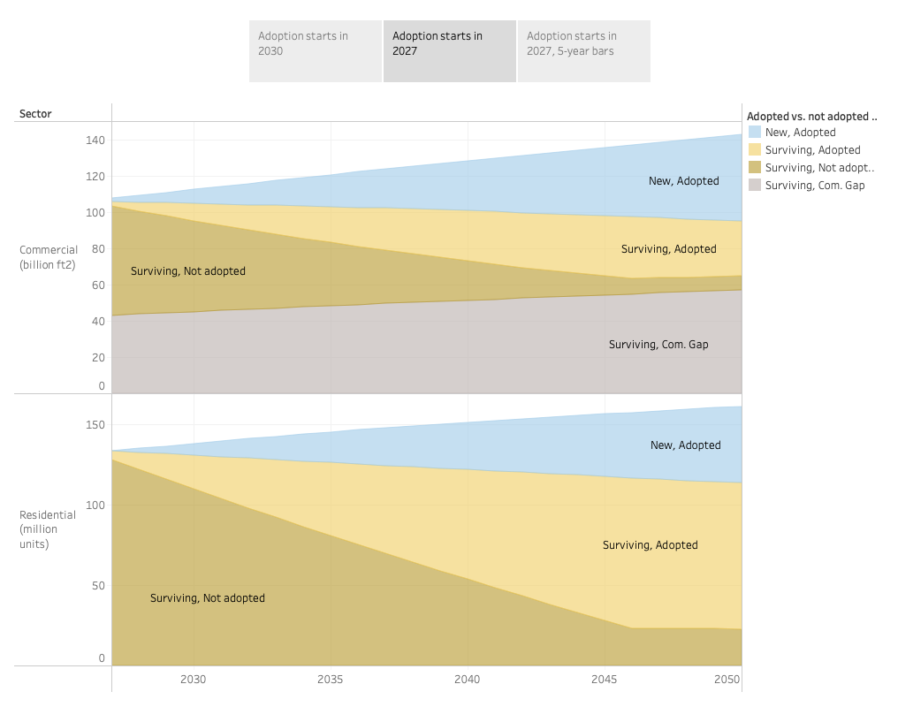

Slide 4
