Slide 1




The Outcomes of Unprotected Sensitive Information
Presented By: Natnael Kebede

Slide 2
American Medical Collection Agency (AMCA)
New York-based third-party billing collections firm
Aggressively collects debt for a range of businesses including medical labs, hospitals, telecom companies, marketers, and toll agencies.
Diagnostic lab testing firm Quest Diagnostics, and medical testing giant, LabCorp were also clients of AMCA
AMCA’s weaknesses that led to the Victimization of millions of individuals:
Payments page was breached
Network was compromised

Slide 3
Quest Diagnostic’s Exposure
AMCA informed Quest about the breach on May 14, 2019 but it took two weeks for AMCA to determine the number of affected people and the type of information lost.
Personal, financial and medical data of nearly 12 million Quest patients. The exposed data included:
SSN
Medical history information
Credit card numbers and bank account information
Service account and balance information

Slide 4
LabCorp’s Exposure
Disclosed days after Quest Diagnostics' breach announcement
Breach persisted between Aug 1, 2018 to Mar 30, 2019
Personal and financial data of 7.7 million consumers including:
First and Last name
DOB
Address
Bank account information
Service account and balance information

Slide 5
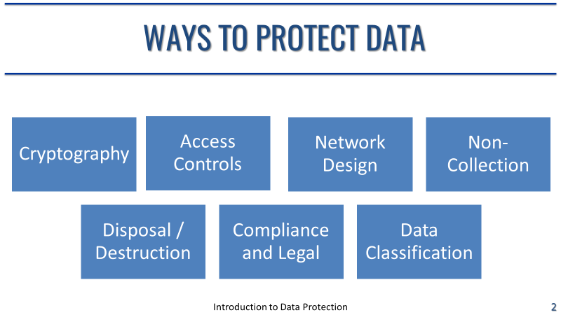
Analysis From Data-Centric Concepts’ Perspective
What are some of the ways that the Vendor, AMACA could have protected the data?
Access control: control in depth using technical systems to prevent unauthorized access to data.
Compliance and Legal: following PCI DSS and HIPAA guidelines.
Cryptography: encrypting PII.
Network design: segmenting network and implementing strong network authentication method.
Perhaps Non-Collection: data such as SSN shouldn’t be collected in the first place if not needed.

Slide 6
Further Consequences of Lost Data and Protection
Can the lost health care data and associated information of individuals be used to cause further attacks on them? What can one do?
Attacks can occur due to healthcare information being highly valued on the dark web as any financial or personal information according to a research conducted by a cybersecurity intelligence firm, Carbon Black.
Don’t recycle passwords to use different services.
Enable 2FA whenever possible.

Slide 7
References
Krebs, B. (2019, June 19). LabCorp: 7.7 Million Consumers Hit in Collections Firm Breach. Krebs on Security In-depth security news and investigation. Retrieved from https://krebsonsecurity.com/2019/06/labcorp-7-7m-consumers-hit-in-collections-firm-breach/
White, S. (2019, June 10). Data breaches show US healthcare cyber security weakness. PrivSec Report. Retrieved from https://gdpr.report/news/2019/06/10/data-breaches-us-healthcare/

