Slide 1
Item Database in a House
Team 9
Carlos Bustos
Junu Dhungana
Natnael Kebede
Octavio Garcia
Robert Leblanc

Slide 2
Introduction
The motive for implementing the house database system was to solve the problem of finding a sharable item in any house.
This Presentation covers the implementation descriptions for a house database. The database is implemented in such a way that that each family member, room, floor and storage is unique and differs from other ones that are identical. These items can be added, moved and removed around the house at different times by different family members who share the items. This allows the people living in that specific house to find, use, and move the items to different locations within the house. Additionally, it allows the tracking of items that are located anywhere within a house at any time.

Slide 3
Summary
Each house in the database is made up of several different floors with each floor containing different number of unique rooms and with a specific room located only on a single floor. The house will also have a unique number of floors with each floor having a unique number of rooms.
Additionally, the floors of the house can include an attic and a basement. Although these are not usually referred to as additional floors in the house, items can still be stored in these additional floors. Furthermore, these rooms may contain multiple storage locations such as closest, safes, cabinets and so on with each of them holding one or more items.

Slide 4
Summary
Items stored in the storage locations are either shared by a certain number of family members while other items can be shared by multiple family members. For instance items such as clothing, cell phones and computers can only be shared by specific family members which other items such as a Television control, chairs and fans can be shared by multiple family members.
Furthermore, family members living in a house can have their own rooms. They possess certain items and share them with other family members. Since they share these items, the items can be moved around the house to different rooms and within the rooms from one storage location to another. Different family members can also move the same items at any dates and times.

Slide 5
Summary
When a new Item is registered in the Database the following information must be entered:
Item_id
Item_owner
Room_id
Room_owner
Floor_numb
House_id
Storage_id

Slide 6
Implementation
The steps we to took towards implementation include:
Designing the mini-world for the database system
Designing the Unified Modeling Language (UML)
Designing the Entity Relationship Diagram (ERD)
Mapping the House ERD Schema into a Relational Database Schema
Normalizing the relationships
Implementation the database
Populating the relations with data and
Querying the database

Slide 7
Demonstrations
Designing the Mini-World
This step covers the focus of the project, the points we are interested in and how our points of interest are related to each other. The project focuses on creating a database for a house in order to track items in any location within a house.
Out points of interest are:
1) House
2) Storage locations within the house:
2.1 Number of floors
2.2 Number of rooms
2.3 Additional storage locations in those rooms can contain
2.3.1 Closets/Desks inside rooms
2.3.2 Desks inside rooms
2.3.3 Cabinets in living room
2.3.4 Tool box in garage
3) Family members
4) Shared items
5) The date the items were placed at a certain storage location.

Slide 8
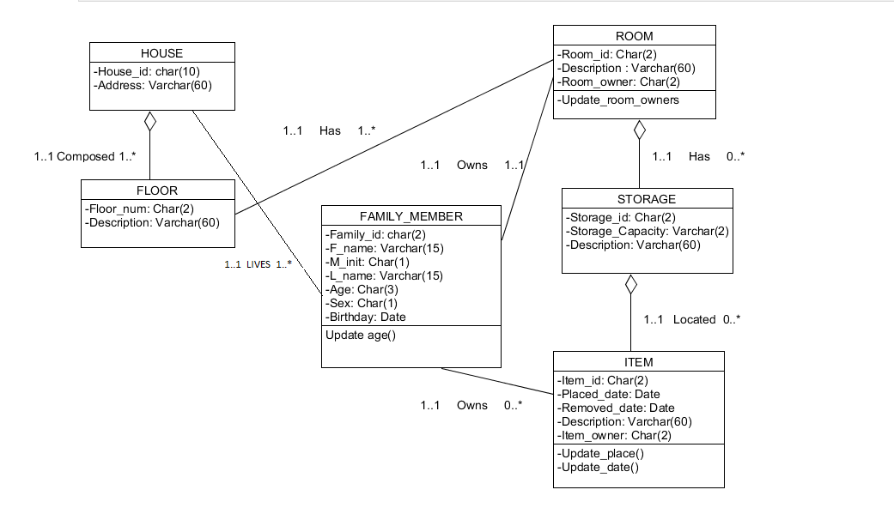
Demonstrations
Designing the Unified Modeling Language (UML)

Slide 9
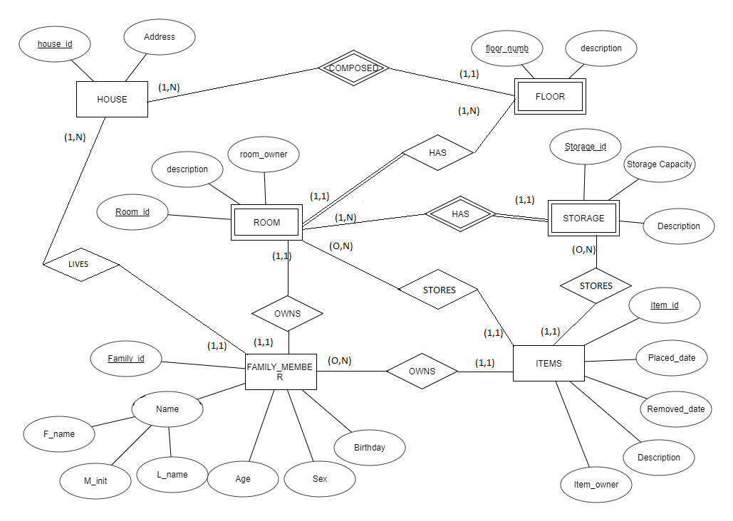
Demonstrations
Designing the Entity Relationship Diagram (ERD)

Slide 10
Demonstrations
UML and ERD
The ERD represents our database in the pictorial form. It gives information in a way that is easier for person to understand how the entities are related with each other as well as the attributes in each relation.
UML shows how the SQL database in phpMyAdmin would look like.
UML shows the cardinalities of entities in relationships.
For creating ERD we analyzed the nature of interactions between entities.

Slide 11
Demonstrations
Mapping the House ERD Schema into a Relational Database Schema
Mapping the ERD schema of the house database into a relational database schema involves nine steps (as covered in the lecture). The steps are Mapping of regular entity types, Mapping of weak entity types, Mapping of binary relations (1:1, 1:N, M:N), Mapping of multivalued attributes, mapping of N-ary relationship types, Mapping specialization or generalization and Mapping of union types. Based on these steps, the appropriate ones that apply to the ERD of this database should be taken in order to design the relational database schema.
Designing the house relational database schema involves:
Step 1: Mapping of regular entity types
Step 2: Mapping of weak entity types
Step 3: Mapping of binary 1:1 relation types and
Step 4: Mapping of binary 1: N relationship types.

Slide 12
Demonstrations
Normalizing the relationships
The initial relation of the database was already in the first normal form (1NF). That is, there were no nested relations, composite and multivalued attributes.
In order to implement the database, we have applied the second normal form (2NF) and third normal form (3NF) to our Database Schema. The second normal form (2NF) allows every non-prime attribute in the relation to be functionally dependent on the primary key. The third normal form (3NF) is in the second normal form (2NF) and allows no non-prime attribute in the relation to be transitively dependent on the primary key.

Slide 13
Demonstrations
Mapping And Normalizing the House ERD
House
Floor
Room
Storage
Family_member
House_of_fmbr
Item
Item_location

Slide 14
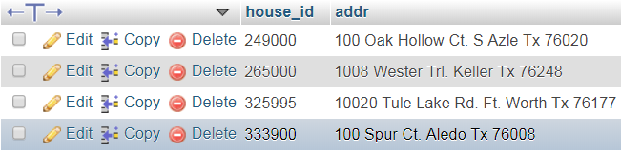
Demonstrations Populating the HOUSE relation with data
Populating HOUSE
Description
This Relation represents the houses in the Database with their Unique ID that can be used to track anything in any house

Slide 15
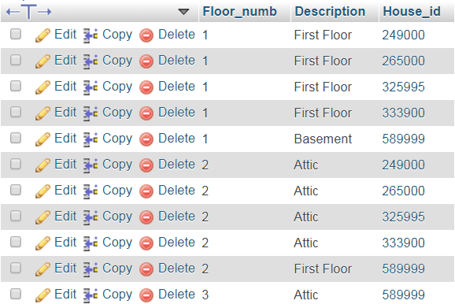
Demonstrations Populating the FLOOR relation with data
Populating FLOOR
Description
This Relation represents a Floor in a specific house with a brief description of what that floor is.

Slide 16
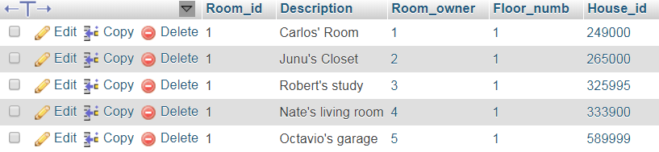
Demonstrations Populating the ROOM relation with data
Populating ROOM
Description
The above relation represents the rooms and their corresponding information in each house

Slide 17
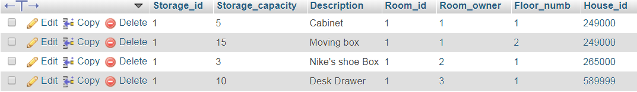
Demonstrations Populating the STORAGE relation with data
Populating STORAGE
Description
The relation shows the additional possible storage locations in the House

Slide 18
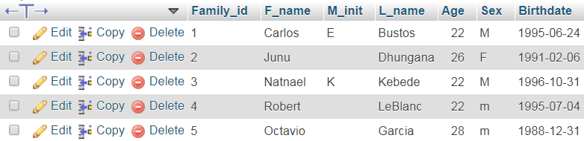
Demonstrations Populating the FAMILY_MEMBER relations with data
Description
After creating the Family_Member table, we populated it with data from our Group Members. Each Row represents basic information for each Family_Member

Slide 19
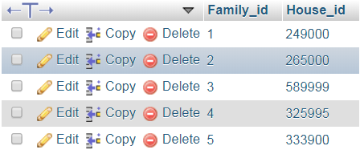
Demonstrations Populating the HOUSE_OF_FMBR relation with data
Populating HOUSE_OF_FMBR
Description
This relation was the result of normalizing the family_member table to the second normal form and populating the relation

Slide 20
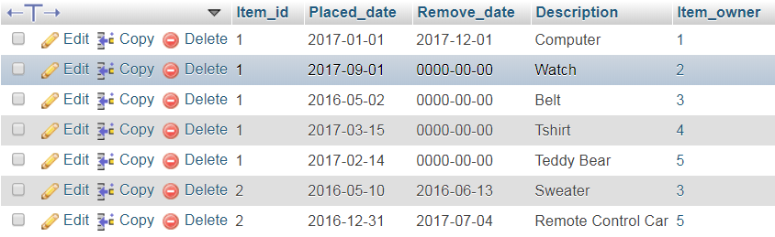
Demonstrations Populating the ITEM relation with data
Populating ITEM
Description
This relation identifies the items that will be stored and tracked in different houses in the database

Slide 21
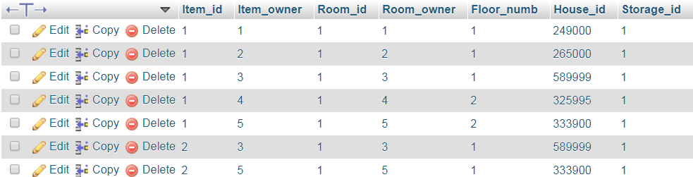
Demonstrations Populating the ITEM_LOCATION relation with data
Populating ITEM_LOCATION
Description
This relation identifies the location of all items in the Database as well as tracking their owner

Slide 22
Demonstrations
Implementation of the database
Implementing the Design for the database involves drafting in accordance with the UML, ERD and database schema. Additionally, it involved the normalization of relations.

Slide 23
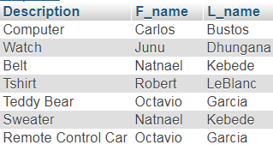
Demonstrations Querying the database
SELECT item.Description, family_member.F_name, family_member.L_name
FROM item
JOIN family_member ON
Item.Item_owner = family_member.Family_id

Slide 24
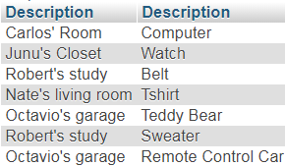
Demonstrations Querying the database
SELECT room.Description ,
item.Description
FROM room
JOIN item
ON room.Room_owner = item.Item_owner;

Slide 25
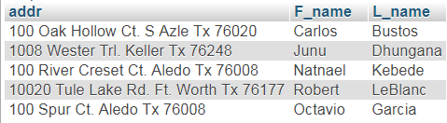
Demonstrations Querying the database
SELECT house.addr , family_member.F_name , family_member.L_name
FROM house , family_member, house_of_fmbr
WHERE house.house_id = house_of_fmbr.House_id AND house_of_fmbr.Family_id = family_member.Family_id
GROUP BY family_member.L_name
ORDER BY family_member.Family_id;

Slide 26

Demonstrations Querying the database
SELECT item.Description , family_member.F_name , family_member.M_init , family_member.L_name
FROM item , family_member
WHERE item.Item_owner = family_member.Family_id AND family_member.Sex = 'F‘
GROUP BY family_member.F_nameORDER BY item.Description

Slide 27

Demonstrations Querying the database
SELECT family_member.Age , family_member.F_name , family_member.M_init , family_member.L_name
FROM family_member
GROUP BY family_member.Age
HAVING family_member.Age > '25'

Slide 28
Conclusion
As demonstrated before the database has been implemented, populated, and tested with several queries that reflect the correct operation of the database.
The database we have created can be commercialized to households to assist them in effectively tracking shared Items across one or multiple homes.

