Slide 1
Kebe Robot Shop
By Natnael Kebede

Slide 2
Are you Satisfied With Other Companies Service?
We at Kebe Robot Shop are Different.

Slide 3
You May Ask Why
Our Software is designed to satisfy our customers with specific Robots they want weather its for business or home.

Slide 4

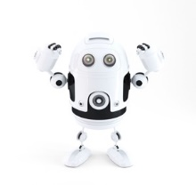

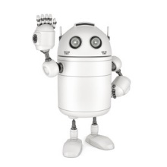
A Wide Range OF Models

Slide 5
User Types
Kebe Robot Shop is designed for multi-users!
Project Manager
Shop Manager
Sales Associate
Customers

Slide 6
Features
Create your own Robot with the parts and features you want.
Display Robot Parts and Models
View what your created model looks like
Calculate your Cost
Order Online
View order history and customer Bills
Create Sales Report

