Slide 1
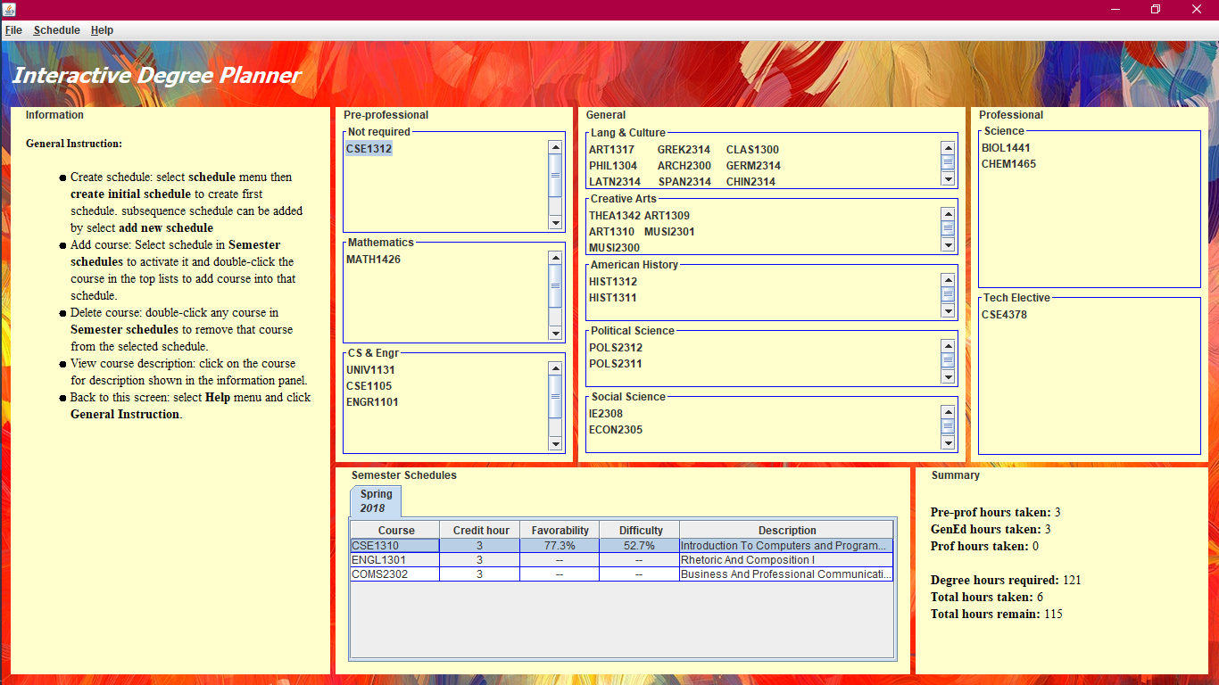

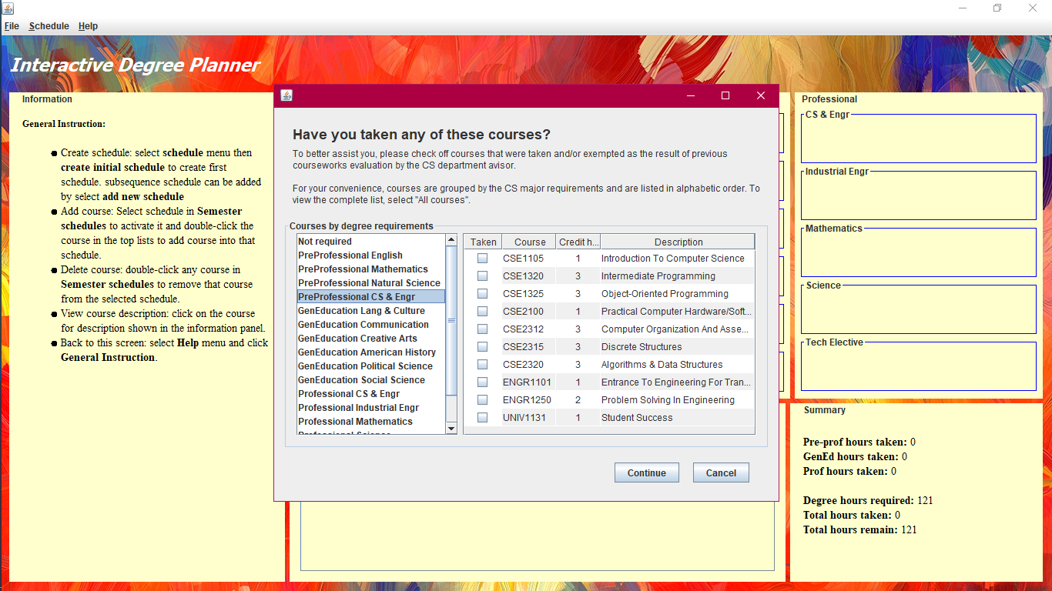
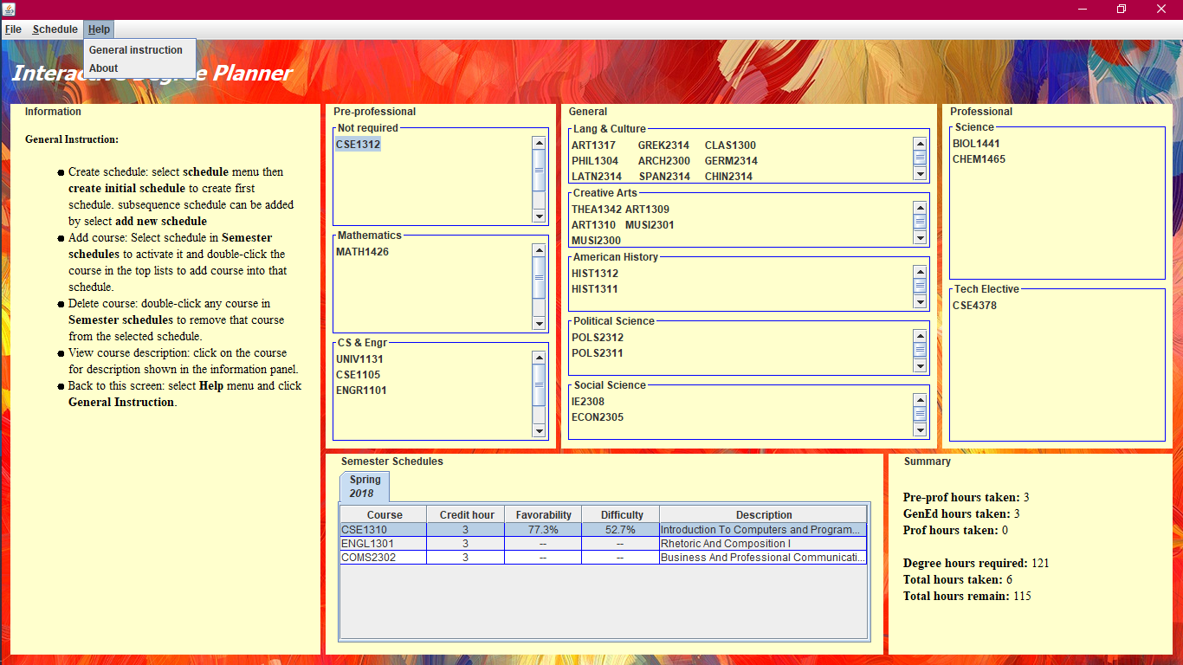
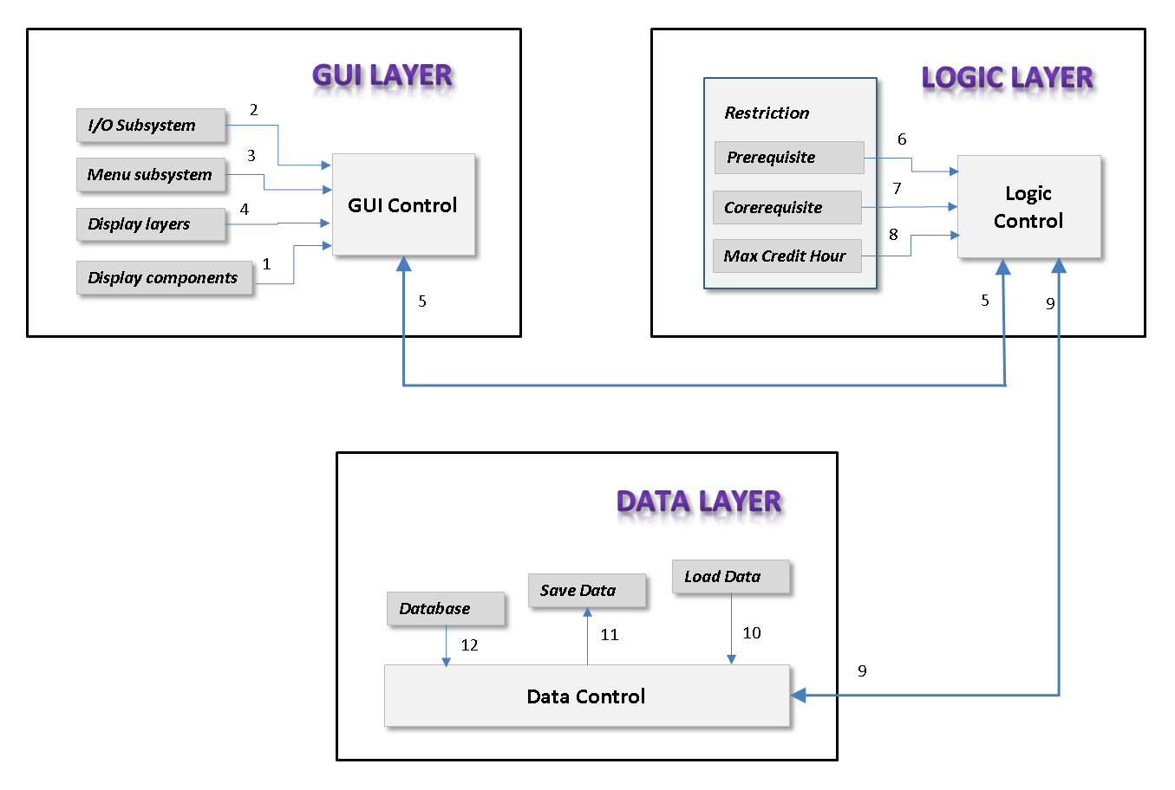
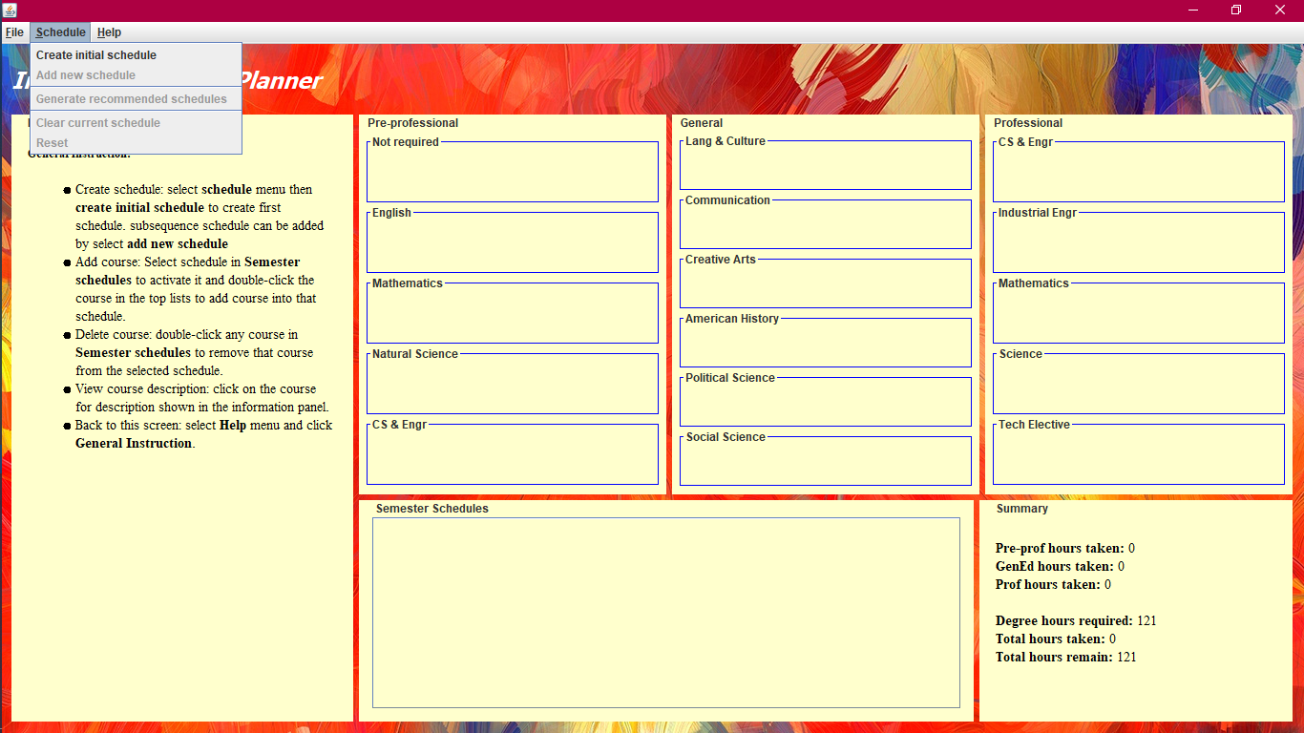
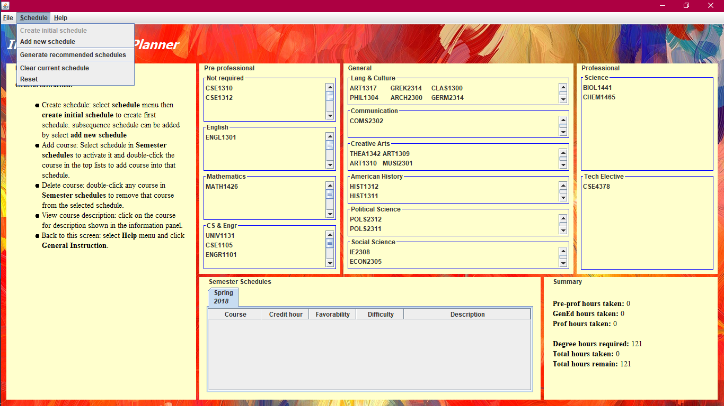
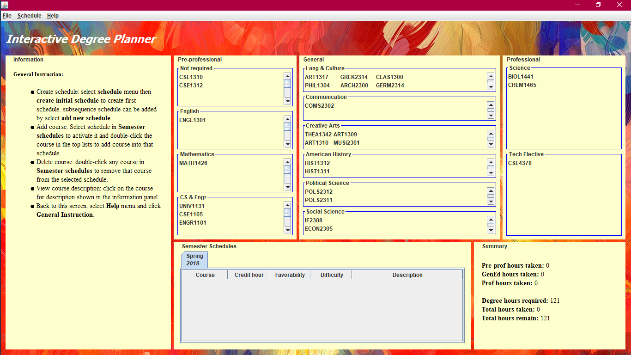
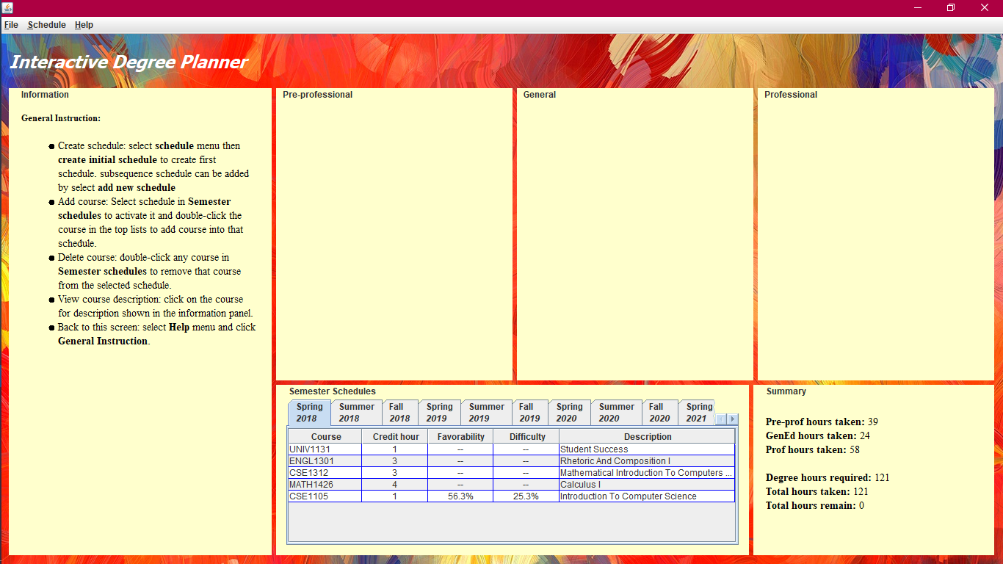
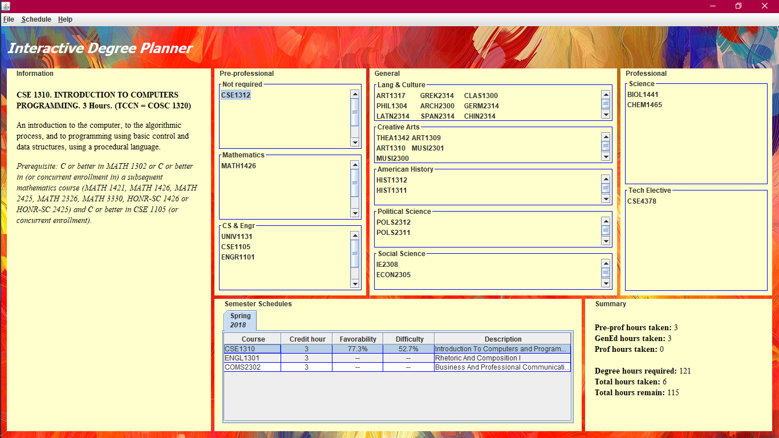
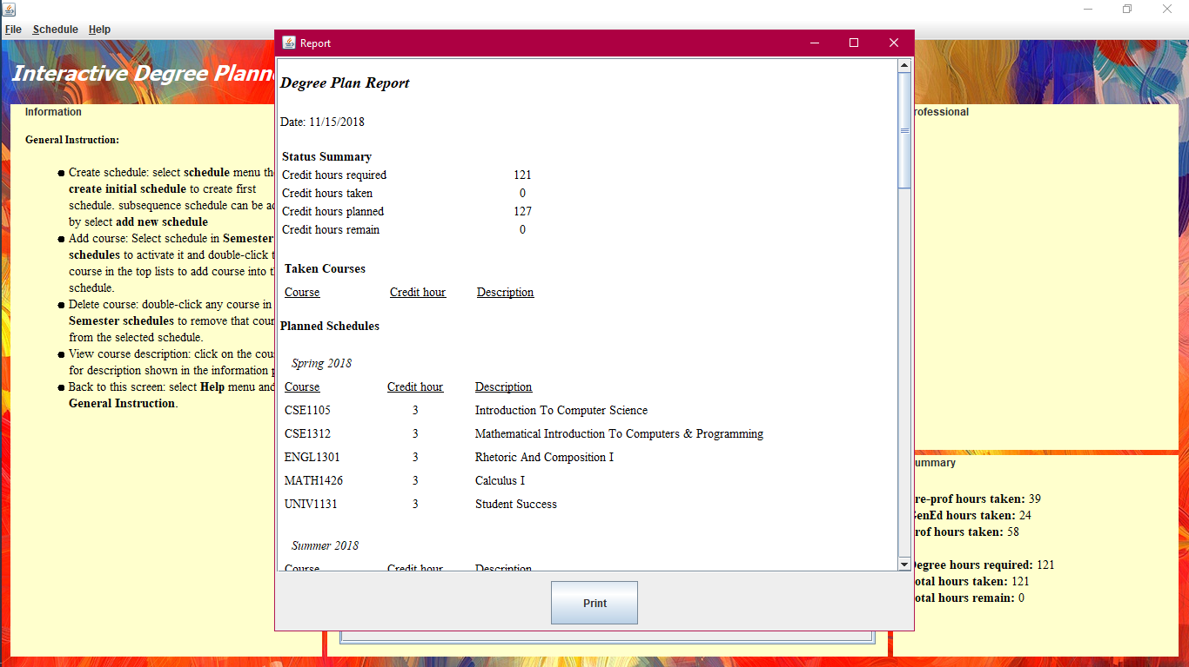

SUCCESS CRITERIA
This idea was generated from the need of students to plan their academic schedule in a way that allows them to advance in the major while reducing the difficulty of each semester. New students in particular will benefit from this application since it will provide them with a guide on how to structure their academic work through each semester. Both students that decide to take the classes suggested by the application, and those that have not used the schedule will benefit from its suggestions and hopefully understand how to create their own schedule.
Degree Planner
PROJECT MISSION
Provide a desktop application that can be used by students majoring in any of the three fields offered by the Computer Science and Engineering department at the University of Texas at Arlington. The desktop application helps students reduce the burden of having to research the classes they want to take by creating balanced schedule for each semester.
PROJECT VISION
Create tentative schedules that takes into consideration the difficultly of classes so that students can make use of it once they have decided on a major. These schedules take into consideration the difficulty of the classes. The consideration of the difficulty result in a balanced schedule that allow the students to advance in their major while reducing the burden of having to research the classes they want to take.
RESULTS
Architectural Design
Detailed Design
DATA LAYER DESIGN
This layer is responsible for all interaction with the users of the system. The GUI layer will contain the main method where program execution will start. At the start of the program this layer will be responsible for showing the user a welcome message along with a description of what the program could do, along with helpful tips. The layer also accept input from the user and sends this data to the logic unit for processing. once this data has been processed the GUI layer will show the user a new screen based on their responses to the previous questions. The subsystems included are input/output, screen components, menu and screen layers.
DATA LAYER DESIGN
The data layer will have the following three subsystems: database, save, and load. The three major functions of this layer will be to communicate with the system database, save current work and load any previous work if the user wishes to continue from a saved session. At the beginning of the execution, the data layer will upload all course information to a vector. This vector will be housed in the logic unit, where it will be manipulated according to the user’s response to the system inquiry.
LOGIC LAYER DESIGN
All the system logic will be housed in this layer. The logic layer will be responsible for verifying individual
course requirements as well as course difficulty distribution. This layer will communicate with both the
GUI and Data layers to guide the user through the use of the system. The user answers will be computed
in this layer with the results of these computations being the output viewed by the user.

