Slide 1
Logic
Solve some problems using logic. You have already done this when solving the various puzzles so far. Especially useful is when a contradiction leads to a clue. Another useful tool is to eliminate impossible scenarios.
There are three boxes. One is labeled "APPLES" another is labeled "ORANGES". The last one is labeled "APPLES AND ORANGES". You know that each is labeled incorrectly. You may ask me to pick one fruit from one box which you choose.
How can you label the boxes correctly?
Invitation to Computer Science, 5th Edition
1

Slide 2
Boolean Logic
Puzzles like these led to a branch of Mathematics and Philosophy called Logic.
Logic was basically making statements, putting them together to make a claim, and then studying the veracity of the claim. Anytime you use this method to prove some argument, you are using logic.
As mathematicians delved further, they defined Boolean Logic as a set of objects (statements) and logic operators followed very specific rules.
As usual, the mathematical theory (model!!!!!) was picked up by electrical engineers to create the “brain” of the computer (solving a real-world problem!!!!!).
Invitation to Computer Science, 5th Edition
2

Slide 3
Computers
Computers “do” things by executing a series of commands (an algorithm expressed as a computer program)
The commands are stored in BINARY!
Interpretation of the BINARY pattern stored in memory leads to the execution of a certain specific task is done with LOGIC.
Invitation to Computer Science, 5th Edition
3

Slide 4
Slight Review
All the computer “knows” is stored in memory
Everything in memory is stored in binary
To make things easier for humans, binary is expressed in (mostly) hex (base 16)
Memory can hold:
Numeric values
Text values
Program commands = instructions
Invitation to Computer Science, 5th Edition
4

Slide 5
Boolean Logic
Boolean logic
Construction of computer circuits is based on this
Objects and operators
Boolean expression = function combining objects and operators
Statement or Compound statement that evaluates to either true or false
Operators
And, Or, Not
Invitation to Computer Science, 5th Edition
5

Slide 6
Boolean Logic
Example of And:
If I get some money and I find transportation, I will see you at the movies
Statements:
I get money
I find transportation
Invitation to Computer Science, 5th Edition
6

Slide 7
Boolean Logic - And
What are the possible combinations of the two statements?
I get money I find transportation
I get money I do not find transportation
I do not get money I find transportation
I do not get money I not find transportation
Invitation to Computer Science, 5th Edition
7

Slide 8
Boolean Logic - AND
Set the conditions and result as a truth table
Inputs: I get money (p) [0=no money]
I find transportation (q) [q=no transportation)
When will I see you at the movies?
p | q | Movies? M(p,q)
0 | 0 | 0
0 | 1 | 0
1 | 0 | 0
1 | 1 | 1
8

Slide 9
Boolean Logic - Or
Example: If I find a taxi or I find a bus, I will see you at the movies.
p =
q =
Truth table:
When will I see you at the movies??
Invitation to Computer Science, 5th Edition
9

Slide 10
Computers and Electricity
Gate
A device that performs a basic operation on
electrical signals
Circuits
Gates combined to perform more
complicated tasks

Slide 11
Computers and Electricity
How do we describe the behavior of gates and circuits?
Boolean expressions
Uses Boolean algebra, a mathematical notation for expressing two-valued logic
Logic diagrams
A graphical representation of a circuit; each gate has its
own symbol
Truth tables
A table showing all possible input values and the associated
output values

Slide 12
Gates
Six types of gates
NOT
AND
OR
XOR
NAND
NOR
Typically, logic diagrams are black and white with gates distinguished only by their shape
We use color for clarity (and fun)

Slide 13
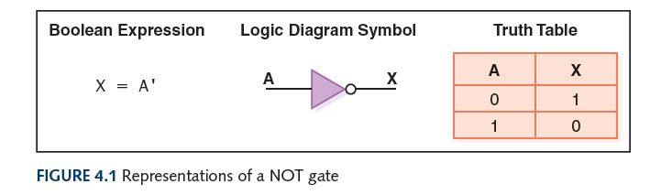
NOT Gate
A NOT gate accepts one input signal (0 or 1) and returns the complementary (opposite) signal as output

Slide 14
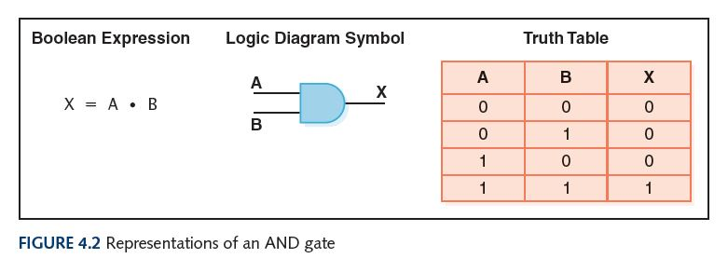
AND Gate
An AND gate accepts two input signals
If both are 1, the output is 1; otherwise,
the output is 0

Slide 15
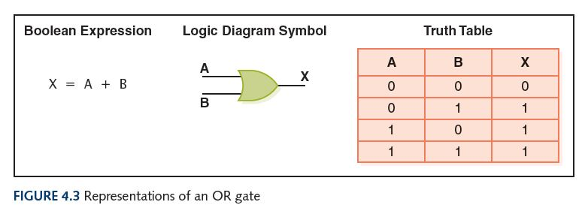
OR Gate
An OR gate accepts two input signals
If both are 0, the output is 0; otherwise,
the output is 1

Slide 16
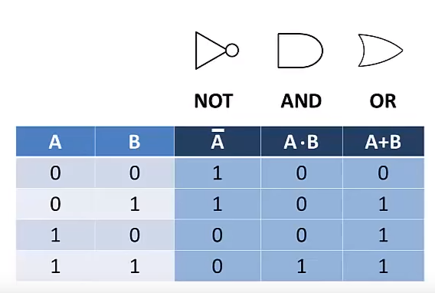
Truth Table

Slide 17
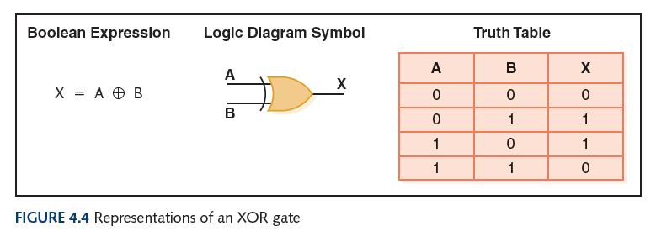
XOR Gate
An XOR gate accepts two input signals
If both are the same, the output is 0; otherwise,
the output is 1

Slide 18
XOR Gate
Note the difference between the XOR gate and the OR gate; they differ only in one input situation
When both input signals are 1, the OR gate produces a 1 and the XOR produces a 0
XOR is called the exclusive OR because its output is 1 if (and only if):
either one input or the other is 1,
excluding the case that they both are

Slide 19
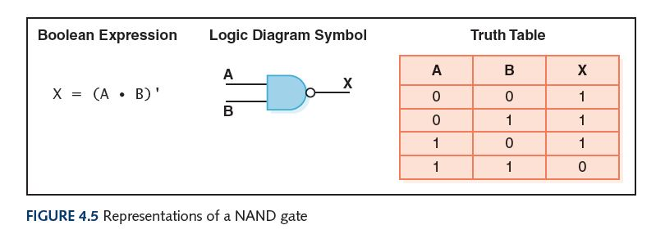
NAND Gate
The NAND (“NOT of AND”) gate accepts two input signals
If both are 1, the output is 0; otherwise,
the output is 1

Slide 20
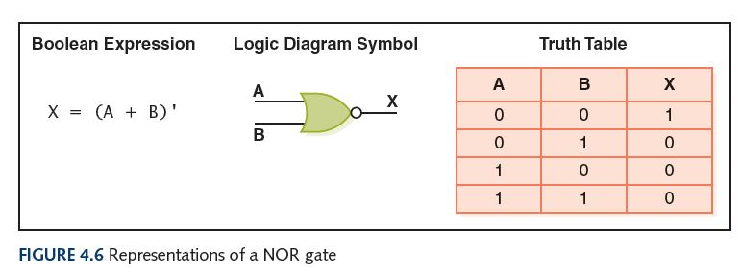
NOR Gate
The NOR (“NOT of OR”) gate accepts two inputs
If both are 0, the output is 1; otherwise,
the output is 0

Slide 21
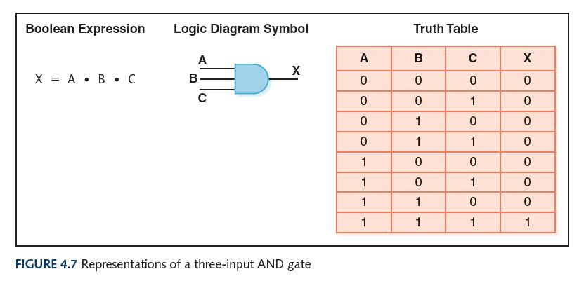
Gates with More Inputs
Some gates can be generalized to accept three or more input values
A three-input AND gate, for example, produces an output of 1 only if all input values are 1

Slide 22
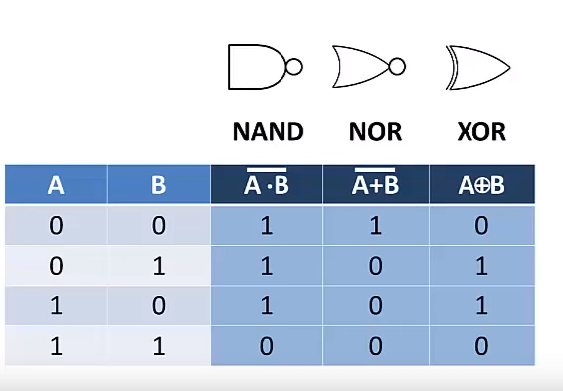
Truth Table

Slide 23
Review of Gate Processing
Gate | Behavior
NOT | Inverts its single input
AND | Produces 1 if all input values are 1
OR | Produces 0 if all input values are 0
XOR | Produces 0 if both input values are the same
NAND | Produces 0 if all input values are 1
NOR | Produces 1 if all input values are 0

Slide 24
Constructing Gates
Transistor
A device that acts either as a wire that conducts electricity or as a resistor that blocks the flow of electricity, depending on the voltage level of an input signal
A transistor has no moving parts, yet acts like a switch
It is made of a semiconductor material, which is neither a particularly good conductor of electricity nor a particularly good insulator

Slide 25
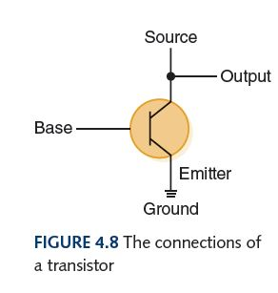
Constructing Gates
Note: If an electrical signal is grounded, it is “pulled low” to zero volts
A transistor has three terminals
A collector (or source)
A base
An emitter
What’s the Output in Figure 4.8?
If the Base signal is low, the transistor acts like an open switch, so the Output is the same as the Source
If the Base signal is high, the transistor acts like a closed switch, so the Output is pulled low
What gate did we just describe?

Slide 26
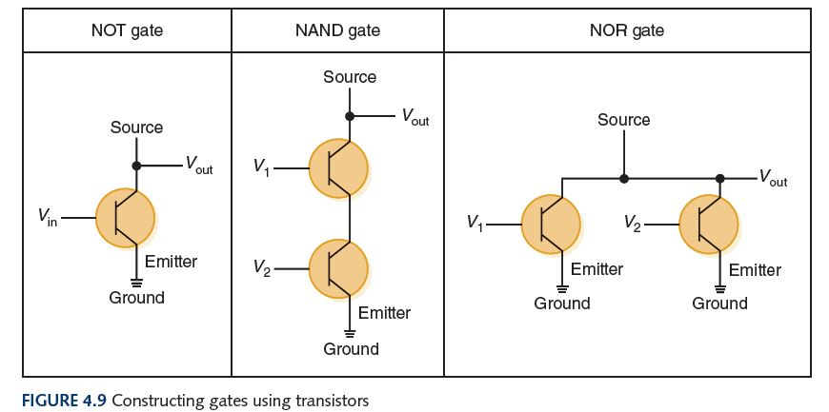
Constructing Gates
The easiest gates to create are the NOT, NAND, and NOR gates

Slide 27
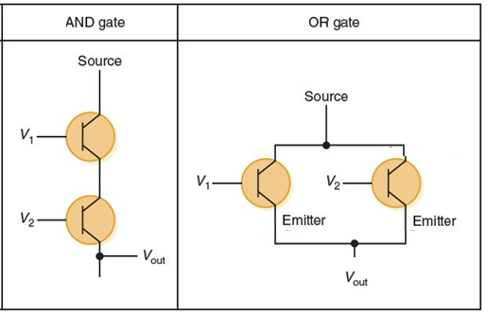

Slide 28
Circuits
Combinational circuit
The input values explicitly determine the output
Sequential circuit
The output is a function of the input values and the existing state of the circuit
We describe the circuit operations using
Boolean expressions
Logic diagrams
Truth tables
Are you surprised?

Slide 29
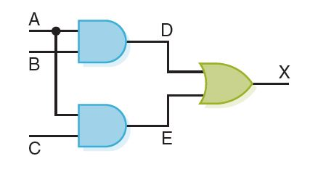
Combinational Circuits
Gates are combined into circuits by using the output of one gate as the input for another
This same circuit using a Boolean expression is AB + AC

Slide 30
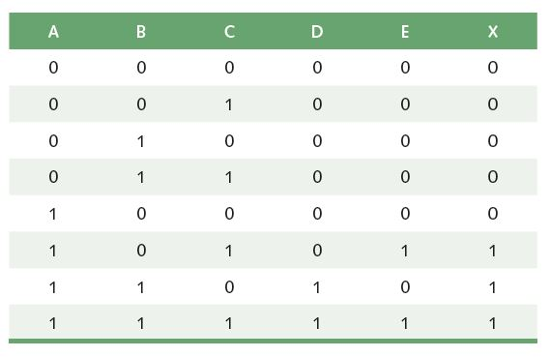
Combinational Circuits
Three inputs require eight rows to describe all possible input combinations

Slide 31
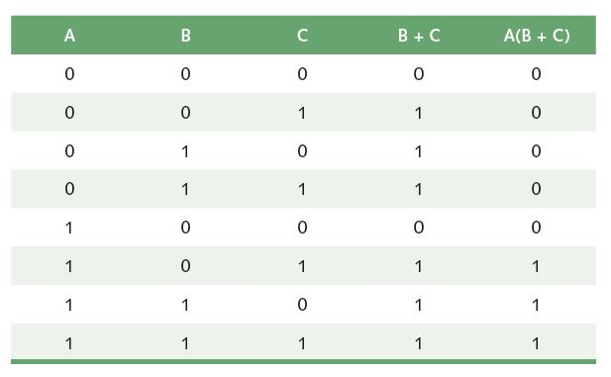
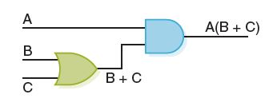
Combinational Circuits
Consider the following Boolean expression A(B + C)
Does this truth table look familiar?
Compare it with previous table

Slide 32
Combinational Circuits
Circuit equivalence
Two circuits that produce the same output for identical input
Boolean algebra
Allows us to apply provable mathematical principles to help design circuits
A(B + C) = AB + BC (distributive law) so circuits must be equivalent

Slide 33
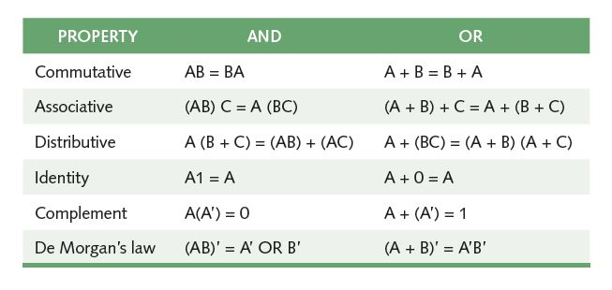
Properties of Boolean Algebra

Slide 34
Adders
At the digital logic level, addition is performed in binary
Addition operations are carried out by special circuits called, appropriately, adders

Slide 35
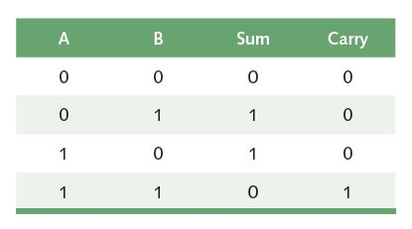
Adders
The result of adding two binary digits could produce a carry value
Recall that 1 + 1 = 10 in base two
Half adder
A circuit that computes the sum of two bits and produces the correct carry bit
Truth table

Slide 36
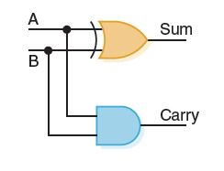
Adders
Circuit diagram representing a half adder
Boolean expressions
sum = A ⊕ B
carry = AB

Slide 37
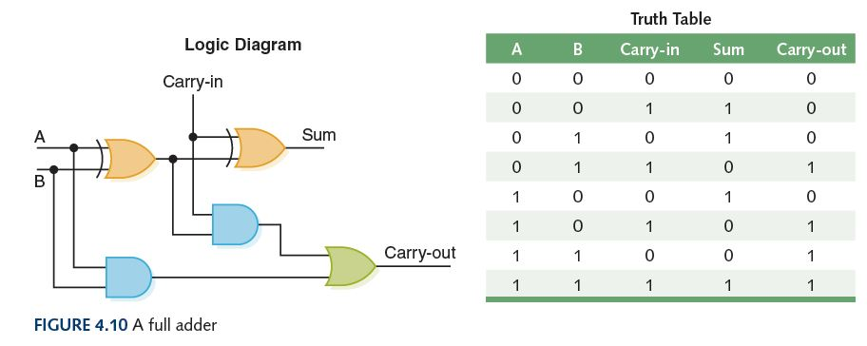
Adders
Full adder
A circuit that takes the carry-in value into account

Slide 38
Multiplexers
Multiplexer (or MUX)
A circuit that uses a few input control signals to determine which of several input data signals is routed to its output signal

Slide 39
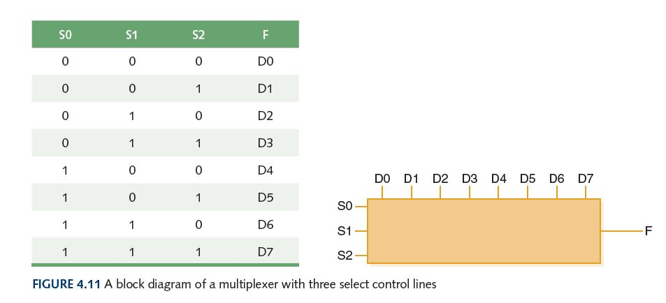
Multiplexers
The control lines S0, S1, and S2 determine which of eight other input lines (D0 … D7) are routed to the output (F)

Slide 40
Circuits as Memory
Digital circuits can be used to store information
These circuits form a sequential circuit, because the output of the circuit is also used as input to the circuit

Slide 41
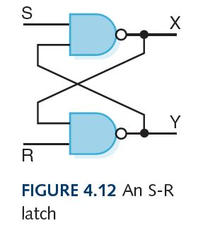
Circuits as Memory
An S-R latch stores a single binary digit (1 or 0)
There are several ways an S-R latch circuit can be designed using various kinds of gates

Slide 42
Circuits as Memory
Assume that S and R are never both 0 at the same time
The design of this circuit guarantees that the two outputs X and Y are always complements of each other
The value of X at any point in time is considered to be the current state of the circuit
Therefore, if X is 1, the circuit is storing a 1; if X is 0, the circuit is storing a 0

Slide 43
Integrated Circuits
Integrated circuit (also called a chip)
A piece of silicon on which multiple gates have been embedded
Silicon pieces are mounted on a plastic or ceramic package with pins along the edges that can be soldered onto circuit boards or inserted into appropriate sockets

Slide 44
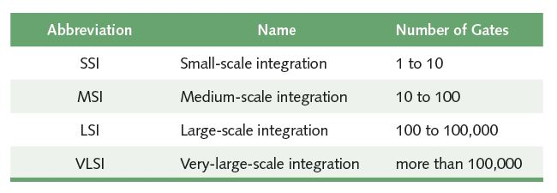
Integrated Circuits
Historically, integrated circuits have been classified by the number of gates (or transistors) they contain
As of 2014, chips exist with over 20 billion transistors

Slide 45
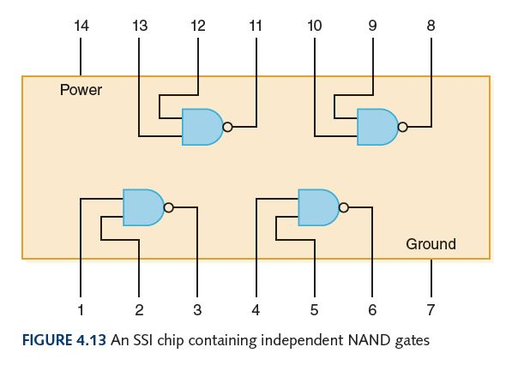
Integrated Circuits

Slide 46
CPU Chips
The most important integrated circuit in any computer is the Central Processing Unit, or CPU
Each CPU chip has a large number of pins through which essentially all communication in a computer system occurs

