Slide 1
cs2010 lecture 2
Based on slides from Prof. Sriharsha Mallapuram

Slide 2
Some concepts
Concepts:
Code
Pseudocode
Flowcharts

Slide 3
Design tools
Pseudocode | Flowchart
Can be done easily on word processor Implements structured design elements well Not visual No standard | Standardized visual Difficult to modify requires special software to do on computer

Slide 4
Start
Write a program to calculate your paycheck. Input your hours worked and your pay rate and calculate net pay.
Input payRate
Input hrsWorked
netPay = payRate * hrsWorked
Pseudocode:
Input payRate
Input hrsWorked
netPay = payRate * hrsWorked
Output netPay
Output netPay
Stop

Slide 5
Step 1:Analysis
Define the Problem
IPO
1. Input: Determine what is given
=>nouns, adjectives
2. Output: Determine what is required
=>nouns, adjectives
3. Processing: Determine the transformations needed, actions needed to produce the required output
=>verbs, adverbs

Slide 6
variables
Input and output data
Nouns
Naming convention
  No spaces
  Meaningful names
  Usually begin with lowercase
  Examples: roomWidth, numPeople, studentName

Slide 7
Example 1
Read three numbers, add them together and print the total.
Variables only

Slide 8
1. Identify inputs
Underline nouns
Read three numbers, add them together and print the total.
Break up several values into separate variables

Slide 9
1. Identify inputs fill Input column first
Read three numbers, add them together and print the total.
Break up several values into separate variables

Slide 10
2. Identify outputs output column next
Read three numbers, add them together and print the total.
Break up several values into separate variables
No verbs here

Slide 11
3. Processing-Define processing steps by bolding verbs
Read three numbers, add them together and print the total.
The read and print verbs are implicit to input and output, so we just need to add.

Slide 12
Each verb is a process step
Read three numbers, add them together and print the total.
Input | Processing | Output
num1 |  | total
num2
num3

Slide 13
Step 3: define list of actions
Read three numbers, add them together and print the total.
Hint: Use verbs
these steps usually involve the input and output defined in step 1
Input | Processing | Output
num1 | Read input(s). | total
num2 | Add numbers together
num3 | Print output(s).

Slide 14
Example 2:
Write a program to prompt the operator for the maximum and minimum temperature readings on a particular day, accept those readings as integers, and calculate and display on the screen the average temperature.
Input | Processing | Output

Slide 15
Example 2:
Write a program to prompt the operator for the maximum and minimum temperature readings on a particular day, accept those readings as integers, and calculate and display on the screen the average temperature.
Input | Processing | Output

Slide 16
Example 2:
Write a program to prompt the operator for the maximum and minimum temperature readings on a particular day, accept those readings as integers, and calculate and display on the screen the average temperature.
Input | Processing | Output
maxTemp |  | avgTemp
minTemp

Slide 17
Example 2:
Write a program to prompt the operator for the maximum and minimum temperature readings on a particular day, accept those readings as integers, and calculate and display on the screen the average temperature.
Input | Processing | Output
maxTemp | Read input(s). | avgTemp
minTemp
 | Print output(s).

Slide 18
Example 2:
Write a program to prompt the operator for the maximum and minimum temperature readings on a particular day, accept those readings as integers, and calculate and display on the screen the average temperature.
Input | Processing | Output
maxTemp | Read input(s). | avgTemp
minTemp | Calculate average.
 | Print output(s).

Slide 19
Example 2:
Write a program to prompt the operator for the maximum and minimum temperature readings on a particular day, accept those readings as integers, and calculate and display on the screen the average temperature.
Input | Processing | Output
maxTemp | Read input(s). | avgTemp
minTemp | Set avgTemp to be (minTemp + maxTemp / 2)
 | Print output(s).

Slide 20
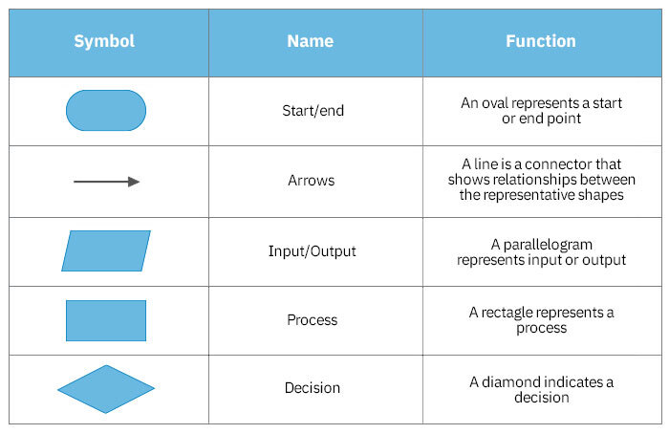
Flowchart Symbols
Notes:
Resource: https://www.zenflowchart.com/flowchart-symbols

Slide 21
Avg Temp program
Have IPO table
Write pseudocode
Write flowchart
Write code

Slide 22
Representing Algorithms (2 of 5)
Sequential operations perform a single task
The three basic sequential operations:
  Computation: a single numeric calculation
  Input: gets data values from outside the algorithm
  Output: sends data values to the outside world
A sequential algorithm is made up only of sequential operations
A variable is a named storage location to hold a data value
Example: computing average miles per gallon

Slide 23
Representing Algorithms Sequential Algorithm
FIGURE 2.3
Step | Operation
1 | Get values for gallons used, starting mileage, ending mileage
2 | Set value of distance driven to (ending mileage - starting mileage)
3 | Set value of average miles per gallon to (distance driven ÷ gallons used)
4 | Print the value of average miles per gallon
5 | Stop
Algorithm for computing average miles per gallon (version 1)

Slide 24
Representing Algorithms (3 of 5)
Control operation: changes the normal flow of control
Conditional statement: asks a question and selects among alternative options:
    Evaluate the true/false condition
    If the condition is true, then do the first set of operations and skip the second set
    If the condition is false, skip the first set of operations and do the second set
Example: check for good or bad gas mileage

Slide 25
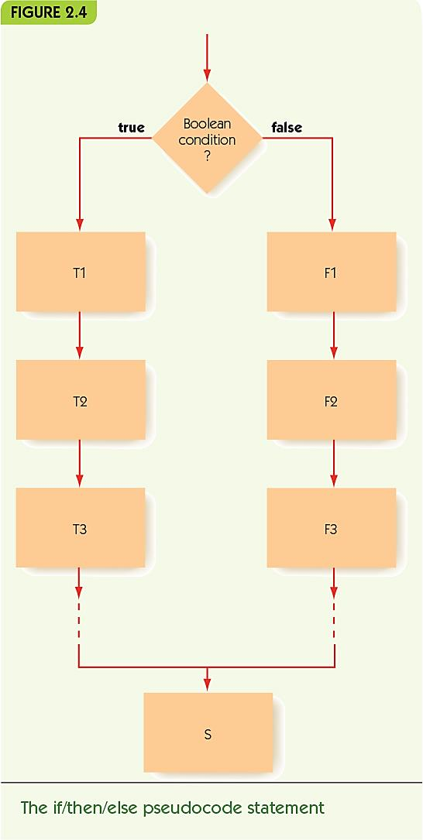
Representing Algorithms Conditional Statement (1 of 2)

Slide 26
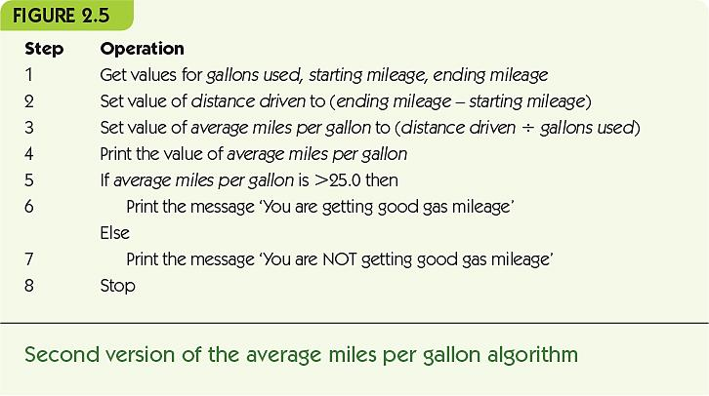
Representing Algorithms Conditional Statement (2 of 2)

Slide 27
Good mileage program
Have pseudocode table
Write IPO table
Write flowchart
Write code

Slide 28
Representing Algorithms (4 of 5)
Iteration: an operation that causes looping, repeating a block of instructions
While statement repeats while a condition remains true
  Continuation condition: a test to see if while loop should continue
  Loop body: instructions to perform repeatedly
Example: repeated mileage calculations

Slide 29
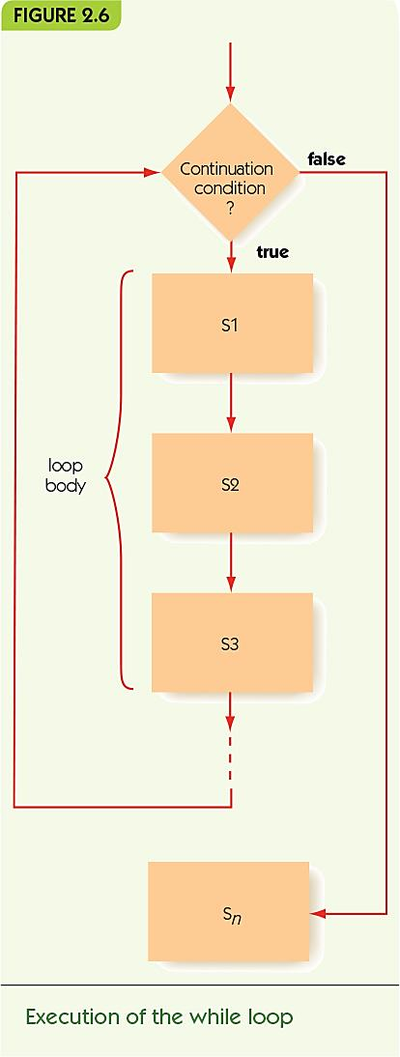
Representing Algorithms Iteration and Loop Body (1 of 2)

Slide 30
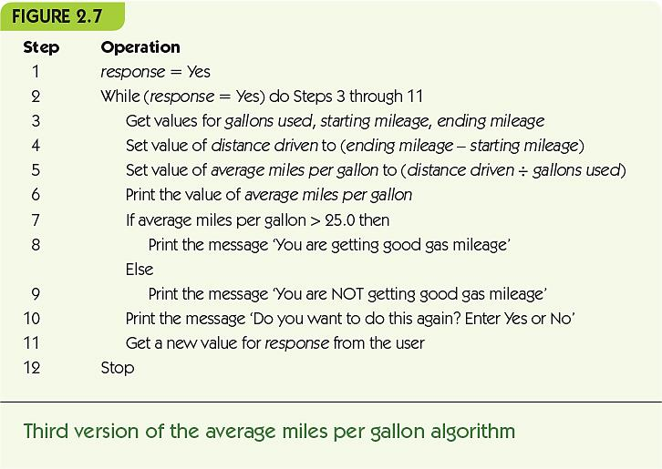
Representing Algorithms Iteration and Loop Body (2 of 2)

Slide 31
Representing Algorithms (5 of 5)
Do/while, alternate iterative operation
  Continuation condition appears at the end
  Loop body always performed at least once
Primitive operations: sequential, conditional, and iterative are all that is needed

Slide 32
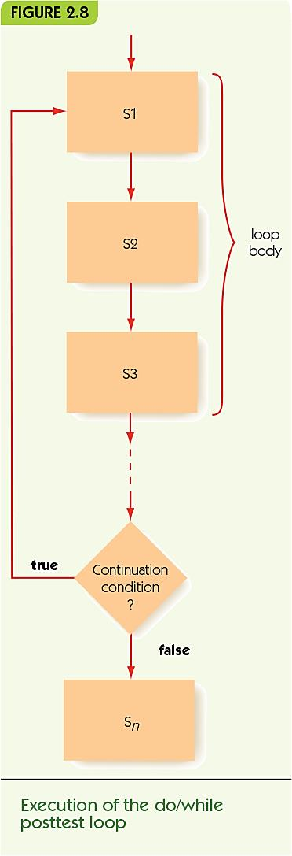
Representing Algorithms Do/While Posttest Loop (1 of 2)

Slide 33
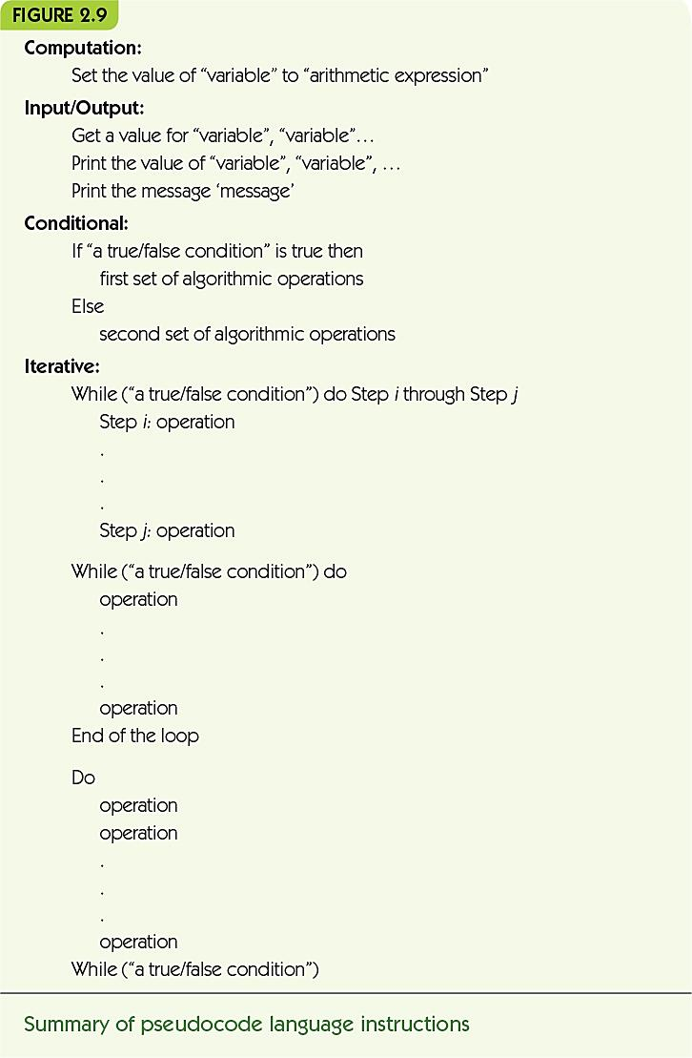
Representing Algorithms Do/While Posttest Loop (2 of 2)

Slide 34
Examples of Algorithmic Problem Solving Example 1: Go Forth and Multiply (1 of 5)
Given two nonnegative integer values, a ≥ 0, b ≥ 0, compute and output the product (a × b) using the technique of repeated addition. That is, determine the value of the sum a + a + a + … + a (b times).

Slide 35
Examples of Algorithmic Problem Solving Example 1: Go Forth and Multiply (2 of 5)
Get input values
  Get values for a and b
Compute the answer
  Loop b times, adding each time*
Output the result
  Print the final value*
* steps need elaboration

Slide 36
Examples of Algorithmic Problem Solving Example 1: Go Forth and Multiply (3 of 5)
Loop b times, adding each time
  Get values for a and b
  Set the value of count to 0
  While (count < b) do
    … the rest of the loop*
    Set the value of count to (count + 1)
  End of the loop
* steps need elaboration

Slide 37
Examples of Algorithmic Problem Solving Example 1: Go Forth and Multiply (4 of 5)
Loop b times, adding each time
  Get values for a and b
  Set the value of count to 0
  Set the value of product to 0
  While (count < b) do
    Set the value of product to (product + a)
    Set the value of count to (count + 1)
  End of the loop
Output the result
  Print the value of product

Slide 38
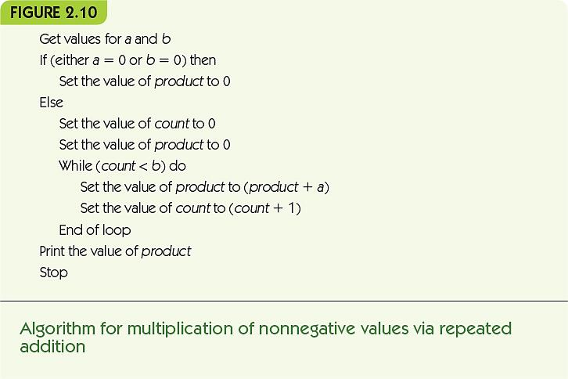
Examples of Algorithmic Problem Solving Example 1: Go Forth and Multiply (5 of 5)

Slide 39
Alternative representations for that pseudocode
IPO Table?
Inputs
Whole algo is process
Outputs
Flow chart
Let’s draw it
Code?
Let’s write it

Slide 40
Flowchart Symbols
Notes:
Resource: https://www.zenflowchart.com/flowchart-symbols

