Slide 1
CS 5600 Computer Systems
Lecture 7: Virtual Memory

Slide 2
Motivation and Goals
Base and Bounds
Segmentation
Page Tables
TLB
Multi-level Page Tables
Swap Space

Slide 3
Main Memory
Main memory is conceptually very simple
Code sits in memory
Data is either on a stack or a heap
Everything gets accessed via pointers
Data can be written to or read from long term storage
Memory is a simple and obvious device
So why is memory management one of the most complex features in modern OSes?

Slide 4
Protection and Isolation
Physical Memory
Physical memory does not offer protection or isolation
0xFFFFFFFF
Kernel Memory
Process 1
w/ Secret Data
Oh sorry, I didn’t mean to overwrite your task_structs ;)
Evil Process
I’m in your process, stealing your data ;)
0x00000000

Slide 5
Compilation and Program Loading
Physical Memory
0xFFFFFFFF
Compiled programs include fixed pointer addresses
Example:
000FE4D8 <foo>:
…
000FE21A: push eax
000FE21D: push ebx
000FE21F: call 0x000FE4D8
Problem: what if the program is not loaded at corresponding address?
Kernel Memory
Addr of foo(): 0x0DEB49A3
Process 2
Addr of foo(): 0x000FE4D8
Process 1
0x00000000

Slide 6
Physical Memory has Limited Size
0xFFFFFFFF
RAM is cheap, but not as cheap as solid state or cloud storage
What happens when you run out of RAM?
Kernel Memory
Process 4
Process 5
Process 3
Process 2
Process 1
0x00000000

Slide 7
Physical vs. Virtual Memory
Clearly, physical memory has limitations
No protection or isolation
Fixed pointer addresses
Limited size
Etc.
Virtualization can solve these problems!
As well as enable additional, cool features

Slide 8
A Toy Example
What do we mean by virtual memory?
Processes use virtual (or logical) addresses
Virtual addresses are translated to physical addresses
Process’ View of
Virtual Memory
Magical Address Translation Black Box
Physical Memory
(Reality)
0xFFFF
0xFFFF
Kernel Memory
All the memory belongs to me!
Process 3
Physical Address
Process 1
I am master of all I survey!
Process 2
Process 1
Virtual Address
0x0000
0x0000

Slide 9
Implementing Address Translation
In a system with virtual memory, each memory access must be translated
Can the OS perform address translation?
Only if programs are interpreted
Modern systems have hardware support that facilitates address translation
Implemented in the Memory Management Unit (MMU) of the CPU
Cooperates with the OS to translate virtual addresses into physical addresses

Slide 10
Virtual Memory Implementations
There are many ways to implement an MMU
Base and bound registers
Segmentation
Page tables
Multi-level page tables
We will discuss each of these approaches
How does it work?
What features does it offer?
What are the limitations?
Old, simple, limited functionality
Modern, complex, lots of functionality

Slide 11
Goals of Virtual Memory
Transparency
Processes are unaware of virtualization
Protection and isolation
Flexible memory placement
OS should be able to move things around in memory
Shared memory and memory mapped files
Efficient interprocess communication
Shared code segments, i.e. dynamic libraries
Dynamic memory allocation
Grow heaps and stacks on demand, no need to pre-allocate large blocks of empty memory
Support for sparse address spaces
Demand-based paging
Create the illusion of near-infinite memory

Slide 12
Motivation and Goals
Base and Bounds
Segmentation
Page Tables
TLB
Multi-level Page Tables
Swap Space

Slide 13
Base and Bounds Registers
A simple mechanism for address translation
Maps a contiguous virtual address region to a contiguous physical address region
Process’ View of
Virtual Memory
Physical Memory
0xFFFF
Kernel Memory
0x1001
Process 1
0x10FF
0x0001
Register | Value
EIP | 0x0023
ESP | 0x0F76
BASE | 0x00FF
BOUND | 0x1000
Process 1
0x00FF
0x0000

Slide 14
Base and Bounds Example
Process’ View of
Virtual Memory
0x0023 mov eax, [esp]
1) Fetch instruction
0x0023 + 0x00FF = 0x0122
2) Translate memory access
0x0F76 + 0x00FF = 0x1075
3) Move value to register
[0x1075] → eax
Physical Memory
0xFFFF
Kernel Memory
0x1001
2
Process 1
1
2
0x10FF
0x0001
Process 1
1
Register | Value
EIP | 0x0023
ESP | 0x0F76
BASE | 0x00FF
BOUND | 0x1000
0x00FF
0x0000

Slide 15
Protection and Isolation
Process’ View of
Virtual Memory
0x0023 mov eax, [0x4234]
1) Fetch instruction
0x0023 + 0x00FF = 0x0122
2) Translate memory access
0x4234 + 0x00FF = 0x4333
0x1333 > 0x10FF
(BASE + BOUND)
Raise Protection Exception!
Physical Memory
0xFFFF
Kernel Memory
2
2
0x1001
Process 1
0x10FF
Process 1
1
1
0x0001
0x00FF
0x0000
Register | Value
EIP | 0x0023
ESP | 0x0F76
BASE | 0x00FF
BOUND | 0x1000

Slide 16
Implementation Details
BASE and BOUND are protected registers
Only code in Ring 0 may modify BASE and BOUND
Prevents processes from modifying their own sandbox
Each CPU has one BASE and one BOUND register
Just like ESP, EIP, EAX, etc…
Thus, BASE and BOUND must be saved a restored during context switching

Slide 17
Base and Bound Pseudocode
PhysAddr = VirtualAddress + BASE
if (PhysAddr >= BASE + BOUND)
RaiseException(PROTECTION_FAULT)
Register = AccessMemory(PhysAddr)

Slide 18
Advantages of Base and Bound
Physical Memory
0xFFFFFFFF
Kernel Memory
Simple hardware implementation
Simple to manage each process’ virtual space
Processes can be loaded at arbitrary fixed addresses
Offers protection and isolation
Offers flexible placement of data in memory
No, I’m loaded at address 0x00AF
Process 2
Previous BASE → 0x00FF
New BASE → 0x10A0
I’m loaded at address 0x00AF
Process 1
0x00000000

Slide 19
Limitations of Base and Bound
Processes can overwrite their own code
Processes aren’t protected from themselves
No sharing of memory
Code (read-only) is mixed in with data (read/write)
Process memory cannot grow dynamically
May lead to internal fragmentation
Physical Memory
0xFFFFFFFF
Kernel Memory
/bin/bash
Data
Code
/bin/bash
Code is duplicated in memory :(
Data
Code
0x00000000

Slide 20
Internal Fragmentation
BOUND determines the max amount of memory available to a process
How much memory do we allocate?
Empty space leads to internal fragmentation
What if we don’t allocate enough?
Increasing BOUND after the process is running doesn’t help
Physical Memory
Wasted space = internal fragmentation
Increasing BOUND doesn’t move the stack away from the heap
Stack
Stack
Heap
Heap
Code

Slide 21
Motivation and Goals
Base and Bounds
Segmentation
Page Tables
TLB
Multi-level Page Tables
Swap Space

Slide 22
Towards Segmented Memory
Having a single BASE and a single BOUND means code, stack, and heap are all in one memory region
Leads to internal fragmentation
Prevents dynamically growing the stack and heap
Segmentation is a generalization of the base and bounds approach
Give each process several pairs of base/bounds
May or may not be stored in dedicated registers
Each pair defines a segment
Each segment can be moved or resized independently

Slide 23
Segmentation Details
The code and data of a process get split into several segments
3 segments is common: code, heap, and stack
Some architectures support >3 segments per process
Each process views its segments as a contiguous region of memory
But in physical memory, the segments can be placed in arbitrary locations
Question: given a virtual address, how does the CPU determine which segment is being addressed?

Slide 24
Segments and Offsets
Key idea: split virtual addresses into a segment index and an offset
Example: suppose we have 14-bit addresses
Top 2 bits are the segment
Bottom 12 bits are the offset
4 possible segments per process
00, 01, 10, 11
13 | 12 | 11 | 10 | 9 | 8 | 7 | 6 | 5 | 4 | 3 | 2 | 1 | 0
Segment
Offset

Slide 25
Separation of Responsibility
The OS manages segments and their indexes
Creates segments for new processes in free physical memory
Builds a table mapping segments indexes to base addresses and bounds
Swaps out the tables and segment registers during context switches
Frees segments from physical memory
The CPU translates virtual addresses to physical addresses on demand
Uses the segment registers/segment tables built by the OS

Slide 26
Segmentation Example
0x0023 mov eax, [esp]
1) Fetch instruction
0x0023 (EIP) - 00000000100011
0x0020 (CS) + 0x0023 = 0x0043
2) Translate memory access
0x2015 (ESP) – 10000000010101
0x0400 (SS) + 0x0015 = 0x0415
Process’ View of
Virtual Memory
Physical Memory
0xFFFF
0x3FFF
Kernel Memory
0xB100
Heap
0x3000
0xB000
Code
Stack
Stack
0x2000
Heap
Heap
0x0500
0x1000
0x0400
Stack
Segment | Index | Base | Bound
CS (Code) | 00 | 0x0020 | 0x0100
HS (Heap) | 01 | 0xB000 | 0x0100
SS (Stack) | 10 | 0x0400 | 0x0100
0x0120
0x0020
Code
Code
0x0000
0x0000

Slide 27
Segmentation Pseudocode
// get top 2 bits of 14-bit VA
Segment = (VirtualAddress & SEG_MASK) >> SEG_SHIFT
// now get offset
Offset = VirtualAddress & OFFSET_MASK
if (Offset >= Bounds[Segment])
RaiseException(PROTECTION_FAULT)
else
PhysAddr = Base[Segment] + Offset
Register = AccessMemory(PhysAddr)

Slide 28
More on Segments
In the previous example, we use a 14-bit address space with 2 bits reserved for the segment index
This limits us to 4 segments per process
Each segment is 2¹² = 4KB in size
Real segmentation systems tend to have
More bits for the segments index (16-bits for x86)
More bits for the offset (16-bits for x86)
However, segments are course-grained
Limited number of segments per process (typically ~4)

Slide 29
Segment Permissions
Process 1’s View of
Virtual Memory
Many CPUs (including x86) support permissions on segments
Read, write, and executable
Disallowed operations trigger an exception
E.g. Trying to write to the code segment
0x3FFF
0x3000
.rodata
Stack
0x2000
Heap
Index | Base | Bound | Permissions
00 | 0x0020 | 0x0100 | RX
01 | 0xB000 | 0x0100 | RW
10 | 0x0400 | 0x0100 | RW
11 | 0xE500 | 0x100 | R
0x1000
0x0000
Code

Slide 30
x86 Segments
Intel 80286 introduced segmented memory
CS – code segment register
SS – stack segment register
DS – data segment register
ES, FS, GS – extra segment registers
In 16-bit (real mode) x86 assembly, segment:offset notation is common
mov [ds:eax], 42 // move 42 to the data segment, offset // by the value in eax
mov [esp], 23 // uses the SS segment by default

Slide 31
x86 Segments Today
Segment registers and their associated functionality still exist in today’s x86 CPUs
However, the 80386 introduced page tables
Modern OSes “disable” segmentation
The Linux kernel sets up four segments during bootup
Pages are used to virtualize memory, not segments
Segment Name | Description | Base | Bound | Ring
KERNEL_CS | Kernel code | 0 | 4 GB | 0
KERNEL_DS | Kernel data | 0 | 4 GB | 0
USER_CS | User code | 0 | 4 GB | 3
USER_DS | User data | 0 | 4 GB | 3
Used to label pages with protection levels

Slide 32
What is a Segmentation Fault?
If you try to read/write memory outside a segment assigned to your process
Examples:
char buf[5];
strcpy(buf, “Hello World”);
return 0; // why does it seg fault when you return?
Today “segmentation fault” is an anachronism
All modern systems use page tables, not segments

Slide 33
Shared Memory
Same 00 and 01 physical segments
Different 01 and 10 physical segments
Process 1’s View of
Virtual Memory
Process 2’s View of
Virtual Memory
0x3FFF
0x3FFF
Index | Base | Bound
00 | 0x0020 | 0x0100
01 | 0xC000 | 0x0100
10 | 0x0600 | 0x0100
11 | 0xE500 | 0x0300
Shared Data
Shared Data
0x3000
0x3000
Stack
Stack
0x2000
0x2000
Heap
Index | Base | Bound
00 | 0x0020 | 0x0100
01 | 0xB000 | 0x0100
10 | 0x0400 | 0x0100
11 | 0xE500 | 0x0300
Heap
0x1000
0x1000
0x0000
Code
0x0000
Code

Slide 34
Advantages of Segmentation
All the advantages of base and bound
Better support for sparse address spaces
Code, heap, and stack are in separate segments
Segment sizes are variable
Prevents internal fragmentation
Supports shared memory
Per segment permissions
Prevents overwriting code, or executing data

Slide 35
External Fragmentation
Problem: variable size segments can lead to external fragmentation
Memory gets broken into random size, non-contiguous pieces
Example: there is enough free memory to start a new process
But the memory is fragmented :(
Compaction can fix the problem
But it is extremely expensive
Physical Memory
Kernel Memory
Heap
Heap
Code
Code
Stack
Stack
Stack
Code
Heap
Heap
Heap
Stack
Stack
Code
Code

Slide 36
Motivation and Goals
Base and Bounds
Segmentation
Page Tables
TLB
Multi-level Page Tables
Swap Space

Slide 37
Towards Paged Memory
Segments improve on base and bound, but they still aren’t granular enough
Segments lead to external fragmentation
The paged memory model is a generalization of the segmented memory model
Physical memory is divided up into physical pages (a.k.a. frames) of fixed sizes
Code and data exist in virtual pages
A table maps virtual pages → physical pages (frames)

Slide 38
Toy Example
Suppose we have a 64-byte virtual address space
Lets specify 16 bytes per page
How many bits do virtual addresses need to be in this system?
2⁶ = 64 bytes, thus 6 bit addresses
How many bits of the virtual address are needed to select the physical page?
64 bytes / 16 bytes per page = 4 pages
2² = 4, thus 2 bits to select the page
Virtual Memory
64
Page 3
48
Page 2
32
Page 1
5 | 4 | 3 | 2 | 1 | 0
16
Page 0
0
Virtual Page #
Offset

Slide 39
Toy Example, Continued
mov eax, [21]
Translation
21 – 010101
117 – 1110101
Physical Memory
128
Page 7
112
Page 6
Virtual Memory
96
Page 5
64
80
Page 3
Page 4
48
Page 2
64
Page 3
32
Page 1
48
Page 2
16
Virtual Page # | Physical Page #
00 (0) | 010 (2)
01 (1) | 111 (7)
10 (2) | 100 (4)
11 (3) | 001 (1)
Page 0
32
Page 1
0
16
Page 0
0

Slide 40
Concrete Example
Assume a 32-bit virtual and physical address space
Fix the page size at 4KB (4096 bytes, 2¹²)
How many total pages will there be?
2³² / 2¹² = 1048576 (2²⁰)
How many bits of a virtual address are needed to select the physical page?
20 bits (since there are 1048576 total pages)
Assume that each page table entry is 4 bytes large
How big will the page table be?
1048586 * 4 bytes = 4MB of space
Each process needs its own page table
100 processes = 400MB of page tables

Slide 41
Concrete Example, Continued
Process 1’s View of
Virtual Memory
The vast majority of each process’ page table is empty, i.e. the table is sparse
Process 1 requires:
2 KB for code (1 page)
7 KB for stack (2 pages)
12 KB for heap (3 pages)
Physical Memory
2³²
2³⁰
Stack
Page k + 1
Kernel Memory
Stack
Page k
VPN | PFN | Valid?
0 … i - 1 | whatever | 0
i | d | 1
i + 1 … j – 1 | whatever | 0
j | b | 1
j + 1 | f | 1
j + 2 | e | 1
j + 3 … k - 1 | whatever | 0
k | a | 1
k + 1 | c | 1
Page f
Heap
Page e
Heap
Page d
Code
Heap
Page j + 3
Page c
Stack
Heap
Page j + 2
Page b
Heap
Heap
Page j + 1
Modify [ j+3, g, 1]
Page a
Stack
Heap
Page j
Page g
Heap
Code
Page i
0
0

Slide 42
Page Table Implementation
The OS creates the page table for each process
Page tables are typically stored in kernel memory
OS stores a pointer to the page table in a special register in the CPU (CR3 register in x86)
On context switch, the OS swaps the pointer for the old processes table for the new processes table
The CPU uses the page table to translate virtual addresses into physical addresses

Slide 43
x86 Page Table Entry
On x86, page table entries (PTE) are 4 bytes
31 - 12 | 11 - 9 | 8 | 7 | 6 | 5 | 4 | 3 | 2 | 1 | 0
Page Frame Number (PFN) | Unused | G | PAT | D | A | PCD | PWT | U/S | W | P
Bits related to permissions
W – writable bit – is the page writable, or read-only?
U/S – user/supervisor bit – can user-mode processes access this page?
Hardware caching related bits: G, PAT, PCD, PWT
Bits related to swapping
P – present bit – is this page in physical memory?
A – accessed bit – has this page been read recently?
D – dirty bit – has this page been written recently?
We will revisit these later in the lecture…

Slide 44
Page Table Pseudocode
// Extract the VPN from the virtual address
VPN = (VirtualAddress & VPN_MASK) >> SHIFT
// Form the address of the page-table entry (PTE)
PTEAddr = PTBR + (VPN * sizeof(PTE))
// Fetch the PTE
PTE = AccessMemory(PTEAddr)
if (PTE.Valid == False) // Check if process can access the page
RaiseException(SEGMENTATION_FAULT)
else if (CanAccess(PTE.ProtectBits) == False)
RaiseException(PROTECTION_FAULT)
// Access is OK: form physical address and fetch it
offset = VirtualAddress & OFFSET_MASK
PhysAddr = (PTE.PFN << PFN_SHIFT) | offset
Register = AccessMemory(PhysAddr)

Slide 45
Tricks With Permissions and Shared Pages
Recall how fork() is implemented
OS creates a copy of all pages controlled by the parent
fork() is a slooooow operation
Copying all that memory takes a looooong time
Can we improve the efficiency of fork()?
Yes, if we are clever with shared pages and permissions!

Slide 46
Copy-on-Write
Key idea: rather than copy all of the parents pages, create a new page table for the child that maps to all of the parents pages
Mark all of the pages as read-only
If parent or child writes to a page, a protection exception will be triggered
The OS catches the exception, makes a copy of the target page, then restarts the write operation
Thus, all unmodified data is shared
Only pages that are written to get copied, on demand

Slide 47
Copy-on-Write Example
Physical Memory
Parents Page Table
2³⁰
Kernel Memory
Function | VPN | PFN | Writable?
Code | i | d | 0
Heap | j | b | 1
Stack | k | a | 1
0
Page f
Heap
m
1
Page m
0
Stack
Write
Page d
Code
Childs Page Table
Protection Exception
Function | VPN | PFN | Writable?
Code | i | d | 0
Heap | j | b | 0
Stack | k | a | 0
Page a
Stack
Stack
Write
Write
1
0

Slide 48
Zero-on-Reference
How much physical memory do we need to allocate for the heap of a new process?
Zero bytes!
When a process touches the heap
Segmentation fault into OS kernel
Kernel allocates some memory
Zeros the memory
Avoid accidentally leaking information!
Restart the process

Slide 49
Advantages of Page Tables
All the advantages of segmentation
Even better support for sparse address spaces
Each page is relatively small
Fine-grained page allocations to each process
Prevents internal fragmentation
All pages are the same size
Each to keep track of free memory (say, with a bitmap)
Prevents external fragmentation
Per segment permissions
Prevents overwriting code, or executing data

Slide 50
Problems With Page Tables
Page tables are huge
On a 32-bit machine with 4KB pages, each process’ table is 4MB
One a 64-bit machine with 4KB pages, there are 240 entries per table → 240 * 4 bytes = 4TB
And the vast majority of entries are empty/invalid!
Page table indirection adds significant overhead to all memory accesses

Slide 51
Page Tables are Slow
0x1024 mov [edi + eax * 4], 0x0
0x1028 inc eax
0x102C cmp eax, 0x03E8
0x1030 jne 0x1024
How many memory accesses occur during each iteration of the loop?
4 instructions are read from memory
[edi + eax * 4] writes to one location in memory
5 page table lookups
Each memory access must be translated
… and the page tables themselves are in memory
Naïve page table implementation doubles memory access overhead

Slide 52
Motivation and Goals
Base and Bounds
Segmentation
Page Tables
TLB
Multi-level Page Tables
Swap Space

Slide 53
Problem: Page Table Speed
Page tables give us a great deal of flexibility and granularity to implement virtual memory
However, page tables are large, thus they must go in RAM (as opposed to in a CPU register)
Each virtual memory access must be translated
Each translation requires a table lookup in memory
Thus, memory overhead is doubled
How can we use page tables without this memory lookup overhead?

Slide 54
Caching
Key idea: cache page table entries directly in the CPU’s MMU
Translation Lookaside Buffer (TLB)
Should be called address translation cache
TLB stores recently used PTEs
Subsequent requests for the same virtual page can be filled from the TLB cache
Directly addresses speed issue of page tables
On-die CPU cache is very, very fast
Translations that hit the TLB don’t need to be looked up from the page table in memory

Slide 55
Example TLB Entry
31
30
29
28
27
26
25
24
23
22
21
20
19
18
17
16
15
14
13
12
11
10
9
8
7
6
5
4
3
2
1
0
Virtual Page Number (VPN)
G
ASID
Physical Frame Number (PFN)
C
D
V
VPN & PFN – virtual and physical pages
G – is this page global (i.e. accessible by all processes)?
ASID – address space ID
D – dirty bit – has this page been written recently?
V – valid bit – is this entry in the TLB valid?
C – cache coherency bits – for multi-core systems
More on this later…

Slide 56
TLB Control Flow Psuedocode
Fast Path
VPN = (VirtualAddress & VPN_MASK) >> SHIFT
(Success, TlbEntry) = TLB_Lookup(VPN)
if (Success == True) // TLB Hit
if (CanAccess(TlbEntry.ProtectBits) == True)
Offset = VirtualAddress & OFFSET_MASK
PhysAddr = (TlbEntry.PFN << SHIFT) | Offset
AccessMemory(PhysAddr)
else
RaiseException(PROTECTION_FAULT)
else // TLB Miss
PTEAddr = PTBR + (VPN * sizeof(PTE))
PTE = AccessMemory(PTEAddr)
if (PTE.Valid == False)
RaiseException(SEGMENTATION_FAULT)
else if (CanAccess(PTE.ProtectBits) == False)
RaiseException(PROTECTION_FAULT)
TLB_Insert(VPN, PTE.PFN, PTE.ProtectBits)
RetryInstruction()
Make sure we have permission, then proceed
Slow Path
Load the page table entry from memory, add it to the TLB, and retry

Slide 57
Reading an Array (no TLB)
Suppose we have a 10KB array of integers
Assume 4KB pages
With no TLB, how many memory accesses are required to read the whole array?
10KB / 4 = 2560 integers in the array
Each requires one page table lookup, one memory read
5120 reads, plus more for the instructions themselves

Slide 58
Reading an Array (with TLB)
Process 1’s View of
Virtual Memory
Same example, now with TLB
10KB integer array
4KB pages
Assume the TLB starts off cold (i.e. empty)
How many memory accesses to read the array?
2560 to read the integers
3 page table lookups
2563 total reads
TLB hit rate: 96%
Array Data
Page j + 2
Array Data
Page j + 1
Array Data
Page j
TLB
VPN | PFN
j | a
j + 1 | b
j + 2 | c

Slide 59
Locality
TLB, like any cache, is effective because of locality
Spatial locality: if you access memory address x, it is likely you will access x + 1 soon
Most of the time, x and x + 1 are in the same page
Temporal locality: if you access memory address x, it is likely you will access x again soon
The page containing x will still be in the TLB, hopefully

Slide 60
Be Careful With Caching
Recall: TLB entries have an ASID (address space ID) field. What is this for?
Here’s a hint: think about context switching
Process 1’s Page Table
TLB
Process 2 Page Table
VPN | PFN
i | d
j | b
k | a
VPN | PFN
i | d
J | b
k | a
VPN | PFN
i | r
j | u
k | s
Problem: TLB entries may not be valid after a context switch
VPNs are the same, but PFN mappings have changed!

Slide 61
Potential Solutions
Clear the TLB (mark all entries as invalid) after each context switch
Works, but forces each process to start with a cold cache
Only solution on x86 (until ~2008)
Associate an ASID (address space ID) with each process
ASID is just like a process ID in the kernel
CPU can compare the ASID of the active process to the ASID stored in each TLB entry
If they don’t match, the TLB entry is invalid

Slide 62
Replacement Policies
On many CPUs (like x86), the TLB is managed by the hardware
Problem: space in the TLB is limited (usually KB)
Once the TLB fills up, how does the CPU decide what entries to replace (evict)?
Typical replacement policies:
FIFO: easy to implement, but certain access patterns result in worst-case TLB hit rates
Random: easy to implement, fair, but suboptimal hit rates
LRU (Least Recently Used): algorithm typically used in practice

Slide 63
Hardware vs. Software Management
Thus far, discussion has focused on hardware managed TLBs (e.g. x86)
PTE = AccessMemory(PTEAddr)
TLB_Insert(VPN, PTE.PFN, PTE.ProtectBits)
CPU dictates the page table format, reads page table entries from memory
CPU manages all TLB entries
However, software managed TLBs are also possible (e.g. MIPS and SPARC)

Slide 64
Software Managed TLB Pseudocode
VPN = (VirtualAddress & VPN_MASK) >> SHIFT
(Success, TlbEntry) = TLB_Lookup(VPN)
if (Success == True) // TLB Hit
if (CanAccess(TlbEntry.ProtectBits) == True)
Offset = VirtualAddress & OFFSET_MASK
PhysAddr = (TlbEntry.PFN << SHIFT) | Offset
Register = AccessMemory(PhysAddr)
else
RaiseException(PROTECTION_FAULT)
else // TLB Miss
RaiseException(TLB_MISS)
The hardware does not:
Try to read the page table
Add/remove entries from the TLB

Slide 65
Implementing Software TLBs
Key differences vs. hardware managed TLBs
CPU doesn’t insert entries into the TLB
CPU has no ability to read page tables from memory
On TLB miss, the OS must handle the exception
Locate the correct page table entry in memory
Insert the PTE into the TLB (evict if necessary)
Tell the CPU to retry the previous instruction
Note: TLB management instructions are privileged
Only the kernel can modify the TLB

Slide 66
Comparing Hardware and Software TLBs
Hardware TLB
Software TLB
Advantages
Less work for kernel developers, CPU does a lot of work for you
Disadvantages
Page table data structure format must conform to hardware specification
Limited ability to modify the CPUs TLB replacement policies
Advantages
No predefined data structure for the page table
OS is free to implement novel TLB replacement policies
Disadvantages
More work for kernel developers
Beware infinite TLB misses!
OSes page fault handler must always be present in the TLB
Easier to program
Greater flexibility

Slide 67
TLB Summary
TLBs address the slowdown associated with page tables
Frequently used page table entries are cached in the CPU
Prevents repeated lookups for PTEs in main memory
Reduce the speed overhead of page tables by an order of magnitude or more
Caching works very well in this particular scenario
Lots of spatial and temporal locality

Slide 68
Motivation and Goals
Base and Bounds
Segmentation
Page Tables
TLB
Multi-level Page Tables
Swap Space

Slide 69
Problem: Page Table Size
At this point, we have solved the TLB speed issue
However, recall that pages tables are large and sparse
Example: 32-bit system with 4KB pages
Each page table is 4MB
Most entries are invalid, i.e. the space is wasted
How can we reduce the size of the page tables?
Many possible solutions
Multi-layer page tables are most common (x86)

Slide 70
Simple Solution: Bigger Pages
Suppose we increase the size of pages
Example: 32-bit system, 4MB pages
2³² / 2²² = 1024 pages per process
1024 * 4 bytes per page = 4KB page tables
What is the drawback?
Increased internal fragmentation
How many programs actually have 4MB of code, 4MB of stack, and 4MB of heap data?

Slide 71
Alternate Data Structures
Thus far, we’ve assumed linear page tables
i.e. an array of page table entries
What if we switch to an alternate data structure?
Hash table
Red-black tree
Why is switching data structures not always feasible?
Can be done of the TLB is software managed
If the TLB is hardware managed, then the OS must use the page table format specified by the CPU

Slide 72
Inverted Page Tables
Our current discussion focuses on tables that map virtual pages to physical pages
What if we flip the table: map physical pages to virtual pages?
Since there is only one physical memory, we only need one inverted page table!
Traditional Tables
Inverted Table
Standard page tables: one per process
VPN | PFN
i | d
j | b
k | a
PFN | VPN
i | d
j | b
k | a
VPN | PFN
i | r
j | u
k | s
VPN | PFN
i | r
j | u
k | s
Inverted page tables: one per system

Slide 73
Normal vs. Inverted Page Tables
Advantage of inverted page table
Only one table for the whole system
Disadvantages
Lookups are more computationally expensive
How to implement shared memory?
Table must be scanned to locate a given VPN, thus O(n) lookup time
Traditional Table
Inverted Table
VPN serves as an index into the array, thus O(1) lookup time
VPN | PFN
i | d
j | b
k | a
PFN | VPN
i | d
j | b
k | a

Slide 74
Multi-Level Page Tables
Key idea: split the linear page table into a tree of sub-tables
Benefit: branches of the tree that are empty (i.e. do not contain valid pages) can be pruned
Multi-level page tables are a space/time tradeoff
Pruning reduces the size of the table (saves space)
But, now the tree must be traversed to translate virtual addresses (increased access time)
Technique used by modern x86 CPUs
32-bit: two-level tables
64-bit: four-level tables

Slide 75
Multi-Level Table Toy Example
Imagine a small, 16KB address space
64-byte pages, 14-bit virtual addresses, 8 bits for the VPN and 6 for the offset
How many entries does a linear page table need?
2⁸ = 256 entries
Process 1’s View of
Virtual Memory
2¹⁴
Stack
Page 255
Assume 3 pages out of 256 total pages are in use
Heap
Page 4
0
Code
Page 0

Slide 76
From Linear to Two-levels Tables
How do you turn a linear table into a multi-level table?
Break the linear table up into page-size units
256 table entries, each is 4 bytes large
256 * 4 bytes = 1KB linear page tables
Given 64-byte pages, a 1KB linear table can be divided into 16 64-byte tables
Each sub-table holds 16 page table entries
13 | 12 | 11 | 10 | 9 | 8 | 7 | 6 | 5 | 4 | 3 | 2 | 1 | 0
Page Directory Index
(Table Level 1)
Virtual Page #
Page Table Index
(Table Level 2)
Offset

Slide 77
Process 1’s View of
Virtual Memory
13 | 12 | 11 | 10 | 9 | 8 | 7 | 6 | 5 | 4 | 3 | 2 | 1 | 0
2¹⁴
Stack
Page 255
Virtual Page Number
Offset
Heap
Page 4
0
Code
Page 0
Linear Page Table
VPN | PFN | Valid?
00000000 | a | 1
... |  | 0
00000100 | b | 1
… |  | 0
11111111 | c | 1
253 tables entries are empty, space is wasted :(

Slide 78
Process 1’s View of
Virtual Memory
13 | 12 | 11 | 10 | 9 | 8 | 7 | 6 | 5 | 4 | 3 | 2 | 1 | 0
2¹⁴
Stack
Page 255
Page Directory
Index
Page Table
Index
Offset
Heap
Page 4
Page Table 0000
0
Code
Page 0
Index | PFN | Valid?
0000 | a | 1
… |  | 0
0100 | b | 1
… |  | 0
Page Directory
Index | Valid?
0000 | 1
0001 | 0
0010 | 0
… | 0
1111 | 1
Page Table 1111
Empty sub-tables don’t need to be allocated :)
Index | PFN | Valid?
0000 |  | 0
… |  | 0
1111 | c | 1

Slide 79
32-bit x86 Two-Level Page Tables
31
24
23
16
15
8
7
0
10-bits
PD Index
10-bits
PT Index
12-bits
Offset
Page
Directory
Page
Tables
Physical
Memory
CR3
Register

Slide 80
64-bit x86 Four-Level Page Tables
63
56
55
48
47
40
39
32
31
24
23
16
15
8
7
0
Physical
Memory
9-bits
PD3
Index
9-bits
PD2
Index
9-bits
PD1
Index
9-bits
PT Index
12-bits
Offset
Page
Directories 2
Page
Directories 1
Page
Tables
Page
Directory 3
CR3
Register

Slide 81
Don’t Forget the TLB
Multi-level pages look complicated
And they are, but only when you have to traverse them
The TLB still stores VPN → PFN mappings
TLB hits avoid reading/traversing the tables at all

Slide 82
Multi-Level Page Table Summary
Reasonably effective technique for shrinking the size of page tables
Implemented by x86
Canonical example of a space/time tradeoff
Traversing many levels of table indirection is slower than using the VPN as an index into a linear table
But, linear tables waste a lot of space

Slide 83
Motivation and Goals
Base and Bounds
Segmentation
Page Tables
TLB
Multi-level Page Tables
Swap Space

Slide 84
Status Check
At this point, we have a full-featured virtual memory system
Transparent, supports protection and isolation
Fast (via TLBs)
Space efficient (via multi-level tables)
Are we done?
No!
What if we completely run out of physical memory?
Can virtualization help?

Slide 85
Swap Space
Key idea: take frames from physical memory and swap (write) them to disk
This frees up space for other code and data
Load data from swap back into memory on-demand
If a process attempts to access a page that has been swapped out…
A page-fault occurs and the instruction pauses
The OS can swap the frame back in, insert it into the page table, and restart the instruction

Slide 86
Swapping Example
0xFFFF
Suppose memory is full
The user opens a new program
Swap out idle pages to disk
If the idle pages are accessed, page them back in
Kernel Memory
Active
Process 4
Process 5
Process 3
Active
Process 2
Active
Process 1
Hard
Drive
Idle
0x0000

Slide 87
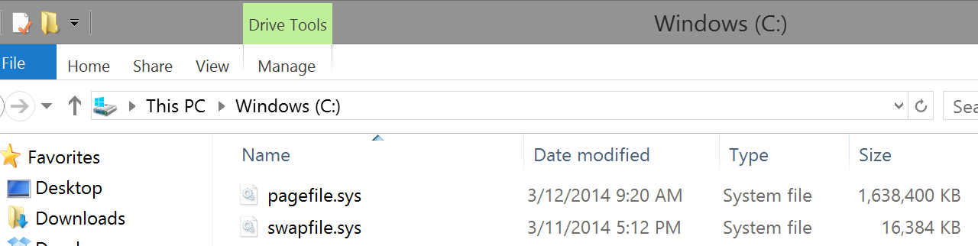
All Modern OSes Support Swapping
On Linux, you create a swap partition along with your normal ext3/4 filesystem
Swapped pages are stored in this separate partition
Windows

Slide 88
Implementing Swap
Data structures are needed to track the mapping between pages in memory and pages on disk
Meta-data about memory pages must be kept
When should pages be evicted (swapped to disk)?
How do you choose which page to evict?
The functionality of the OSes page fault handler must be modified

Slide 89
x86 Page Table Entry, Again
On x86, page table entries (PTE) are 4 bytes
31 - 12 | 11 - 9 | 8 | 7 | 6 | 5 | 4 | 3 | 2 | 1 | 0
Page Frame Number (PFN) | Unused | G | PAT | D | A | PCD | PWT | U/S | W | P
P – present bit – is this page in physical memory?
OS sets or clears the present bit based on its swapping decisions
1 means the page is in physical memory
0 means the page is valid, but has been swapped to disk
Attempts to access an invalid page or a page that isn’t present trigger a page fault

Slide 90
Handling Page Faults
Thus far, we have viewed page faults as bugs
i.e. when a process tries to access an invalid pointer
The OS kills the process that generate page faults
However, now handling page faults is more complicated
If the PTE is invalid, the OS still kills the process
If the PTE is valid, but present = 0, then
The OS swaps the page back into memory
The OS updates the PTE
The OS instructs the CPU to retry the last instruction

Slide 91
Page Fault Pseudocode
VPN = (VirtualAddress & VPN_MASK) >> SHIFT
(Success, TlbEntry) = TLB_Lookup(VPN)
if (Success == True) // TLB Hit
if (CanAccess(TlbEntry.ProtectBits) == True)
Offset = VirtualAddress & OFFSET_MASK
PhysAddr = (TlbEntry.PFN << SHIFT) | Offset
Register = AccessMemory(PhysAddr)
else RaiseException(PROTECTION_FAULT)
else // TLB Miss
PTEAddr = PTBR + (VPN * sizeof(PTE))
PTE = AccessMemory(PTEAddr)
if (PTE.Valid == False) RaiseException(SEGMENTATION_FAULT)
if (CanAccess(PTE.ProtectBits) == False)
RaiseException(PROTECTION_FAULT)
if (PTE.Present == True) // assuming hardware-managed TLB
TLB_Insert(VPN, PTE.PFN, PTE.ProtectBits)
RetryInstruction()
else if (PTE.Present == False) RaiseException(PAGE_FAULT)

Slide 92
When Should the OS Evict Pages?
Memory is finite, so when should pages be swapped?
On-demand approach
If a page needs to be created and no free pages exist, swap a page to disk
Proactive approach
Most OSes try to maintain a small pool of free pages
Implement a high watermark
Once physical memory utilization crosses the high watermark, a background process starts swapping out pages

Slide 93
What Pages Should be Evicted?
Known as the page-replacement policy
What is the optimal eviction strategy?
Evict the page that will be accessed furthest in the future
Provably results in the maximum cache hit rate
Unfortunately, impossible to implement in practice
Practical strategies for selecting which page to swap to disk
FIFO
Random
LRU (Least recently used)
Same fundamental algorithms as in TLB eviction

Slide 94
Examples of Optimal and LRU
Assume the cache can store 3 pages
Optimal (Furthest in the Future)
LRU
Access | Hit/Miss? | Evict | Cache State
0 | Miss |  | 0
1 | Miss |  | 0, 1
2 | Miss |  | 0, 1, 2
0 | Hit |  | 0, 1, 2
1 | Hit |  | 0, 1, 2
3 | Miss | 2 | 0, 1, 3
0 | Hit |  | 0, 1, 3
3 | Hit |  | 0, 1, 3
1 | Hit |  | 0, 1, 3
2 | Miss | 3 | 0, 1, 2
0 | Hit |  | 0, 1, 2
Access | Hit/Miss? | Evict | Cache State
0 | Miss |  | 0
1 | Miss |  | 0, 1
2 | Miss |  | 0, 1, 2
0 | Hit |  | 0, 1, 2
1 | Hit |  | 0, 1, 2
3 | Miss | 2 | 0, 1, 3
0 | Hit |  | 0, 1, 3
3 | Hit |  | 0, 1, 3
1 | Hit |  | 0, 1, 3
2 | Miss | 0 | 1, 2, 3
0 | Miss | 3 | 0, 1, 2

Slide 95
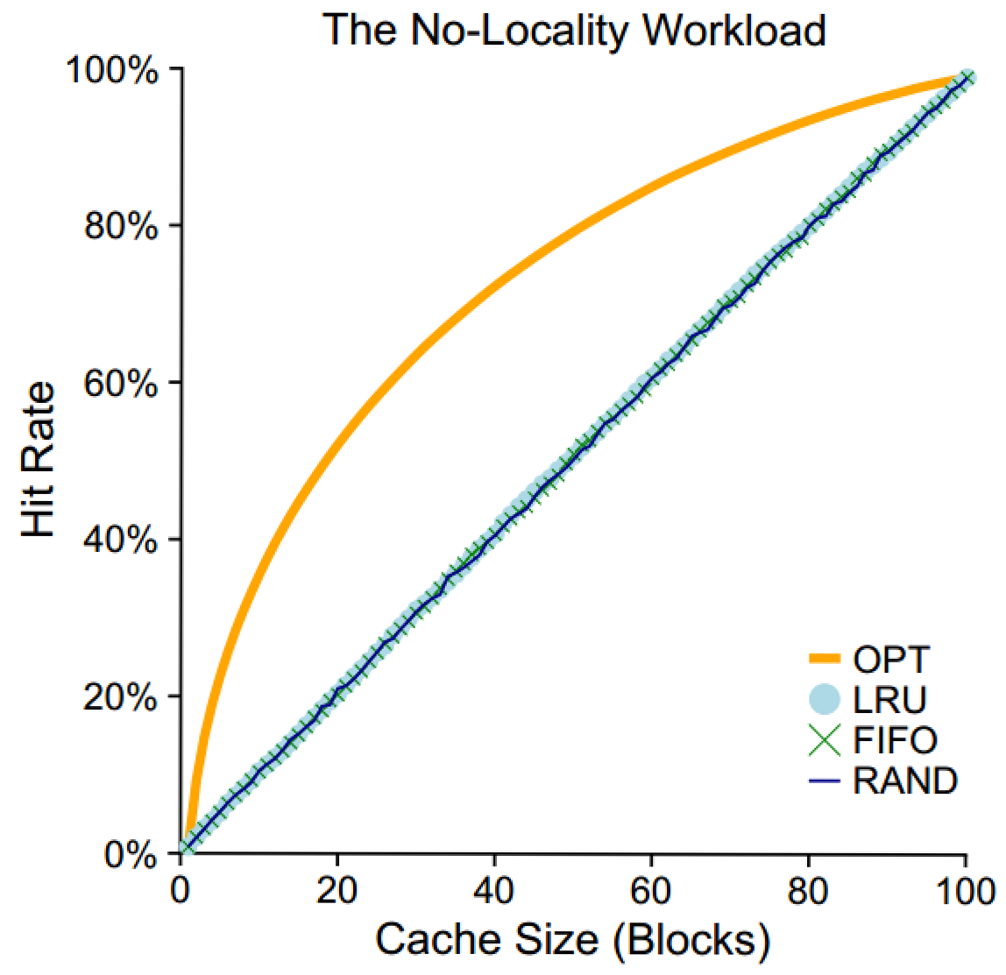
All memory accesses are to 100% random pages
When memory accesses are random, its impossible to be smart about caching

Slide 96
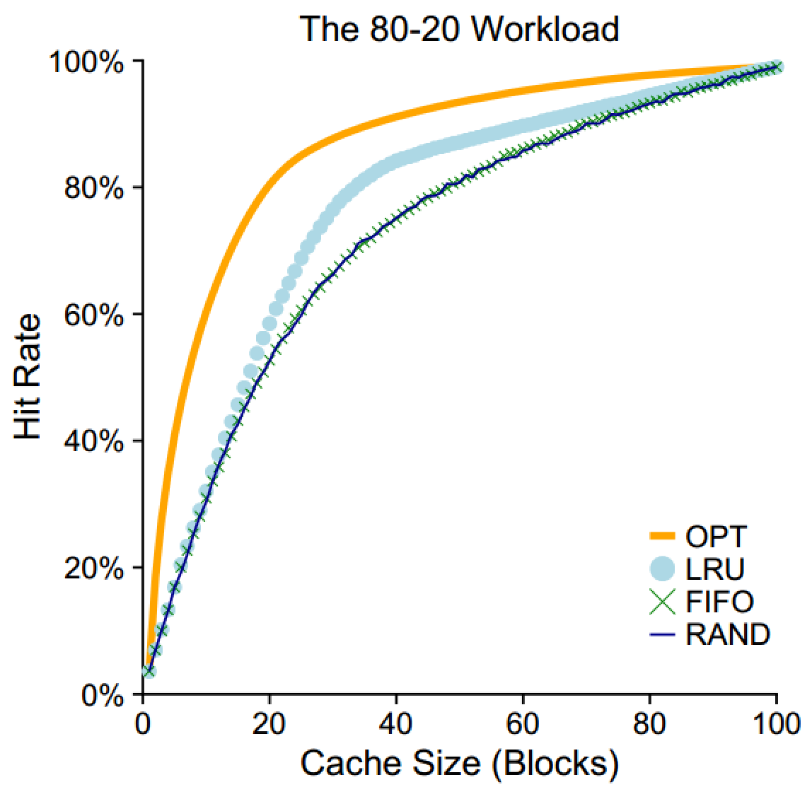
80% of memory accesses are for 20% of pages
LRU does a better job of keeping “hot” pages in RAM than FIFO or random

Slide 97
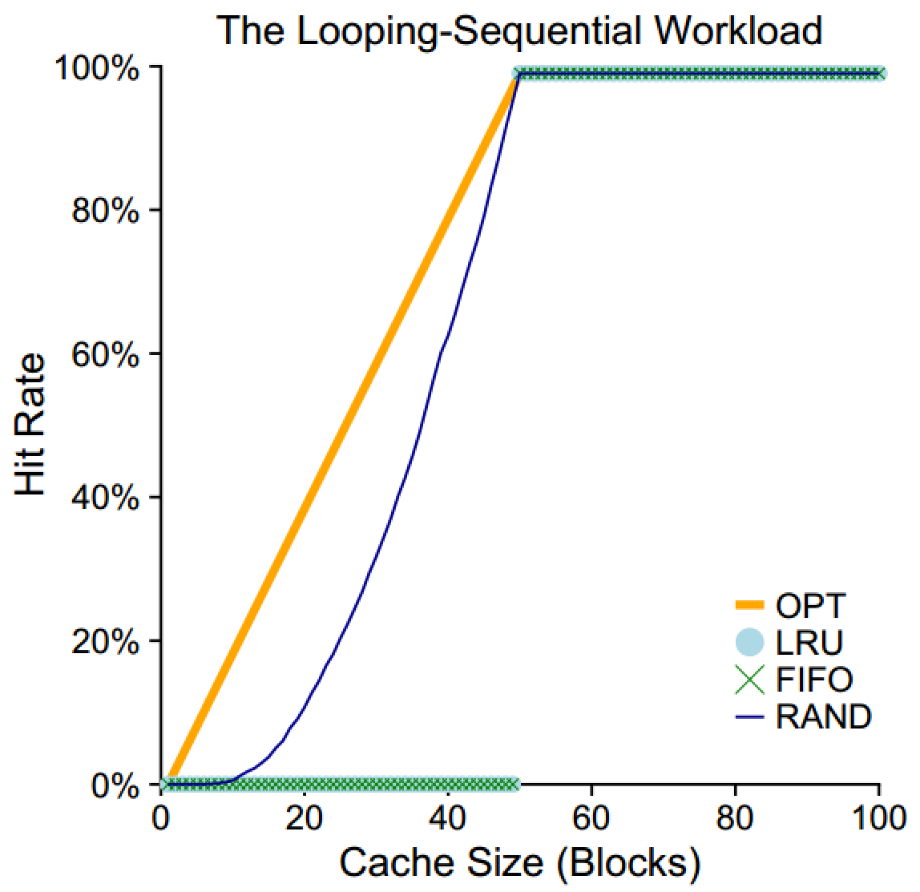
The process sequentially accesses one memory address in 50 pages, then loops
When C >= 50, all pages are cached, thus hit rate = 100%
When the cache size is C < 50, LRU evicts page X when page X + C is read
Thus, pages are not in the cache during the next iteration of the loop

Slide 98
Implementing Historical Algorithms
LRU has high cache hit rates in most cases…
… but how do we know which pages have been recently used?
Strategy 1: record each access to the page table
Problem: adds additional overhead to page table lookups
Strategy 2: approximate LRU with help from the hardware

Slide 99
x86 Page Table Entry, Again
On x86, page table entries (PTE) are 4 bytes
31 - 12 | 11 - 9 | 8 | 7 | 6 | 5 | 4 | 3 | 2 | 1 | 0
Page Frame Number (PFN) | Unused | G | PAT | D | A | PCD | PWT | U/S | W | P
Bits related to swapping
A – accessed bit – has this page been read recently?
D – dirty bit – has this page been written recently?
The MMU sets the accessed bit when it reads a PTE
The MMU sets the dirty bit when it writes to the page referenced in the PTE
The OS may clear these flags as it wishes

Slide 100
Approximating LRU
The accessed and dirty bits tell us which pages have been recently accessed
But, LRU is still difficult to implement
On eviction, LRU needs to scan all PTEs to determine which have not been used
But there are millions of PTEs!
Is there a clever way to approximate LRU without scanning all PTEs?
Yes!

Slide 101
The Clock Algorithm
Imagine that all PTEs are arranged in a circular list
The clock hand points to some PTE P in the list
function clock_algo() {
start = P;
do {
if (P.accessed == 0) {
evict(P);
return;
}
P.accessed = 0;
P = P.next;
} while (P != start);
evict_random_page();
}

Slide 102
Incorporating the Dirty Bit
More modern page eviction algorithms also take the dirty bit into account
For example: suppose you must evict a page, and all pages have been accessed
Some pages are read-only (like code)
Some pages have been written too (i.e. they are dirty)
Evict the non-dirty pages first
In some cases, you don’t have to swap them to disk!
Example: code is already on the disk, simply reload it
Dirty pages must always be written to disk
Thus, they are more expensive to swap

Slide 103
RAM as a Cache
RAM can be viewed as a high-speed cache for your large-but-slow spinning disk storage
You have GB of programs and data
Only a subset can fit in RAM at any given time
Ideally, you want the most important things to be resident in the cache (RAM)
Code/data that become less important can be evicted back to the disk

