Slide 1
CS 5600 Computer Systems
Lecture 5: Synchronization, Deadlock, and Lock-free Data Structures

Slide 2
Motivating Parallelism
Synchronization Basics
Types of Locks and Deadlock
Lock-Free Data Structures

Slide 3
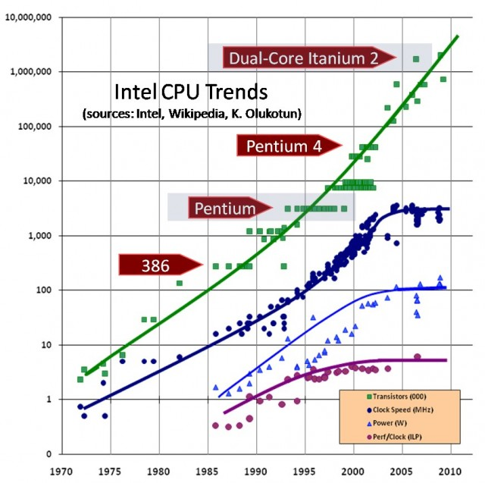
Transistors
Clock Speed
Power Draw
Perf/Clock

Slide 4
Implications of CPU Evolution
Increasing transistor count/clock speed
Greater number of tasks can be executed concurrently
However, clock speed increases have essentially stopped in the past few years
Instead, more transistors = more CPU cores
More cores = increased opportunity for parallelism

Slide 5
Concurrency vs. Parallelism
Concurrent execution on a single-core system:
Parallel execution on a dual-core system:
Core 1
P1 | P2 | P3 | P4 | P1 | P2 | P3 | P4 | P1 | …
Time
Core 1
P1 | P3 | P1 | P3 | P1 | P3 | P1 | P3 | P1 | …
Core 2
P2 | P4 | P2 | P4 | P2 | P4 | P2 | P4 | P2 | …
Time

Slide 6
Two Types of Parallelism
Data parallelism
Same task executes on many cores
Different data given to each task
Example: MapReduce
Task parallelism
Different tasks execute on each core
Example: any high-end videogame
1 thread handles game AI
1 thread handles physics
1 thread handles sound effects
1+ threads handle rendering

Slide 7
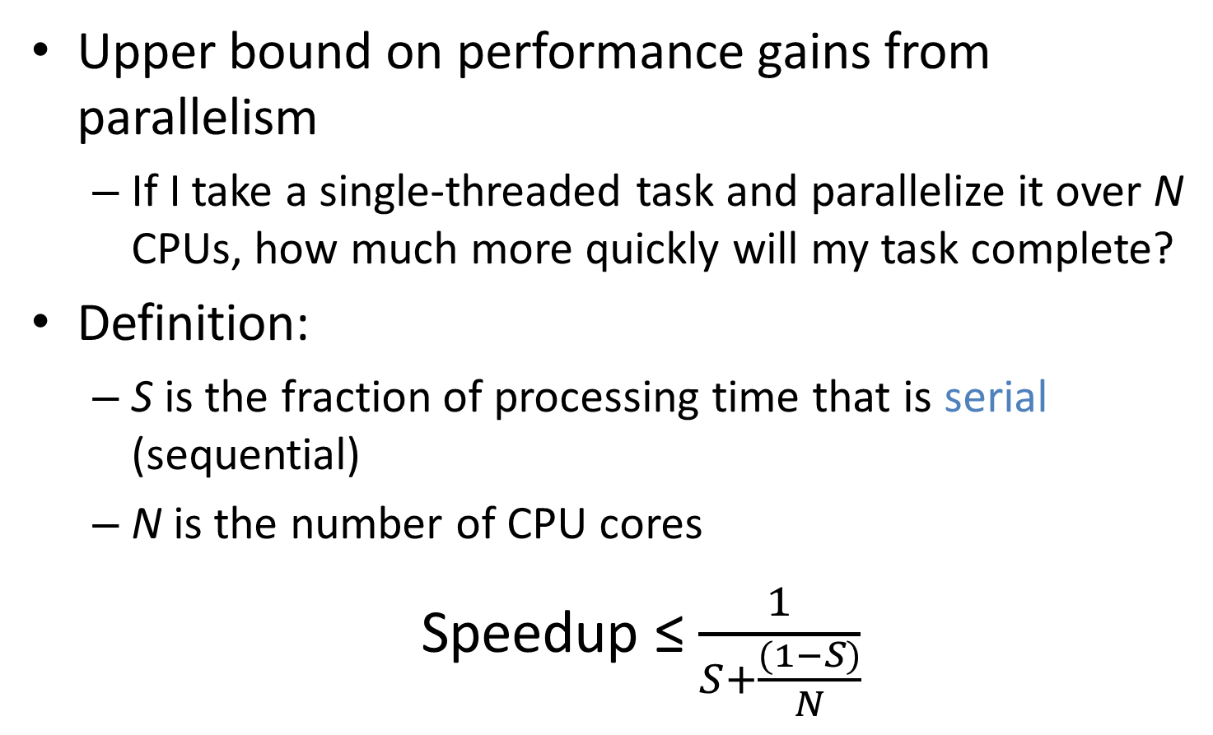
Amdahl’s Law
Upper bound on performance gains from parallelism
If I take a single-threaded task and parallelize it over N CPUs, how much more quickly will my task complete?
Definition:
S is the fraction of processing time that is serial (sequential)
N is the number of CPU cores
Speedup ≤ $\frac{1}{S+\frac{(1−S)}{N}}$

Slide 8
Example of Amdahl’s Law
Suppose we have an application that is 75% parallel and 25% serial
1 core: 1/(.25+(1-.25)/1) = 1 (no speedup, obviously)
2 core: 1/(.25+(1-.25)/2) = 1.6
4 core: 1/(.25+(1-.25)/4) = 2.29
What happens as N→∞?
Speedup approaches 1/S
The serial portion of the process has a disproportionate effect on performance improvement
?
?
?

Slide 9
Amdahl’s Law

Slide 10
Limits of Parallelism
Amdahl’s Law is a simplification of reality
Assumes code can be cleanly divided into serial and parallel portions
In other words, trivial parallelism
Real-world code is typically more complex
Multiple threads depend on the same data
In these cases, parallelism may introduce errors
Real-world speedups are typically < what is predicted by Amdahl’s Law

Slide 11
Gustafson's Law
Amdahl’s law assumes the problem size remains constant.
Generally if you have twice as much processing power, you’re going to attack a problem of twice the size.
As long as the parallel part of your algorithm is most expensive in terms of the problem size, Amdahl is wrong and more processors will scale nicely.

Slide 12
Gustafson Example
Parallel Merge Sort
Parallel work: n * log n
Serial work n + (n/2) + (n/4) + … = 2
Serial portion = 2/log n
N | Alpha
2 | 2/(2+1) = 66%
256 | 2/(2+8) = 20%
1M | 2/(2+20) = 10%
1T | 2/(2+40) = 5%

Slide 13
Motivating Parallelism
Synchronization Basics
Types of Locks and Deadlock
Lock-Free Data Structures

Slide 14
The Bank of Lost Funds
Consider a simple banking application
Multi-threaded, centralized architecture
All deposits and withdrawals sent to the central server
class account {
private money_t balance;
public deposit(money_t sum) {
balance = balance + sum;
} }
What happens if two people try to deposit money into the same account at the same time?

Slide 15
balance = balance + sum;
mov eax, balance
mov ebx, sum add eax, ebx mov balance, eax
balance
$100
$50
$0
eax = $100
eax = $0
eax = $0
eax = $50
Thread 1
Thread 2
deposit($50)
mov eax, balance
mov ebx, sum
Context Switch
deposit($100)
mov eax, balance
mov ebx, sum
add eax, ebx
mov balance, eax
add eax, ebx mov balance, eax
Context Switch

Slide 16
Race Conditions
The previous example shows a race condition
Two threads “race” to execute code and update shared (dependent) data
Errors emerge based on the ordering of operations, and the scheduling of threads
Thus, errors are nondeterministic

Slide 17
Example: Linked List
elem = pop(&list):
tmp = list
list = list->next
tmp->next = NULL return tmp
push(&list, elem):
elem->next = list
list = elem
What happens if one thread calls pop(), and another calls push() at the same time?
Thread 1 |  | Thread 2
1. tmp = list
 |  | 2. elem->next = list
3. list = list->next
 |  | 4. list = elem
5. tmp->next = NULL
tmp
list
list
1
2
3
∅
list
∅
elem
4

Slide 18
Critical Sections
These examples highlight the critical section problem
Classical definition of a critical section:
“A piece of code that accesses a shared resource that must not be concurrently accessed by more than one thread of execution.”
Unfortunately, this definition is misleading
Implies that the piece of code is the problem
In fact, the shared resource is the root of the problem

Slide 19
Atomicity
Race conditions lead to errors when sections of code are interleaved
These errors can be prevented by ensuring code executes atomically
(a)
(b)
Read
Read
Read
Read
Add
Add
Add
Store
Store
Add
Read
Read
Add
Add
Store
Store
Store
Store
Interleaved Execution
Non-Interleaved (Atomic) Execution

Slide 20
Mutexes for Atomicity
Mutual exclusion lock (mutex) is a construct that can enforce atomicity in code
Thread 1
Thread 2
m = mutex_create();
…
mutex_lock(m);
// do some stuff
mutex_unlock(m);
mutex_lock(m)
critical
section
(returns)
unlock(m)
blocked
(returns)
(returns)
critical
section

Slide 21
Fixing the Bank Example
Thread 1
Thread 2
class account {
mutex m;
money_t balance
public deposit(money_t sum) {
m.lock();
balance = balance + sum;
m.unlock();
}
}
LOCK
Read
LOCK
Add
Store
UNLOCK
Read
Add
Store
UNLOCK

Slide 22
Implementing Mutual Exclusion
Typically, developers don’t write their own locking-primitives
You use an API from the OS or a library
Why don’t people write their own locks?
Much more complicated than they at-first appear
Very, very difficult to get correct
May require access to privileged instructions
May require specific assembly instructions
Instruction architecture dependent

Slide 23
Mutex on a Single-CPU System
void sema_down(struct semaphore * sema) {
enum intr_level old_level;
old_level = intr_disable();
while (sema->value == 0) { /* wait */ }
sema->value--;
intr_level(old_level);
}
void lock_acquire(struct lock * lock) {
sema_down(&lock->semaphore);
lock->holder = thread_current();
}
On a single-CPU system, the only preemption mechanism is interrupts
If are interrupts are disabled, the currently executing code is guaranteed to be atomic
This system is concurrent, but not parallel

Slide 24
The Problem With Multiple CPUs
In a multi-CPU (SMP) system, two or more threads may execute in parallel
Data can be read or written by parallel threads, even if interrupts are disabled
sema->value = 1
sema->value = ?
CPU 1 - Thread 1
CPU 2 - Thread 2
sema_down() {
sema_down() {
while (sema->value == 0) { … }
while (sema->value == 0) { … }
sema->value--;
sema->value--;
}
}
24

Slide 25
Instruction-level Atomicity
Modern CPUs have atomic instruction(s)
Enable you to build high-level synchronized objects
On x86:
The lock prefix makes an instruction atomic
lock inc eax ; atomic increment
lock dec eax ; atomic decrement
Only legal with some instructions
The xchg instruction is guaranteed to be atomic
xchg eax, [addr] ; swap eax and the value in memory

Slide 26
Behavior of xchg
Non-Atomic xchg
Atomic xchg
CPU 1
memory
CPU 2
CPU 1
memory
CPU 2
eax: 1 1 0 0
0 0
1 1 1
eax: 2 2 0
0 0 1 2 2
eax: 1 1 0 0
eax: 2 2 1
xchg
xchg
xchg
xchg
Illegal execution
Legal execution
Atomicity ensures that each xchg occurs before or after xchg’s from other CPUs

Slide 27
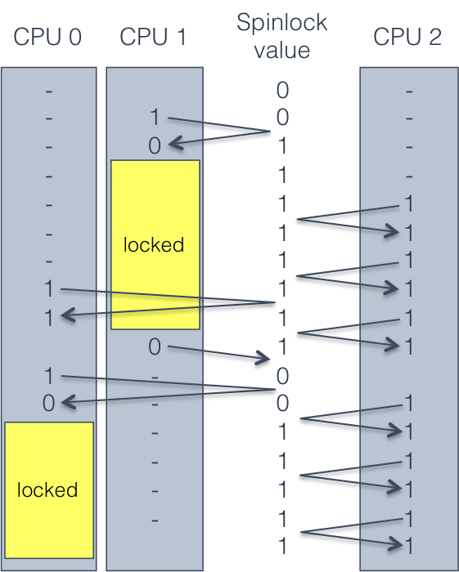
Building a Spin Lock with xchg
spin_lock:
mov eax, 1
xchg eax, [lock_addr]
test eax, eax
jnz spinlock
spin_unlock:
mov [lock_addr], 0
CPU 1 locks.
CPUs 0 and 2 both try to lock, but cannot.
CPU 1 unlocks.
CPU 0 locks, simply because it requested it slightly before CPU 2.

Slide 28
Well-Behaved Mutexes
Textbooks refer to the Mutual Exclusion Problem
Design a lock mechanism that guarantees the following properties:
Mutual exclusion: only one process may hold the lock at a time
Progress: the decision about which process gets the lock next cannot be postponed indefinitely
Bounded waiting: if all lockers unlock, no process can wait forever to get the lock
A mutex having these properties is well-behaved

Slide 29
Building a Multi-CPU Mutex
typedef struct mutex_struct {
int spinlock = 0; // spinlock variable
int locked = 0; // is the mutex locked? guarded by spinlock
queue waitlist; // waiting threads, guarded by spinlock
} mutex;
void mutex_lock(mutex * m) {
spin_lock(&m->spinlock);
if (!m->locked){
m->locked = 1;
spin_unlock(&m->spinlock);
}
else {
m->waitlist.add(current_process);
spin_unlock(&m->spinlock);
yield();
// wake up here when the mutex is acquired
}
}
void mutex_unlock(mutex * m) {
spin_lock(&m->spinlock);
if (m->waitlist.empty()) {
m->locked = 0;
spin_unlock(&m->spinlock);
}
else {
next_thread = m->waitlist.pop_from_head();
spin_unlock(&m->spinlock);
wake(next_thread);
}
}

Slide 30
Compare and Swap
Sometimes, literature on locks refers to compare and swap (CAS) instructions
CAS instructions combine an xchg and a test
On x86, known as compare and exchange
spin_lock:
mov ecx, 1
mov eax, 0
lock cmpxchg ecx, [lock_addr]
jnz spinlock
cmpxchg compares eax and the value of lock_addr
If eax == [lock_addr], swap ecx and [lock_addr]

Slide 31
The Price of Atomicity
Atomic operations are very expensive on a multi-core system
Caches must be flushed
CPU cores may see different values for the same variable if they have out-of-date caches
Cache flush can be forced using a memory fence (sometimes called a memory barrier)
Memory bus must be locked
No concurrent reading or writing
Other CPUs may stall
May block on the memory bus or atomic instructions

Slide 32
Motivating Parallelism
Synchronization Basics
Types of Locks and Deadlock
Lock-Free Data Structures

Slide 33
Other Types of Locks
Mutex is perhaps the most common type of lock
But there are several other common types
Semaphore
Read/write lock
Condition variable
Used to build monitors

Slide 34
Semaphores
Generalization of a mutex
Invented by Edsger Dijkstra
Associated with a positive integer N
May be locked by up to N concurrent threads
Semaphore methods
wait() – if N > 0, N--; else sleep
signal() – if waiting threads > 0, wake one up; else N++

Slide 35
The Bounded Buffer Problem
Canonical example of semaphore usage
Some threads produce items, add items to a list
Some threads consume items, remove items from the list
Size of the list is bounded
class semaphore_bounded_buffer:
mutex m
list buffer
semaphore S_space = semaphore(N)
semaphore S_items = semaphore(0)
put(item):
S_space.wait()
m.lock()
buffer.add_tail(item)
m.unlock()
S_items.signal()
get():
S_items.wait()
m.lock()
result = buffer.remove_head()
m.unlock()
S_space.signal()
return result

Slide 36
Example Bounded Buffer
buffer | S_items | S_space
[] | 0 | 2
[a] | 1 | 1
[a, b] | 2 | 0
[b] | 1 | 1
[b, c] | 2 | 0
Thread 1 | Thread 2 | Thread 3 | Thread 4
put(a)
 | put(b)
 |  | put(c)
 |  |  | get()

Slide 37
Read/Write Lock
Sometimes known as a shared mutex
Many threads may hold the read lock in parallel
Only one thread may hold the write lock at a time
Write lock cannot be acquired until all read locks are released
New read locks cannot be acquired if a writer is waiting
Ideal for cases were updates to shared data are rare
Permits maximum read parallelization

Slide 38
Example Read/Write Lock
list | readers | writers
[a, b] | 0 | 0
[a, b] | 1 | 0
[a, b] | 2 | 0
[a, b] | 1 | 0
[a, b] | 0 | 0
[a, b] | 0 | 1
[a, b, c] | 0 | 1
[a, b, c] | 0 | 0
[a, b, c] | 1 | 0
[a, b, c] | 1 | 0
Thread 1 | Thread 2 | Thread 3
lock_r()
 | lock_r()
 |  | lock_w()
unlock_r()
 | unlock_r()
lock_r()
 |  | unlock_w()

Slide 39
When is a Semaphore Not Enough?
class weighted_bounded_buffer:
mutex m
list buffer
int totalweight
get(weight):
while (1):
m.lock()
if totalweight >= weight:
result = buffer.remove_head()
totalweight -= result.weight
m.unlock()
return result
else:
m.unlock()
yield()
put(item):
m.lock()
buffer.add_tail(item)
totalweight += item.weight
m.unlock()
No guarantee the condition will be satisfied when this thread wakes up
Lots of useless looping :(
In this case, semaphores are not sufficient
weight is an unknown parameter
After each put(), totalweight must be checked

Slide 40
Condition Variables
Construct for managing control flow amongst competing threads
Each condition variable is associated with a mutex
Threads that cannot run yet wait() for some condition to become satisfied
When the condition is satisfied, some other thread can signal() to the waiting thread(s)
Condition variables are not locks
They are control-flow managers
Some APIs combine the mutex and the condition variable, which makes things slightly easier

Slide 41
Condition Variable Example
class weighted_bounded_buffer:
mutex m
condition c
list buffer
int totalweight = 0
int neededweight = 0
get(weight):
m.lock()
if totalweight < weight:
neededweight += weight
c.wait(m)
neededweight -= weight
result = buffer.remove_head()
totalweight -= result.weight
m.unlock()
return result
put(item):
m.lock()
buffer.add_tail(item)
totalweight += item.weight
if totalweight >= neededweight
and neededweight > 0:
c.signal(m)
else:
m.unlock()
signal() hands the locked mutex to a waiting thread
wait() unlocks the mutex and blocks the thread
When wait() returns, the mutex is locked
In essence, we have built a construct of the form:
wait_until(totalweight >= weight)

Slide 42
Monitors
Many textbooks refer to monitors when they discuss synchronization
A monitor is just a combination of a mutex and a condition variable
There is no API that gives you a monitor
You use mutexes and condition variables
You have to write your own monitors
In OO design, you typically make some user-defined object a monitor if it is shared between threads
Monitors enforce mutual exclusion
Only one thread may access an instance of a monitor at any given time
synchronized keyword in Java is a simple monitor

Slide 43
Be Careful When Writing Monitors
Original Code
Modified Code
get(weight):
m.lock()
if totalweight < weight:
neededweight += weight
c.wait(m)
neededweight -= weight
result = buffer.remove_head()
totalweight -= result.weight
m.unlock()
return result
put(item):
m.lock()
buffer.add_tail(item)
totalweight += item.weight
if totalweight >= neededweight
and neededweight > 0:
c.signal(m)
else:
m.unlock()
get(weight):
m.lock()
if totalweight < weight:
neededweight += weight
c.wait(m)
result = buffer.remove_head()
totalweight -= result.weight
m.unlock()
return result
put(item):
m.lock()
buffer.add_tail(item)
totalweight += item.weight
if totalweight >= neededweight
and neededweight > 0:
c.signal(m)
neededweight -= item.weight
else:
m.unlock()
Incorrect! The mutex is not locked at this point in the code

Slide 44
Pthread Synchronization API
Mutex
Condition Variable
pthread_mutex_t m; pthread_mutex_init(&m, NULL);
pthread_mutex_lock(&m);
pthread_mutex_trylock(&m);
pthread_mutex_unlock(&m);
pthread_mutex_destroy(&m);
pthread_rwlock_t rwl;
pthread_rwlock_init(&rwl, NULL);
pthread_rwlock_rdlock(&rwl);
pthread_rwlock_wrlock(&rwl);
pthread_rwlock_tryrdlock(&rwl);
pthread_rwlock_trywrlock(&rwl);
pthread_rwlock_unlock(&rwl);
pthread_rwlock_destroy(&rwl);
pthread_cond_t c; pthread_cond_init(&c, NULL);
pthread_cond_wait(&c &m);
pthread_cond_signal(&c);
pthread_cond_broadcast(&c);
pthread_cond_destroy(&c);
sem_t s;
sem_init(&s, NULL, <value>);
sem_wait(&s);
sem_post(&s);
sem_getvalue(&s, &value);
sem_destroy(&s);
Read/Write Lock
POSIX Semaphore

Slide 45
Layers of Locks
mutex A mutex B | Thread 1 lock A lock B // do something unlock B unlock A | Thread 2 lock B lock A // do something unlock A unlock B
Thread 1 | Thread 2
lock(A)
lock(B)
unlock(B)
unlock(b)
 | lock(B)
 | lock(A)
 | unlock(A)
 | unlock(B)
Thread 1 | Thread 2
lock(A)
lock(B)
 | lock(B)
unlock(B)
unlock(A) | lock(A)
 | unlock(A)
 | unlock(B)
Thread 1 | Thread 2
lock(A) | lock(B)
lock(B) | lock(A)
Deadlock :(

Slide 46
When Can Deadlocks Occur?
Four classic conditions for deadlock
Mutual exclusion: resources can be exclusively held by one process
Hold and wait: A process holding a resource can block, waiting for another resource
No preemption: one process cannot force another to give up a resource
Circular wait: given conditions 1-3, if there is a circular wait then there is potential for deadlock
One more issue:
Buggy programming: programmer forgets to release one or more resources

Slide 47
Circular Waiting
Simple example of circular waiting
Thread 1 holds lock a, waits on lock b
Thread 2 holds lock b, waits on lock a
Thread 1 | Thread 2
lock(A) | lock(B)
lock(B) | lock(A)
Thread 2
Lock A
Lock B
Thread 1

Slide 48
Avoiding Deadlock
If circular waiting can be prevented, no deadlocks can occur
Technique to prevent circles: lock ranking
Locate all locks in the program
Number the locks in the order (rank) they should be acquired
Add assertions that trigger if a lock is acquired out-of-order
No automated way of doing this analysis
Requires careful programming by the developer(s)

Slide 49
Lock Ranking Example
#1: mutex A #2: mutex B | Thread 1 lock A assert(islocked(A)) lock B // do something unlock B unlock A | Thread 2 assert(islocked(A)) lock B lock A // do something unlock A unlock B
Rank the locks
Add assertions to enforce rank ordering
In this case, Thread 2 assertion will fail at runtime

Slide 50
When Ranking Doesn’t Work
Example: Thread Safe List
In some cases, it may be impossible to rank order locks, or prevent circular waiting
In these cases, eliminate the hold and wait condition using trylock()
class SafeList { method append(SafeList more_items){
lock(self)
lock(more_items)
Problem:
Safelist A, B
Thread 1: A.append(B)
Thread 2: B.append(A)
Solution: Replace lock() with trylock()
method append(SafeList more_items){
while (true) {
lock(self) if (trylock(more_items) == locked_OK)
break
unlock(self)
} // now both lists are safely locked

Slide 51
Motivating Parallelism
Synchronization Basics
Types of Locks and Deadlock
Lock-Free Data Structures

Slide 52
Beyond Locks
Mutual exclusion (locking) solves many issues in concurrent/parallel applications
Simple, widely available in APIs
(Relatively) straightforward to reason about
However, locks have drawbacks
Priority inversion and deadlock only exist because of locks
Locks reduce parallelism, thus hinder performance

Slide 53
Lock-Free Data Structures
Is it possible to build data structures that are thread-safe without locks?
YES
Lock-free data structures
Include no locks, but are thread safe
However, may introduce starvation
Due to retry loops (example in a few slides)

Slide 54
Wait-Free Data Structures
Wait-free data structures
Include no locks, are thread safe, and avoid starvation
Wait-free implies lock-free
Wait-free is much stronger than lock-free
Wait-free structures are very hard to implement
Impossible to implement for many data structures
Often restricted to a fixed number of threads

Slide 55
Advantages of Going Lock-Free
Potentially much more performant than locking
Locks necessitate waits, context switching, CPU stalls, etc…
Immune to thread killing
If a thread dies while holding a lock, you are screwed
Immune to deadlock and priority inversion
You can’t deadlock/invert when you have no locks :)

Slide 56
Caveats to Going Lock-Free
Very few standard libraries/APIs implement these data structures
Implementations are often platform-dependent
Rely on low-level assembly instructions
Many structures are very new, not widely known
Not all data structures can be made lock-free
For many years, nobody could figure out how to make a lock-free doubly linked list
Buyer beware if implementing yourself
Very difficult to get right

Slide 57
Lock-free Queue Example: Enqueue
Usage: one reader, one writer
class Node {
Node * next;
int data;
};
// Queue pointers
volatile Node * first;
volatile Node * last;
volatile Node * divider;
lock_free_queue() {
// add the dummy node
first = last = divider
= new Node(0);
}
void enqueue(int& t) {
last->next = new Node(t);
last = last->next;
// garbage collect dequeued nodes
while (first != divider) {
Node * tmp = first;
first = first->next;
delete tmp;
}
}
Node 0
Node 1
Node 2
Node 3
first
divider
last

Slide 58
Lock-free Queue Example: Dequeue
Usage: one reader, one writer
class Node {
Node * next;
int data;
};
// Queue pointers
volatile Node * first;
volatile Node * last;
volatile Node * divider;
lock_free_queue() {
// add the dummy node
first = last = divider
= new Node(0);
}
bool dequeue(int& t) {
if (divider != last) {
t = divider->next->value;
divider = divider->next;
return true;
}
return false;
}
Node 0
Node 1
Node 2
Node 3
first
divider
last

Slide 59
Lock-free Queue Example: Enqueue
Usage: one reader, one writer
class Node {
Node * next;
int data;
};
// Queue pointers
volatile Node * first;
volatile Node * last;
volatile Node * divider;
lock_free_queue() {
// add the dummy node
first = last = divider
= new Node(0);
}
void enqueue(int& t) {
last->next = new Node(t);
last = last->next;
// garbage collect dequeued nodes
while (first != divider) {
Node * tmp = first;
first = first->next;
delete tmp;
}
}
Node 0
Node 1
Node 2
Node 3
Node 4
first
divider
last

Slide 60
Why Does This Work?
The enqueue thread and dequeue thread write different pointers
Enqueue: last, last->next, first, first->next
Dequeue: divider, divider->next
Enqueue operations are independent of dequeue operations
If these pointers overlap, then no work needs to be done
The queue always has >1 nodes (starting with the dummy node)

Slide 61
More Advanced Lock-Free Tricks
Many lock-free data structures can be built using compare and swap (CAS)
bool cas(int * addr, int oldval, int newval) {
if (*addr == oldval) { *addr = newval; return true; }
return false;
}
This can be done atomically on x86 using the cmpxchg instruction
Many compilers have built in atomic swap functions
GCC: __sync_bool_compare_and_swap(ptr, oldval, newval)
MSVC: InterlockedCompareExchange(ptr,oldval,newval)

Slide 62
Lock-free Stack Example: Push
Usage: any number of readers and writers
class Node {
Node * next;
int data;
};
// Root of the stack
volatile Node * head;
void push(int t) {
Node* node = new Node(t);
do {
node->next = head;
} while (!cas(&head, node->next, node));
}
head
Node 1
Node 2
Node 3
New Node 1

Slide 63
Lock-free Stack Example: Push
Usage: any number of readers and writers
class Node {
Node * next;
int data;
};
// Root of the stack
volatile Node * head;
void push(int t) {
Node* node = new Node(t);
do {
node->next = head;
} while (!cas(&head, node->next, node));
}
Thread 2
New Node 2
head
Node 1
Node 2
Node 3
New Node 1
Thread 1

Slide 64
Lock-free Stack Example: Pop
bool pop(int& t) {
Node* current = head;
while(current) {
if(cas(&head, current, current->next)) {
t = current->data;
delete current;
return true;
}
current = head;
}
return false;
}
class Node {
Node * next;
int data;
};
// Root of the stack
volatile Node * head;
current
head
Node 1
Node 2
Node 3

Slide 65
Retry Looping is the Key
Lock free data structures often make use of the retry loop pattern
Read some state
Do a useful operation
Attempt to modify global state if it hasn’t changed (using CAS)
This is similar to a spinlock
But, the assumption is that wait times will be small
However, retry loops may introduce starvation
Wait-free data structures remove retry loops
But are much more complicated to implement

Slide 66
Many Reads, Few Writes
Suppose we have a map (hashtable) that is:
Constantly read by many threads
Rarely, but occasionally written
How can we make this structure lock free?
class readmap {
mutex mtx;
map<string, string> map;
string lookup(const string& k) {
lock l(mtx);
return map[k];
}
void update(const string& k,
const string& v) {
lock lock(mtx);
map[k] = v;
}
};

Slide 67
Duplicate and Swap
class readmap {
map<string, string> * map;
readmap() { map = new map<string, string>(); }
string lookup(const string& k) {
return (*map)[k];
}
void update(const string& k, const string& v) {
map<string, string> * new_map = 0;
do {
map<string, string> * old_map = map;
if (new_map) delete new_map;
// clone the existing map data
new_map = new map<string, string>(*old_map);
(*new_map)[k] = v;
// swap the old map for the new, updated map!
} while (cas(&map, old_map, new_map));
}
};

Slide 68
Memory Problems
What is the problem with the previous code?
} while (cas(&map, old_map, new_map));
The old map is not deleted (memory leak)
Does this fix things?
} while (cas(&map, old_map, new_map));
delete old_map;
Readers may still be accessing the old map!
Deleting it will cause nondeterministic behavior
Possible solution: store the old_map pointer, delete it after some time has gone by

Slide 69
Hazard Pointers
Construct for managing memory in lock-free data structures
Straightforward concept:
Read threads publish hazard pointers that point to any data they are currently reading
When a write thread wants to delete data:
If it is not associated with any hazard pointers, delete it
If it is associated with a hazard pointer, add it to a list
Periodically go through the list and reevaluate the data
Of course, this is tricky in practice
You need lock-free structures to:
Enable publishing/updating hazard pointers
Store the list of data blocked by hazards

Slide 70
The ABA Problem
Subtle problem that impacts many lock-free algorithms
Compare and swap relies on the uniqueness of pointers
Example: cas(&head, current, current->next)
However, sometimes the memory manager will reuse pointers
item * a = stack.pop();
free a;
item * b = new item();
stack.push(b);
assert(a != b); // this assertion may fail!

Slide 71
ABA Example
bool pop(int& t) {
Node* current = head;
while(current) {
if(cas(&head, current, current->next)) {
t = current->data;
delete current;
return true;
}
current = head;
}
return false;
}
Order of Events
Thread 1: pop() { current = head;
 | Thread 2: pop() {…}
 | Thread 2: push(int N) {…}
cas(...);
Thread 1: current
0x0F12: Node 4
0xA8B0: Node 3
head
0x0F12: Node 1
0x055D:Node 2

Slide 72
Applications of Lock-Free Structures
Stack
Queue
Deque
Linked list
Doubly linked list
Hash table
Many variations on each
Lock free vs. wait free
Memory managers
Lock free malloc() and free()
The Linux kernel
Many key structures are lock-free

Slide 73
References
Geoff Langdale, Lock-free Programming
http://www.cs.cmu.edu/~410-s05/lectures/L31_LockFree.pdf
Herb Sutter, Writing Lock-Free Code: A Corrected Queue
http://www.drdobbs.com/parallel/writing-lock-free-code-a-corrected-queue/210604448

